Slide 1
Musculoskeletal Pathology
د. طارق العديلي
tnaladily@ju.edu.jo
مستشفى الجامعة – مبنى العيادات الخارجية
الطابق 3- مختبر أمراض الدم
الساعات المكتبية الخميس 11-12
Reference: Robbins Basic Pathology 8-9th edition

Slide 2
Congenital Bone diseases
Range from localized malformation to generalized hereditary disorders
Can be isolated, or part of a more complex syndrome (with other systems defects)
Mostly result of mutations in the homeobox gene
Result from abnormal migration and development of mesenchymal cells, or from abnormal bone & cartilage growth and maintenance of normal matrix components

Slide 3
Abnormal migration and development
Dysostosis خلل العظم: localized abnormal bone formation Craniofacial dysostosis
Bone aplasia عدم تنسج: absence of finger or limb
Supernumerary digits or ribs
Abnormal bone fusion (rib fusion, craniosynostosis تعظم الدروز الباكر) )
Phocomelia تفقٌّم الأطراف: multiple absent or short, fused bones in limbs, Thalidomide, genetic

Slide 4
Osteogenesis Imperfecta تكون العظم الناقص
Group of hereditary disorders caused by defective synthesis of type I collagen
Gene mutations in the coding sequences for α₁ or α₂ chains
Mutant type 1 collagen is defective and prematurely degraded
Bone matrix amount is too little, results in bone fragility, deformity
Different types of mutations, range in severity
Type 1: most common, normal life expectancy
Type 2: severest, death early in life or in utero (severe fractures)
Also affects skin, joints, and eyes (blue sclera), hearing loss (conduction defects in the middle and inner ear bones), and small misshapen teeth are a result of dentin deficiency

Slide 5
Achondroplasiaودانة العظم
Major cause of dwarfism
Point mutation in the fibroblast growth factor receptor 3 (FGFR3) that results in permanent activation
Activated FGFR3 inhibits chondrocyte proliferation; as a result, the normal epiphyseal growth plate of the long bones is suppressed
Patients have normal head and trunk, but short bowing limbs
AD transmission, most cases represent new acquired mutation
The affected individuals are typically heterozygotes, since homozygosity leads to abnormalities in chest development and death from respiratory failure soon after birth

Slide 6
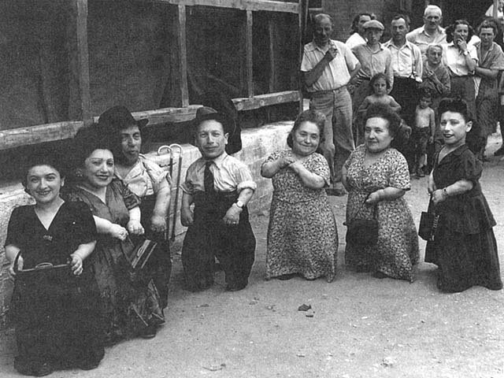

Slide 7
Osteopetrosis تصخر العظم
Rare genetic disorders characterized by reduced osteoclast-mediated bone resorption and therefore defective bone remodelling
Normally, bone matrix degradation requires first acidification of contact site
Multiple mechanisms, one is known, as deficiency in enzyme Carbonic Anhydrase II, required for the osteoclast hydrogen ion excretion important for acidification
The affected bone is grossly dense and stone-like. Paradoxically, the architecture is not normal and fractures are common
Cranial nerves compressions, deafness
Decreased hematopoiesis (infections)
Hepatosplenomegaly (extramedullary hematopoiesis)
Treatment: bone marrow transplant

Slide 8
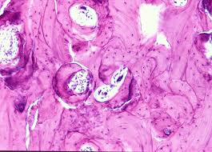
Osteopetrosis: markedly thickened bone trabeculae, marrow spaces are minimal

Slide 9
Acquired diseases of bone development
Osteoporosis هشاشة العظم
Paget disease
Vitamin D deficiency
Hyperparathyroidism

Slide 10
osteoporosis
Decreased bone mass, prone to fracture
Grossly: bone appears porous and spongy
Localized: disuse of a limb
Generalized: primary, secondary

Slide 11
Osteoporotic vertebral body (right) shortened by compression fractures, compared with a normal vertebral body. Note that the osteoporotic vertebra has a characteristic loss of horizontal trabeculae and thickened vertical trabeculae

Slide 12
Primary Osteoporosis
The most common form of osteoporosis; senile, postmenopausal
Senile osteoporosis affects all aging individuals
Postmenopausal osteoporosis obviously affects only women after menopause
Peak bone mass is achieved during young adulthood, then in the third or fourth decade in both sexes, bone resorption begins to outpace bone deposition
Such losses generally occur in areas containing abundant cancelloues (trabecular) bone and are therefore more pronounced in the spine and femoral neck
The rate of loss can be accelerated by the postmenopausal state
Osteoporosis-related fractures cause significant morbidity and mortality

Slide 13
Pathogenesis
Osteoblasts and stroma synthesize
1) Receptor Activator for Nuclear factor κB (RANK)- ligand
2) Macrophage colony-stimulating factor (M-CSF)
3) Osteoprotegerin (OPG)
Together, RANK ligand and M-CSF convert macrophages into osteoclasts
OPG bind RANK ligand and blocks osteoclast formation
Dysregulation of these interactions occur with aging and decreased estrogen, resulting in relative increased osteoclast activity compared to osteoblast function
Other causes: high cortisol, hyperthyroidism, hyperparathyroidism, drugs

Slide 14
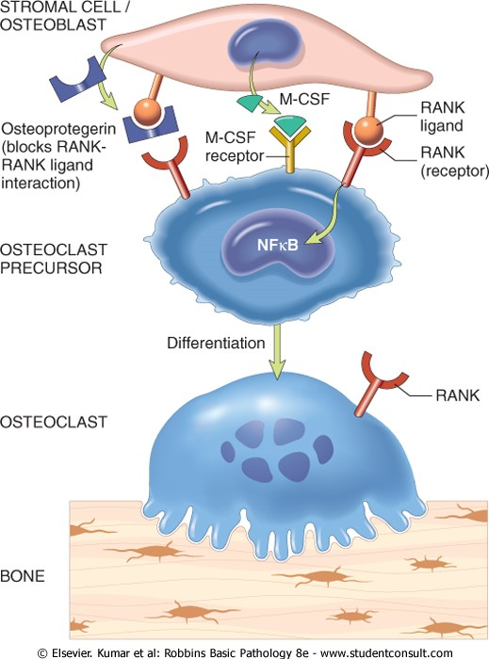
Paracrine mechanisms regulating osteoclast formation and function. Osteoclasts are derived from the same stem cells that produce macrophages. RANK (receptor activator for nuclear factor-κB) receptors on osteoclast precursors bind RANK ligand (RANKL) expressed by osteoblasts and marrow stromal cells. Along with macrophage colony-stimulating factor (M-CSF), the RANK-RANKL interaction drives the differentiation of functional osteoclasts. Stromal cells also secrete osteoprotegerin (OPG) that acts as a decoy receptor for RANKL, preventing it from binding the RANK receptor on osteoclast precursors. Consequently OPG prevents bone resorption by inhibiting osteoclast differentiation

Slide 15
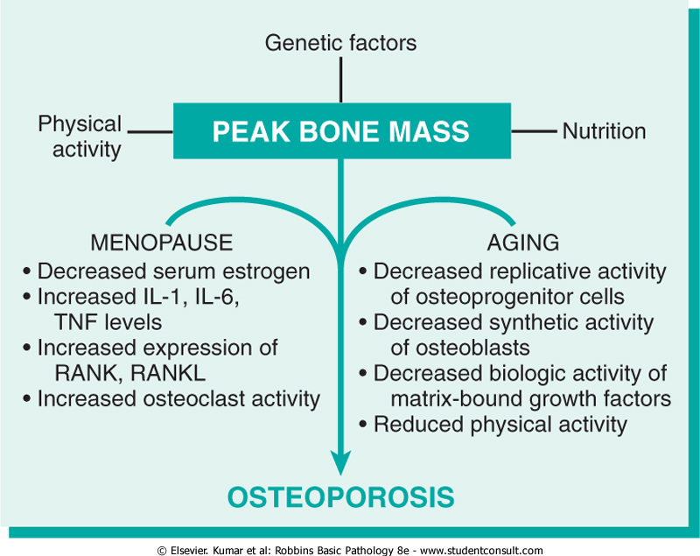

Slide 16
Paget disease
Repetitive episodes of severe, regional osteoclastic activity and bone resorption (osteolytic stage), followed by exuberant bone formation (mixed osteoclastic-osteoblastic stage), and finally by an apparent exhaustion of cellular activity (osteosclerotic stage)
The net effect of this process is gain in bone mass; however, the newly formed bone is disordered and lacks strength
Does not occur until mid-adulthood but becomes progressively more common thereafter
White population

Slide 17
Pathogenesis
Original name (osteitis deformans)
Paramyxovirus antigens can be demonstrated in osteoclasts (but the virus is not isolated from tissue)
IL-1 and M-CSF are secreted in large amounts from infected cells, activating other osteoclasts
Genetic background: osteoclasts in Paget disease appear to be intrinsically hyper-responsive to activating agents such as vitamin D and RANK ligand

Slide 18
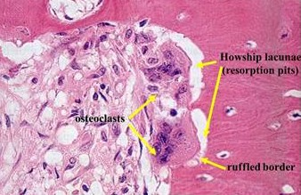
Morphology
Paget disease can be monostotic or polyostotic (more common)
Axial bones and proximal femur most commonly affected
In the initial lytic phase,
osteoclasts (and their associated
Howship lacunae) are numerous
and abnormally large

Slide 19
Morphology
Mixed phase: persistent osteoclasts but the bone surfaces become lined by prominent osteoblasts. The marrow is replaced by loose connective tissue containing osteoprogenitor cells, as well as numerous blood vessels needed to meet the increased metabolic demands of the tissue. The newly formed bone may be woven or lamellar
The pathognomonic histologic feature is a mosaic pattern of lamellar bone (likened to a jigsaw puzzle)
As the osteoblastic activity burns out, the resulting cortex is softened and prone to deformation and fracture under stress
Sarcoma may complicate the disease in 1% of patients

Slide 20
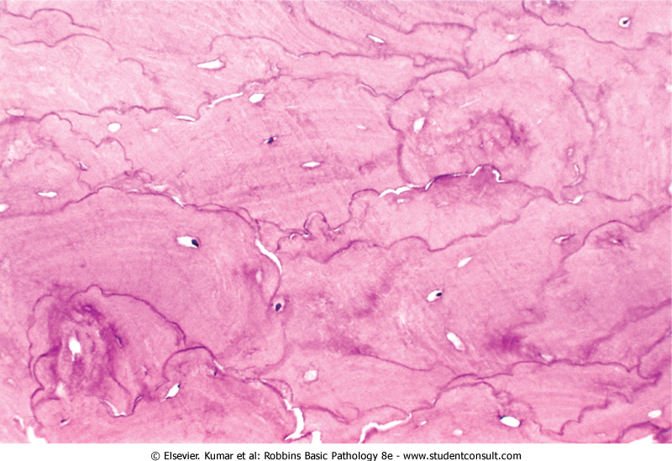
Mosaic pattern of lamellar bone pathognomonic of Paget disease

Slide 21
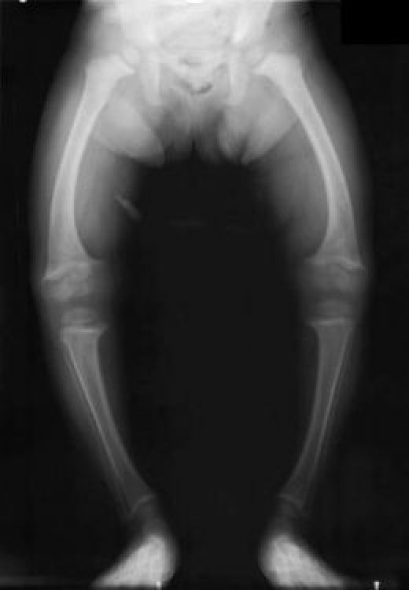
Vitamin D deficiency
The fundamental change is defective bone mineralization resulting in nonmineralized osteoid
This contrasts with osteoporosis, where the mineral content of the remaining bone is normal, but the total bone mass is decreased
Rickets كُساح refers to a childhood disorder in which deranged bone growth produces distinctive skeletal deformities
Osteomalacia تلين العظم is the adult counterpart;
bone that forms during the remodeling process is
undermineralized, resulting in osteopenia قلة العظم
and predisposition to fractures

Slide 22
Hyperparathyroidism
PTH increases RANKL production by osteoblasts => activating osteoclasts
Increased urinary excretion of phosphate
Increased synthesis of active vitamin D, 1,25(OH)₂-D, by the kidneys, which in turn enhances calcium absorption from the gut and mobilizes bone calcium (hypercalcemia)

Slide 23
Morphology
Increased osteoclasts, bone resorption, especially in periosteum, prominent in phalanges
Increased connective tissue (fibrosavcular core)
With persistent disease, repeated hemorrhage and increased osteoclasts appear as brown tumor, cysts follow (osteitis fibrosa cystica)

Slide 24
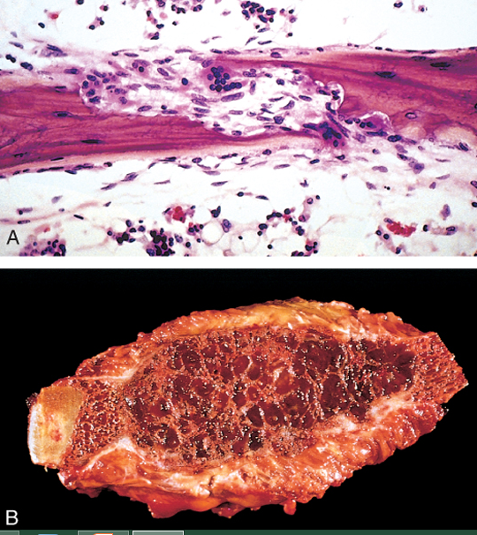
Bony manifestations of hyperparathyroidism. A, Osteoclasts gnawing into and disrupting lamellar bone. B, Resected rib, with expansile cystic mass ("brown tumor").

Slide 25
Pyogenic Osteomyelitits
Most commonly secondary to hematogenous spread (then direct extension and traumatic implantation)
Staph Aureus is the most common organism
Group B-strep and E. Coli are the most common in neonates
Sickle cell disease patients have increased proclivity to Salmonella
Mixed bacteria, including anaerobes, occur in traumatic osteomyelitis
In 50% of clinical practice cases, no bacteria is isolated

Slide 26
Morphology
Acute stage: sheets of neutophils, dead cells, entrapped necrotic bone (called sequestrum)
Bacteria and inflammation reach the periosteum through Haversian system
In children, the periosteum is loosely attached to the cortex; therefore, subperiosteal abscesses can form and extend along the bone surface
Lifting of the periosteum further impairs the blood supply to the affected region, and both suppurative and ischemic injury can cause segmental bone necrosis
Rupture of the periosteum can lead to an abscess in the surrounding soft tissue and formation of a draining sinus

Slide 27
In infants (uncommonly in adults), epiphyseal infection can spread into the adjoining joint to produce suppurative arthritis, sometimes with extensive destruction of the articular cartilage and permanent disability
An analogous process can involve vertebrae, with an infection destroying intervertebral discs and spreading into adjacent vertebrae
After the first week of infection chronic inflammatory cells become more numerous. Leukocyte cytokine release stimulates osteoclastic bone resorption, fibrous tissue growth, and bone formation in the periphery (woven and lamellar) which forms a shell of living tissue around a segment of devitalized (involucrum)
Viable organisms can persist in the sequestrum for years after the original infection.

Slide 28
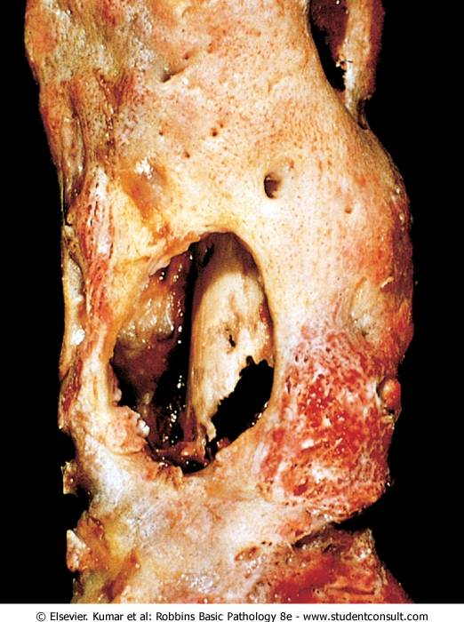
Resected femur from a person with chronic osteomyelitis. Necrotic bone (the sequestrum) visible in the center of a draining sinus tract is surrounded by a rim of new bone (the involucrum)

Slide 29
Mycobacterial osteomyelitis
Mycobacterial infection of bone complicates 1% to 3% of cases of pulmonary tuberculosis
The organisms usually reach the bone through the bloodstream, although direct spread from a contiguous focus of infection (e.g., from mediastinal nodes to the vertebrae) can also occur
With hematogenous spread, long bones and vertebrae are favored sites. The lesions are often solitary but can be multicentric, particularly in patients with an underlying immunodeficiency
Because the tubercle bacillus is microaerophilic, the synovium, with its higher oxygen pressures, is a common site of initial infection
The infection then spreads to the adjacent epiphysis, where it causes a typical granulomatous inflammation with caseous necrosis and extensive bone destruction
Tuberculosis of the vertebral bodies, or Pott disease, is an important form of osteomyelitis. Infection at this site causes vertebral deformity and collapse, with secondary neurologic deficits
Extension of the infection to the adjacent soft tissues with the development of psoas muscle abscesses is fairly common in Pott disease.

Slide 30
Bone tumors
Metastatic tumors are more common
Primary tumor can be benign or malignant
Benign, matrix producing tumors are more common, especially before 40
Tumors are classified according to cell of origin and pattern of differentiation
Osteochondroma is most common benign tumor
Osteosarcoma is most common cancer
Long bones are more commonly affected

Slide 31
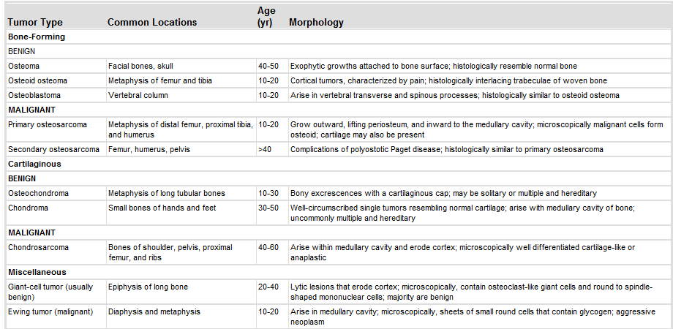

Slide 32
Osteoma
Developmental abnormality rather than true neoplasm
Middle age patients
Occurs in skull, face and sinuses
Bony hard protrusions
Solitary, multiple in Gardner syndrome
Mixture of woven and lamellar bones
Does not transform

Slide 33
Osteoid osteoma and osteoblastoma
Benign tumors
Teenage and middle age
Arise in the cortex
Similar histology and radiology (radiolucent nidus)
OO arises in proximal femur and tibia (<2cm), painful (respond to aspirin)
Osteoblastoma arises in vertebra (large), painful, does not respond to aspirin
Treatment: excision, NO radiation

Slide 34
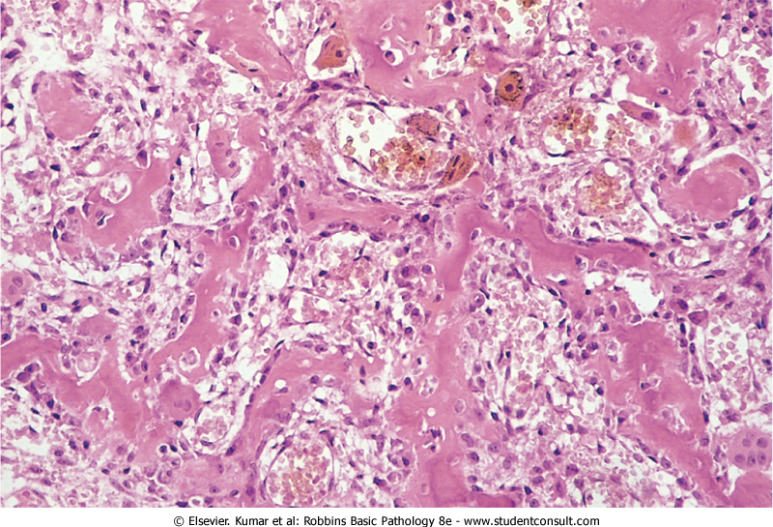
Osteoid osteoma showing randomly oriented trabeculae of woven bone rimmed by prominent osteoblasts. The intertrabecular spaces are filled by vascular loose connective tissue

Slide 35
Osteosarcoma
Bone-producing tumor
Most common primary bone tumor (after excluding hematopoietic tumors)
Occur at all age groups, but >75% less than 20
Occur at all sites, but Metaphysis of long bones (60% around knee)
Most osteosarcoma is primary, solitary, intramedullary, and poorly differentiated, producing a predominantly bony matrix

Slide 36
Pathogenesis
RB gene mutations occur in 60% to 70% of sporadic tumors, and individuals with hereditary retinoblastomas (due to germ-line mutations in the RB gene)
Spontaneous osteosarcomas also frequently exhibit mutations in genes that regulate the cell cycle including p53, cyclins, cyclin-dependent kinases, and kinase inhibitors
Many osteosarcomas develop at sites of greatest bone growth

Slide 37
Morphology
Grossly, gray-white tumors exhibiting hemorrhage and cystic degeneration
Tumors frequently destroy the surrounding cortices and produce soft tissue masses
They spread extensively in the medullary canal, infiltrating and replacing the marrow, but only infrequently penetrating the epiphyseal plate or entering the joint space
Microscopically: cells vary in size and shape, and frequently have large hyperchromatic nuclei and mitoses
Production of mineralized or unmineralized bone (osteoid) by malignant cells
The neoplastic bone is typically coarse and ragged but can also be deposited in broad sheets
Cartilage and fibrous tissue can also be present in varying amounts. When malignant cartilage is abundant, the tumor is called a chondroblastic osteosarcoma

Slide 38
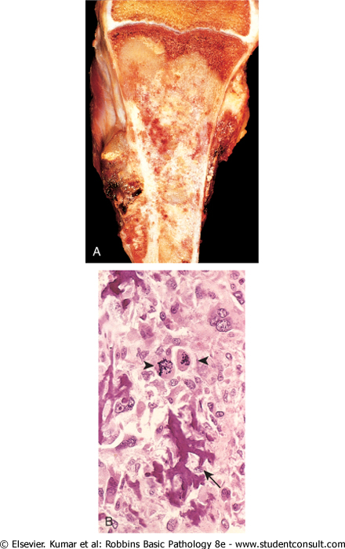
Osteosarcoma. A, Mass involving the upper end of the tibia. The tan-white tumor fills most of the medullary cavity of the metaphysis and proximal diaphysis. It has infiltrated through the cortex, lifted the periosteum, and formed soft tissue masses on both sides of the bone. B, Histologic appearance, with coarse, lacelike pattern of neoplastic bone (arrow) produced by anaplastic tumor cells. Note the wildly aberrant mitotic figures (arrowheads).

Slide 39
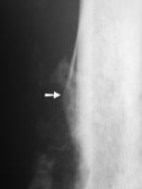
Clinical
Painful enlarging mass
Spontaneous fracture
X-ray: triangular
Growth (Codman triangle) between
Cortex and periosteum
Hematogenous spread

Slide 40
Osteochondroma
AKA exostoses, benign neoplasm
they are relatively common benign cartilage-capped outgrowths attached by a bony stalk to the underlying skeleton
Solitary osteochondromas are usually first diagnosed in late adolescence and early adulthood (male-to-female ratio of 3:1)
multiple osteochondromas become apparent during childhood, occurring as multiple hereditary exostosis, an autosomal dominant disorder
Inactivation of both copies of the EXT gene in chondrocytes is implicated in both sporadic and hereditary osteochondromas
Osteochondromas develop at the metaphysis near the growth plate of long tubular bones, especially about the knee, also in pelvis, scapula, ribs, phalanges

Slide 42
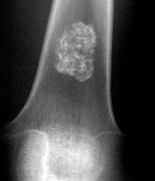
Chondroma
Chondromas are benign tumors of hyaline cartilage
When they arise within the medulla, they are termed enchondromas; when on the bone surface they are called juxtacortical chondromas
Enchondromas are usually diagnosed in persons between ages 20 and 50; they are typically solitary and located in the metaphyseal region of tubular bones, the favored sites being the short tubular bones of the hands and feet
Ollier disease is characterized by multiple chondromas preferentially involving one side of the body
Maffucci syndrome is characterized by multiple chondromas associated with benign soft tissue angiomas
Enchondromas are translucent, central calcification, O-ring sign
Enchondromas are usually smaller than 3 cm. Microscopically, there is well-circumscribed hyaline matrix and cytologically benign chondrocytes

Slide 43
Chondrosarcoma
Cartilage-producing malignant tumors
Can be intramedullary or juxtacortical
Less common than osteosarcoma
Usually >40 years
Tumor grade is determined by cellularity, cytologic atypia, and mitotic activity
Low-grade tumors resemble normal cartilage. Higher grade lesions contain pleomorphic chondrocytes with frequent mitotic figures
Multinucleate cells are present with lacunae containing two or more chondrocytes
Approximately 10% of patients with conventional low-grade chondrosarcomas have a second high-grade poorly differentiated component, might include osteosarcoma
Most common sites: pelvis, shoulder, ribs (not long bones)

Slide 44
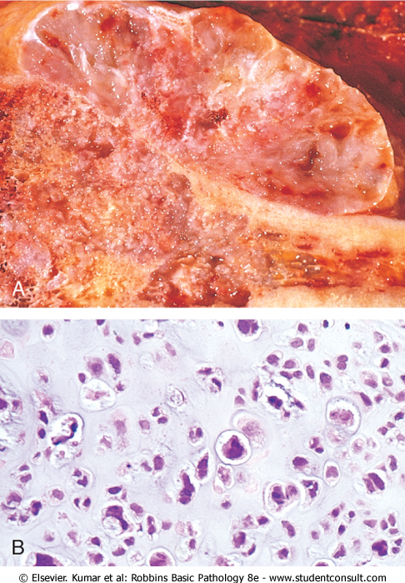
Chondrosarcoma. A, Islands of hyaline and myxoid cartilage expand the medullary cavity and grow through the cortex to form a sessile paracortical mass. B, Anaplastic chondrocytes within a chondroid matrix.

Slide 45
Fibrous Cortical Defect and Nonossifying Fibroma
Fibrous cortical defects occur in 30% to 50% of all children >2
Developmental defects rather than true neoplasms
The vast majority are smaller than 0.5 cm and arise in the metaphysis of the distal femur or proximal tibia
50% are bilateral or multiple. Larger lesions (5-6 cm) develop into nonossifying fibromas
Fibrous cortical defects and nonossifying fibromas both present as sharply demarcated radiolucencies surrounded by a thin zone of sclerosis
Microscopically are cellular lesions composed of cytologically benign fibroblasts and activated macrophages, including multinucleated forms. The fibroblasts classically exhibit a storiform (pinwheel) pattern
Usually asymptomatic and resolve, if large, may cause pathologic fracture

Slide 46
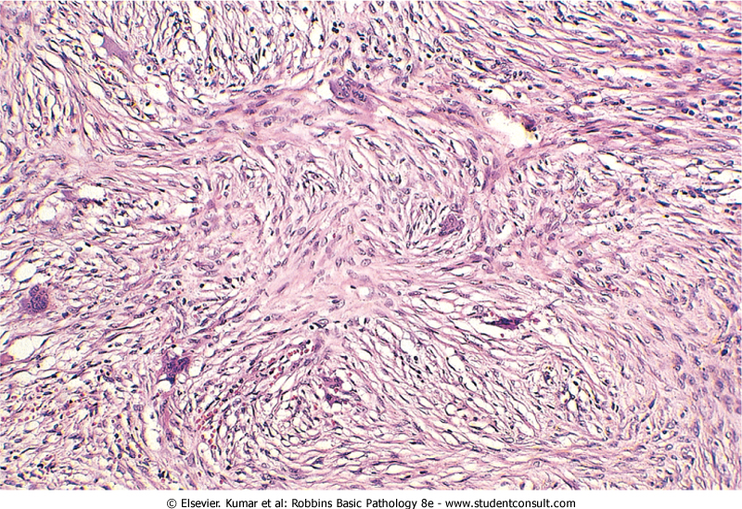
Fibrous cortical defect or nonossifying fibroma. Characteristic storiform pattern of spindle cells interspersed with scattered osteoclast-type giant cells

Slide 47
Fibrous Dysplasia
FD is a benign tumor that is better regarded as developmental arrest
All components of normal bone are present, but they fail to differentiate into mature structures
FD occurs as one of three clinical patterns:
(1) involvement of a single bone (monostotic), 70% of cases, early adolescents, In descending order of frequency: ribs, femur, tibia, jawbones, calvaria, and humerus are most commonly affected. Lesions are asymptomatic and usually discovered incidentally
(2) involvement of multiple bones (polyostotic) 29%, earlier age, progress, femur is most common, causes marked deformity and fractures
(3) polyostotic disease, associated with café au lait skin pigmentations and endocrine abnormalities, especially precocious puberty (McCune-Albright syndrome) result from a somatic (not hereditary) embryonic mutation yielding a G-protein that constitutively activates adenyl cyclase with resultant cyclic adenosine monophosphate overproduction and cellular hyperfunctioning (precocious puberty)
However, fibrous dysplasia can cause marked enlargement and distortion of bone, so that if the face or skull is involved, disfigurement can occur

Slide 48
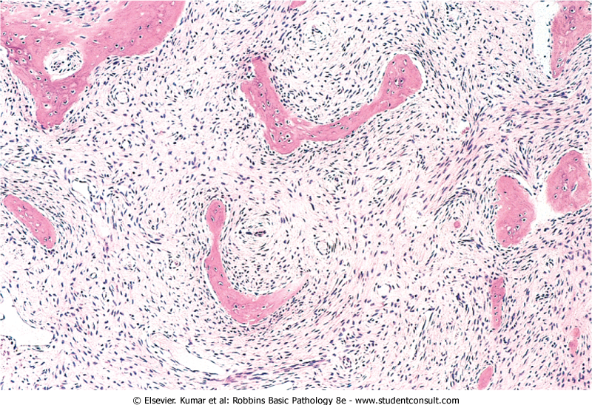
Fibrous dysplasia. Curved trabeculae of woven bone (Chinese letters) arising in a fibrous tissue. Note the absence of osteoblasts rimming the bones

Slide 49
Morphology and clinical
Well-circumscribed, intramedullary lesions of varying sizes
By x-ray, lesions exhibit a characteristic ground-glass appearance with well-defined margins
Symptomatic lesions are readily cured by conservative surgery
Polyostotic involvement is frequently associated with progressive disease, and more severe skeletal complications
Rarely, polyostotic disease can transform into osteosarcoma, especially following radiotherapy

Slide 50
Ewing sarcoma
Ewing sarcoma and primitive neuroectodermal tumors (PNETs) are primary malignant small round-cell tumors of bone and soft tissue
They share an identical chromosome translocation, they should be viewed as the same tumor, differing only in degree of differentiation PNETs demonstrate neural differentiation whereas Ewing sarcomas are undifferentiated by traditional marker analysis

Slide 51
Pathogenesis
Next to osteosarcomas, they are the second most common pediatric bone sarcomas
Most patients are 10 to 15 years old
80% are younger than age 20
Boys are affected slightly more frequently than girls
Racial predilection; blacks are rarely afflicted
Translocation that causes fusion of the EWS gene on 22q12 with a member of the ETS family of transcription factors, most commonly FL1 gene on 11q24, and the ERG gene on 21q22
The resulting chimeric protein functions as a constitutively active transcription factor to stimulate cell proliferation

Slide 52
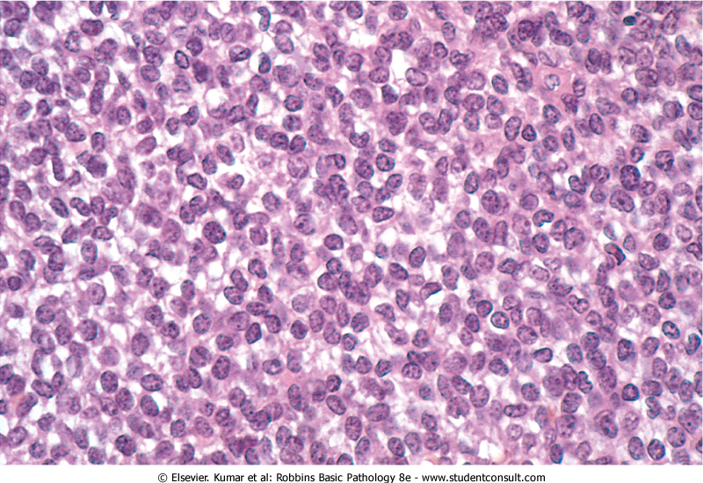
Ewing sarcoma. Sheets of small round cells with scant, cleared cytoplasm

Slide 53
Arises in medullary cavity
Most common: long bones (femur), pelvis
Aggressive, highly invasive, necrotic
Sheets of primitive cells, slightly larger than lymphocytes, with occasional presence of Homer-Wright rosettes (tumor cells circled about a central fibrillary space) indicates neural differentiation
X-ray: bone mass, lytic lesions. There is a characteristic periosteal reaction depositing bone in an onionskin fashion

Slide 54
Metastasis
More common than primary tumors
Rich vascularity, nutrients, slow perfusion
Mostly in axial skeleton
Cancer itself does not erode the bone
Most cancer cells secret prostaglandins, interleukins, and PTHRp that stimulate osteoclastic bone resorption causing lytic lesions
Some cancers (prostate) stimulate osteobasts (sclerotic lesions)
Mixed lytic/blastic lesions are common

Slide 55
Arthritis
Osteoarthritis
Gout
Pseudogout
Lyme disease

Slide 56
Osteoarthritis
Degenerative joint disease
The most common joint disorder
Important cause of physical disability in individuals over the age of 65
The fundamental feature of osteoarthritis is degeneration of the articular cartilage
Bone changes are secondary
Inflammation can be present as a minor component
Primary OA: most common, insidious onset, no initiating factor, oligoarticular
Secondary OA: 5% of cases, young age, history of trauma, DM, hemochromatosis, marked obesity, one or many joints
Gender has some influence; knees and hands are more commonly affected in women, whereas hips are more commonly affected in men

Slide 57
Pathogenesis
Normal function of joint cartilage: prevents friction and spreads load across the joint to protect the underlying bone
Normal cartilage is elastic, regain normal architecture after compression (proteoglycans), and to have high tensile strength (collagen II), both produced by chondrocytes
Mechanical stresses and aging causes damage to chondrocytes
Genetic factors also seem to contribute to osteoarthritis susceptibility, particularly in the hands and hips, but the responsible genes are not known
Degenerating cartilage contains more water and less proteoglycan and collagen, its function is compromised
Chondrocytes in the deeper layers proliferate to compensate, but with time, they fail

Slide 58
Morphology
The earliest structural changes in osteoarthritis include enlargement, proliferation, and disorganization of the chondrocytes in the superficial part of the articular cartilage
Subsequently, vertical and horizontal cracking of the matrix occur as the superficial layers of the cartilage are degraded
With time, the subchondral bone plate is exposed
Friction smooths and burnishes the exposed bone, giving it the appearance of polished ivory (bone eburnation). The underlying cancellous bone becomes sclerotic and thickened
Small fractures can dislodge pieces of cartilage and subchondral bone into the joint, forming loose bodies (joint mice)
Mushroom-shaped osteophytes (bony outgrowths) develop at the margins of the articular surface
Synovium moves into subchondral bone and forms cysts. In severe disease, a fibrous synovial pannus covers the peripheral portions of the articular surface

Slide 59
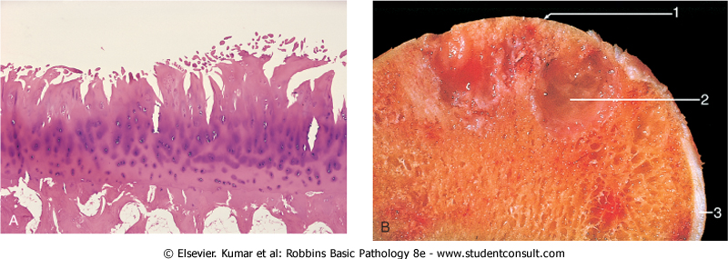
Osteoarthritis. A, Histologic demonstration of the characteristic fibrillation of the articular cartilage. B, Severe osteoarthritis with 1, Eburnated articular surface exposing subchondral bone. 2, Subchondral cyst. 3, Residual articular cartilage

Slide 60
Clinical Features
Osteoarthritis is an insidious
Patients, in their 50s and 60s
Characteristic symptoms include deep, aching pain exacerbated by use, morning stiffness, crepitus, and limited range of movement
Osteophytes cause nerve impingement (radicular pain, muscle spasms, muscle atrophy, and neurologic deficits)
Heberden nodes in the fingers, representing prominent osteophytes at the distal interphalangeal joints, are characteristic in women.
With time, significant joint deformity can occur, but unlike rheumatoid arthritis, fusion does not take place.

Slide 61
Gout النقرس
Accumulation of excessive amounts of uric acid (end product of purine metabolism)
Recurrent episodes of acute arthritis, sometimes accompanied by the formation of large crystalline aggregates called tophi, and chronic joint deformity
All of these result from precipitation of monosodium urate crystals
Although an elevated level of uric acid is an essential component of gout, not all such individuals develop gout, indicating that influences besides hyperuricemia contribute to the pathogenesis
Gout is traditionally divided into primary and secondary forms, accounting for about 90% and 10% of cases, respectively
Primary gout, basic cause is unknown or (less commonly) when it is due to an inborn metabolic defect that causes hyperuricemia
In secondary gout the cause is known, but gout is not necessarily the main or even dominant clinical disorder

Slide 63
Types
Acute arthritis: dense neutrophilic infiltrate permeating the synovium and synovial fluid. Long, slender, needle-shaped monosodium urate crystals are frequently found in the cytoplasm of the neutrophils and in the synovium
Chronic tophaceous arthritis: repetitive acute attacks. Crust in the synovium (hyperplastia, fibrosis, inflammatory cells), then forms a pannus that destroys the underlying cartilage, and leading to bone erosions. In severe cases: ankylosis
Tophi: large aggregations of urate crystals surrounded by an intense inflammatory reaction of lymphocytes, macrophages, and foreign-body giant cells. Tophi appear in cartilage of joints, ligaments, tendons, and soft tissues, including the ear lobes, nasal cartilages, and skin of the fingertips
Gouty nephropathy: medullary tophi, intratubular precipitations, or free uric acid crystals and renal calculi. Secondary complications such as pyelonephritis can occur, especially when there is urinary obstruction

Slide 64
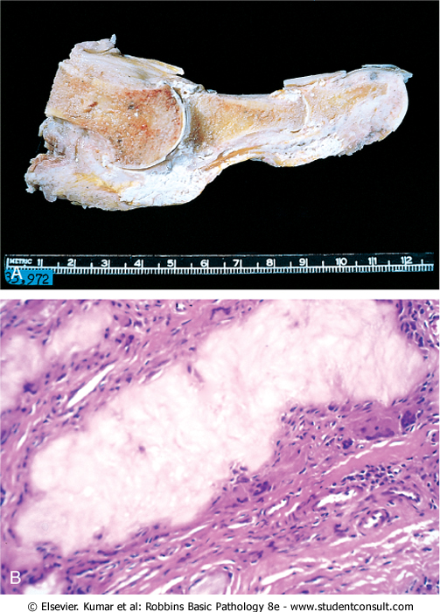
Gout. A, Amputated great toe with white tophi involving the joint and soft tissues. B, Photomicrograph of a gouty tophus. An aggregate of dissolved urate crystals is surrounded by reactive fibroblasts, mononuclear inflammatory cells, and giant cells.

Slide 65
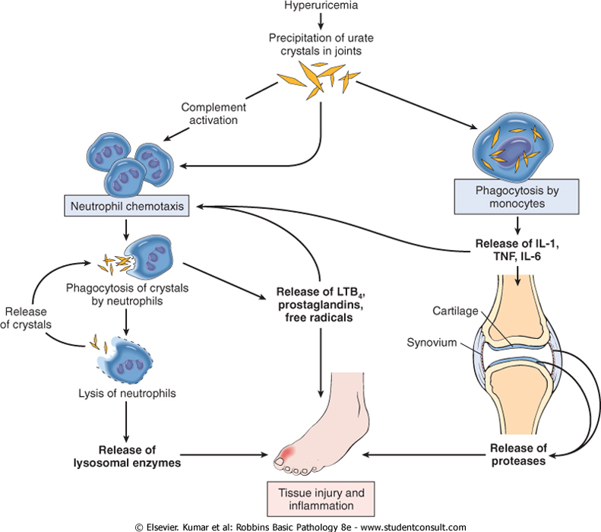

Slide 66
Pseudogout
AKA chondrocalcinosis
Calcium pyrophosphate crystal deposition disease
Pseudogout typically first occurs in those age 50 or older
Accumulation and crystallization with calcium
Recruitment and activation of inflammatory cells
Joint involvement can last from several days to weeks
may be monoarticular or polyarticular; the knees, followed by the wrists, elbows, shoulders, and ankles, are most commonly affected
Ultimately, approximately 50% of patients experience significant joint damage
Therapy is supportive; no known treatment prevents or retards crystal formation

Slide 67
Infectious arthritis
Hematogenous, or complication of osteomyelitis
Rapid destruction of joint structures and permanent deformity (sudden pain, fever)
Haemophilus influenzae <2 years
S. aureus is the main causative agent in older children and adults
gonococcus is prevalent during late adolescence and young adulthood
Individuals with sickle cell disease are prone to infection with Salmonella at any age

Slide 68
Lyme arthritis
Borrelia burgdorferi, transmitted by deer ticks, common in the United States
Involves multiple organ systems and is usually divided into three stages
In stage 1 Borrelia spirochetes multiply at the site of the tick bite and cause an expanding area of redness (erythema chronicum migrans) + fever and lymphadenopathy but usually disappears in a few weeks' time
In stage 2, the early disseminated stage, spirochetes spread hematogenously and cause secondary annular skin lesions, lymphadenopathy, migratory joint (large joints) and muscle pain, cardiac arrhythmias, and meningitis, often with cranial nerve involvement. If the disease is not treated, antibodies develop that are useful for serodiagnosis of Borrelia infection. Some spirochetes, however, escape host antibody and T-cell responses by sequestering themselves in the central nervous system or as intracellular forms within endothelial cells.
In stage 3, the late disseminated stage, which occurs 2 or 3 years after the initial bite, Lyme Borrelia organisms cause a chronic arthritis, sometimes with severe damage to large joints, and an encephalitis that varies from mild to debilitating.
Lyme arthritis develops in roughly 60% to 80% of untreated patients and is the dominant feature of late disease. The arthritis may be caused by immune responses against Borrelia antigens that cross-react with proteins in the joints.
Histologically, there is a chronic papillary synovitis with synovial hyperplasia, fibrin deposition, mononuclear cell infiltrates
In only 25% of cases do silver stains reveal a sprinkling of organisms
Chronic arthritis with pannus formation and permanent deformities develops in roughly one of ten patients.

