Slide 1
Myasthenia Gravis

Slide 3
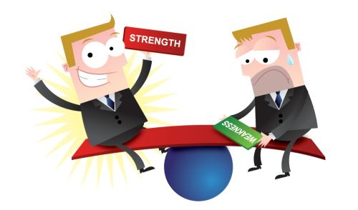
MyAsthenia Gravis
Muscle
Weakness
Severe

Slide 4
Immunized Rabbits Experiment

Slide 5
What Happens????

Slide 6
What type of immunoglobulin is involved????
IgG

Slide 8
The Case of MR.WELD

Slide 9
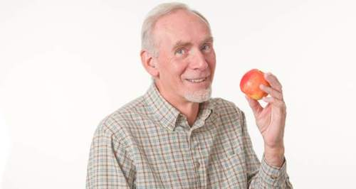
-71 year old male -Good health -active for whole life

Slide 10
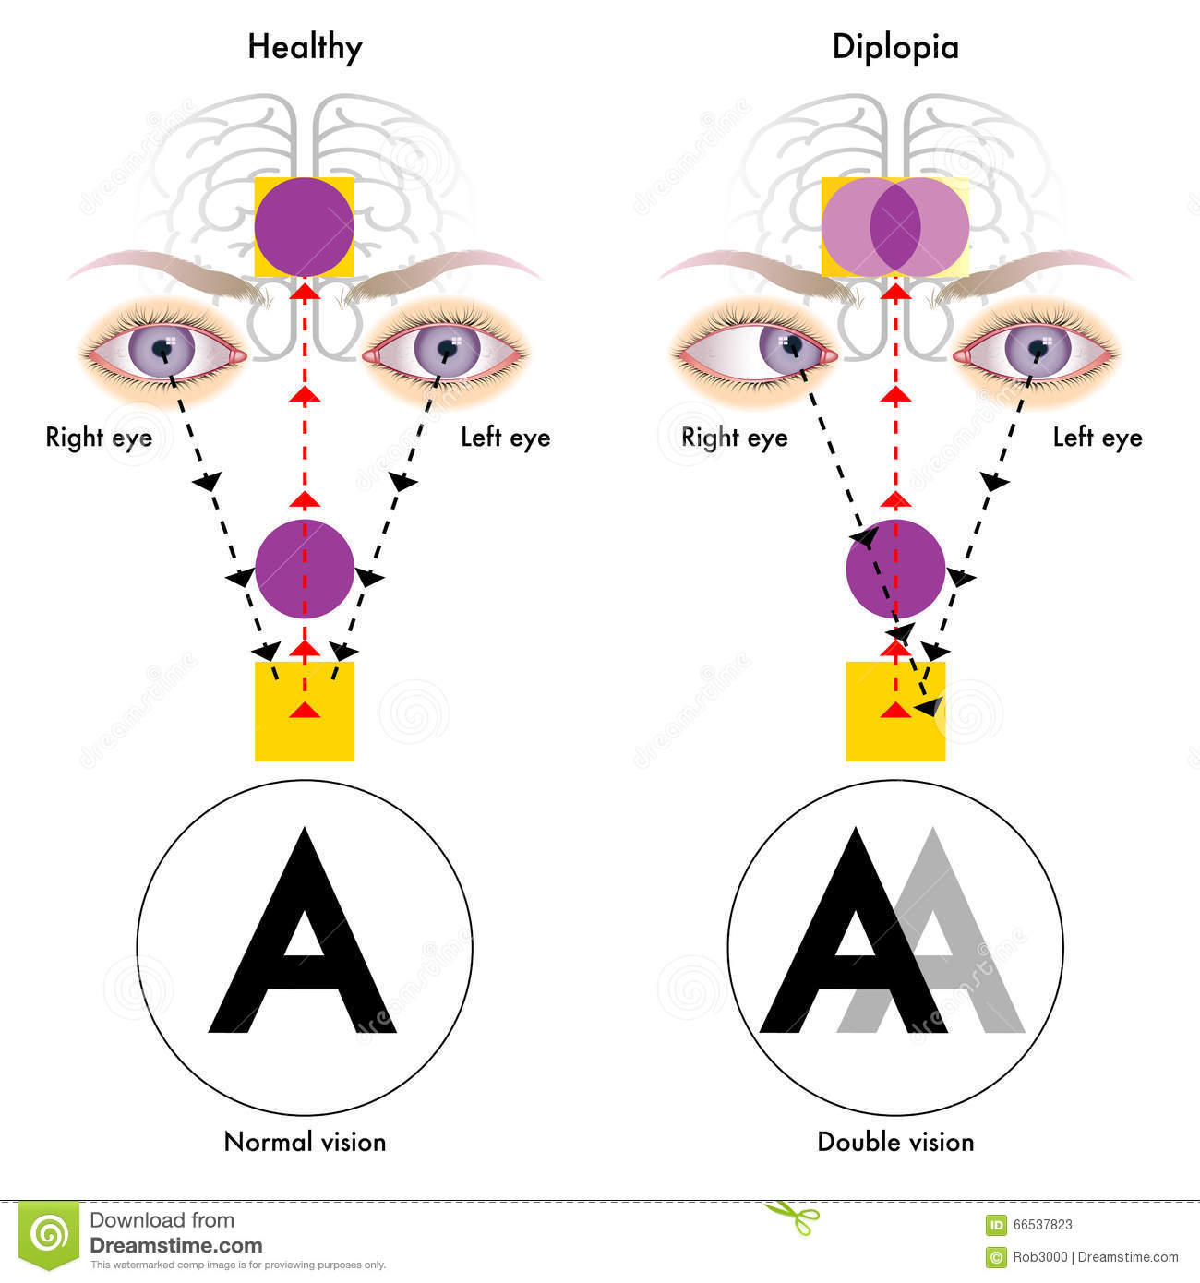
Diplopia for 4 months

Slide 11
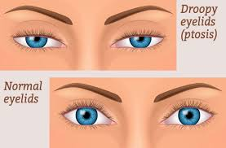
Ptosis in both eyes

Slide 12
Ocular movement limitation

Slide 13
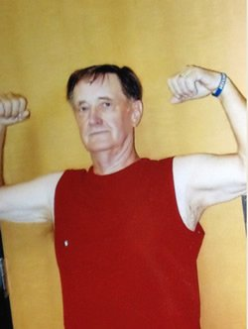
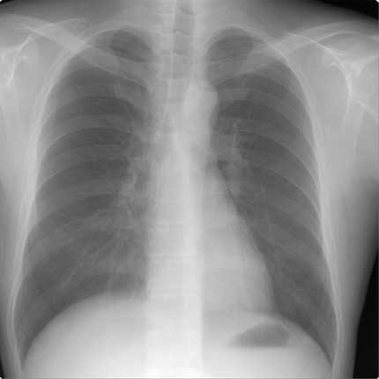
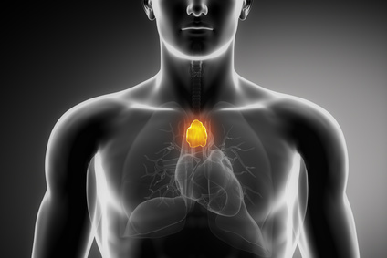
Remainder of neurological examination was normal
No other muscle weakness was found
Radiological examination of the chest was normal
No evidence of enlarged thymus---- different in younger people?????

Slide 14
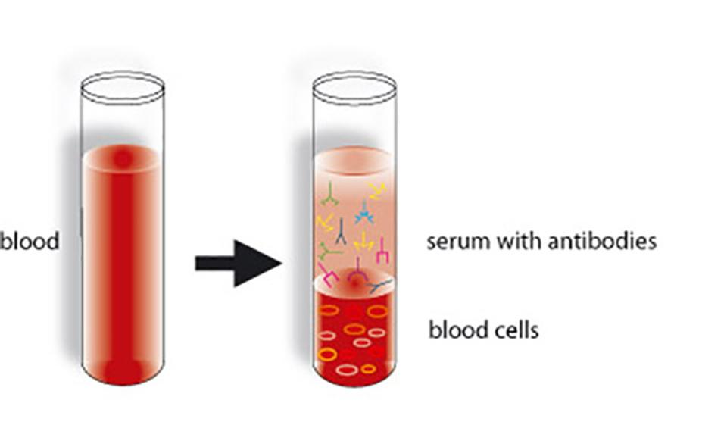
Blood serum contained 6.8 units of antibody to the acetylcholine receptor (normal<.5)

Slide 15
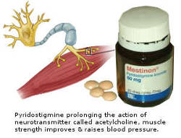
He was told to take pyridostigmine inhibitor of cholinesterase

Slide 16
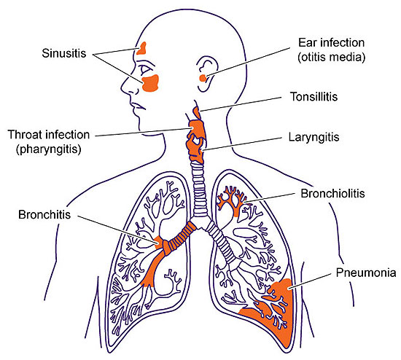
Three years later……
Developed a severe respiratory infection…breaking tolerance

Slide 17
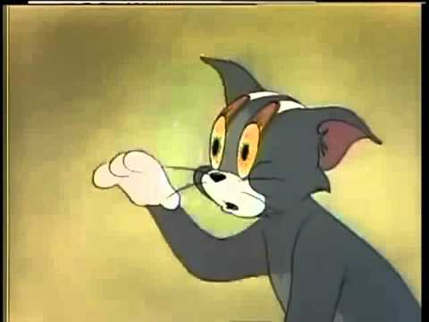
Ptosis became so severe he had to tape his eye lids to keep eyes open

Slide 18
Diplopia recurred.
Speech became indistinct…..weakness of facial muscles and tongue.
Abnormality in ocular movements became apparent again.
Difficulty in chewing and swallowing food….diet of only soft food
He could only tolerate a quarter of recommended dose of pyridostigmine.
Difficulty in breathing….vital capacity = 3.5 liters.

Slide 19
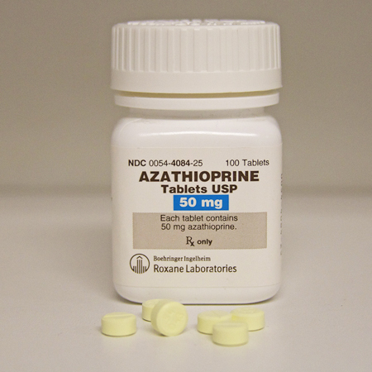
Treated with azathioprine…immunosupressive agent

Slide 20
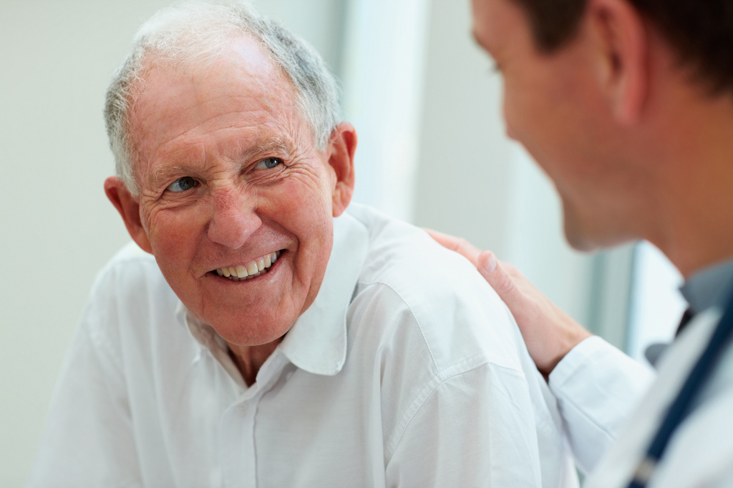
Mr.weld is better!

Slide 21
Finally done!!!

