Slide 1
1-Mycobacteria 2-Chlamydia 3-Mycoplasam 4-Legionella 5- Spirochetes
Prof. Dr. Asem Shehabi & Dr. Suzan Matar
Faculty of Medicine, University of Jordan

Slide 2
1-Mycobacteria Group
Acid-Fast Bacilli.. Aerobic.. Cell Wall.. Mixed protein-polysaccharides, High Phospholipids (mycolic acid, waxes).. Resistant to Dryness, low Acidity, Alcohol, detergents.. Susceptible to UV-light, Heat, Common Human.. Asymptomatic persons. domestic Animal, Birds, Environment..kill 3-5 Million yearly
Human/animals Pathogens.. Slow growth in vitro culture (2-6 weeks).. Causing tissue necrosis in lung and any body part.
Common Pathogens: Mostly M. tuberculosis ..Lung & systemic tubercusosis.. Less than 1% M. bovis .. Animals, Dairy products..Mostly Intestinal tuberculosis.

Slide 3
2-Mycobacteria Group
Pulmonary Tuberculosis/ Exudative type: Slow intracellular growth in lung tissue..Incubation time 1-12 months.. droplet infection.. Primarily mild Lung lesion Mostly Children (90%).. Asymptomatic infection, Rarely active lesions..Recovery.. Hypersensivity Immunity..Positive skin tuberculin test..
Asymptomatic infection is not necessary result in Disease
Active-Productive type: Adult infection.. Reactivation of old tuberculosis lesions..may present in any Body site.. Intestinal tract, Kidney, bones.. Meningitis common in children.
Lung lesion: Cough, Bloody sputum, night sweats ,weight loss.. Detection X-ray and positive tuberculin test..Larger reaction.

Slide 4
2/Mycobacteria
Atypical Mycobacteria .. pigmented and non-pigmented..Slow and rapid grower types common in environment..Rarely cause of lung or systemic Tuberculosis.. Immunosuppresed.
Nonpathogenic species.. genital tract, skin (M. smegmatis.. rapid growth (3-7 days)..rarly skin lesions.
Lab Diagnosis: Direct AFS.. Ziehl-Neelsen stain, Culture 2-6 weeks, Lowenstein -Jensen Medium, Sputum, urine, Pleural fluid, CSF, Biopsy.
Treatment: Combination of anti-tuberculosis drugs 6-24 months).
Prevention.. BCG vaccine (Bacilli Calemtte- Guerin)..Children..Protective 30-50%

Slide 5
2-Chlamydia group
Chlamydia : Small Gram-ve cell wall, few amount of lipopolysaccharides.. obligate intracellular.. Microaerophilic dimorphic growth & , Infectious stage.. Elementary bodies/ Infectious.. responsible for attaching to the host mucosa cell and promoting its entry.. Develop Inclusion bodies/Reticulate bodies ..replication.
Chlamydia trachomatis: A common cause of STD worldwide.. Nonspecific urethritis.. Prostatitis, Vagnitis.. Cervicitis, infertility.
Newborns with chlamydial conjunctivitis: have mild to severe eyes redness, swollen eyelids, discharge from the eyes which can be thin and watery or thick and yellow.. Trachoma .. Blindness if not treated.

Slide 6
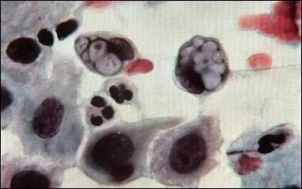
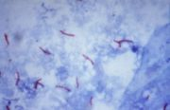
Chlamydia inclusion bodies/Acid-Fast Mycobacteria

Slide 7
2-Chlamydia
Chlamydia pneumoniae.. Attached to Tracheal epithelial cells acute bronchitis.. Atypical pneumonia.. Mild-severe pulmonary infection..mild-sever cough, Common in children.. Less other ages
Diagnosis & treatment : Clinical features & serological test.. Detection specific antibodies developed after 4-8 weeks infection
McCoy tissue culture.. PCR test..
Antibiotics treatment.. No Vaccine

Slide 8
3-Mycoplasma group
The smallest Bacteria .. Lack Cell Wall.. Lipid bi-layer Membrane.. Microaerophilic.. Associated with mucosal Respiratory/Urinary. .Human, Animals, Birds.
1-M. pneumoniae: Human pathogens.. Infection Pharyngitis, Bronchitis, Pneumonia.. Dry cough.. Fever, Common old children & Young adults.. Less others ages, Common infection in Fall-Winter.
2-M.hominis/M.genitalium : Part of normal oral- genital flora, opportunistic pathogens.. cause Nonspecific urethritis, vaginitis, cervicitis.
Diagnosis & treatment: Sputum & Urine special Culture media.. Cold-Agglutination Test, ELSA Specific antibodies, PCR, Antibiotics.. No Vaccine.

Slide 9
4-Legionella pneumonphila
Legionnaires’ disease -Thin G-ve Coccobacilli/ Filments.. Facultative Anaerobes.. Survive 0-80 C.. Cold/Hot Water.. Air Condition, Wet Soil, Droplet infection ..Aerosols, Fine sprays , Respiratory Mucosa Lung.. Intracellular.. Monocyte-Macrophage.. Extracellular growth,Not contagious disease.
Clinical Features: High Fever, dry Cough, vomiting, and stomach discomfort, Diarrhea. Other common symptoms include headaches, muscle aches, chest pain, and shortness of breath, Pneumonia, Renal Failure, Death.. Old/ Immumodeficient / heavy Smoking Persons.
Diagnosis & treatment: Special Culture Media, Blood-sputum culture, Detection Specific antibodies, PCR, Antibiotics.. No Vaccine.

Slide 10
Spirochetes Group-1
Gram-ve.. Spiral forms.. Long.. which have long helically coiled cells (5-20um).. Common Human, Animals, Arthropodes.. Nonpathogenic /Pathogenic.
1- Treponema species: Nonpathogenic.. Oral cavity.
2-Treponema palldium: Syphilis.. Veneral Disease.. Sexual Contact.. entering the host via breaches in mucosa of genital & oral tracts..distribute to blood and lymph systems following multiplication in tissue
Incub. 2-week-Few Months: Acute-Chronic Infection.. Mucosa/Skin Lesions-Chancre on Genitalia, Anal area/Mouth.. Systemic Disease.. Affect Any Body Organ.. Meningitis, Hepatitis, Nephritis, Granulomatous lesions. Congenital Syphilis.. Pregnancy, affects fetus.. death and abortion.

Slide 11
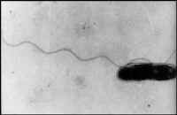
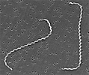
Legionella- Spirochete Cells

Slide 12
Spirochetes Group-2
Lab Diagnosis: Direct Dark-field Microscopy.. Serological Test.. Rapid Plasma Reagin (RPR) / VDRL, confirmed by Fluorescent Treponemal Antibody (FTA-ABS).. No artificial Culture.. Antibiotics
4- Borrelia species: Worldwide.. Epidemic/Endemic Relapsing Fever.. Biting Insects (Human Lice/ Animal Ticks).. Septicemia.. Low-High Fever, Chills, Severe Headache, Common Relapses.
Borrelia Burgdorferi: Lyme Disease.. Common USA, Biting Insects (Ticks).. Wild Animals, Rodents, Birds ..Incub. Few Weeks- Months..Single/Multiple Skin Erythematic Lesions.. Systemic Disease.. Arthritis, CNS.. Cardiac Abnormalities.
5-Liptospiral diseases: Zoonosis, mild-severe fatal systemic .. Weils’s disease ..high Fever, Jaundice, vasculitis , Bleeding.
Diagnosis: Serological Tests, Special fluid culture methods

Slide 13
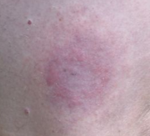
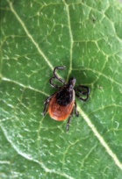
Lyme Disease/ Tick Erythematic lesions

