Slide 1
Pathology of The Breast
Anything added is italic

Slide 2
Lesions of female breast are much more common than lesions of male breast
Most of these lesions are benign
Breast cancer is 1st most common cancer; and 2nd most common cause of cancer deaths in women, following carcinoma of the lung.
Benign conditions are more common than malignancy (look next slide)
clinical significance of benign conditions:
1- possible clinical confusion with malignancy
2- association of certain variants with breast carcinoma.
MORE COMMON IN FEMALES

Slide 3
Breast diseases (patients with symptoms in breast)
Symptoms are an exaggeration of normal physiology
Bnign tumor of the breast

Slide 4
Major symptoms involving the breast
سلايد مضاف added slide
Breast lump
Pain and tenderness
Nipple discharge
As we already said, underlying cause more commonly is a benign condition. But still, they might indicate carcinoma.

Slide 5
Fibrocystic changes Fibro: Fibrosis, cystic: cyst formation, changes: a spectrum of changes in breast tissue responding to cyclic hormonal changes rather than a disease)
most common cause of breast "lumps”
exaggeration of cyclic breast changes that occur normally in the menstrual cycle.
HRT and OCPs do not increase incidence; (OCPs may decrease the risk).
arise during reproductive period of life and regress following menopause (because it’s dependent on hormones
Very common (at autopsy 60%-80% of women). Could be asymptomatic
A spectrum of changes (fibrosis and cysts formation in one side, to proliferative types)

Slide 6
سلايد مضاف added slide
Cyclic changes in breast
Follicular/ Proliferative phase | Luteal / secretory
under the effect of estrogen Proliferation of cells in breast substance | Under the effect of progesterone Producrion of Secretions in breast substance
Breast histology: Lobules: secrete Ductules:to distal ductal system that open into the nipple
Fibrocystic changes involve both lobules and ductules
Spectrum..
Fibrosis and cyst formation
Proliferative + Atypia (atypical hyperplasia) Increased risk of carcinoma in either breast

Slide 7
TUMORS OF THE BREAST

Slide 8
1- Fibroadenoma (biphasic growth involves fibrous tissue (fibro) and glands (adeno). oma=benign
most common benign neoplasm of female breast. Usually young age
increase in estrogen activity
enlarge late in menstrual cycle and during pregnancy.
After menopause regress and calcify.
Most in third decade of life.
a discrete, solitary, freely movable nodule, (1 to 10 cm). Usually easily "shelled out“ surgically.
i.e. during physical examination the lesion is not fixed to the overlying skin or underlying chest wallMeans that it hasn’t invaded surrounding tissue

Slide 9
Fibroadenoma
Stromal cells are the source of neoplasm
Cytogenetic studies ➔ stromal cells are monoclonal and so represent the neoplastic element of these tumors (the neoplastic stromal cells secrete growth factors that induce proliferation of epithelial cells(the glands)).
Fibroadenomas almost never become malignant.

Slide 10
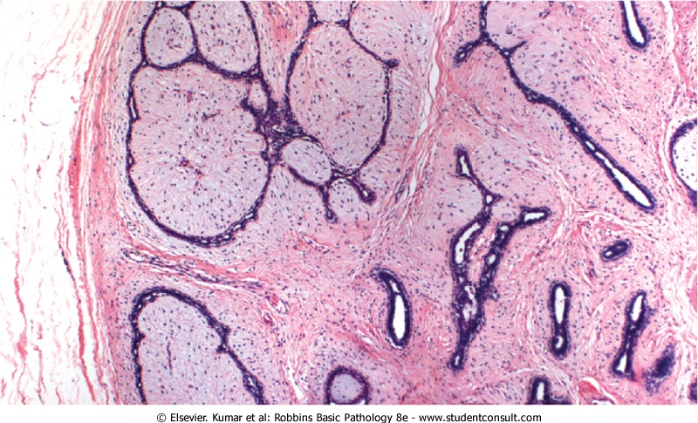
Fibroadenoma
Well-demarcated
Stroma
Gland (lobules and ductules)

Slide 11
Carcinoma of the Breast
the most common cancer in females
ranking second only to lung cancer as a cause of cancer death in women.
75% are older than age 50.
Only 5% are < 40.(familial cases)

Slide 12
Pathogenesis
(1)Genetic Changes
familial syndromes (BRCA genes) BRCA genes are also involvedd in familial serous ovarian cancers and cancers in fallopian tubes
sporadic breast cancer: e.g. overexpression of the HER2/NEU proto-oncogene( an epithelial growth factor receptor) (30% of cases)
(2)Hormonal Influences
increased exposure to estrogen (unopposed estrogen: high levels of estrogen are not balanced by progesterone)
(3)Environmental Variables

Slide 13
Factor | Relative Risk
Well-Established Influences
Geographic factors | Varies in different areas
Age | Increases after age 30yr
Family history
First-degree relative with breast cancer | 1.2-3.0
Premenopausal | 3.1
Premenopausal and bilateral | 8.5-9.0
Postmenopausal | 1.5
Postmenopausal and bilateral | 4.0-5.4
Menstrual history
Age at menarche <12yr | 1.3
Age at menopause >55yr | 1.5-2.0
Pregnancy
First live birth from ages 25 to 29yr | 1.5
First live birth after age 30yr | 1.9
First live birth after age 35yr | 2.0-3.0
Nulliparous | 3.0
Benign breast disease
Proliferative disease without atypia | 1.6
Proliferative disease with atypical hyperplasia | >2.0
Lobular carcinoma in situ | 6.9-12.0
Less Well-Established Influences
Exogenous estrogens
Oral contraceptives
Obesity
High-fat diet
Alcohol consumption
Cigarette smoking
Don’t memorize this table just know the circled things and the side notes.
Low level of evidence

Slide 14
From the previously presented table:
سلايد مضاف added slide
Risk factors of breast cancer:
Age
Family history; only worrisome if: - it is a 1st degree relative (mother, sister, or daughter) -she got it before the age of 45 -it was bilateral (indicates a field defect + it might be lobular carcinoma which is bilateral and could be familial) -she was premenopausal
Menestural history ( early menerache and late menopause increase your risk because that mean you were exposed to estrogen for longer periods
Pregnancy is protective (it increases progesterone levels) . Null parity (ما خلفت) and increased age at first delivery increase your risk
Benign neoplasms: if proliferative fibrocystic changes + atypia → Carcinoma in situ

Slide 15
Major Risk Factors
Age.
Genetics and Family History:
50% of hereditary breast cancer → mutations in BRCA1; 30% in BRCA2 .
Prolonged exposure to exogenous estrogens postmenopausally (hormone replacement therapy HRT)
Ionizing radiation, in early life years

Slide 16
Morphology of breast cancer
- The locations of the tumors within breast are:
Upper outer quadrant 50% (most common) Most of the breast substance (lobules and associated ductules) is in that area
Central portion (sub-areola) 20%
Lower outer quadrant 10%
Upper inner quadrant 10%
Lower inner quadrant 10%

Slide 17
Breast cancers are classified into:
Noninvasive (Carcinoma in situ)(confined by a basement membrane and do not invade into stroma or lymphovascular channels) , include:
Ductal carcinoma in situ (DCIS) . Most common
Lobular carcinoma in situ (LCIS). Confined by BM of the lobule
Invasive (infiltrating)
Invasive ductal carcinoma – also called: NOS (not otherwise specified يعني: ليس أيًا من الأنواع الأخرى) (most common type (70-80% of cases), and worst type)
Invasive lobular carcinoma (nearly 20% of cases)
Medullary carcinoma
Colloid (mucinous) carcinoma
Tubular carcinoma
Other types
Will be discussed today

Slide 18
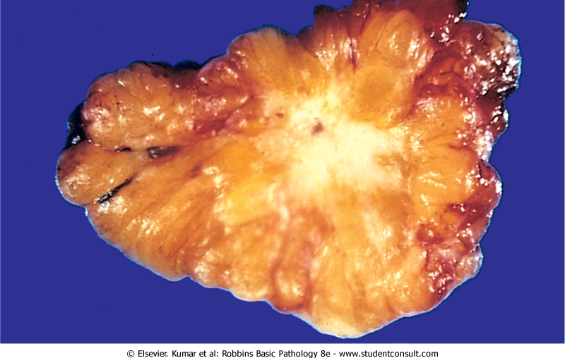
Malignant breast carcinoma: you can see infiltrative borders of the tumor indicate malignancy

Slide 19
Ductal carcinoma in-situ DCIS
ranges from low to high nuclear grade.
comedo subtype of DCIS: high-grade nuclei with extensive central necrosis. (The name derives from the toothpaste-like necrotic tissue).
Calcifications are common→ screening by mammography. If micocalcifications wrer detected in mammogramy they should be biopsied
Prognosis : excellent (97% survival post mastectomy) and yes, they undergo mastectomy
Treatment strategies: surgery, radiation, tamoxifen (antiestrogen)
Significance: adjacent invasive CA; become invasive if untreated
Ducts become filled with dysplastic cells , they become distended and large in size and centrally cells become necrotic giving the appearance of tooth paste- like material
Extra: Remember from general pathology that dystrophic calcificstion happens on top of necrosis

Slide 20
Comedo DCIS
Necrosis

Slide 21
Invasive ductal carcinoma
"not otherwise specified“= NOS
70% to 80%
Precancerous lesion: DCIS
Clinical presentation: a mammographic density; a hard palpable mass. Advanced cancers may cause retraction of nipple, or fixation to chest wall.
Receptor profile (important prognostically and therapeutically i.e. targeted therapy): 2/3 express Estrogen Receptor (use tamoxifen) or Progesterone Receptor; 1/3 overexpresses HER2/NEU.(use antiboy against HER2/NEU called herceptin)

Slide 22
Invasive ductal carcinoma

Slide 23
Invasive lobular carcinoma
< 20% of all breast carcinomas.
Precancerous lesion. LCIS (2/3) .
multicentric and bilateral (10% to 20%). If you find in one breast you should check the other
Lots of cases are familial so if a patient was diagnosed other first degree family members are recommended to be evaluated
Clinical presentation. palpable masses or mammographic densities
Almost all of these carcinomas express ER and PR, but HER2/NEU overexpression is usually absent.

Slide 24
Physical Features Common to All Invasive Cancers
Might be discovered by the patient or examiner
Fixation: tumor adherence to pectoral muscles or deep fascia of chest wall
retraction or dimpling of skin or nipple: tumor adherence to overlying skin
peau d'orange (orange peel): Involvement of lymphatic pathways cause localized lymphedema; the skin becomes thickened around exaggerated hair follicles
A type of localized edema involving the breast when Lymphatic channels are occluded by tumor

Slide 25
Spread of Breast Cancer
Carcinoma usu favors lymphatic spread But sometimes hematogenous spread is involved as well
lymphatic and hematogenous channels.
Favored mets are the lungs, skeleton, liver, and adrenals and (less commonly) the brain, spleen, and pituitary.
Metastases may appear many years after apparent therapeutic control of the primary lesion. So you should follow-up with the patient
SCREENING :
mammographic screening
Magnetic resonance imaging MRI

Slide 26
Prognosis depends on:
1- Tumor size. (stage)
2- Lymph node involvement (&number of lymph nodes involved) by metastases.
3- Distant metastases.
4- Grade
5- Histologic type (invasive ductal NOS is the worst)
6- Presence or absence of estrogen or progesterone receptors.
7- Proliferative rate of cancer.
8- Aneuploidy (worse prognosis).
9- Overexpression of HER2/NEU (predict response to a monoclonal antibody ("Herceptin")).
Most imp.

Slide 27
Male breast pathology
Gynecomastia
Enlargement of the male breast (not related to cancer unless in pathologic not because of the gynecomastia itself but because of increased estrogen)
absolute or relative estrogen excesses.
According to cause, divided into:
1- pathologic gynecomastia: important because it indicates that there is a source of excess estrogen: cirrhosis of the liver; Klinefelter syndrome; estrogen-secreting tumors; estrogen therapy (for prostate cancer); digitalis (digoxin) therapy.
2- Physiologic gynecomastia:at both extreme of ages puberty and extreme old age.
Under microscopy: exaggeration of normal tissue
Enlargement is caused by increased mamillary tissue (lobules)

Slide 28
Carcinoma of the male breast
male: female breast cancer →1: 125.
advanced age.
Because of scant amount of breast substance in male, the tumor rapidly infiltrates overlying skin and underlying thoracic wall.
Unfortunately, (½) have lymph nodes mets and more distant sites by time of diagnosis.
Rapid advancement

