Slide 1
Nonsteroidal Anti-inflammatory Drugs (NSAIDs) and Analgesics
Dr. Alia Shatanawi

Slide 2
Inflammatory pathways
Cyclooxygenase (COX) pathway of arachidonate metabolism produces prostaglandins
Effects on blood vessels, on nerve endings, and on cells involved in inflammation.
The lipoxygenase pathway of arachidonate metabolism yields leukotrienes
have a powerful chemotactic effect on eosinophils, neutrophils, and macrophages and promote bronchoconstriction and alterations in vascular permeability.

Slide 3
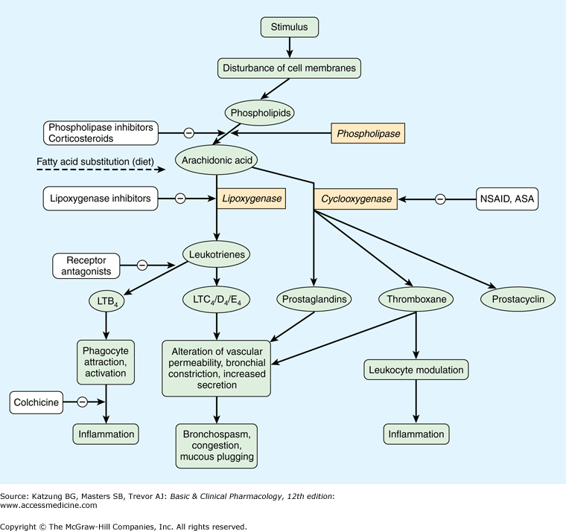
Notes:
Zileuton

Slide 4
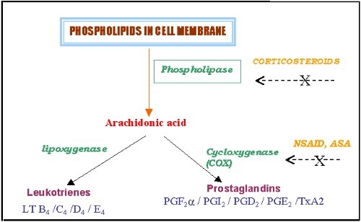

Slide 5
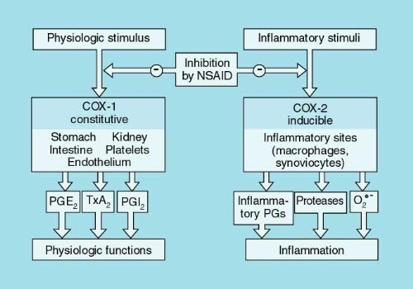

Slide 6
Cyclo-oxygenase (COX)
Exists in the tissue as constitutive isoform (COX-1).
At site of inflammation, cytokines stimulates the induction of the 2nd isoform (COX-2).
Inhibition of COX-2 is thought to be due to the anti-inflammatory actions of NSAIDs.
Inhibition of COX-1 is responsible for their GIT toxicity.
Most currently used NSAIDs are somewhat selective for COX-1, but selective COX-2 inhibitors are available.

Slide 7
Comparison of Analgesics
Feature | Narcotic (Opioids) | Nonnarcotic (nonopioid)
Efficacy | Strong | Weak
Prototype | Morphine | Aspirin
Pain Relieved | Any Type | Musculoskeletal
Site of Action | Central | Peripheral and Central
Mechanism | Specific Receptors | PG Synthesis
Danger | Tolerance & Dependence | G.I irritation
Anti-inflammatory | No | Yes
Antipyretic | No | Yes
Antiplatelets | No | Yes
8

Slide 8
Pain
- Universal, Complex, Subjective experience
- No. 1 Reason people take medications
- Generally is related to some type of tissue damage and serves as a warning signal

Slide 9
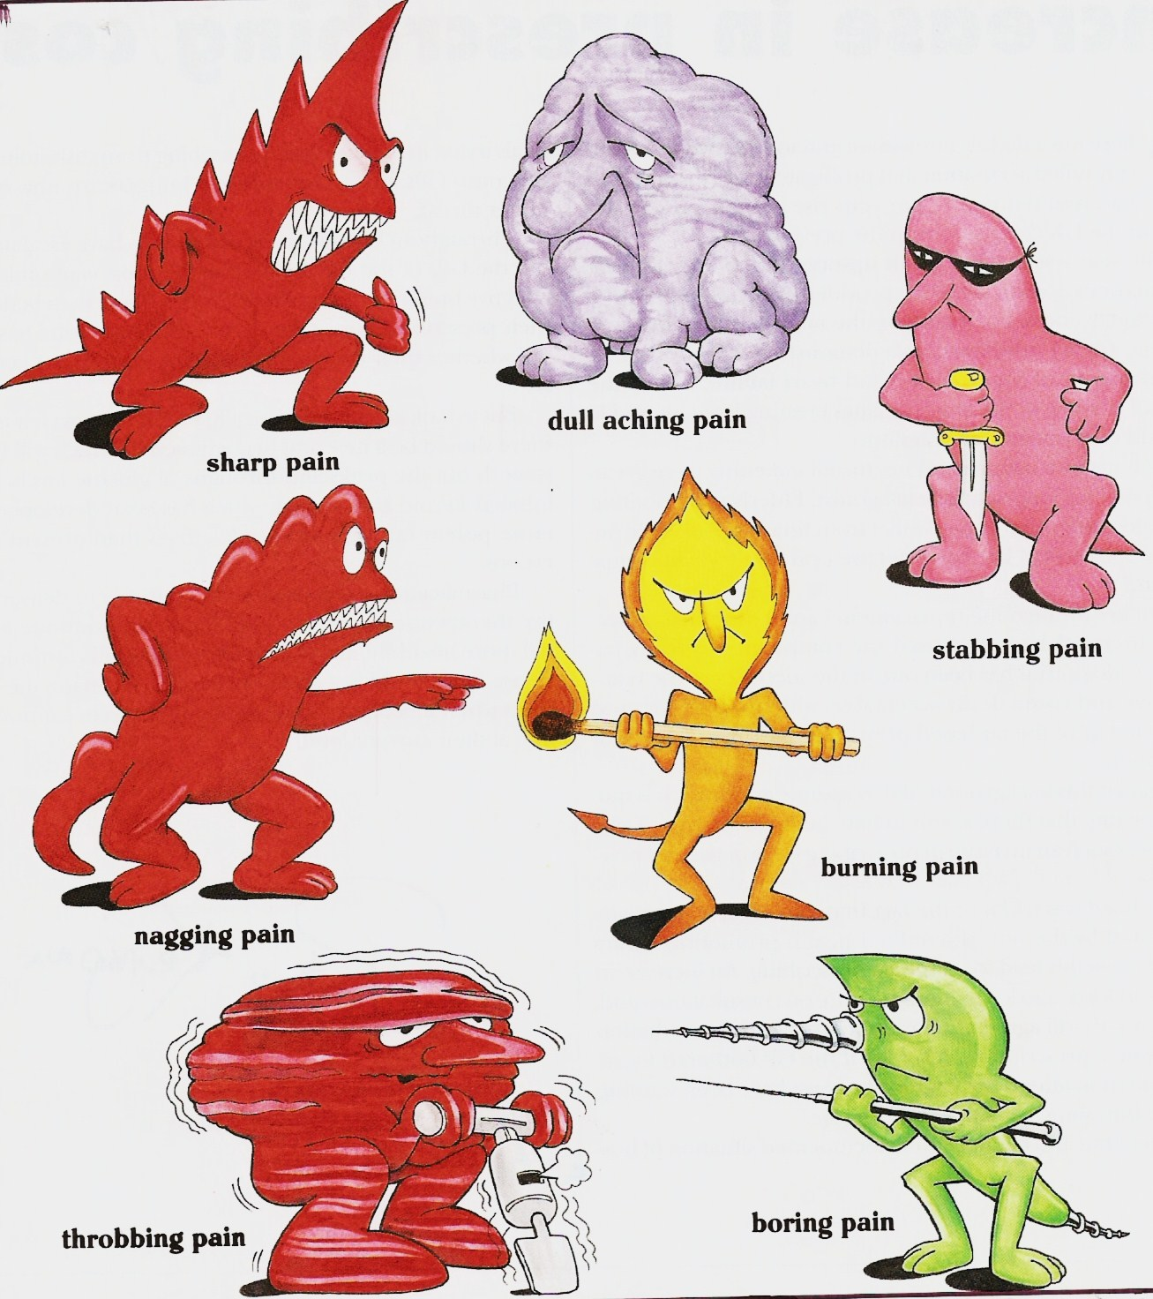
Munir Gharaibeh

Slide 10
Analgesics
-Pain killers
- Derived from Greek an- "without" & -algia "pain".
An analgesic, or painkiller, is any member of the group of drugs used to achieve analgesia — relief from pain .
- Act in various ways on the peripheral and central nervous systems.

Slide 11
Analgesics
The non-steroidal anti-inflammatory drugs (NSAIDs)
Paracetamol = acetaminophen
Opioid drugs

Slide 12
NSAIDs
The NSAIDs are a group of chemically dissimilar agents that differ in their antipyretic, analgesic, and anti-inflammatory activities.
inhibiting the cyclooxygenase enzymes that catalyze the first step in prostanoid biosynthesis.
>>>> decreased prostaglandin synthesis with both beneficial and unwanted effects.

Slide 13
Non-steroidal anti-inflammatory drugs (NSAIDs)
pain
fever
Inflammation
By inhibition of cyclo-oxygenase enzymes COX1 & COX2.

Slide 14
NSAIDs
An anti-inflammatory action:
decrease Vasodilator PG (PGE₂, PGI₂) leads to less vasodilatation and, indirectly, less edema.
The inhibition of activity of adhesion molecule.
Accumulation of inflammatory cells is also reduced.

Slide 15
NSAIDs
An analgesic effect:
Decreased prostaglandin generation means decrese sensitivty of nociceptive nerve endings to inflammatory mediators.
Relief of headache is due to decreased prostaglandin-mediated vasodilatation.

Slide 16
NSAIDs
An antipyretic effect:
this is partly due to a decrease in the mediator prostaglandin that is responsible for elevating the hypothalamic set-point for temperature control in fever.

Slide 17
Mechanisms of Action
Antipyretic actions – Fever, incr T° are hypothalamic problems.
- So, NSAIDs do not decr body T°.
- Fever → release of endog pyrogens (e.g., interleukin-1) released from leucocytes → acts directly on the thermoregulatory centers in hypothalamus → incr body T°.
- This is assoc with incr in brain PGs (pyrogenic).
- Aspirin prevents the T°-rising effects of interleukin-1 by preventing the incr in brain PGs.

Slide 18
Pharmacological Effects (cont’d)
Diverse group of chemicals, but all inhibit cyclooxygenase.
Resultant inhibition of PG synthesis is largely responsible for their therapeutic effects.
But, inhibition of PG synthase in gastric mucosa → GIT damage (dyspepsia, gastritis).

Slide 19
NSAID
Mechanism of Action:
Inhibition of PG synthesis
Cyclooxygenase (COX) Enzyme:
COX-1 or Constitutional form of COX.
COX-2 or Induced form of COX.
13

Slide 20
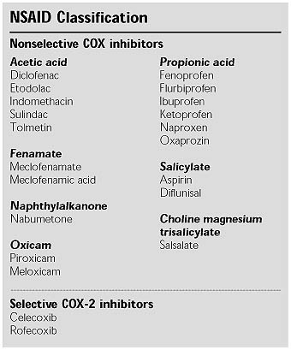

Slide 21
Cardiovascular
• Platelets: Inhibition of platelet COX-1-derived TxA₂ with the net effect of increasing bleeding time (inhibition of platelet aggregation)
• Endothelial COX-2 derived PGI₂ can inhibit platelet aggregation (inhibition augments aggregation by TxA₂).
Aspirin (acetylsalicylic acid) covalently modifies and, irreversibly inhibits platelet COX. The enzyme is inhibited for the lifetime of the platelet (~8 -11 days). Effect achieved at very low dose.
• Basis of therapeutic efficacy in stroke and MI (reduces mortality and prevents recurrent events).

Slide 22
Additional Cardiovascular Considerations
• Blood vessels/smooth muscle
COX-2 derived PGI₂ can antagonize catecholamine- and angiotensin II-induced vasoconstriction (NSAIDs can elevate bp).
• Atherosclerosis
Inhibition of COX-2 can destabilize atherosclerotic plaques (due to its anti-inflammatory actions)

Slide 23
Renal
COX-1 and COX-2 – generated PGs (TxA₂, PGF₂ , PGI₂ (glom), PGE₂ (medulla), powerful vasodilators).
NSAIDs tend to promote Na⁺ retention and can therefore increase bp. Can counteract effects of many anti-hypertensives (diuretics, ACE inhibitors and -AR antagonists).
PGs have minimal impact on normal renal blood flow, but become important in the compromised kidney.
Patients (particularly elderly and volume depleted) are at risk of renal ischemia with NSAIDs.

Slide 24
Gastrointestinal
PGs (generated via COX-1)
1) inhibit stomach acid secretion,
2) stimulate mucus and HCO₃⁻ secretion, vasodilation and therefore,
3) are cytoprotective for the gastric mucosa.
Therefore, NSAIDs with COX-1 inhibitory activity will produce opposite effects, leading to:
Gastric distress, gastric bleeding, sudden acute hemorrhage (effects are dose-dependent)

Slide 25
Gestation
PGs (generated from COX-2) are involved in the initiation and progression of labor and delivery. Therefore, inhibition of their production by NSAIDs can prolong gestation.
Respiratory system
High doses (salicylates) cause partial uncoupling of oxidative phosphorylation with increased CO₂ production (COX-independent effects). Increase in plasma CO₂ → hyperventilation. Even higher doses cause depression of respiration.

Slide 26
Common Adverse Effects
Platelet Dysfunction
Gastritis and peptic ulceration with bleeding (inhibition of PG + other effects)
Acute Renal Failure in susceptible
Sodium+ water retention and edema
Analgesic nephropathy
Prolongation of gestation and inhibition of labor.
GIT bleeding and perforation

Slide 27
Aspirin
It can cause irreversible inactivation of COX-1 and COX-2.
Aspirin is the prototype of traditional NSAIDs and was officially approved by the FDA in 1939.

Slide 28
Mechanism of action
Aspirin is a weak organic acid that is unique among the NSAIDs in that it irreversibly inactivates cyclooxygenase
The other NSAIDs are all reversible
Aspirin is rapidly deacetylated by esterases in the body producing salicylate, which has anti-inflammatory, antipyretic, and analgesic effects.

Slide 29
The antipyretic and anti-inflammatory effects of salicylate are due primarily to the blockade of prostaglandin synthesis at the thermoregulatory centers in the hypothalamus and at peripheral target sites.
Furthermore, by decreasing prostaglandin synthesis, salicylate also prevents the sensitization of pain receptors to both mechanical and chemical stimuli.
Aspirin may also depress pain stimuli at subcortical sites

Slide 30
ACTIONS
The NSAIDs, including aspirin, have three major therapeutic actions , they reduce
inflammation (anti-inflammation), pain (analgesia), and fever (antipyretic)

Slide 31
Anti-inflammatory actions:
Because aspirin inhibits cyclooxygenase activity, it diminishes the formation of prostaglandins and, thus, modulates those aspects of inflammation in which prostaglandins act as mediators.
Aspirin inhibits inflammation in arthritis, but it neither arrests the progress of the disease nor induces remission.

Slide 32
Analgesic action:
Prostaglandin E2 (PGE2) is thought to sensitize nerve endings to the action of bradykinin, histamine, and other chemical mediators released locally by the inflammatory process.
management of pain of low to moderate intensity arising from musculoskeletal disorders rather than that arising from the viscera.

Slide 33
Antipyretic action:
Fever occurs when the set-point of the anterior hypothalamic thermoregulatory center is elevated
> impeding PGE2 synthesis and release > resets the hypothalamus toward normal
it rapidly lowers the body temperature of febrile patients by increasing heat dissipation as a result of peripheral vasodilation and sweating.
Aspirin has no effect on normal body temperature.

Slide 34
Respiratory actions:
At therapeutic doses, aspirin increases alveolar ventilation. uncouple oxidative phosphorylation, which leads to elevated CO2 and increased respiration.
Higher doses work directly on the respiratory center in the medulla, resulting in hyperventilation and respiratory alkalosis
At toxic levels, central respiratory paralysis >> acidosis

Slide 35
Gastrointestinal effects:
PGE2 stimulate synthesis of protective mucus in both the stomach and small intestine.
In the presence of aspirin, these prostanoids are not formed, resulting in increased gastric acid secretion and diminished mucus protection.
Agents used for the prevention of gastric and/or duodenal ulcers include proton-pump inhibitors (PPIs); esomeprazole, lansoprazole, omeprazol

Slide 36
Effect on platelets:
TXA2 enhances platelet aggregation >> Low doses 81 mg daily of aspirin can irreversibly inhibit thromboxane production in platelets via inhibition of cyclooxygenase.
Because platelets lack nuclei, they cannot synthesize new enzyme, and the lack of thromboxane persists for the lifetime of the platelet (7 days)>> As a result prolonged bleeding time.

Slide 37
Actions on the kidney:
Cyclooxygenase inhibitors prevent the synthesis of PGE2 and PGI2 that are responsible for maintaining renal blood flow.
Decreased synthesis of prostaglandins can result in retention of sodium and water and may cause edema and hyperkalemia in some patients.
Interstitial nephritis can also occur with all NSAIDs except aspirin

Slide 38
Therapeutic uses
Anti-inflammatory, antipyretic, and analgesic uses:
The salicylic acid derivatives are used in the treatment of gout, rheumatic fever, osteoarthritis, and RA.
Commonly treated conditions requiring analgesia include headache, arthralgia, and myalgia.
External applications:
Salicylic acid is used topically to treat corns and warts.

Slide 39
Cardiovascular applications:
Aspirin is used to inhibit platelet aggregation. Low doses are used prophylactically to
reduce the risk of recurring transient ischemic attacks (TIAs) and stroke or death
2) reduce the risk of death in those having an acute myocardial infarction . ,,, angina

Slide 40
pharmacokinetics
Administration and distribution:
After oral administration, the un-ionized salicylates are passively absorbed from the stomach and the small intestine
Rectal absorption of the salicylates is slow and unreliable, but it is a useful route for administration to vomiting children.
Salicylates must be avoided in children and teenagers (<15 years old) with varicella (chickenpox) or influenza to prevent Reye's syndrome.

Slide 41
Dosage:
The salicylates exhibit analgesic activity at low doses; only at higher doses do these drugs show anti-inflammatory activity .
For example, two 325-mg aspirin tablets administered four times daily produce analgesia, whereas higher dose produce both analgesic and anti-inflammatory activity.
For long-term myocardial infarction prophylaxis, the dose is 81 to 162 mg/day
for those with RA or osteoarthritis, the initial dose is 3 grams/day
for stroke prophylaxis, the dose is 50 to 325 mg/day

Slide 42
Fate:
At dosages of 650 mg/day, aspirin is hydrolyzed to salicylate and acetic acid by esterases in tissues and blood .
Salicylate is converted by the liver to water-soluble conjugates that are rapidly cleared by the kidney
Both hepatic and renal function should be monitored periodically in those receiving long-term, high-dose aspirin therapy.
aspirin should be avoided in patients with a creatinine clearance of less than 10 mL/min.

Slide 43
Adverse effects
Gastrointestinal:
The most common GI effects of the salicylates are epigastric distress, nausea, and vomiting.
Microscopic GI bleeding is almost universal in patients treated with salicylates.
At stomach pH, aspirin is uncharged; consequently, it readily crosses into mucosal cells, where it ionizes (becomes negatively charged) and becomes trapped, thus potentially causing direct damage to the cells.

Slide 44
Blood:
inhibition of platelet aggregation and a prolonged bleeding time. (1 week)
Respiration:
In toxic doses, salicylates cause respiratory depression and a combination of uncompensated respiratory and metabolic acidosis.
Metabolic processes:
Large doses of salicylates uncouple oxidative phosphorylation. The energy normally used for the production of adenosine triphosphate is dissipated as heat, which explains the hyperthermia caused by salicylates when taken in toxic quantities

Slide 45
Hypersensitivity: Approximately 15 percent of patients taking aspirin experience hypersensitivity reactions.
Symptoms of true allergy include urticaria, bronchoconstriction, or angioedema. Fatal anaphylactic shock is rare.
Reye's syndrome:
Aspirin and other salicylates given during viral infections has been associated with an increased incidence of Reye's syndrome, which is an often fatal, fulminating hepatitis with cerebral edema.
This is especially encountered in children, who therefore should be given acetaminophen instead of aspirin

Slide 46
Reye's syndrome
Reye's syndrome is a potentially fatal disease that has numerous detrimental effects to many organs, especially the brain and liver, as well as causing a lower than usual level of blood sugar (hypoglycemia).[1] The classic features are a rash, vomiting, and liver damage. The exact cause is unknown and, while it has been associated with aspirin consumption by children with viral illness, it also occurs in the absence of aspirin use.

Slide 47
Drug interactions:
Salicylate is 90 to 95 percent protein bound and can be displaced from its protein-binding sites, resulting in increased concentration of free salicylate
alternatively, aspirin could displace other highly protein-bound drugs, such as warfarin, phenytoin, or valproic acid, resulting in higher free concentrations of the other agent .
Concomitant use of ketorolac and aspirin is contraindicated because of increased risk of GI bleeding and platelet aggregation inhibition.

Slide 48
In pregnancy: Aspirin is classified as FDA pregnancy category C risk during Trimesters 1 and 2
category D during Trimester 3.
Because salicylates are excreted in breast milk, aspirin should be avoided during pregnancy and while breast-feeding.

Slide 49
Toxicity:
The mild form is called salicylism
nausea, vomiting, marked hyperventilation, headache, mental confusion, dizziness, and tinnitus (ringing or roaring in the ears).
Ingestion of as little as 10 g of aspirin can cause death in children.
In serious cases, mandatory measures include the intravenous administration of fluid, dialysis
correction of acid-base and electrolyte balances.

Slide 50
Propionic acid derivatives
Ibuprofen , naproxen, fenoprofe, ketoprofen , flurbiprofen
All these drugs possess anti-inflammatory, analgesic, and antipyretic activity
their GI effects are generally less intense than those of aspirin.
These drugs are reversible inhibitors of the cyclooxygenases
All are well absorbed on oral administration and are almost totally bound to serum albumin.
They undergo hepatic metabolism and are excreted by the kidney.
The most common adverse effects are GI, ranging from dyspepsia to bleeding.
Side effects involving the central nervous system (CNS), such as headache, tinnitus, and dizziness, have also been reported.

Slide 51
Naproxen and Ibuprofen
Pregnancy : category C, category D from
Increase the risk of cardiovascular thrombotic event, MI and stroke.
Increase risk of GI bleeding.
Ibuprofen not exceed 3200mg/day., and take with food or with water to avoid GI effect.
Notes:
强直性脊柱炎，急性肌腱炎，痛经

Slide 52
Acetic acid derivatives
indomethacin , sulindac , Etodolac
All have anti-inflammatory, analgesic, and antipyretic activity. They act by reversibly inhibiting cyclooxygenase.
Despite its potency as an anti-inflammatory agent, the toxicity of indomethacin limits its use to the treatment of acute gouty arthritis, ankylosing spondylitis .
The adverse reactions caused by sulindac are similar to, but less severe than, those of the other NSAIDs, including indomethacin.
Etodolac has effects similar to those of the other NSAIDs

Slide 53
Oxicam derivatives
Piroxicam and meloxicam
are used to treat RA, ankylosing spondylitis, and osteoarthritis.
They have long half-lives, which permit once-daily administration, and the parent drug as well as its metabolites are renally excreted in the urine.
Meloxicam inhibits both COX-1 and COX-2, with preferential binding for COX-2, and at low to moderate doses shows less GI irritation than piroxicam.

Slide 54
Fenamates
Mefenamic
have no advantages over other NSAIDs as anti-inflammatory agents.
Their side effects, such as diarrhea, can be severe, and they are associated with inflammation of the bowel.
Cases of hemolytic anemia have been reported

Slide 55
Heteroaryl acetic acids
Diclofenac and tolmetin , ketorlac
are approved for long-term use in the treatment of RA, osteoarthritis.
Diclofenac is more potent than indomethacin or naproxen.
An ophthalmic preparation is also available.
Diclofenac accumulates in synovial fluid, and the primary route of excretion for the drug and its metabolites is the kidney.

Slide 56
Diclofenac sodium
Used PO 50mg after food, I.M. inj 75mg
Diclofenac potassium is prompt release and has quicker onset where as the Diclofenac sodium is delayed release.
Pregnancy: category C
Toxicity similar to others

Slide 57
Acetaminophen
Acetaminophen inhibits prostaglandin synthesis in the CNS.
This explains its antipyretic and analgesic properties.
Acetaminophen has less effect on cyclooxygenase in peripheral tissues, which accounts for its weak anti-inflammatory activity.
Acetaminophen does not affect platelet function or increase blood clotting time.

Slide 58
Therapeutic uses
Acetaminophen is a suitable substitute for the analgesic and antipyretic effects of aspirin for those patients with gastric complaints, those in whom prolongation of bleeding time would be a disadvantage, or those who do not require the anti-inflammatory action of aspirin.
Acetaminophen is the analgesic/antipyretic of choice for children with viral infections or chickenpox (recall that aspirin increases the risk of Reye's syndrome).

Slide 59
Adverse effects
With normal therapeutic doses, acetaminophen is virtually free of any significant adverse effects.
Renal tubular necrosis and hypoglycemic coma are rare complications of prolonged, large-dose therapy.
large doses Hepatic necrosis, a very serious and potentially life-threatening condition can result.
Renal tubular necrosis may also occur.
Periodic monitoring of liver enzymes tests is recommended for those on high-dose acetaminophen.

Slide 60
Paracetamol = Acetaminophen
Weak PG synthesis inhibitor
CNS actions: Paracetamol also modulates the endogenous cannabinoid system
Not:
antiinflammatory
Platelets inhibitor
Ulcerogenic
Teratogenic
27

Slide 61
Pharmacokinetics
Acetaminophen is rapidly absorbed from the GI tract. A significant first-pass metabolism occurs in the luminal cells of the intestine and in the hepatocytes.
Under normal circumstances, acetaminophen is conjugated in the liver to form inactive metabolites.
A portion of acetaminophen is hydroxylated to form N-acetylbenzoiminoquinone a highly reactive and potentially dangerous metabolite .

Slide 62
At normal doses of acetaminophen, the N-acetylbenzoiminoquinone reacts with the sulfhydryl group of glutathione, forming a nontoxic substance .
Acetaminophen and its metabolites are excreted in the urine.

Slide 63
Paracetamol
Toxicity
Severe hepatotoxicity with high doses
N- acetylcysteine is the antidote when given in the first 24hours.
28

Slide 64
Cyclooxygenase II Inhibitors
Meloxicam
Rofecoxib
Celocoxib
34

Slide 65
Cyclooxygenase II Inhibitors
Do not affect platelet function.
May increase the incidence of edema and hypertension.
Less gastroirritant (half of COX2-non selective drugs).
Higher incidence of cardiovascular thrombotic events.
35
Notes:
Rofecoxib

