Slide 1
Pancreas
Anatomy, Histology And Physiology.

Slide 2
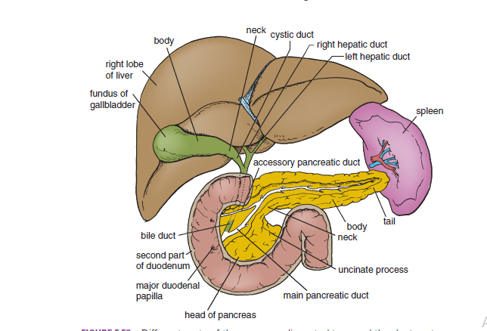
Anatomy:

Slide 3
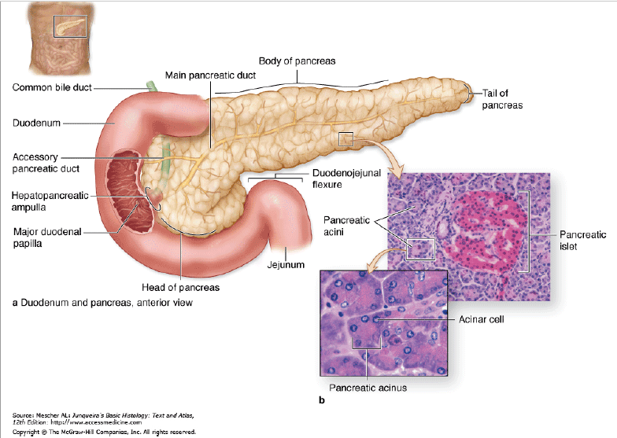
Histology:

Slide 4
Physiology:
-Insulin & energy abundance.
-Energy trapper.
-Short term glucose regulation, minute to minute along with Glucagon.
-β-cells of the Islets of Langerhans secrete insulin and amylin.

Slide 5
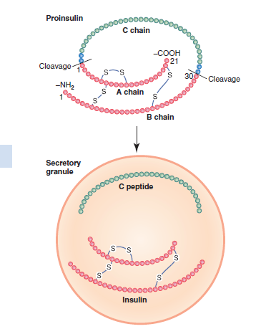
Chemical composition:

Slide 6
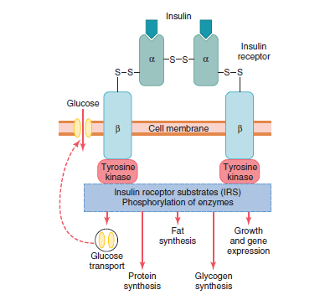
Insulin receptor:

Slide 7
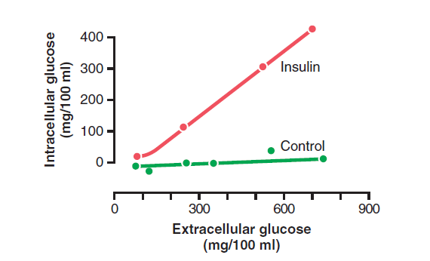
Effect of insulin: uptake of glucose by muscle cells.

Slide 8
Effect of insulin: Hepatocytes
-Think the way insulin does!
Activate enzymes that trap glucose and synthesize glycogen and inhibit those that degrade glycogen.

Slide 9
-Glucokinase ↑
-Glycogen phosphorylase ↓
-Glycogen synthase ↑
The net effect: Increase the amount of glucose in the liver .

Slide 10
The liver can store up to 100 g of glycogen, then what ???

Slide 11
Effect of insulin: Adipocytes
-Inhibit hormone-sensitive lipase.
-Enhance glucose uptake.

Slide 12
Insulin deficiency >>>
-Beta oxidation of FA to form Acetyl coA.
-Conversion of acetyl coA to hydroxybutyric acid,acetoacetic acid (ketosis) and acetone(characteristic breath smell)

Slide 13
Effect of insulin: protein metabolism
-Stimulates uptake of amino acids(like GH)
-Increases mRNA translation.
-Increase transcription of certain DNA sequences .
-Spare proteins and depress the rate of gluconeogenesis.

Slide 14
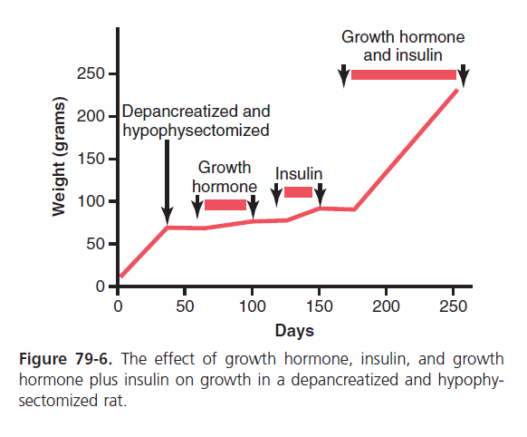
Insulin and GH: synergism

Slide 15
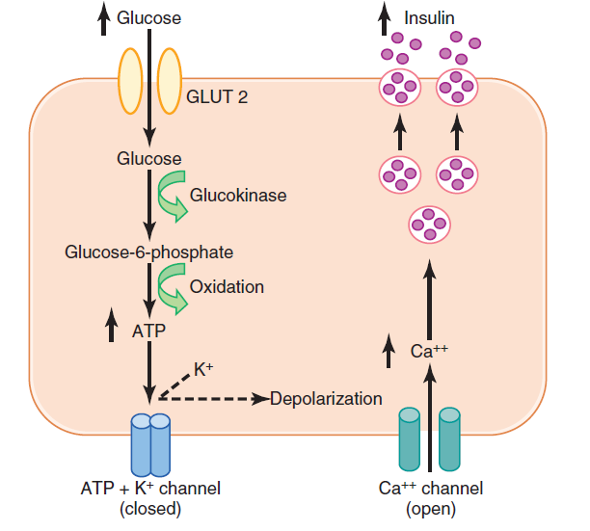
Mechanism of secretion:

Slide 16
Factors affecting insulin secretion:
Increase insulin secretion:
-↑Glucose.
-↑amino acid.
-↑FA.
- ↑ GI hormones.
- ↑ GH,cortisol and glucagon.
-Insulin resistance and obesity.
-Parasympathetic stimulation of G cells.
Decrease insulin secretion:
-↓Glucose.
-Fasting.
-Leptin
-Alpha- adrenergic stimulation.

Slide 17
Glucagon
- Glycogenolysis through activating the enzyme phosphorylase b, cAMP pathway, leading to glycogen cleavage.
-gluconeogenesis.
-adipose cell lipase↑
-ketogenesis

Slide 18
Why is it so important to regulate glucose levels???

Slide 19
-Glucose>>large amount of osmotic pressure>>dehydration.
-Glycosuria.
-Osmotic diuresis and loss of water and electrolytes.
-Tissue damage (vascular, peripheral neuropathy etc).

Slide 20
Diabetes Mellitus

Slide 21
Diabetes mellitus is defined as a syndrome of impaired carbohydrate, fat, and protein metabolism caused by either lack of insulin secretion or decreased sensitivity of the tissues to insulin.

Slide 22
Diabetes mellitus:
-Type I diabetes: insulin-dependant, juvenile.
-Type II diabetes: Insulin resistance, adulthood.

Slide 23
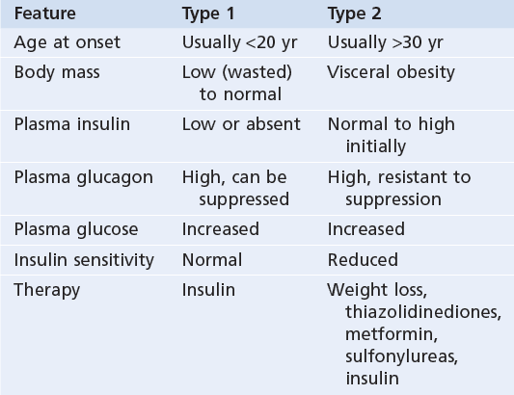
Type I vs Type II

Slide 24
Some numbers:
-The fasting blood glucose>>80-90mg/ml.
-50-70mg/ml excitability of the CNS.
-20-50mg/ml seizures>>coma.
-Glucose threshold in urine 180mg/ml.

