Slide 1
PTH hormone and calcium hemostasis

Slide 2
Outline
Key players of Calcium hemostasis
Parathyroid hormones ( Function, Regulation, Pathophysiology)
Vit D
Calcium
Calcitonin

Slide 3
PTH
Anatomy (briefly)
Importance of Ca and its percentage in blood
Impairment level of Ca and its consequences
Regulation of Calcium level
PTH and its Functions
Relation between Calcium and bone phosphate
Gut

Slide 4
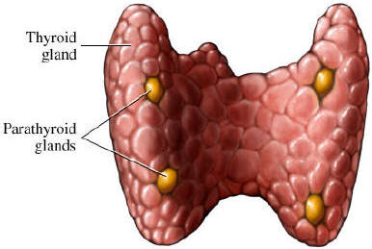
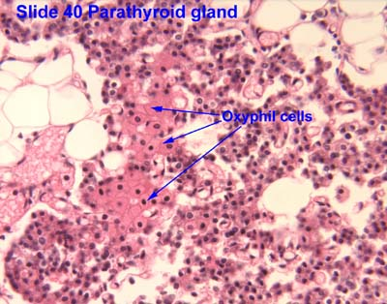
Parathyroid Glands
Chief cells secret PTH
oxyphil cells
Notes:
They are small four glands located behind the thyroid gland, each one from (20-50) mg in weight. Almost all of the parathyroid hormone is synthesized and secreted by chief cells; this tells us that there are two types of cells: 1. Chief cells that produce most of the PTH. 2-oxyphil cells: The function is uncertain until now, but probably they are modified or depleted chief cells that no longer secrete PTH, but they play a role in PTH metabolism. Oxyphil cells are not present in young people, even in some animals, but in the human being it might develop later as modified chief cells. The parathyroid glands develop at 5-14 weeks of gestation. 3- fat cells …
☒superior & inferior thyroid artery …Glands drain ipsilaterally by superior, middle, and inferior thyroid veins.

Slide 5
“Calcium level is normally always around 11mg/100ml of plasma”
Notes:
✓Regulators of Ca level in the blood: PTH: functioning on kidney tubules, bones and intestines so as to normalize the Calcium level which is 11mg/100ml of plasma [Ca level must be maintained within a narrow range the same as PH].

Slide 6
Calcium : functions
maintenance of normal sodium permeability in nerves
Involved in triggering the release of acetylcholine from nerve endings at the neuromuscular junction
Necessary in excitation-contraction coupling in muscle cells
Serves as an intracellular signal for some hormones(2nd Msn)
Required by some enzymes for normal activity
Required for blood clotting to occur normally
Required for protein secretion
Constituent of bone About 99% of our body's calcium is deposited in the bones and teeth.
Notes:
Starting off with some physiological functions of calcium: • Required for the maintenance of normal sodium permeability in nerves • Involved in triggering the release of acetylcholine from nerve endings at the neuromuscular junction • Necessary in excitation-contraction coupling in muscle cells • Serves as an intracellular signal for some hormones(2nd Msn) • Required by some enzymes for normal activity • Required for blood clotting to occur normally • Required for protein secretion • Constituent of bone About 99% of our body's calcium is deposited in the bones and teeth. The remaining 1% is present in body fluids, almost equally divided between diffusible and non-diffusible calcium. The non-diffusible calcium is bound to blood proteins, chiefly to albumin, although a small amount is bound by the globulins in the blood.

Slide 7
Calcium : functions
Key players ( Na, Ach , muscle contraction, other hormones and enzymes , blood clotting, protein secretion , bone)

Slide 8
Calcium : diffusible Vs Non diffusible
Notes:
Starting off with some physiological functions of calcium: • Required for the maintenance of normal sodium permeability in nerves • Involved in triggering the release of acetylcholine from nerve endings at the neuromuscular junction • Necessary in excitation-contraction coupling in muscle cells • Serves as an intracellular signal for some hormones(2nd Msn) • Required by some enzymes for normal activity • Required for blood clotting to occur normally • Required for protein secretion • Constituent of bone About 99% of our body's calcium is deposited in the bones and teeth. The remaining 1% is present in body fluids, almost equally divided between diffusible and non-diffusible calcium. The non-diffusible calcium is bound to blood proteins, chiefly to albumin, although a small amount is bound by the globulins in the blood.

Slide 10
Impaired level of Calcium (Hyper Vs Hypo)
Notes:
Ca3(po4)2

Slide 11
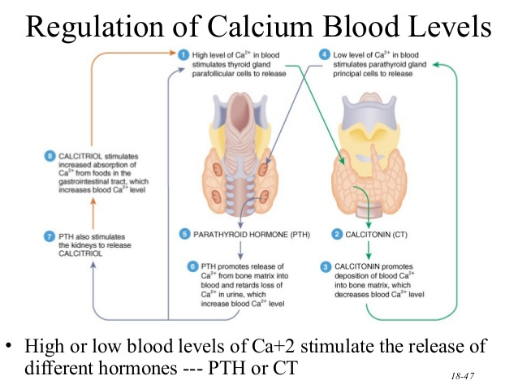
Regulation of Calcium levels

Slide 12
Calcium Hemostasis : PTH , Calcitonin & Vit. D
Ca3(po4)2

Slide 13
PTH hormone
single chain protein
PTH is free in plasma
short half-life
PTH has two types of receptors (sometimes three)
second messenger either cyclic AMP or (DAG and IP3)
Notes:
General information about PTH ✓ -PTH related protein has similar function to PTH [most probably this protein released from the parathyroid glands]. ✓ The parathyroid glands develop at 5-14 weeks of gestation. ✓ PTH is a single chain protein that contains 84 amino Acids. The biologic activity of the hormone resides ·within amino acids from one to thirty four. [Within the first 34 a.a] ✓ PTH is free in plasma with a short half-lifeof 25 min. ✓ PTH is essential for life, without it Ca++ falls in plasma, neuromuscular excitability increases, tetany& death occurs. ✓ The dominant regulator of PTH secretion is the plasma Ca++ level (ionized). Ca++ also regulates the size &the number of Parathyroid cell PTH has two types of receptors (sometimes three), and it uses as a second messenger either cyclic AMP or (DAG and IP3)

Slide 14
Functions and effects
On Kidney (increase Ca re-absorption, Phosphate Excretion, and the synthesis of VitD (1,25-(OH)2-D) )
On the intestines: increase Ca++ absorption
On bones: increase resorption of Ca and Phosphate [then phosphate will be excreted through the kidneys]
other
Notes:
The effects of parathyroid hormone •On kidneys: increase Ca re-absorption, Phosphate Excretion, and the synthesis of VitD (1,25-(OH)2-D)which will function on the intestines: increase Ca++ absorption. •On bones: increase resorption of Ca and Phosphate [then phosphate will be excreted through the kidneys] • So generally, PTH function MAINLY to normalize Ca level due to its functions, such as ✓ Involved in triggering the release of Acetylcholine from ·nerve endings at the Neuromuscular junction [either the release will be deficient or absent depending on the degree of Ca deficiency] ✓ . Involved in excitation-contraction coupling In muscle cells ✓ Serves as an intracellular signal· for some Hormones and enzymes [especially hormones that use DAG and IP3] ✓ . Required by some enzymes for normal Activity. ✓ . Required for blood clotting to occur normally. ✓ Required for proteins secretion. [Such as insulin] ✓.-constituent of the bones

Slide 15
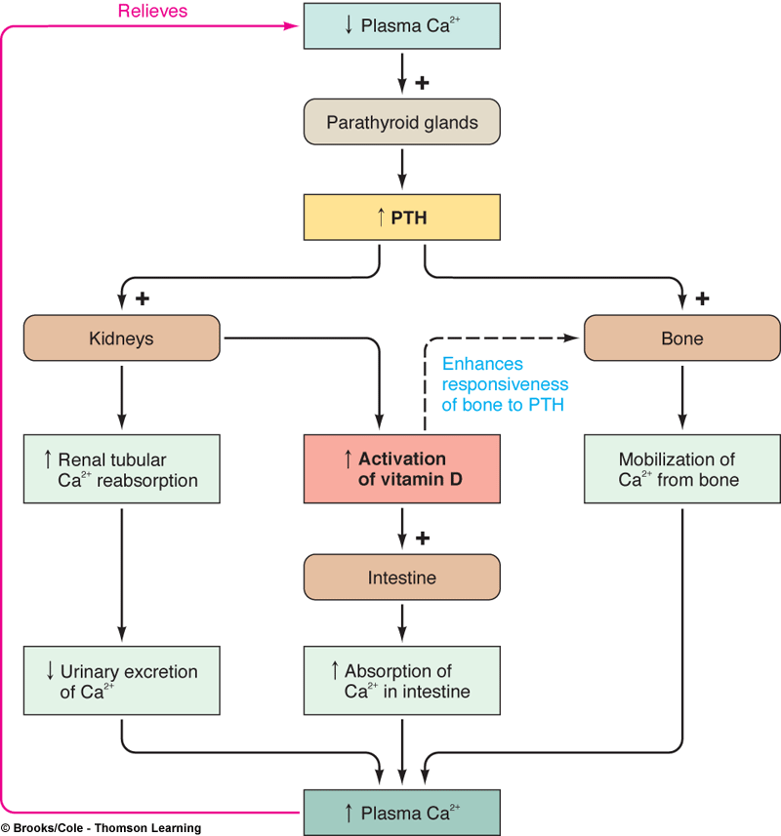
Notes:
PTH: functioning on kidney tubules, bones and intestines

Slide 16
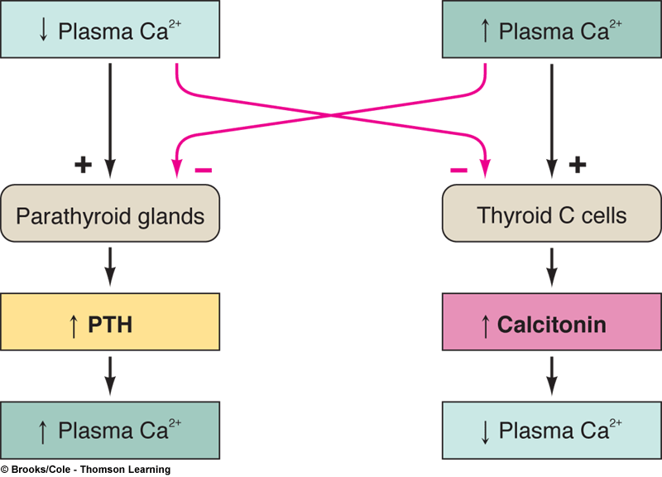
Regulation (loops)
PTH secretion , regulated by:
Ca++ (mainly)
Others ( Mg , Vit D , NT)
Notes:
Regulators of parathyroid hormone : PTH secretion and synthesis are primarily regulated by serum calcium level, although other factors such as Vitamin D, Mg, phosphate and neurotransmitters play a role. ✓ Hypomagnesaemia stimulates PTH secretion, same as Ca++ but less potent. ✓ Arise in plasma phosphate conc. indirectly causes transient increase in PTH secretion. ✓ 1, 25 (OH) 2 -D directly reduces PTH Secretion.

Slide 17
pathophysiology
“Hypo Vs Hyper” tetany vs stones .groans.bones.phycatric overtones
Notes:
Pathphysiology of PTH: ☒ The under activity of the PTH:[because of atrophy or removal of the parathyroid during thyroidectomy. When PTH decreases the bone resorption of ca++ decreases, kidney reabsorption of calcium also decreases, and calcium absorption from intestine is decreased.The result will be decrease in the Ca plasma level (normal limit is 10-11 mg/dl), if it is reduced to (5-6) mgtetany will occur and if it reaches the respiratory system death occurs • How does the tetanization occur?? Ca regulates the function of Na channels, In the case of Hypo-parathyroidism the Ca plasma level is low, leading to continuous opening of sodium channels and continuous entry of Na, continuous depolarization that results in aTETANIZATION; there is no contraction and relaxation only contraction. • The over activity of PTH: [because of a tumor] 1. Alot of Ca reabsorption the kidney tubules. 2. A lot of 1:25 DHCC is produced, so a lot of dietary Ca is absorbed by the intestines. 3. Alot of Ca isresorbed from the bones. Normal PTH produce calcium from around the bones (from the synovial fluid), but excess PTH would produce it from the structure itself causing softening of the bones and fragility a disease called (osteitisfibrosacyctica) not osteoporosis. *Plasma Ca may be increased to 16mg/dl

Slide 18
Calcium and bone phosphate

Slide 19
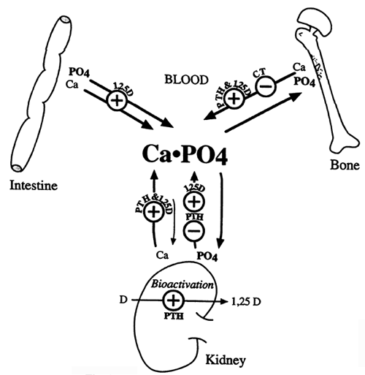
→

Slide 20
Gut

Slide 21
The second major regulator of the Ca level: Vit D
Hormone or vitamin
D3 (skin) , D2 (diet)
Notes:
The second major regulator of the Ca level: • The first regulator is PTH • Vitamin D is a major regulator of Ca and phosphate [both of them] , sometimes it considered a hormone because it is produced in the body and released into the blood then into the liver and the derivatives are produced. And sometimesit is considered a vitamin taken from the ingested food. • Vit D has 2 sources firstly through the skin as D3 and from the diet as D2. Vitamins D3 & D2 have a very little difference in their structures, they are Endocrine systemphysiology essentially pro-hormones that undergo identical processing that converts them to Molecules with identical qualitative & quantitative Actions. Once vitamin D enters the circulation from the skin or the Gut, it is released in blood and concentrated in the liver. There the liver produces the first derivative 25-0H-D. • This molecule is transported to the kidneys where it undergoes alternative fates. If the enzyme 24-Hydroxylase is activated, 24,25-(OH)2 will be formed. [in the kidneys the most potent derivative will be formed >>1,25(OH)-D …aŶd aŶother deriǀatiǀe Ϯϰ,Ϯϱ;OHͿ-D its potency is 1/20th of the previous one .] • 24,25(OH)-D mainly serves to dispose of excess vitamin D.[it means that if there is Ŷeed >>ϭ,Ϯϱ ǁill ďe forŵed ….if there is less Ŷeed Ϯϰ,Ϯϱǁill ďe formed) . • Now we have factors that determine the formation of either 24,25-(OH)2-D or 1,25-(OH)2-D: *Excess 1,25-(OH)2-D, Calcium excess, phosphate excess stimulate the synthesis of 24,25-(OH)2-D. *Vitamin D deficiency, Calcium deficiency, phosphate deficiency, parathyroid hormone all favor synthesis of 1,25(OH)2-D • Vitamin D, 25-0H-D & 1,25-(0H)2-D circulate in the plasma bound to specificproteins.V.D3 has many natural sources like codfish, eggs, and 45- milk, in addition To the skin. BUT V.D2 can be obtained only from the diet, mushrooms are rich in it. in addition to vitamin D2and 3 and their derivatives there are other 15 Metabolite without known function

Slide 22
Vit D : Synthesis
Notes:
Vitamin D will be transferred to the liver to become 25(OH)-D. This compound will be transferred to the kidneys, either to become 1,25 OR 24,25 derivatives. Deficiency of (Ca, phosphate, V.D) and the PTH stimulation leads to formation of the 1, 25(OH)-D by 1-α hǇdroǆǇlase enzyme.1,25(OH)-D ,,Ca and phosphate excess leads to the formation of 24,25 by 24- hydroxylase enzyme

Slide 23
Notes:
When calcium in your blood is low, your parathyroid starts secreting PTH. PTH starts pulling calcium from your bones and into your blood. PTH also starts telling your kidneys to start making more 1,25(OH)₂D. You have vitamin D stores in your body called 25(OH)D that are ready for the kidney to produce 1,25(OH)₂D when needed, if you get adequate vitamin D intake. • When the kidney starts producing 1,25(OH)₂D, it helps the gut absorb more calcium than usual, to make sure you get enough calcium into your body. When 1,25(OH)₂D increases and helps your body get to the right calcium balance, it tells your parathyroid to stop making so much PTH, and stop pulling calcium from your bones. • On the other hand, when calcium in the blood is high, your parathyroid won’t release much PTH at all. The amount of calcium in your blood tells your parathyroid not to release any PTH, and in turn, PTH doesn’t tell your kidney to produce more 1,25(OH)₂D. So you stop absorbing too much calcium and allows your body to lower its blood calcium. • This interaction between calcium, parathyroid and vitamin D is happening constantly; 1,25(OH)₂D and PTH always adjusting to make sure you have the right calcium balance.

Slide 24
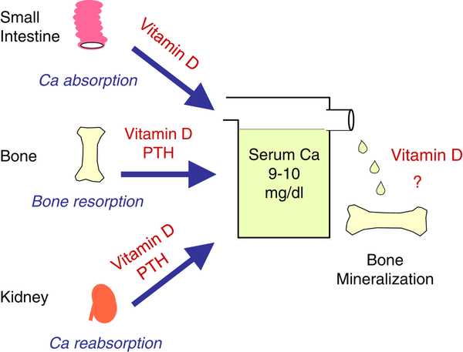
Notes:
PTH and Vit D work synergistically.

Slide 25
Vitamin D and Obesity
Notes:
• Vitamin D is stored in adipose tissue, so obese individuals especially those who have lot of fat in their abdomen have their vitamin D retained by this fat so vit D is not released. They are exposed to many problems even heart problems

Slide 26
When α-1-hydroxylase is activated
Vitamin D deficiency
Ca2+ deficiency
phosphate deficiency
PTH stimulation
Why
To Increase Ca and PO
Notes:
If we have Vitamin D deficiency, Ca2+ deficiency, phosphate deficiency, or PTH stimulation, then the enzyme 1α-hydroxylase is activated and 1,25-(OH)2 -D is formed. Why? Because this molecule can: • Increase Ca2+ and phosphate absorption from the intestines • Increase their reabsorption from the kidneys and decrease their excretion • Promote PTH action • Overall result: increase in blood Ca2+ levels

Slide 27
When 24-hydroxylase is activated
excess Ca2+
excess phosphate
excess 1,25-(OH)2 -D
Notes:
And when we have excess Ca2+ , excess phosphate, or excess 1,25-(OH)2 -D, the enzyme 24-hydroxylase is activated and 24,25-(OH)2 -D is formed. Why? Because this molecule can serve to dispose of excess vitamin D. Notes (from the slides): • 24,25-(OH)2 -D is 1/20th as potent as 1,25-(OH)2 -D • 1,25-(OH)2 -D has the lowest plasma concentration and the shortest half life. (out of the 3 molecules) • 25-(OH)-D has the highest plasma concentration. (out of the 3 molecules)

Slide 28
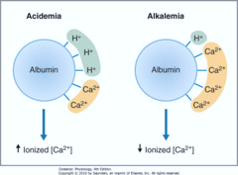
Acidemia Vs Alkalemia
Notes:
Our focus is on the ionized Ca2+ concentration for it is the indicator which PTH secretion depends on, not the protein-bound Ca2+ concentration, though in normal conditions both concentrations are almost equal (almost 1mmol/L as seen in table 21-1 in the previous page.). When aren't they "almost" equal? • When there are disturbances in plasma protein levels. (e.g. hypoalbuminemia) • When there are disturbances in blood pH. (e.g. alkalemia [alkalosis] causes hypocalcaemia, and acidemia [acidosis] causes hypercalcaemia)

Slide 29
Notes:
• Minor factors such as Insulin, prolactin, and GH can also stimulate the enzyme 1α-hydroxylase, in order to form 1,25-(OH)2 -D, in addition to the major ones which are low phosphate, low Ca2+ , and stimulation by PTH. • 1,25-(OH)2 -D itself can stimulate insulin, prolactin, and GH secretion which in turn stimulates its own synthesis. • 1,25-(OH)2 -D also reaches the following sites: Mammary gland, placenta, skin, and avian shell gland. (mineral transfer)

Slide 30
Clinical applications : Rickets & Osteomalacia & many other things :P
Notes:
Clinical application: Rickets disease in children and Osteomalacia (adult rickets) in adults (both are the same). Why does it occur? Three main reasons: • Vitamin D deficiency. Can be due to: ✓ Dietary deficiency ✓ Lack of exposure to sunlight(Relatively unimportant) ✓ Failure to synthesize cholecalciferol (D3 ) in the skin (this occurs in dark-skinned people in a temperature climate ✓ Fat-soluble vitamin malabsorption • Defects in metabolic activation of vitamin D. Can be due to: ✓ 25th carbon hydroxylation failure which occurs in the liver (chronic liver disease; hepatic osteodystrophy) ✓ Rapid metabolism of cholecalciferol and its active metabolites when hepatic enzymes are induced, this is seen in patients taking anticonvulsant (drugs for seizures) ✓ 1 st carbon hydroxylation failure which occurs in the kidney (renal failure; renal osteodystrophy) ✓ Hypoparathyroidism (low PTH) • Impaired action of 1,25-(OH)2 -D in target tissues. Can be due to: ✓ Certain anticonvulsants ✓ Receptor defects ✓ Uremia (raised blood Urea levels) Endocrine system physiology D. Saleem khraisha sheet #6 8/7/2015 Written by: Adnan Najada Page 9 Rickets occur mainly in children who have vitamin D deficiency consequently leading to calcium and phosphate deficiency. Proper exposure to sunlight serves to prevent rickets and that is why this disease tends to occur especially in the spring months because vitamin D formed during the preceding summer is stored in the liver and is still available for use during the early winter months. Normal adults rarely have a serious dietary deficiency of vitamin D or calcium because large quantities of calciumare not needed for bone growth as in children. However, a serious deficiency of both vitamin D and calcium occasionally occurs as a result of steatorrhea (failure to absorb fat), for vitamin D is fat-soluble, and calcium tends to form insoluble soaps with fat; consequently, in steatorrhea vitamin D and calcium tend to pass into the feces. Under these conditions an adult will have such poor calcium and phosphate absorption that adult rickets (Osteomalacia) can occur, though this almost never proceeds to the stage of tetany but very often is a cause of severe bone disability. Note: calcium and phosphate absorption from the bones can prevent clinical signs of rickets for the first few months of vitamin D deficiency.

Slide 31
Calcitonin
counter PTH
straight chain peptide of 32 amino acids
Parafollicular cells
neuromodulator.
Notes:
It is basically what counteracts PTH. Here is what you need to know: • A straight chain peptide of 32 amino acids, has a molecular weight of 3400 • The biologically active core of the molecule probably resides in its central region • Calcitonin is secreted by thyroid parafollicular cells known as "C" cells. Calcitonin is also present in nervous tissue, where it may function as a neuromodulator. • The major stimulus to CT secretion is a rise in plasma calcium concentration.

Slide 32
The major stimulus to CT secretion is a rise in plasma calcium concentration

Slide 33
Calcitonin
decreases plasma calcium levels (by antagonizing the actions of PTH on bone and on the kidney decrease Ca and phosphate reabsorption).
decreases plasma phosphate concentration and increases urinary phosphate excretion slightly
Notes:
• Calcitonin, (CT), decreases plasma calcium levels by antagonizing the actions of PTH on bone and on the kidney decrease Ca and phosphate reabsorption. • The hypocalcemic action is caused by inhibition of both osteocytic osteolysis and osteoclastic bone resorption particularly when these are stimulated by PTH. • However, with respect to phosphate, it has the same net effect as PTH; that is; CT decreases plasma phosphate concentration and increases urinary phosphate excretion slightly. •

Slide 34
The hypocalcemic action is caused by inhibition of both osteocytic osteolysis and osteoclastic bone resorption particularly when these are stimulated by PTH

Slide 35
CT deficiency does not lead to hypercalcaemia & CT hyper secretion does not produce hypocalcaemia.
Notes:
CT deficiency does not lead to hypercalcaemia & CT hyper secretion does not produce hypocalcaemia. It may be that abnormal CT secretion is easily compensated for by adjustment in PTH and vitamin D levels. • Lastly, it is degraded within the liver and kidney, after half-life of 30-60 minutes

Slide 36
Notes:
This graph shows the relationship between plasma Ca2+ levels and the secretion of both PTH and CT.

Slide 37
factors affecting calcium metabolism (other than PTH, CT, and vitamin D)
include:
Glucocorticoids
Growth hormone and somatomedins
Thyroid hormones
Estrogens
Insulin
IGF-1
Epidermal growth factor
Fibroblast growth factor
Platelet-derived growth factor
Osteoclasts activating factor

Slide 38
Phosphate
Notes:
A quick summary about Phosphate regulation: its levels are increased by vitamin D and decreased by PTH and CT. Physiological functions include: • Functions as part of the intracellular buffer system. • Important constituent of a variety of macromolecules, such as nucleic acids, phospholipids, metabolic intermediates, and phosphoproteins. • Constituent of bone. (about 85% of our body's phosphate is in the bones)

Slide 39
Notes:
Note: bone mass in males and females start to differ only after puberty, meaning that in childhood it is the same in both genders. Note: about 9% of our body's water is in the bones.

Slide 40
Osteoporosis
Notes:
Most common of all bone diseases especially in the elderly, it is different from rickets and Osteomalacia for it results from diminished organic matrix rather than abnormal bone calcification. Usually the osteoblastic activity in the bone is less than normal, and consequently the rate of deposition is depressed. But occasionally, the cause of the diminished bone is excess osteoclastic activity. Endocrine system physiology D. Saleem khraisha sheet #6 8/7/2015 Written by: Adnan Najada Page 14 Causes include: • lack of physical activity • diabetes mellitus type II • malnutrition • lack of vitamin C • lack of estrogen (postmenopausal women) • old age • Diseases like Cushing syndrome and Acromegaly. How to prevent the development of osteoporosis ? A) by physical exercise and intake of Ca B) Medications, they are divided into two categories : 1: Drugs against the reabsorption of bones 2: Drugs that induce bone formation. Estrogen supplements is the most widely used in fighting osteoporosis, it's most effective when the female patient start taking them from the onset of Menopause. Now for those how are unable/afraid of taking estrogen they can take Calcitonin, but they are less effective and Expensive drugs. Many women nowadays are starting to take Vit(D) combined with calcium from the onset of Menopause. The Doctor recommends Vit(D) with Estrogen in low doses and under medical supervision

