Slide 1
بسم الله الرحمن الرحيم
TOPICS: Fallopian tube pathology Trophoblastic diseases

Slide 2
Pathology of the Fallopian tubes
If extensive: Pelvic inflammatory disease
Inflammations: (Salpingitis)
almost always bacterial in origin.
Chlamydia, Mycoplasma , coliforms, (postpartum) strept. and staph. are now the major offenders.
fever, lower abdominal or pelvic pain.
:Complications *Important
tubo-ovarian abscess.
adhesions of tubal plicae (risk of ectopic pregnancy)
permanent sterility

Slide 3
The inflamed fallopian tube.(tubo-ovarian abscess) Making an abdominal mass that contains inflammatory cells (neutrophils and pus)
The uterus

Slide 4
Tubal malignancies
SKIP IT
considered rare.
most common is serous carcinoma.
increased in women with BRCA mutations ( In studies of prophylactic oophorectomies:10% →occult foci of malignancy in fimbria).
Because of access to peritoneal cavity, fallopian tube carcinomas frequently spread to omentum and peritoneal cavity at time of presentation (advanced).

Slide 5
ECTOPIC PREGNANCY
implantation of the fertilized ovum outside uterus (the endometrial cavity)
Incidence: 1%
90% of cases → in fallopian tubes It is the site of fertalization, if the journey from the fallopian tube to the endometrium is interrupted because of something in the uterus or the tube -underlying etiology is present in 50% of cases-
other sites: ovaries, abdominal cavity
Predisposing factors: tubal obstruction (50%) PID; tumors; endometriosis; IUCD (it works by preventing implantation in the uterus)..
In 50% : no anatomic cause can be demonstrated.

Slide 6
ECTOPIC PREGNANCY
Early: development of the embryo and placental tissue , might even have fetal heart beats
Later: the placenta burrows through causing intratubal hematoma (hematosalpinx) and intraperitoneal hemorrhage.
Rupture of an ectopic pregnancy: intense abdominal pain (acute abdomen), often followed by shock.
Prompt surgical intervention is necessary.
The tybe will be able to support only the earliest stages of pregnancy. Then: No enough blood supply/ space→hematosalpinx Tube can rupture causing hemorrhage: TOP emergency in gynecology

Slide 7
Added slide سلايد مضاف
So we said 90% of ectopic prgnencies are in the Fallopian tube
10% happen on the surface of the ovary or inside the abdominal cavity.

Slide 8
Trophoblastic diseases
Trophoblasts are cells that support the gestational development of the embryo They are of two types: Cytotrophoblasts and syncitiotrophoblasts Syncitiotrophoblasts secrete hCG So when there is trophoblastic proliferation hCG levels increase

Slide 9
Hydatidiform Mole الحمل العنقودي الكاذب: Complete and Partial caued by abnormal fertilization and so we won’t get a normal enbryo but rathere we’ll get these moles
2 forms of abnormal gestational processes, result from abnormal fertilization:
complete mole: an empty )oblighted) egg is fertilized by two spermatozoa (or a diploid sperm), yielding a diploid karyotype composed of entirely paternal genes
partial mole: a normal egg is fertilized by two spermatozoa (or a diploid sperm), resulting in a triploid karyotype with a predominance of paternal genes

Slide 10
Added slide
سلايد مضاف
Dr. S is dr Hussain Sattar of pathoma, Note: A joke is not a good one when you need to expalin it, بس مرقولنا اياها

Slide 11
complete hydatidiform mole→ does not permit embryogenesis = never contains fetal parts, and the chorionic epithelial cells are diploid (46,XX or, uncommonly, 46,XY).It’s true it has 46 chromosome which sounds normal but the problem is that DNA is all paternal and maternal DNA is very essential for early stages of gestational development. And so there is no fetal tissue
partial hydatidiform mole → compatible with early embryo formation and may contains fetal parts (because there is maternal DNA). has some normal chorionic villi, and is almost always triploid (e.g., 69,XXY).
Trophoblasts proliferate, they carry the same karyotype,

Slide 12
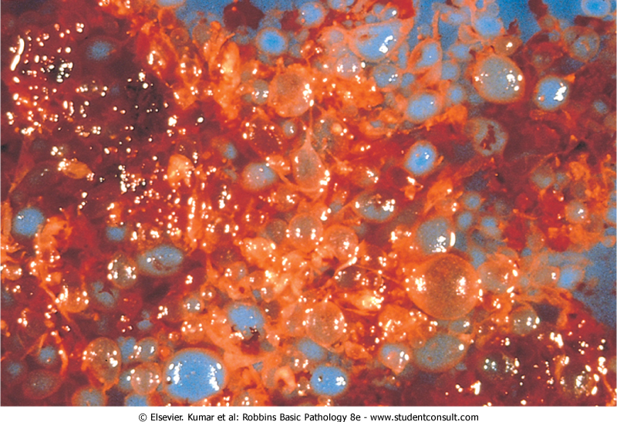
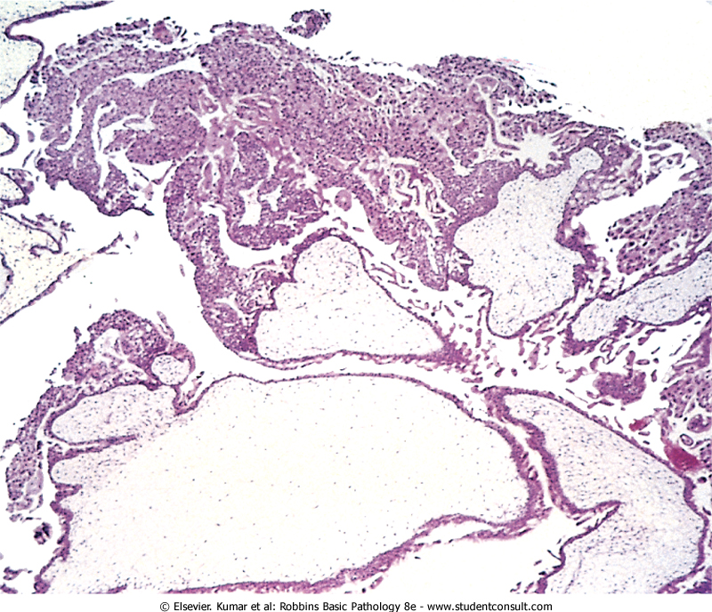
Morphology: cystically dilated chorionic villi (grapelike structures); villi are covered by varying amounts of mildly to highly atypical chorionic epithelium
Big, grape-like, edematous chorionic villi

Slide 13
Feature | Complete Mole | Partial Mole
Karyotype | 46,XX (46,XY) | Triploid (69,XXY)
Villous edema | All villi | Some villi
Trophoblast proliferation | Diffuse; circumferential | Focal; slight
Atypia | Often present | Absent
Serum hCG | Elevated | Less elevated
hCG in tissue | ++++ | +
Behavior | 2% choriocarcinoma | Rare choriocarcinoma

Slide 14
incidence → 1 to 1.5 per 2000 pregnancies; higher incidence in Asian countries.
Moles are most common before maternal age 20 years and after age 40 years i.e. extreme maternal age (risk factor for all trophoblastic diseases including molar pregnency)
Presentation: All signs and symptoms of pregnancy i.e. uterus expands, etc
In presence of antenatal care: Early monitoring of pregnancies by ultrasound →you see an enlarged uterus, no fetus, but grape-like structures (snow-flake appearance) → early diagnosis of hydatidiform mole.
Clinically: Elevations of hCG (higher than expected because it’s secreted by trophoblasts) in the maternal blood and absence of fetal parts or fetal heart sounds

Slide 15
Added slide
سلايد مضاف
Management: Termination of pregnancy by D&C (Dilation and curettage) Why? 1. It’s not a normal process and so we won’t get a fetus out of it
2. Risk of malignancy (choriocarcinoma)**THE FEARD COMPLICATION!! and so you should follow-up with the patient

Slide 16
Prognosis:
complete moles: (Worse prognosis)
80% to 90% → terminated by surgical intervention with no recurrence
10% → invasive mole (invades myometrium) not a malignancy but the mole itself is destructing the myometrium and that is because trophoblasts like invading blood vessels; and that’s one of the reasons we need to intervent.
2% to 3% → choriocarcinoma.
Partial moles:
better prognosis and rarely give rise to choriocarcinomas.

Slide 17
Choriocarcinoma
very aggressive (because trophpblastis like to invade blood vessels) malignant tumor arises from gestational chorionic epithelium or from gonads.
rare (1 in 30,000 preg); more common in Asian and African countries.
Risk greater before age 20 and after age 40.
50% (mostly) arise in complete hyaditidiform moles ; 25% arise after an abortion, and most of the rest FOLLOW normal pregnancy

Slide 18
Added slide
سلايد مضاف
Remember
Here we are discussing trophpblastic choriocarcinoma

Slide 19
Clinically: bloody, brownish discharge and very high titer of hCG in blood and urine.(but the patient is not pregnant)
Aggressive: very hemorrhagic, necrotic masses within the myometrium
Metastasize early. Common locations: lungs and brain.
chorionic villi are not formed (because there is no getational process) ; tumor is composed of anaplastic cytotrophoblast and syncytiotrophoblast.

Slide 20
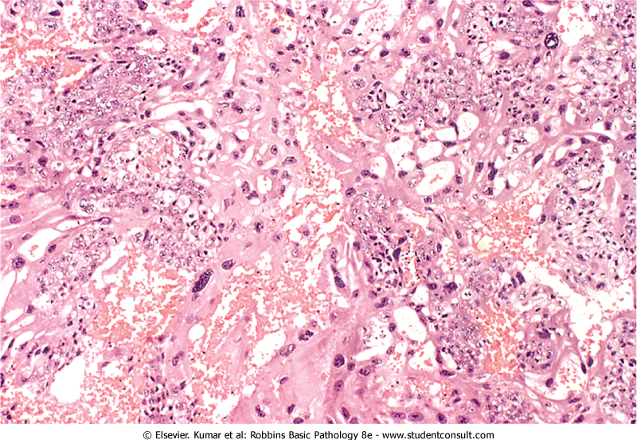
Very hemorrhagic

Slide 21
Prognosis
widespread dissemination via blood to lungs (50%), vagina, brain, liver, and kidneys.
Lymphatic invasion is uncommon
Despite extreme aggressiveness, good response to current chemotherapy.

