Slide 1
Repair
Dr Heyam Awad
FRCPath

Slide 2
Tissue repair
Restoration of tissue architecture and function after injury.
Two types :
1) regeneration.
2) scar formation.

Slide 3
Regeneration
Replacement of damaged cells and restoration of normal function.
Happens by proliferation of residual, uninjured cells that can replicate and by tissue replacement from stem cells.

Slide 4
Scar formation
= repair by fibrous tissue, resulting in a scar.
Happens if the injured tissue unable to replicate or the supportive structures of the tissue are severely injured.
The scar cannot perform the lost function but it gives structural support.

Slide 5
In many situation … both, regeneration and scar formation contribute to repair.

Slide 6
Cell and tissue regeneration
Cells that replicate during repair:
1. Remnant of injured tissue.
2. Endothelial cells.
3. Fibroblasts.
The proliferation of all these cells is controlled by growth factors.

Slide 7
Normal size of cell population is controlled by a balance between:
Cell proliferation
Cell death by apoptosis
Formation of new differentiated cells from stem cells.

Slide 8
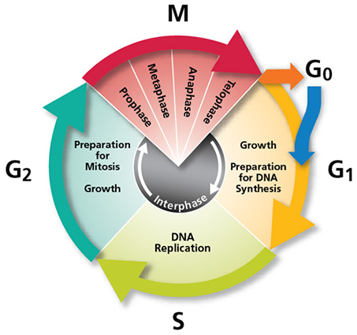
Cell cycle

Slide 9
Cell cycle
Non dividing cells are arrested in G1 phase or exited the cell cycle at G0 phase.
Growth factors .. Stimulate transition from G0 to G1 and beyond into S phase, G2 and M phase.
This progression is regulated by cyclins that are regulated by cyclin dependent kinases.

Slide 10
Proliferation capacities of tissues
Labile cells
Stable cells
Permeant cells

Slide 11
Labile tissue
Labile tissue= continuously dividing tissue. continously lost and replaced by proliferation of mature cells and by maturation from stem cells.
Examples: Hematopietic cells, skin and surface epithelium

Slide 12
Stable tissue
Quiescent , inactive cells
Minimal replicative activity in the normal state.
Can proliferate in response to injury
Examples: Parenchyma of solid organs, Endothelial cells, Fibroblasts, Smooth muscle cells.
Stable tissue ,except the liver, has limited capacity to regenerate.

Slide 13
Permanent tissue
Permanent tissue: terminally differentiated and non proliferative.
Neurons and cardiac muscle
Limited stem cell replication and differentiation occur in some areas of the adult brain
Cardiac stem cells may proliferate.
Skeletal muscle usually classified as permanent but stellate cells provide some regeneration.

Slide 14
Stem cells
Self renewal capacity
Asymmetric replication

Slide 15
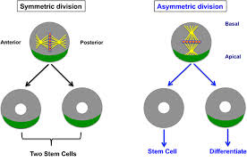
Asymmetric replication

Slide 16
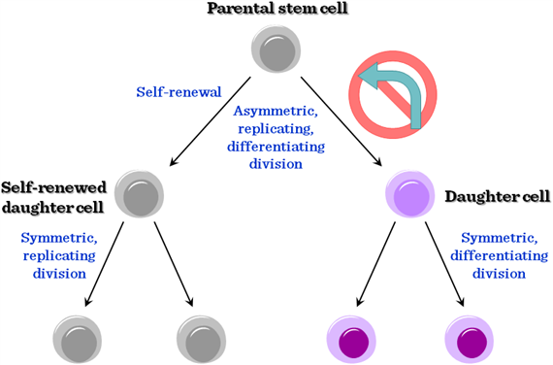

Slide 17
Stem cells
1. embryonic stem cells.
2. adult stem cells.

Slide 18
Embryonic stem cells
Undifferentiated.
Extensive cell renewal capacity.
Can differentiate to the three germ cell layers.

Slide 19
Adult stem cells
Less undifferentiated.
Their lineage potential restricted to the differentiated cells in the organ they are found in.
Important in maintaining tissue size and in repair.

Slide 20
Tissue (adult) stem cell use in medicine
Restricted by:
1. Difficulty in isolating them to purity
2. They are present in stem cell niches… without which they cannot function properly.

Slide 21
Stem cell niches
microenvironment, within the specific anatomic location where stem cells are found, which interacts with stem cells to regulate cell fate.

Slide 22
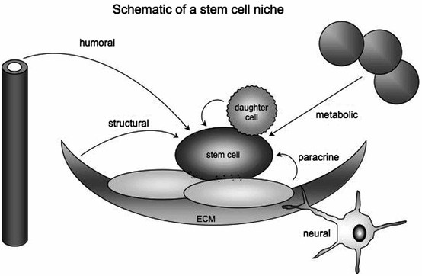
Stem cell niches

Slide 23
Tissue stem cells uses
Treatment of certain diseases…. Leukaemia and lymphoma….. By hematopoietic stem cells.
Regenerative medicine… to regenerate damaged tissues……… difficult because of the problems mentioned previously!

Slide 24
Embryonic stem cells uses
Regenerative medicine..
Problem: immunologic rejection.
Solution: tried to generate stem cells from patients’ own cells = iPS.

Slide 25
iPS
= induced pleuripotent stem cells.
How? By identifying certain genes needed for stem-cell-ness
These genes are introduced in differentiated cells… this causes reprogramming of somatic cell nucleus.. It acquires properties of embryonic stem cells .
Clinical usefulness???

Slide 26
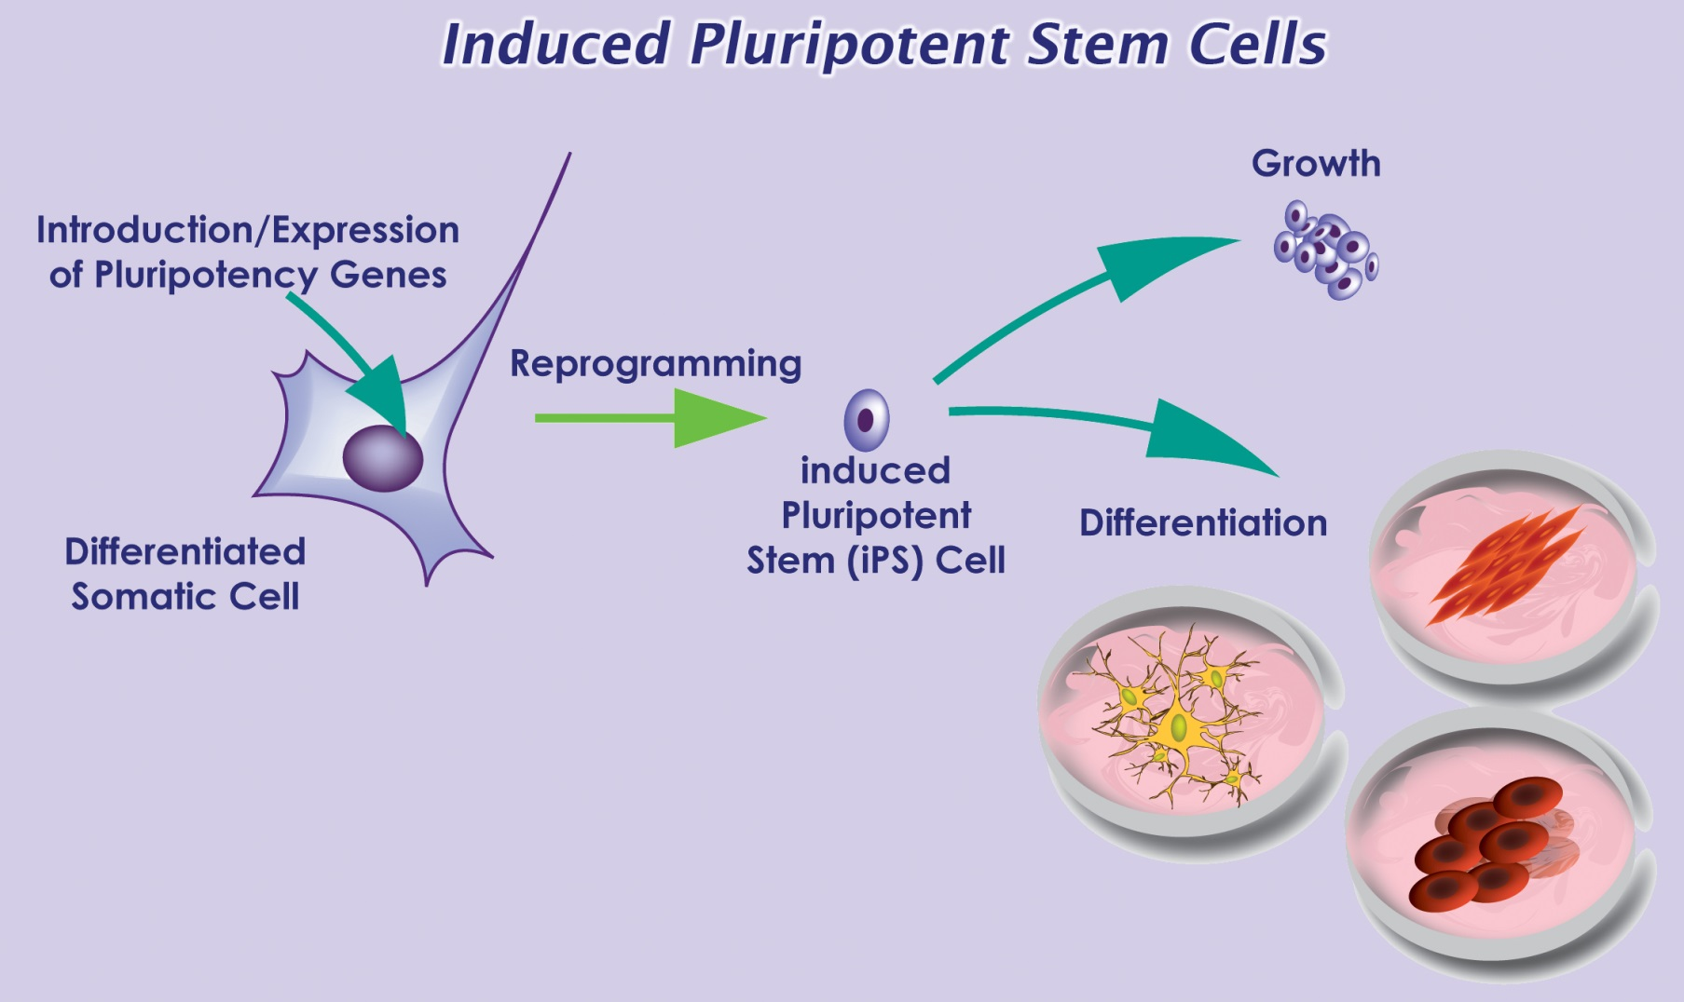
iPS

Slide 27
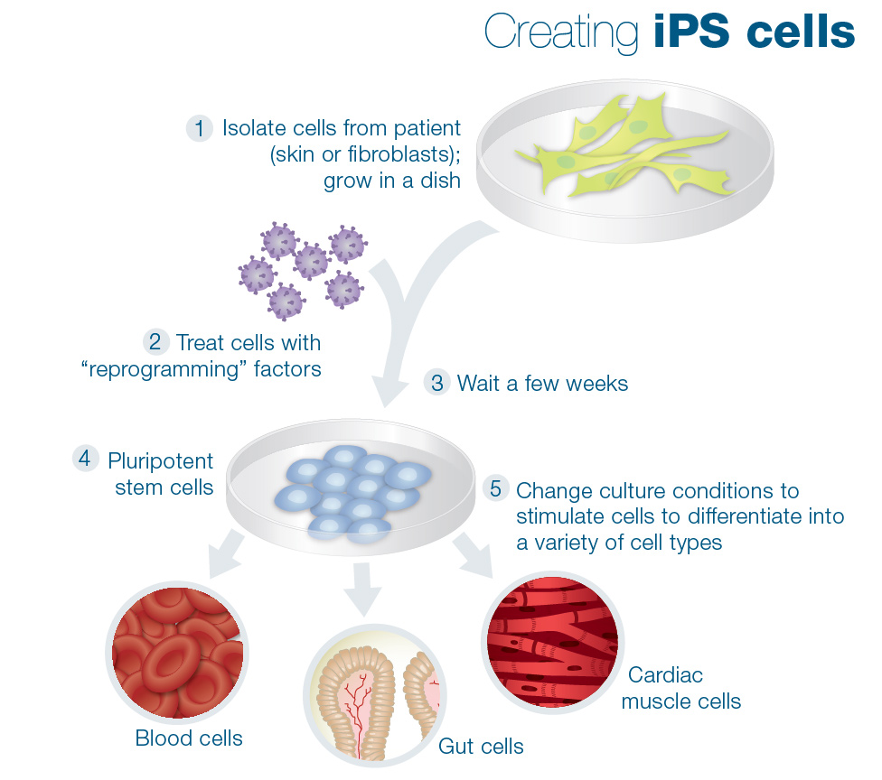

Slide 28
Growth factors
Proteins that stimulate cell survival and proliferation.
They can also promote migration, differentiation and other cellular responses.
derived from macrophages, endothelial cells, mesenchymal and many other cells.

Slide 29
GFs
EPIDERMAL GROWTH FACTOR
TGF ALPHA
TGF BETA
HEPATOCYTE GF
PDGF
KERATINOCYTE GF
VEGF

Slide 30
GF
GF stimulate cell growth by:
1. promote entry to cell cycle.
2.releive blocks on cell cycle progression.
3.Prevent apoptosis.
4. increase protein synthesis

Slide 31
Signalling mechanisms of GFs
GFs function through receptors…. And trigger biochemical signals … which stimulate or repress gene expression

Slide 32
GF signalling
Can be
Autocrine.. On the same cell that produced the factor
Paracrine… between adjacent cells
Endocrine.. Through blood.

Slide 33
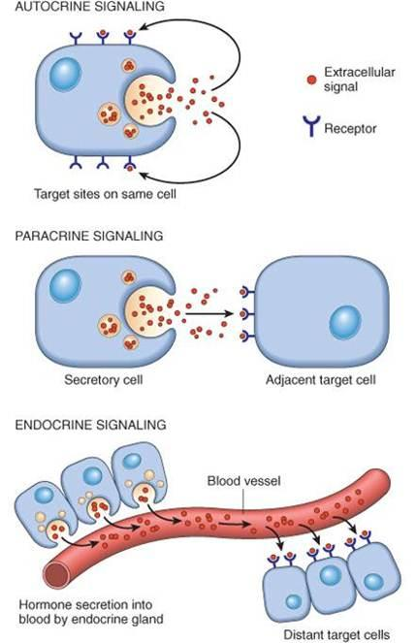

Slide 34
GF receptors
Receptors with intrinsic kinase activity.
G protein coupled receptors
Receptors without intrinsic enzymatic activity.

Slide 35
Receptors with intrinsic kinase activity
Ligand binds to receptor… dimerization and phosphorylation of the receptor subunits….
Phosphorylated receptor… bind and activate intracellular proteins ….cell proliferation .

Slide 36
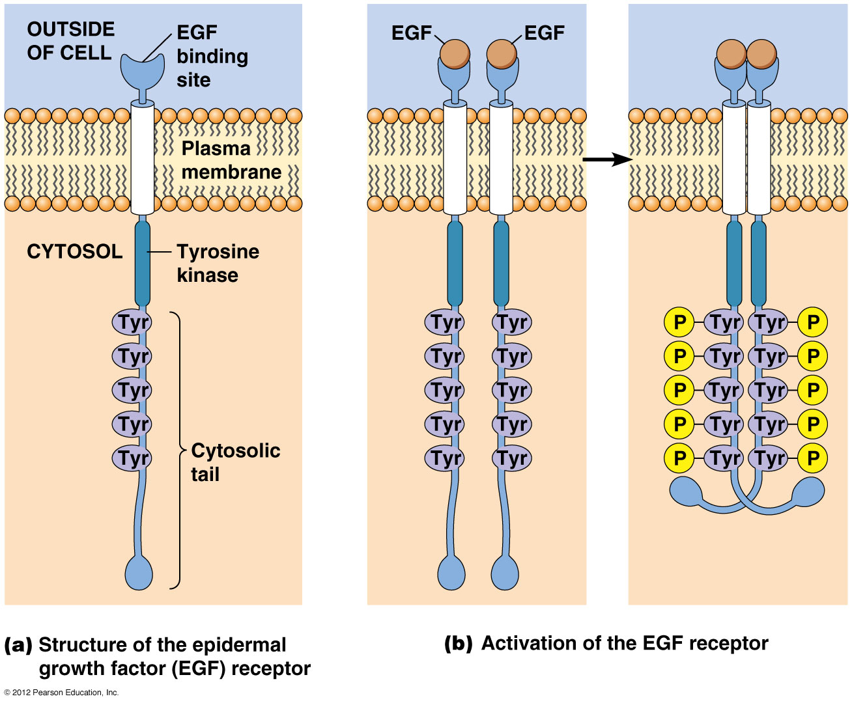

Slide 37
G coupled proteins
Seven transmembrane alpha helices, coupled with G protein (GTP binding protein).
Ligand binding: GDP in the G protein changes to GTP… receptor activated.
Signal transduction through second messengers including cAMP .

Slide 38
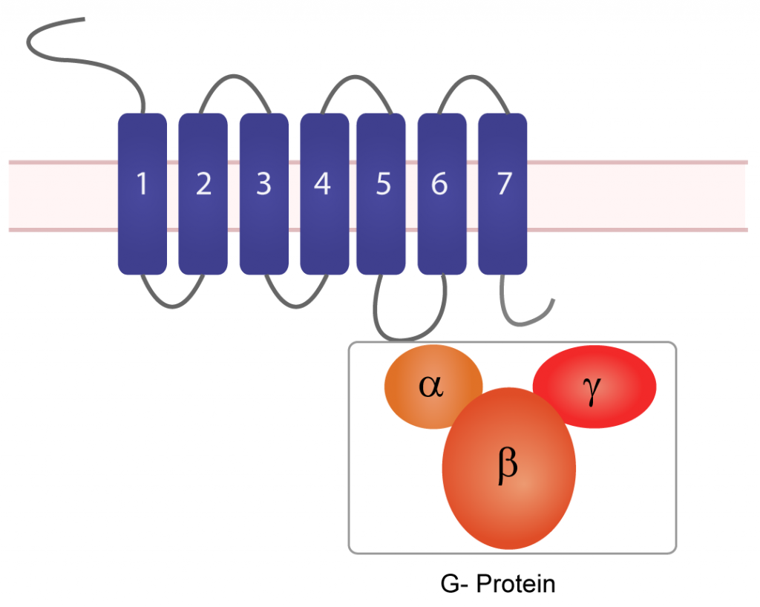

Slide 39
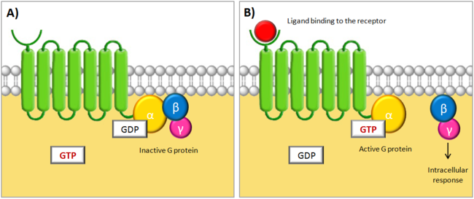
G protein- coupled receptors

Slide 40
Receptors without intrinsic enzymatic activity
Ligand.. Conformational change of receptor intracellular domain…. So it can bind to intracytoplasmic kinase (Janus kinases = JAKs).
Now receptor activated… stimulation of STATs (signal transducers and activators of transcription)…. goes to nucleus… induces transcription

Slide 41
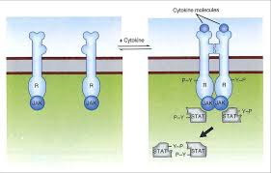

Slide 42
