Slide 1
Patient Centered Medicine & Diagnostic process
Ruba M Jaber
Family medicine consultant/ women and child’s health specialist
Assistant prof family medicine

Slide 2
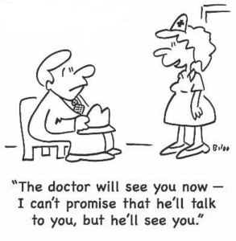

Slide 3
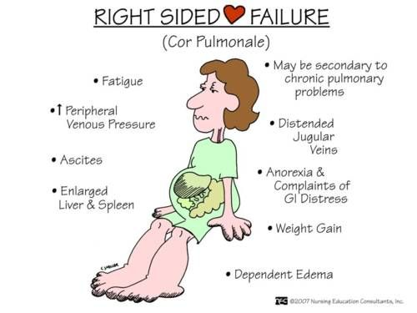
What is Disease?

Slide 4
Illness ….

Slide 5
Case study
Salman is 21 year old, university student, presented to your clinic with mild feeling of hotness, runny nose, headache, aching body and dry cough for the last 2 days…
He is asking for your help

Slide 6
Salman is 4th year medical student….
Quiz at the end of the week
Very difficult to have sick leave
Travel 2 hrs by bus in this hot weather each day
He was not feeling in good mood for the past 4 weeks, still can enjoy outings with the guys,, but do not have time
Needs to be cured now!!!!!

Slide 7
Case study 2:
65 year old Nuha, came to you asking for help for her knee pains, that started gradually over the last 2 years.
It is becoming worse for the last month or so…

Slide 8
Widowed
3 sons , all very busy, visit her on weekends
No chronic medical conditions
Afraid of becoming dependent on others
Feeling lonely and terrified of getting on wheel chair like her mother

Slide 9
Case study 3
52 year old Ahmad. Heavy smoker, came to you with heaviness like chest pain with SOB for the past 2 hrs…..

Slide 11
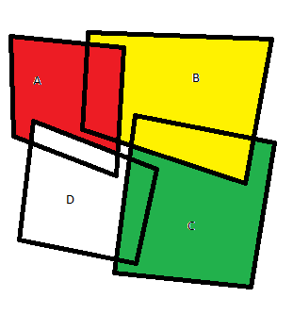
What is the difference?
Social
Psychological
Pathological
Quality of life

Slide 12
Diagnostic process
Problem Solving
Different prevalence
Age
Sex
Settings

Slide 13
Diagnostic Process Traditional/ Inductive Methods
• The complete history and physical
• Gather all the information before making a diagnosis
• A battery of tests

Slide 14
Diagnostic Process • Inductive Method of Problem Solving:
Unproductive
Confusing
Time-consuming

Slide 15
Diagnostic Process in Family Medicine
• In the course of research, family physician will look for positive (confirming) and negative (refuting) evidence.
• This is hypothetico-deductive approach
• The process is cyclical and family physicians must prepare to revise and test the hypotheses further until it is refined to the point at which management decision is justified.

Slide 16
Diagnostic Process Hypothetico-deductive reasoning
• Form your diagnosis or hypotheses
• Gather information with a purpose
• Directed search
• Selective hx/pe/ix

Slide 17
Diagnostic Process Hypotheses Formulation PST Approach:
• Probability (most likely)
• Seriousness (most serious)
• Treatability (should not be missed)

Slide 18
Ranking of hypotheses
The hypotheses are placed in ranking order based on two main criteria: probability and payoff.
Payoff is an indication of the consequences of diagnosing or not diagnosing a disease. The more serious the disease and the more amendable to treatment, the greater the positive payoff of making the diagnosis and the greater the negative payoff of missing on it.
If the disease has a high payoff, it will rank high on the list even low probability, e.g., acute appendicitis in children with abdominal pain

Slide 19
Ranking of hypotheses
If considerations of payoff is not the case, the hypotheses are ranked in order of probability.
• This is the conditional probability.
• If depression is first ranking hypotheses, one will begin the search of evidence for and against depression.
• If the diagnosis is supported, one will test it further to rule out other possible causes accounting for depressive like symptoms
• Family physicians not necessary always think of common problems and this depends entirely on cues, e.g, projectile vomiting in early infancy looks for pyloric stenosis

Slide 20
A 30 year old clerk comes in with cold and cough for 2 weeks.
What would you ask?
What would you do?

Slide 21
A 76 year old man comes with cough for 2 months.
What would you ask?
What would you do?

Slide 22
Probability: Consider prevalence, duration, age, previous smoking history, occupation, previous episodes
Most serious: Ca, history of Ca
Treatability: Bronchitis, COPD

Slide 23
Diagnostic Probability: Duration 3 days 3 days

Slide 24
3 weeks

Slide 25
3 months

