Slide 1
GASTROINTESTINAL OBSTRUCTION
PROF HASHEM AL-MOMANI
SENIOR CONSULTANT PEDIATRIC SURGEON

Slide 2
Hypertrophic Pyloric Stenosis
The incidence is 3 per 1000 live births.
Etiology is unknown, but pylorospasm to formula protein cause a work hypertrophy of the muscle.
Diagnostic characteristics are:
  Non-bilious projectile vomiting
  Classically 3-6 weeks of age
  Palpable pyloric muscle "olive"
Metabolic alkalosis

Slide 3
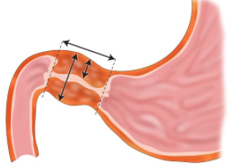

Slide 4
DIAGNOSTIC WORKUP
ABG
Ultrasonography
Contrast studies

Slide 5

Ultrasound

Slide 6
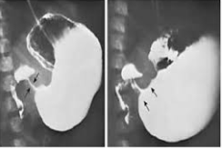
Contrast meal

Slide 7
TREATMENT
Correction of hypochloremic alkalosis and dehydration
Pyloromyotomy.

Slide 8
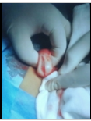

Slide 9
Post-operative management
50% will have one to several episodes of vomiting
Initial feeds start 8-12 hours after surgery.

Slide 10
Duodenal Malformations
Intrinsic (atresia, stenosis, webs)
Extrinsic (annular pancreas, ladd's bands)
Most commonly distal to ampulla and therefore bilious vomiting is present
Failure of recanalization of the second part of the duodenum results in congenital obstruction of the lumen

Slide 11
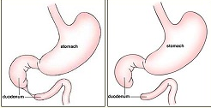

Slide 12
The diagnostic characteristics are:
Bilious vomiting,
History of polyhydramnios in mother
Abdominal x-ray "double-bubble" sign

Slide 13
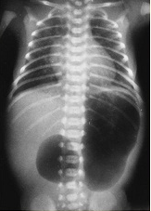

Slide 14
Treatment
Duodeno-duodenostomy bypass for atresias, annular pancreas, and some stenosis.
Duodenoplasty for webs, and stenosis, and
Lysis of ladd's bands and ladd's procedure for malrotation.

Slide 15
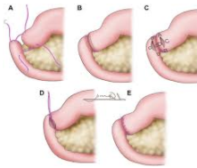
Duodeno-duodenostomy

Slide 16
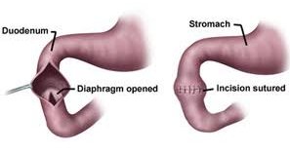
Duodenoplasty

Slide 17
Malrotation and Volvulus
Most patients present in first month of life (neonatal), but may present at any time.
  Bilious vomiting (the deadly vomit)
  Abdominal distension
  Metabolic acidosis.
UGIS is more reliable than barium enema

Slide 18
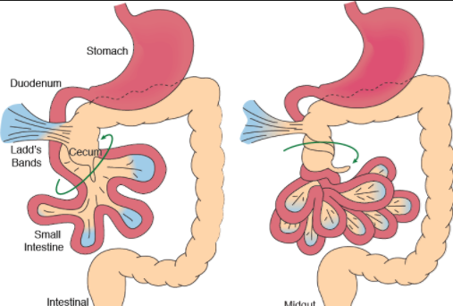

Slide 19
TREATMENT
Fluid and electrolyte replacement.
The treatment is immediate operation :Ladd's procedure consist of:
  Reduce volvulus
  Widen the mesentry
  Lysed Ladd's bands
  Appendectomy.

Slide 20
INTESTINAL ATRESIAS
Intestinal atresias are caused by intrauterine mesenteric vascular accident
They are equally distributed from the ligament of treitz to the ileocecal junction.
Colonic atresias are very rare.

Slide 21
DIAGNOSIS
Polyhydramnios (the higher the atresia)
Bilious vomiting
Abdominal distension
No meconeum.

Slide 22
CLASSIFICATION
Type I: an intraluminal diaphragm with seromuscular continuity.
Type II: cord-like segment between the bowel blinds ends.
Type IIIA: atresia with complete separation of blind ends and V-shaped mesenteric defect
Type IIIB: an "apple peel"deformity.
Type IV: multiple atresias of the small intestine.

Slide 23
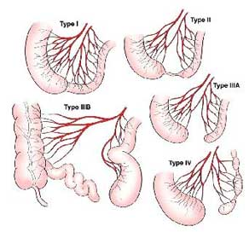

Slide 24
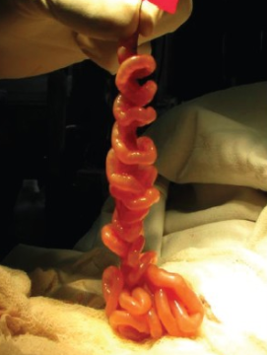

Slide 25
treatment consists of
Preoperative stabilization
  GI decompression
  Electrolytes disturbances' correction
  Antibiotherapy
  Normothermia
Exploratory laparotomy, resection and anastomosis

Slide 26
MECONIUM ILEUS
Meconium ileus is a neonatal intraluminal intestinal obstruction caused by inspissated meconium blocking the distal ileum.
Occurs in 10-15% of all patients with cystic fibrosis, and 85-95% of patients with meconium ileus have cystic fibrosis.
The meconium has a reduced water, abnormal high protein and mucoproteint content

Slide 27
DIAGNOSIS
AXR
  Multiple loops of dilated small bowel
  Coarse granular "soap-bubble" appearance

Slide 28
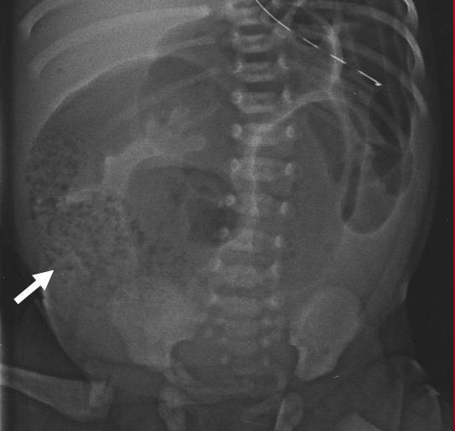
AXR

Slide 29
TREATMENT
Nonoperative- gastrograffin enema after the baby is well-hydrated
Surgical therapy :
  Ileostomy with irrigation
  Resection with anastomosis
  Resection with ileostomy

Slide 30
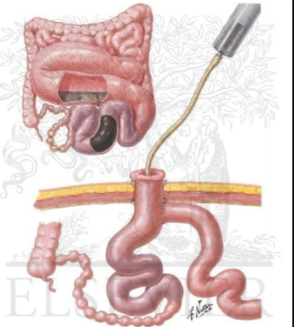

Slide 31
Post-operative management includes:
10% acetylcysteine p.O.
Oral feedings (pregestimil)
Pancreatic enzyme replacement
Prophylactic pulmonary therapy

Slide 32
ANORECTAL MALFORMATIONS
(ARM)
(IMPERFORATE ANUS)
The incidence of ARM is approximately 1 in 4000-5000 live births and it is more common in males.
ARM is classified as either
  "high" the rectum ends above the levator muscles
  "low" the rectum ends below the levator muscles
High lesions are more frequent in males, low ones in females.

Slide 33
Perineal signs in low malformations that will NOT need a colostomy are:
Meconium in perineum
Bucket-handle defect
Anal membrane
Anal stenosis.

Slide 34
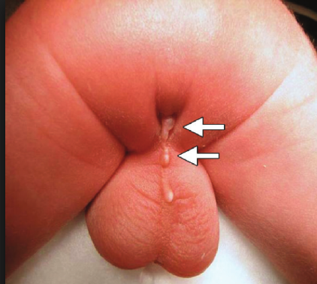
Perineal fistula

Slide 35
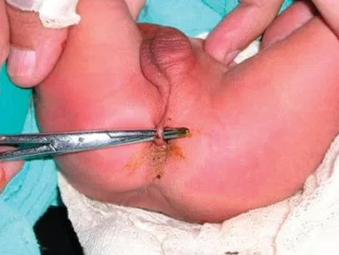
Bucket-handle defect

Slide 36
High malformation needing a colostomy.
Meconium in urine
Flat perineum (lack of intergluteal fold)
Absence of anal dimple

Slide 37
INVERTOGRAM
Invertogram or cross-table lateral film in prone position to decide rectal pouch position.
  Bowel > 1 cm from skin level will need a colostomy,
  Bowel < 1 cm from skin can be approach perineally.

Slide 38
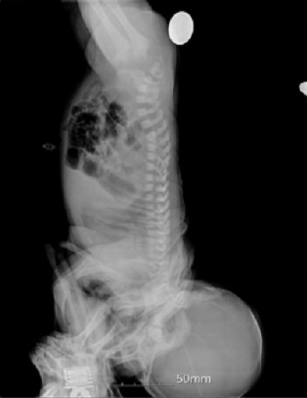
INVERTOGRAM

Slide 39
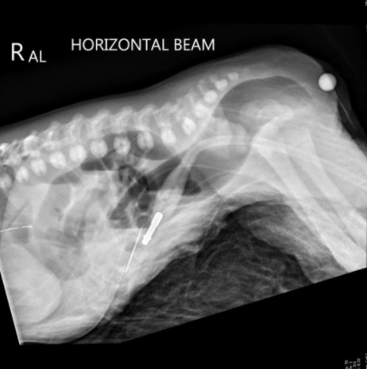
Cross-table lateral film

Slide 40
INTUSSUSCEPTION
Occurs in infants between 4-10 months of age.
Over half of the cases are in the first year of life.
Frequently occurs after a recent upper respiratory infection
The baby has intermittent periods of severe discomfort with screaming, stiffening and drawing up of the legs, followed by periods of rest.
Vomiting
Bloody, mucoid (currant jelly) stool
Dehydration
Lethargy

Slide 41
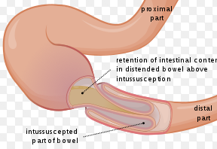

Slide 42
DIAGNOSIS
Ultrasound
Ba enema

Slide 43
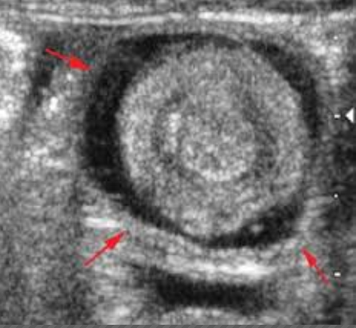
Ultrasound

Slide 44
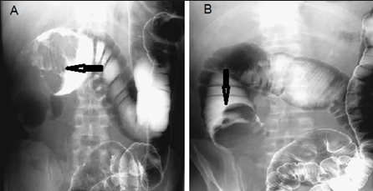
Ba enema

Slide 45
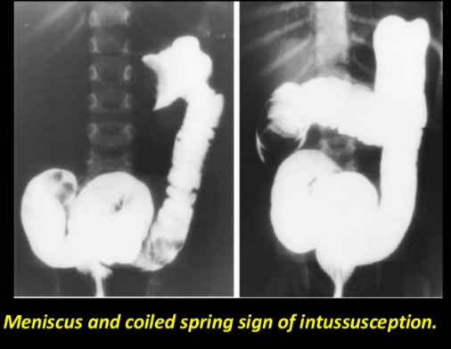

Slide 46
TREATMENT
Hydrostatic reduction
Operative

