Slide 1
Peptic Ulcer Disease
Prof. Dr. Mahmoud M.S Abu-Khalaf, MB, BCh, FACS, FRCS (edin)
Fourth year
Medical Students
University of Jordan

Slide 2
Indications for Surgical Intervention in Peptic Ulcer
Urgent Complications
Bleeding
Perforation
Obstruction
Usually by inflammation and fibrosis at the outflow of the stomach
Failure of non-operative treatment (Intractability)
Now Rare
Persistent Intractable symptoms؛ Needs to take NSAIDs
Possible Malignancy

Slide 3
Bleeding Peptic Ulcer
Bleeding Peptic Ulcer is managed within the scope of UGI Bleeding.
There are many causes of UGI bleeding.
Common causes:
PUD - 50%
Esophageal varices – 5-10%, may be more in Jordan.
GI erosions in patients with liver and kidney failure.
NSAIDs
Others.

Slide 4
Bleeding PUD
DU
GU
Ulcers in lower end of esophagus
Ulcers associated with hypergastinemia (Zollinger – Ellison Syndrome)

Slide 5
Protocols for Management of UGI bleeding
IV Lines – two large bore cannulas.
Drawing blood for Lab.
IV Fluid resuscitation.
Foley Catheter, hourly output monitoring
NG Insertion, Irrigation.
Thorough clinical assessment
Arrange for UGI endoscopy if the patient is hemodynamically stable
Resuscitate and stabilize unstable patient

Slide 6
Endoscopic stigmas which suggest the likelihood of further bleeding from peptic ulcer
Active bleeding vessel.
Visible Vessel in Ulcer base.
Adherent Clot.
Black Spot in Ulcer base.

Slide 7
Re-bleeding in PUD
Class of Evidence:
Hemodynamic evidence.
Clinical evidence.
Re-endoscopy.
Hematological evidence.

Slide 8
PUD Bleeding
Bleeding has stopped in UGI endoscopy – Medical Management – in 50-75%
Active bleeding in UGI endoscopy 25%.
Endoscopic interventional procedure.
Local injection of vasoconstrictors or sclerosants.
Thermal coagulation with a heat probe.
Cold coagulation with a cryobroble
Failure of endoscopic intervention to stop bleeding
1-2%
Surgical intervention
DU Bleeding
Ulcer exposure
The bleeding vessel under-run with a suture
Vagatomy and Pylorophasty
Or HSV
Or partial gastrectomy
Gu bleeding
Partial gastrectomy

Slide 9
Outcome bleeding PUD
Age Factor.
Comorbidities.

Slide 10
Peptic Ulcer Disease
Gastric outflow obstruction
Obstruction is the consequence of inflammatory Oedema and/or fibrosis.
Inflammatory Oedema subsides with effective anti ulcer treatment.
Fibrosis persists.
Which is the major component?

Slide 11
Clinical Presentations
Vomiting
Free from bile
Partially digested food.
A meal eating a day or more before.
Weight loss
Dehydration
Electrolytes imbalance
Metabolic alkalosis.
Hyponatremia
Hypokalemia
Nutritional deficit
Physical examination
Signs of weight loss.
Signs of dehydration.
Succession splash.
Features of Hypokalemia

Slide 12
Gastric outlet obstruction
Management
Fluid resuscitation.
deficit normal saline.
maintenance
N/G tube, washing, aspiration, suction.
Urine output monitoring.
UGI endoscopy – 4th or 5th day.
Exclude malignancy
Surgery if obstruction does not resolve.
Bilateral trucal vasotomy & pyloroblasty
Versus endoscopic dilatation and stenting.

Slide 13
Perforated Peptic Ulcer Disease
The global prevalence of PUD has decreased in recent decades
H.Pyluri eradication regimens
Introduction of PPIs
The rate of PU perforation has remained stable in several regions of the world.
Patients population affected by PUD perforation are:
Older.
With comorbidities.
Fewer than the third of patients have a history of peptic ulcer disease before perforation.

Slide 14
Clinical Presentation
Acute pain
Signs of Peritonitis
Chemical peritonitis
Bacterial peritonitis

Slide 15
Pathophysiology
Severity of pain
Spreading peritonitis
Progressive – Chemical to Bacterial – Sepsis
Fluid loss – Third Spice – Dehydration
Continuous soiling of feritoned fluid

Slide 16
Management
Pain control
I.V fluid resuscitation
Antibiotics
Stop continuation of soiling of peritoneal cavity

Slide 17
Imaging Studies
Erect chest x-rays – free air under the diagram
(70-75%) - Historical
Abdominal computerized tomography.
(70-98%)

Slide 18
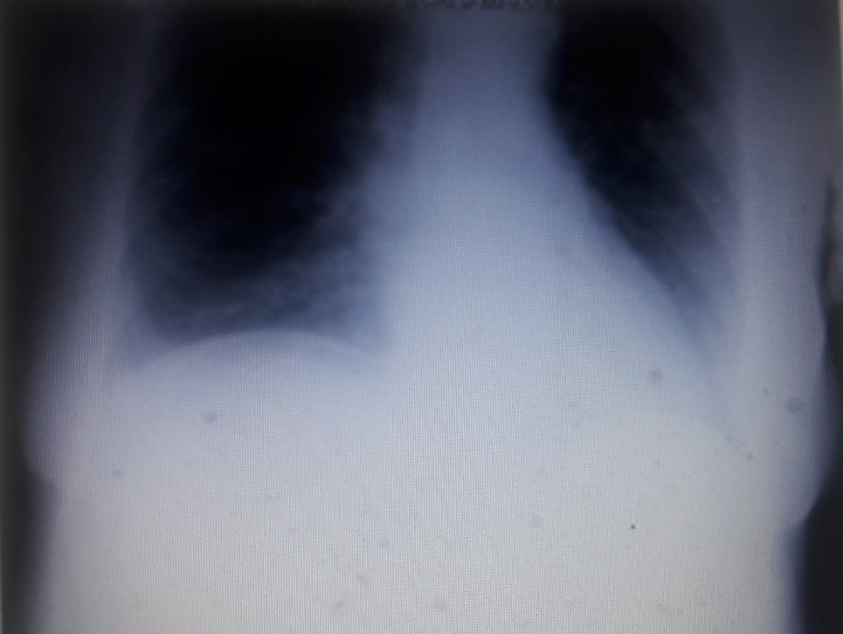
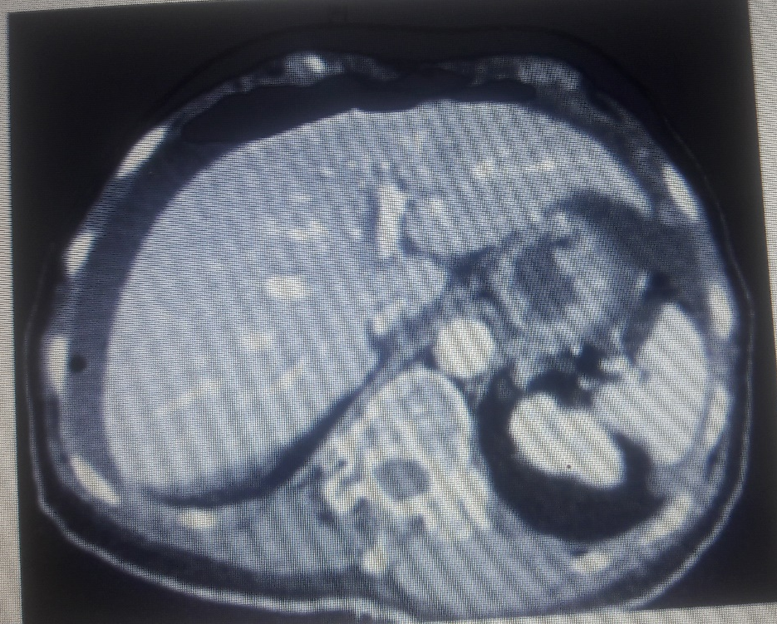

Slide 19
Risk Scoring
Boey Score
Age - ≥60
Duration of symptoms - ≥24 hours
Shock
PULPScore
Age - ≥65
Active malignant disease or acquired Immunodeficiency syndrome
Liver cirrhosis
Steroid use
Duration - ≥ 24 hours
Preoperative shock
Serum creatinine level over 130mml/l
ASA Score over I.

Slide 20
Surgical treatment
Pain Control – analgesls– Narcotics
Correct dehydration – resuscitatin with IVs
Antibiotics
N/G suction
PPIs I.V
Surgical Intervention to stop soiling
Simple structure of perforation site with or without the addition of omental patch
Laparoscopic repair Vs open surgery repair.
Non-operative treatment in high risk patients

Slide 21
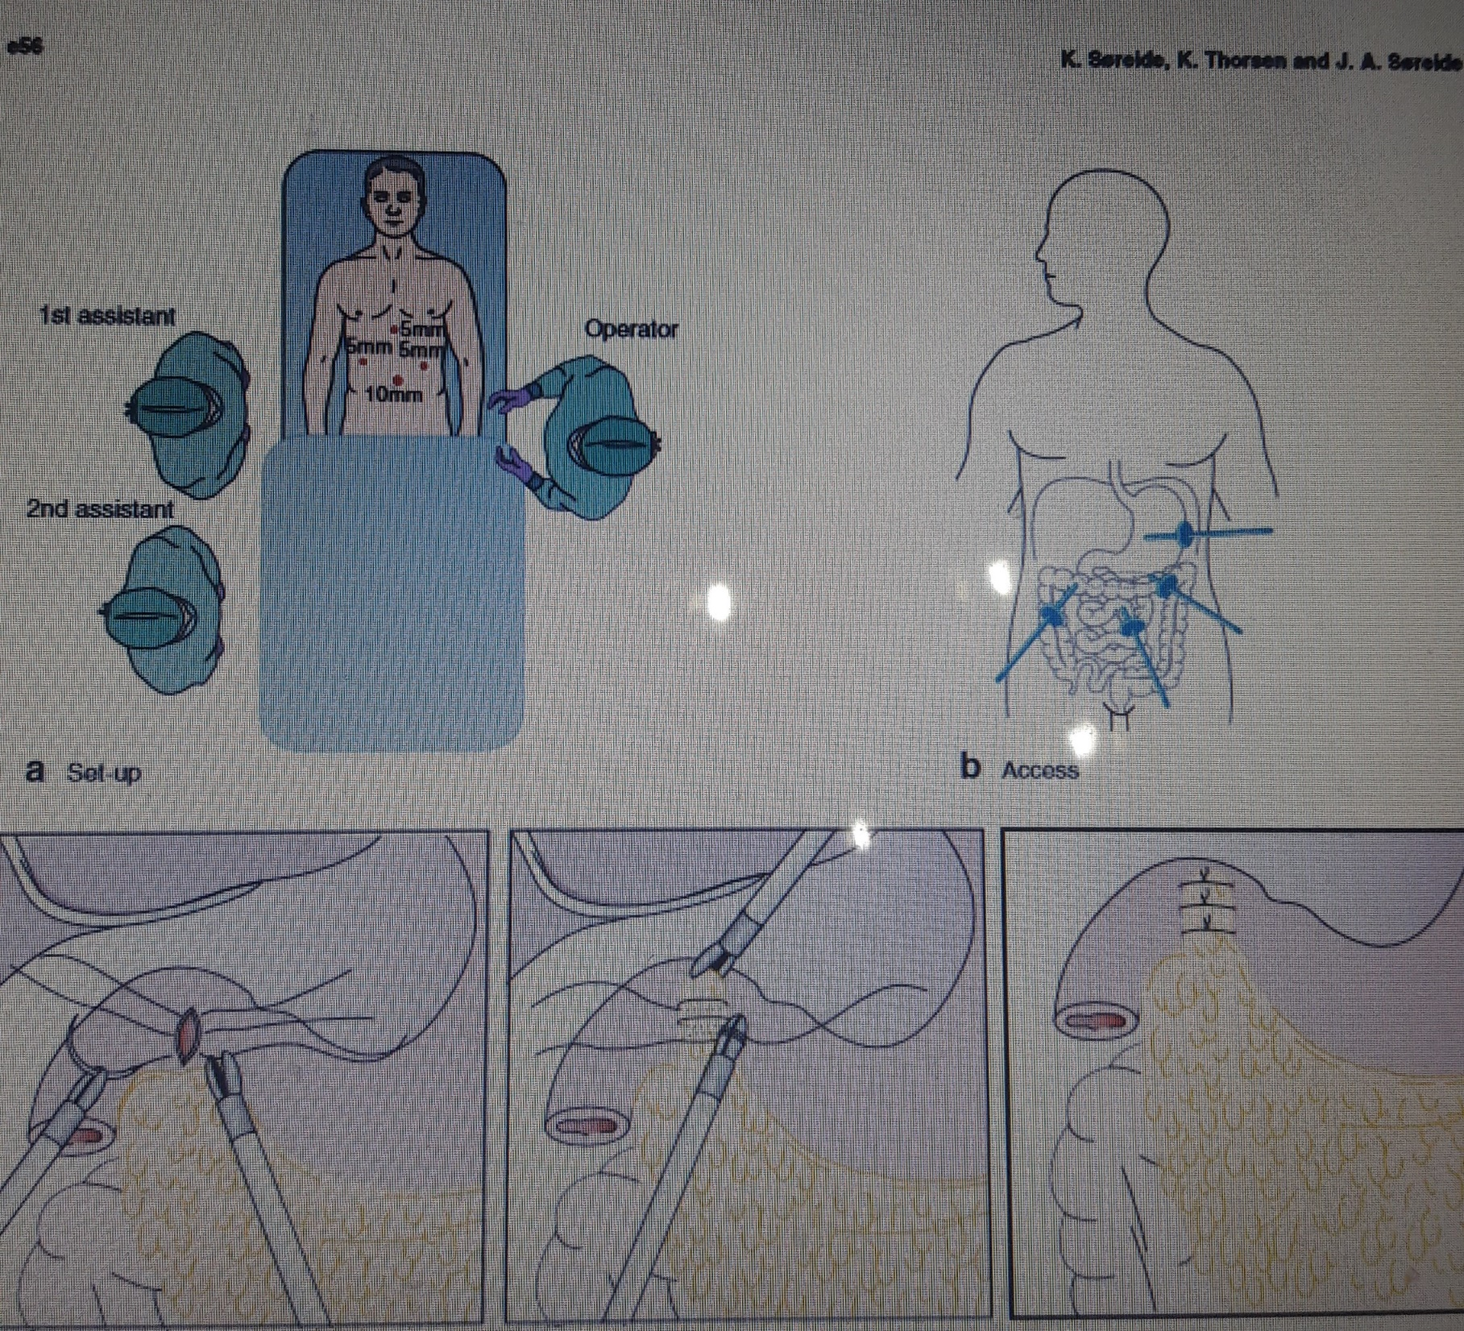

Slide 22
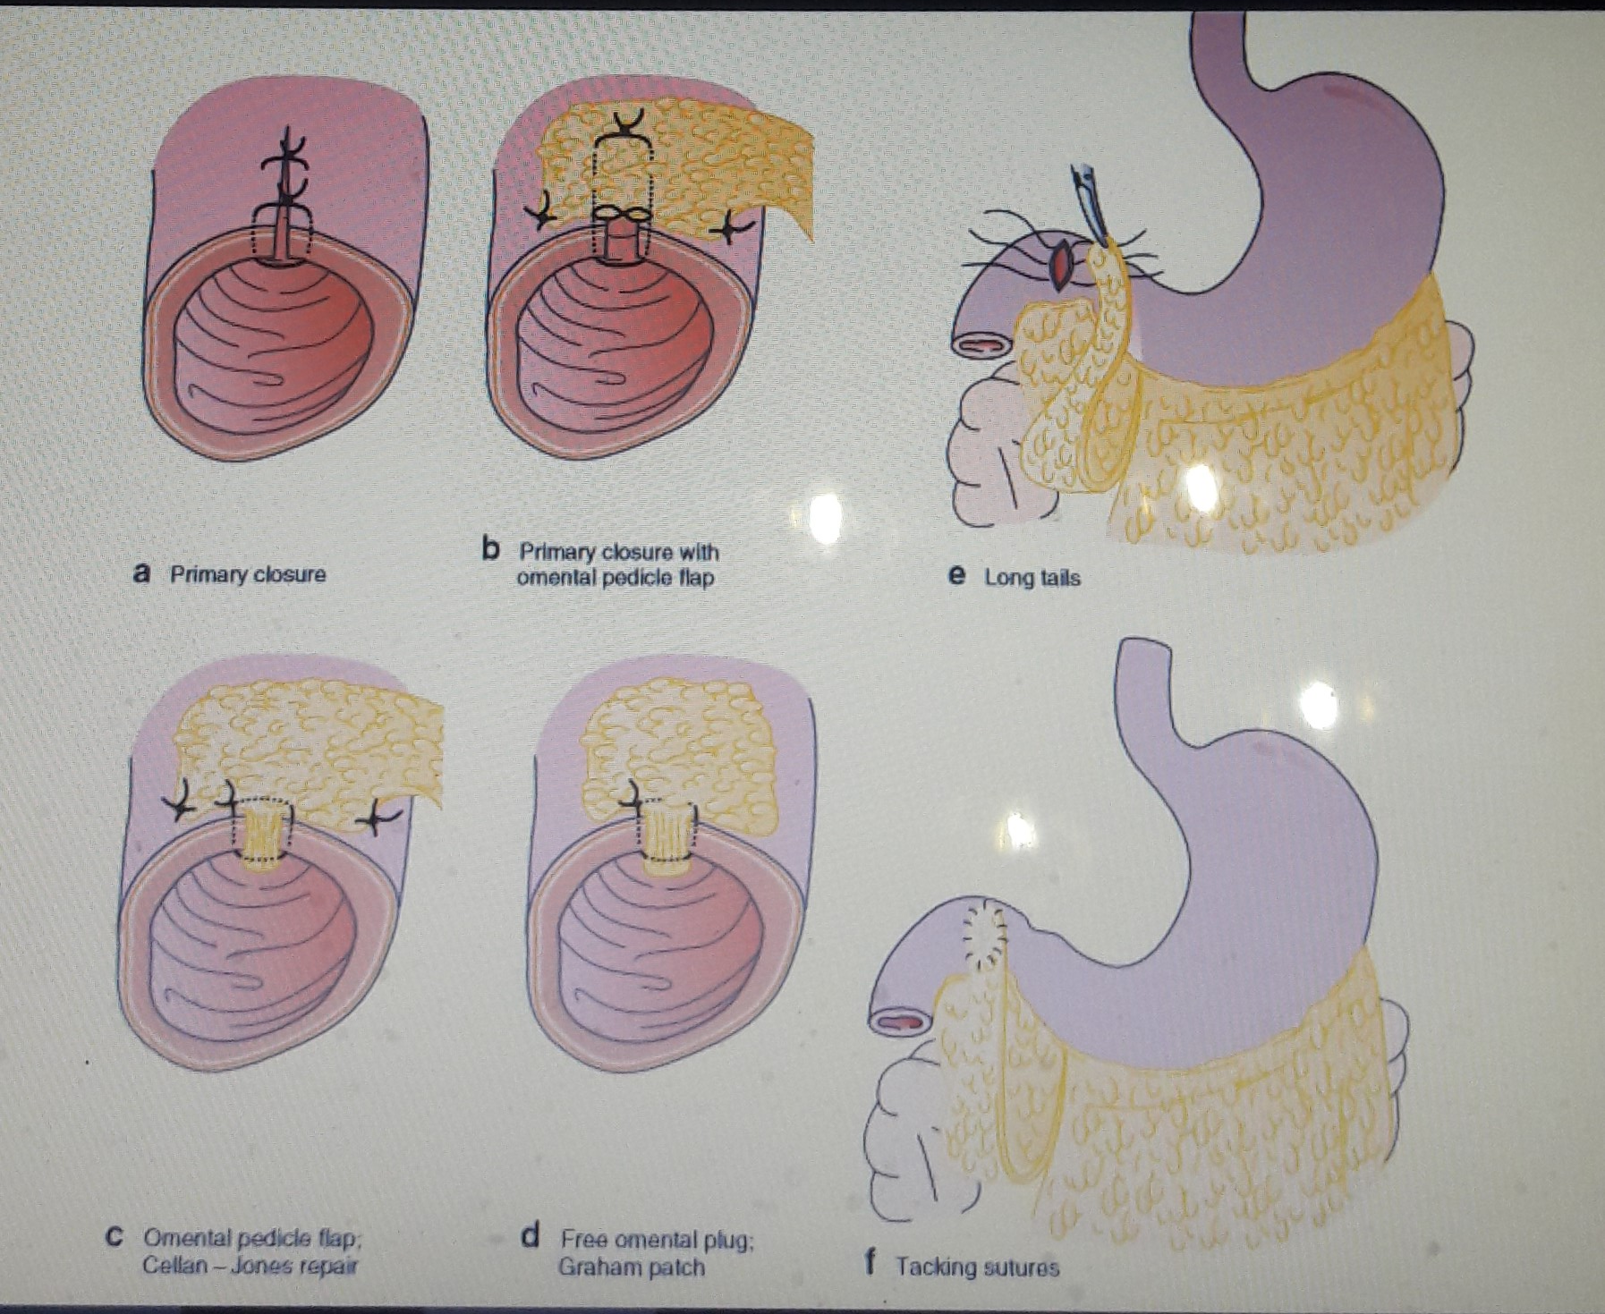

Slide 23
