Slide 1
Drugs Used to Treat Variceal Hemorrhage
Recall from patho. This is a serious complication of portal hypertension is variceal bleeding. When blood pressure increases in the portal vein system, veins in the esophagus, stomach, and rectum enlarge to accommodate blocked blood flow through the liver

Slide 2
Drugs Used to Treat Variceal Hemorrhage
Portal hypertension most commonly occurs as a consequence of chronic liver disease.
Portal hypertension is caused by increased blood flow within the portal venous system and increased resistance to portal flow within the liver.
Splanchnic blood flow is increased in patients with cirrhosis.
The extra blood flow causes the veins in the esophagus to balloon outward.
Varices can rupture, leading to massive upper GI bleeding.
This condition in one line: Chronic liver disease >portal BF increase >HT > dilation of vein > rapture of veins >Hemorrhage
59

Slide 3
Management
To treat this condition we must First Think how to stop the bleeding . We must think of agents that are vasoconstrictors , agents that decrease the blood flow & agents that reduce portal venous pressures.
+++++
This is achieved by these drugs :
Somatostatin & Octreotide
Vasopressin
Beta-Receptor-Blocking Drugs

Slide 4
1-Somatostatin & Octreotide
In patients with cirrhosis and portal hypertension, intravenous (IV) somatostatin or octreotide reduces portal blood flow and variceal pressures.
They inhibit the release of glucagon and other gut peptides that alter mesenteric blood flow.
They promote initial homeostasis from bleeding esophageal varices.
They are generally administered for 3–5 days.
60

Slide 5
Vasopressin (antidiuretic hormone)
is a potent arterial vasoconstrictor.
IV infusion causes splanchnic arterial vasoconstriction that leads to reduced splanchnic perfusion and lowered portal venous pressures.
vasopressin was commonly used to treat acute variceal hemorrhage. because of its high adverse-effect profile, it is no longer used for this purpose.

Slide 6
Vasopressin was the drug of choice for Variceal Hemorrhage, but any more . Because of its Adverse effects with the presence of Somatostatin & Octreotide that are effective with Fewer side effects .
Adverse effects of Vasopressin :
are common. hypertension, myocardial ischemia or infarction, or mesenteric infarction.
Other common adverse effects are nausea, abdominal cramps, and diarrhea (due to intestinal hyperactivity).
vasopressin promotes retention of free water, which can lead to hyponatremia, fluid retention, and pulmonary edema.
Terlipressin is a vasopressin analog that have similar efficacy to vasopressin with fewer adverse effects.
*It cause Hypertension because it constrict the vessels .
62

Slide 7
We still use Vasopressin : patients with acute gastrointestinal (lower gut) bleeding from small bowel or large bowel vascular ectasias or diverticulosis, vasopressin may be infused—to promote vasospasm—into one of the branches of the superior or inferior mesenteric 61 artery through an angiographically placed catheter. (mentioned in the slide)

Slide 8
Beta-Receptor-Blocking Drugs
Beta-receptor antagonists reduce portal venous pressures via a decrease in portal venous inflow.
This decrease is due to a decrease in cardiac output ( β1 blockade) and to splanchnic vasoconstriction ( β2 blockade) caused by the unopposed effect of systemic catecholamines on α receptors.
Thus, nonselective blockers such as propranolol and nadolol are more effective than selective β1 blockers in reducing portal pressures.
Nonselective β blockers significantly reduce the rate of recurrent bleeding.
63

Slide 9
+++++
Further explanations : Beta blocker > block beta-1 receptors in the heart > this decrease cardiac output > this induce reflex vasoconstriction (due to decrease in catecholamines & stimulation of alpha receptors ) >decrease the blood pressure using non selective beta blocker is better than cardiac selective beta blockers (B-1 blockers) Like propranolol & nadolol . which will also block beta 2 receptors

Slide 10
Now we will move to the next slide ..
You must study the GI parasitology to understand it well .

Slide 11
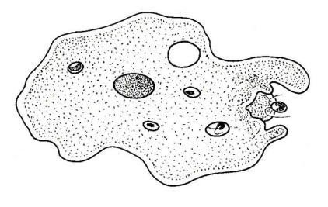
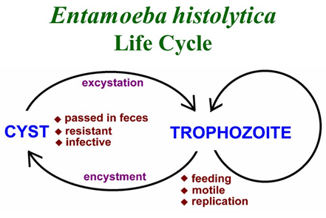
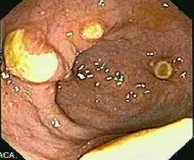
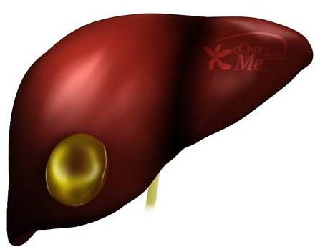
Amebiasis
Amebiasis is infection with
Entamoeba histolytica.
This organism can cause:
Asymptomatic intestinal infection. (the patient won’t be aware)
Mild to moderate colitis.
Severe intestinal infection (dysentery).
Ameboma (a tumor-like mass in the
intestines in amebiasis which results
in a large local lesion of the bowel ).
Liver abscess and other extraintestinal infection.
Ameboma

Slide 12
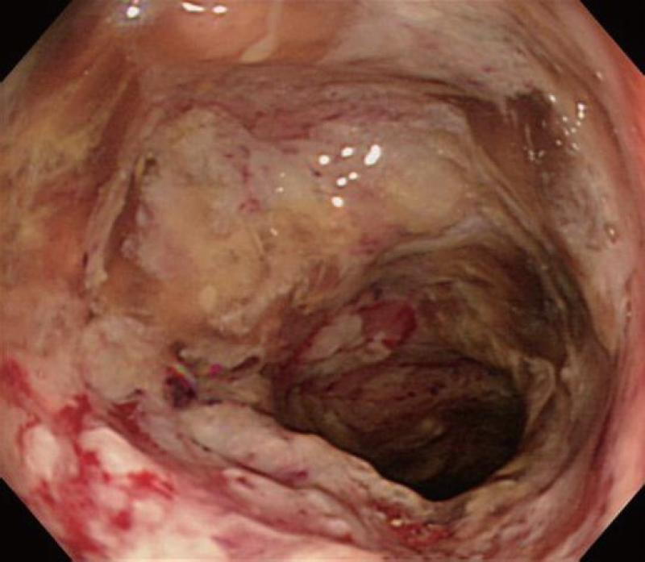
Treatment of Specific Forms of Amebiasis
Asymptomatic Intestinal Infection
Asymptomatic carriers are treated with a luminal amebicide . * amebicide= drugs that kill amebea
Standard luminal amebicides are:
Diloxanide furoate, Iodoquinol, and Paromomycin.
Therapy with a luminal amebicide is also required in the treatment of all other forms of amebiasis. Other manfistications :
(I) Amebic Colitis
Metronidazole + a luminal amebicide
is the treatment of choice.
(II) Tetracyclines and erythromycin are
alternative drugs for moderate colitis but
are not effective against extraintestinal disease(like Liver abscess ).
(III) Dehydroemetine or emetine can also be used, but are best avoided because of toxicity.
Amebic Colitis
For amebiasis we always use these Luminal amebicides (Diloxanide furoate, Iodoquinol & Paromomycin>>remember it as a DIP of drugs for amebae ). However, when there are other manfistications like extraintestinal disease with Amebiasis we ADD other drugs to the DIP.

Slide 13
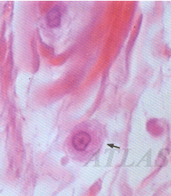
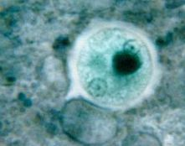
Now Let’s talk about the drugs in more details
Metronidazole
Drug of choice in the treatment of
extraluminal amebiasis.
It kills trophozoites but not
cysts of E histolytica and
effectively eradicates intestinal
& extraintestinal tissue infections.
Tinidazole
Similar activity
& better toxicity profile than metronidazole. Longer half life..
cysts of E histolytica

Slide 14
Pharmacokinetics & Mechanism of Action
Oral metronidazole and tinidazole are readily absorbed.The half-life: Metronidazole 7.5 hours
Tinidazole 12–14 hours.
The nitro group of metronidazole is reduced in anaerobic bacteria and sensitive protozoans.
It inhibits nucleic acid synthesis by disrupting the DNA of microbial cells. This function only occurs when metronidazole is partially reduced, and because this reduction usually happens only in anaerobic cells, it has relatively little effect upon human cells or aerobic bacteria.
The mechanism of tinidazole is the same

Slide 15
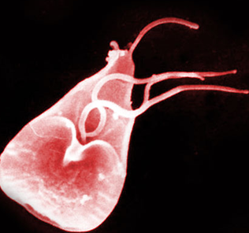
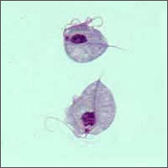
Clinical Uses
Amebiasis
Metronidazole or tinidazole
The drug of choice in the treatment of all tissue infections with E histolytica. (hepatic abscess; intestinal wall/ extraintestinal infections)
Not effective against luminal parasites and so must be used with a luminal amebicide to ensure eradication of the infection. kills trophozoites but not cysts
Giardiasis (infection of the intestine with a flagellate protozoan, which causes diarrhoea and other symptoms.)
Metronidazole is the treatment of choice
Efficacy after a single treatment is about 90%
Tinidazole is equally effective.
Trichomoniasis *an infection caused by parasitic trichomonads, chiefly affecting the urinary tract, vagina, or digestive system
Metronidazole is the treatment of choice.
A single dose of 2 g is effective.
Trichomonas vaginalis
Luminal amebicides are present in the lumen not in the blood ( not absorbed) Metronidazole is absorbed and is present in the blood so it can NOT work on luminal parasites but Tissue parasites

Slide 16
Adverse Effects & Cautions
Common:
Nausea, headache, dry mouth, metallic taste.
Infrequent adverse effects:
vomiting, diarrhea, insomnia, weakness, dizziness, thrush, rash, dysuria, dark urine, vertigo, paresthesias, and neutropenia.
Rare:
Pancreatitis and severe central nervous system toxicity (ataxia, encephalopathy, seizures)
Metronidazole has a disulfiram -like effect.
Tinidazole is better tolerated.
Metronidazole is best avoided in pregnant or nursing women, although congenital abnormalities have not clearly been associated with use in humans.
disulfiram -like effect a drug used in the treatment of alcoholism that acts by inducing nausea and other unpleasant effects following ingestion of alcohol. So Metronidazole cause a disulfiram -like effect.

Slide 17
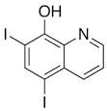
Iodoquinol
Luminal amebicide, but not against
intestinal wall or extraintestinal trophozoites.
90% is excreted in the feces.
Infrequent adverse effects:
Diarrhea , anorexia, nausea, vomiting, abdominal pain, headache, rash, and pruritus.
Taken with meals to limit gastrointestinal toxicity.
Used with caution in patients with optic neuropathy, renal or thyroid disease, or nonamebic hepatic disease.
Should be discontinued if it produces persistent diarrhea or signs of iodine toxicity (dermatitis, urticaria, pruritus, fever). So it is not the drug of choice .
Iodo: has Iodine

Slide 18
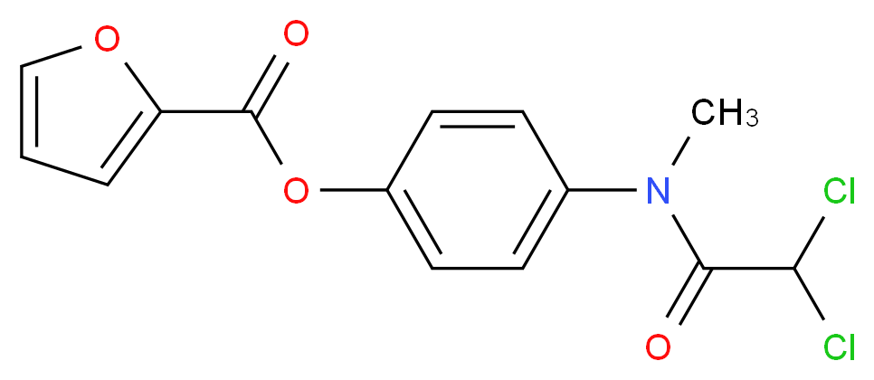
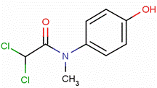
Diloxanide Furoate
Drug of choice for
asymptomatic luminal infections.
Not active against tissue trophozoites.
In the gut, it splits into diloxanide
and furoic acid; about 90% of the
diloxanide is rapidly absorbed.
The unabsorbed diloxanide (10%) is the active antiamebic (so they act as luminal amebicide)The mechanism of action is unknown.
Used with a tissue amebicide, usually metronidazole, to treat serious intestinal & extraintestinal infections.
Adverse effects:
Flatulenceنفخة)) is common, nausea & abdominal cramps are infrequent & rashes are rare.

Slide 19
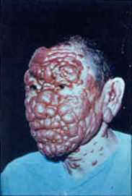
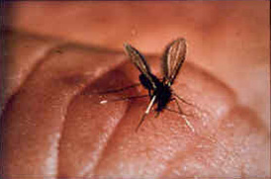
Paromomycin Sulfate
Aminoglycoside antibiotic that is not absorbed from the gastrointestinal tract. (not affected if given orally >>so given IV)
It is used only as a luminal amebicide and has no effect against extraintestinal amebic infections.
Adverse effects
Occasional abdominal distress & diarrhea.
Parenteral (IV) paromomycin is now used
to treat visceral leishmaniasis.
recall Para. MSS
Post-kala-azar dermal leishmaniasis ,
a complication of visceral leishmaniasis.
a sand fly

Slide 20
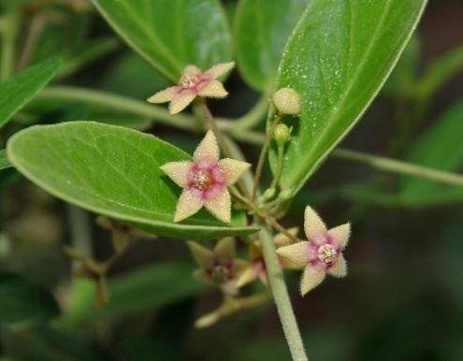
Emetine & Dehydroemetine
Emetine, an alkaloid derived from ipecac (العشبة إللي بالصورة).
Dehydroemetine, a synthetic analog.
Effective against tissue trophozoites of E histolytica,
Their use is limited to severe amebiasis when metronidazole cannot be used.
Used for the minimum period needed to relieve severe symptoms (3–5 days) and should be administered S.C. (preferred) or I.M.
Adverse effects
Pain, tenderness, and sterile abscesses at the injection site; diarrhea, nausea, and vomiting; muscle weakness and discomfort.
Serious toxicities include cardiac arrhythmias, heart failure, and hypotension.
Emetine mediate vomiting (emetic drug )
S.C. =subcutaneous injection slow but long release of drug
IM Intramuscular a fast concentration of the drug in the blood (but brief)

Slide 21
つづく

