Slide 1
ANTHELMINTIC DRUGS
The doctor really just read the slides during the lecture .. I have nth to add except things that would ease the memorization for u ☺

Slide 2
ANTHELMINTIC DRUGS
Albendazole
broad spectrum. drug of choice for hydatid disease & cystecercosis.
also used for (intestinal nematodes) pinworm, hookworm
Mechanism of action:
inhibits microtubule synthesis in nematodes that irreversibly impairs glucose uptake, intestinal parasites are immobilized and die slowly.
orally , absorbed erratically, increased with fatty meal
metabolized in the liver to active metabolite albendazole sulphoxide , half life of 8-12 hours
11
Just for ur Infromation Recall Helminths are parasitic worms hydatid disease is a parasitic disease of tapeworms of theEchinococcus type. Cysticercosis is a parasitic tissue infection caused by larval cysts of the tapeworm Taenia solium .

Slide 3
used on empty stomach for intraluminal parasites but with fatty meal when against tissue parasites.
2. Hydated diseases: drug of choice ,400 mg twice with meals for 1 month
3. Neurocysticercosis: used along with cotricosteroid to decrease the inflammation caused by dying organism
Adverse effects:
short term: use no significant adverse effects.
long term use : abdominal distress, headache ,fever , fatigue, alopecia , increased liver enzymes , pancytopenia. (low level of all blood cells produced by the bone marrow ).
Not given during pregnancy & in hypersensitive people.

Slide 4
ANTHELMINTIC DRUGS
Mebendazole
Pyrantel Pamoate
Piperazine
Niclosamide
Diethylcarbamazine Citrate
Doxycycline
Ivermectin
Bithionol
Praziquantel
Metrifonate
Oxamniquine

Slide 5
ANTHELMINTIC DRUGS | Helminths that work upon
Mebendazole | hook worm, pin worm , ascariasis and trichuriasis
Pyrantel Pamoate | highly effective for pinworm, ascaris & Trichostrongylus orientalis infections and moderately effective against hookworm
Piperazine | Ascariasis only
Niclosamide | tapeworm infections (adult worm but not ova)
Diethylcarbamazine Citrate | for filariasis, Loa loa & tropical eosinophillia
Doxycycline | Wuchereria bancrofti
Ivermectin | onchocerciasis (river blindness) and for strongyloidiasis (flaccid paralysis )
Bithionol | sheep liver fluke (Fasciola hepatica) and lung fluke (Paragonimus westermani
Praziquantel | schistosome infections of all species & most other trematode & cestode infections, including cysticercosis
Metrifonate | Schistosoma haematobium infections.Not active against S mansoni or S japonicum
Oxamniquine | S mansoni infections. Not effective against S haematobium or S japonicum
Check this out AFTER finishing the rest of slides

Slide 6
Mebendazole
has wider spectrum and is more safe than albendazole
Mechanism of action:
inhibits microtubule synthesis, irreversibly impairs glucose uptake. Intestinal parasites are immobilized & die slowly.
kills hook worm, pin worm , ascariasis and trichuriasis.
Less than 10% of drug is absorbed
Absorption increases with fatty meal.converted to inactive metabolites rapidly in liver. half life of 2-6 hours
Given orally before or after meals, tablets should be chewed before swallowing.
Adverse effects and precautions:
short term therapy. Mild GI disturbance.
high dose Hypersensitivity reactions, agranulocytosis (rare) , alopecia ,elevation of liver enzymes .
13 caution under 2ys of age may cause convulsion.

Slide 7
Pyrantel Pamoate
Broad-spectrum antihelminthic, highly effective for pinworm, ascaris & Trichostrongylus orientalis infections and moderately effective against hookworm.
A neuromuscular blocker, causes paralysis of worms, which is followed by expulsion.
Effective in intestinal tract, not in the tissues or the ova
Given orally once with or without food.
For pinworm, the dose is repeated in 2 weeks.
For ascariasis, a single dose be repeated if eggs are found 2 weeks after treatment.
For hookworm, a single dose is effective against light infections. In heavy infections, a 3-day course.
A course of treatment can be repeated in 2 weeks.

Slide 8
Piperazine
Only recommended for the treatment of ascariasis.
Causes paralysis of ascaris by blocking ACh at the myoneural junction.
live worms are expelled by normal peristalsis.
readily absorbed orally and excreted unchanged in urine.
Given orally once daily for 2 days.
For heavy infections treatment is repeated after 1 wk.
Adverse effects: generally mild (5–30%)
nausea, vomiting, diarrhea, abdominal pain, dizziness, & headache.
Neurotoxicity & allergic reactions are rare.

Slide 9
Niclosamide
Used for the treatment of most tapeworm infections.
Niclosamide is a salicylamide derivative.
Minimally absorbed from the GIT.
Adult worms (but not ova) are rapidly killed, due to inhibition of oxidative phosphorylation or stimulation of ATPase activity.
Clinical Uses
2 g once, given in the morning on an empty stomach.
The tablets must be chewed thoroughly and then
swallowed with water. Purgative needed(بحتاج مُسهِّل ).
Adverse effects:
Mild ,infrequent and transitory GI disturbance

Slide 10
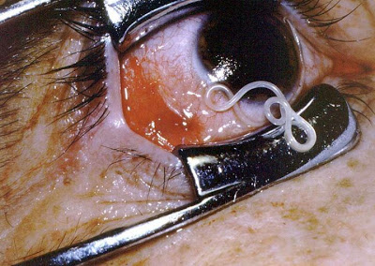
Diethylcarbamazine Citrate
Drug of choice for filariasis, Loa loa &
tropical eosinophillia.
Rapidly absorbed from gut, half life of 2-3 hours , excreted in urine unchanged.
Mechanism of action:
immobilizes microfilariae and alters its surface structure ,making them susceptible to destruction by host defense mechanism
Microfiliariae are rapidly killed .adult worms are killed slowly requiring several course of treatment
The mode of action against adult worms is unknown.

Slide 11
Adverse Reactions
generally mild and transient, include headache, malaise, anorexia, weakness, nausea, vomiting, and dizziness.
Adverse effects also occur as a result of the release of proteins from dying microfilariae or adult worms. Reactions include fever, malaise, papular rash, headache, gastrointestinal symptoms, cough, chest pain, and muscle or joint pain.
Leukocytosis is common (white blood cell count above the normal range in the blood).
Eosinophilia (abnormally high amounts of eosinophils).
Proteinuria may also occur.
Caution when using diethylcarbamazine in patients with hypertension or renal disease.

Slide 12
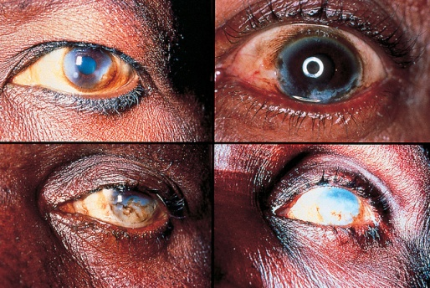
Doxycycline: is an Antibiotic of tetracycline groups , Broad spectrum .. They work on Helminths ,too.
Doxycycline
Has macrofilaricidal activity against Wuchereria bancrofti (lymphatic filariasis), and better activity than any other available drug against adult worms.
Active also against onchocerciasis
(river blindness)
Doxycycline acts indirectly, by killing Wolbachia, an intracellular bacterial symbiont of filarial parasites. (so it kills a bacteria In the microfilaria that cause its death -may be this bac. Is part of its flora- )
It may be used for filariasis, both for treatment of active disease and in mass chemotherapy campaigns.

Slide 13
Ivermectin
Drug of choice for the treatment of onchocerciasis
(river blindness) and for strongyloidiasis.
Strongyloidiasis:
A GABA agonists Paralyzes nematodes, causing a flaccid paralysis in the worm. Does not cross the blood brain barrier in humans (therefore little CNS effects). -but if someone has Meningitis for example it then can cross it-
Onchocerciasis:
Microfilaricidal. It does not kill adult worms but blocks the release of microfilariae.
After a single dose, microfilariae in the skin diminish rapidly within 2–3 days .
Microfilariae in the anterior chamber of the eye decrease slowly over months. Repeated doses have a low macrofilaricidal action and permanently reduce microfilarial production.

Slide 14
Adverse Reactions:
In strongyloidiasis:
fatigue, dizziness, nausea, vomiting, abdominal pain, and rashes.
In onchocerciasis
Occurs in 5–30% ,generally mild due to the killing of microfilariae.
A more intense reaction in 1–3%
A severe reaction in 0.1%, including high fever, hypotension, and bronchospasm.
Swellings and abscesses occasionally occur at 1–3 weeks at sites of adult worms.
Corneal opacities & eye lesions may develop several days after treatment.

Slide 15
Bithionol
the drug of choice in the treatment of sheep liver fluke (Fasciola hepatica) and the second drug of choice in lung fluke (Paragonimus westermani ).
Mechanism of action:
Unknown, bithionol may work may uncoupling oxidative phosphorylation, thus reducing the production of ATP in the helminthes.
Adverse Reactions:
generally mild (40% of patients) and include:
diarrhea, abdominal cramps, anorexia, nausea, vomiting, dizziness, and headache.
Skin rashes may occur, a reaction to antigens released from dying worms.

Slide 16
The doctor told us a story about Bithionol
Discovery : there was a zoo keeper who owned two Bengal tigers that died because of Paragonimus westermani fluke *before discovering them *.. He wanted to know what killed his tigers He took a biopsy from them ,examine them & discover this fluke .. So it was named after him.. westermani

Slide 17
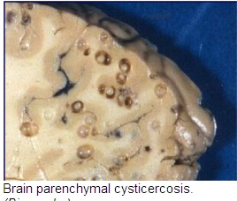
Praziquantel
Effective in schistosome infections of all species & most other trematode & cestode infections, including cysticercosis.
safe and effective as a single oral dose.
Useful in mass treatment of several infections.
Plasma concentrations of praziquantel increase when the drug is taken with a high-carbohydrate meal.
It increases the permeability of cell membranes to calcium, resulting in paralysis,
dislodgement, and death.
Mild and transient adverse effects,
except for Neurocysticercosis
due to inflammatory reactions
around dying parasites.

Slide 18
Metrifonate
Safe, low-cost alternative drug for Schistosoma haematobium infections.
Not active against S mansoni or S japonicum.
Organophosphate cholinesterase inhibitor temporarily paralyzes the adult worms, resulting in their shift from the bladder venous plexus to small arterioles of the lungs, where they are trapped, encased by the immune system, and die.
Given three times orally at 14-day
intervals.
A prophylactic agent when given
monthly to children
Used in mass treatment programs.

Slide 19
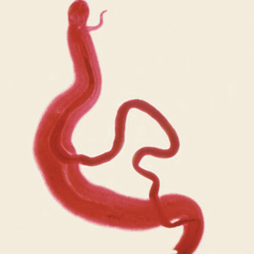
Oxamniquine
Alternative to praziquantel for the
treatment of S mansoni infections.
Used extensively for mass treatment.
Not effective against S haematobium or S japonicum.
Active against both mature and immature stages.
The mechanism of action is unknown.
Contraction and paralysis of the worms results in detachment from terminal venules in the mesentery and transit to the liver, where many die.
Surviving females return to the mesenteric vessels but cease to lay eggs.
In mixed schistosome infections, it has been used in combination with metrifonate.

