Slide 1
Pituitary Gland.

Slide 2
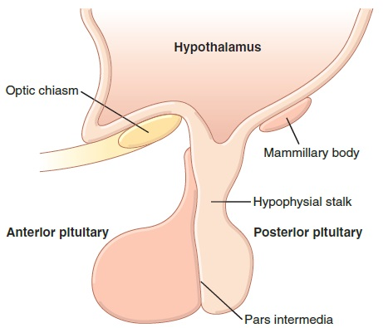
Overview

Slide 3
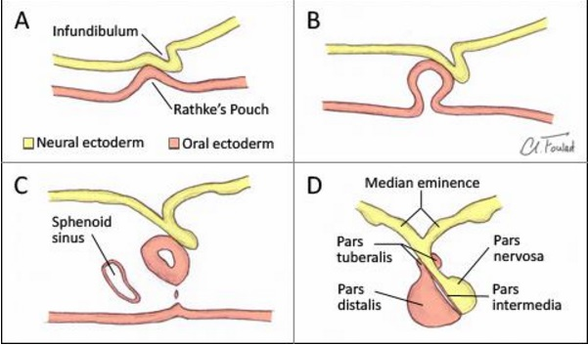
Quick Embryology

Slide 4
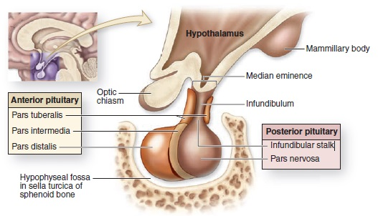
Quick Anatomy

Slide 5
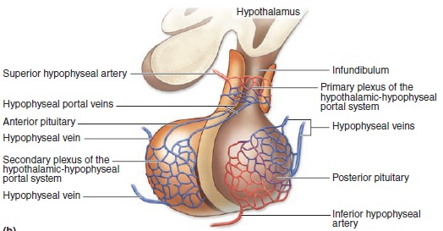
Superior hypophysial artery: Infundibulum stalk, median eminence, and adenohypophysis. (hypothalamic-hypophyseal portal system).
Inferior hypophysial artery: neurohypophysis.

Slide 6
Physiology and Histology
Let’s start with the Anterior Pituitary:
Six hormones get released; which are:
Growth Hormone (GH)
Prolactin (PRL)
Adrenocorticotropin Hormone (ACTH)
Thyroid-Stimulating Hormone (TSH)
Luteinizing Hormone (LH)
Follicle-Stimulating Hormone (FSH)

Slide 7
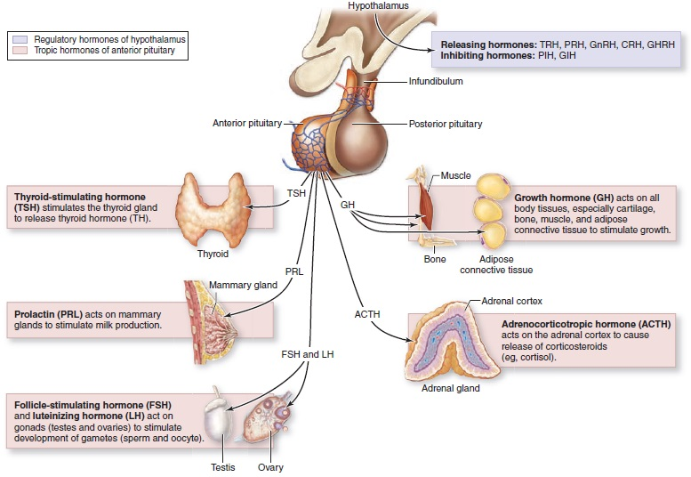

Slide 8
But from what cells?
Chromophils:
Acidophils (pink):
Somatotrophs: GH
Lactotrophs: PRL
Basophils (blue):
Gonadotrophs: FSH, LH
Thyrotophs: TSH
Corticotrophs: ACTH
Chromophobes:

Slide 9
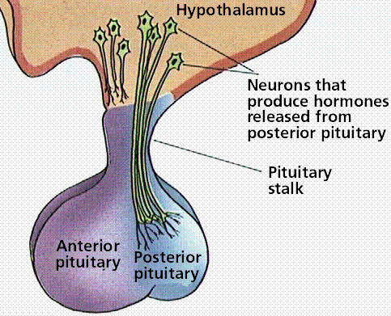
Hypothalamus Job

Slide 10
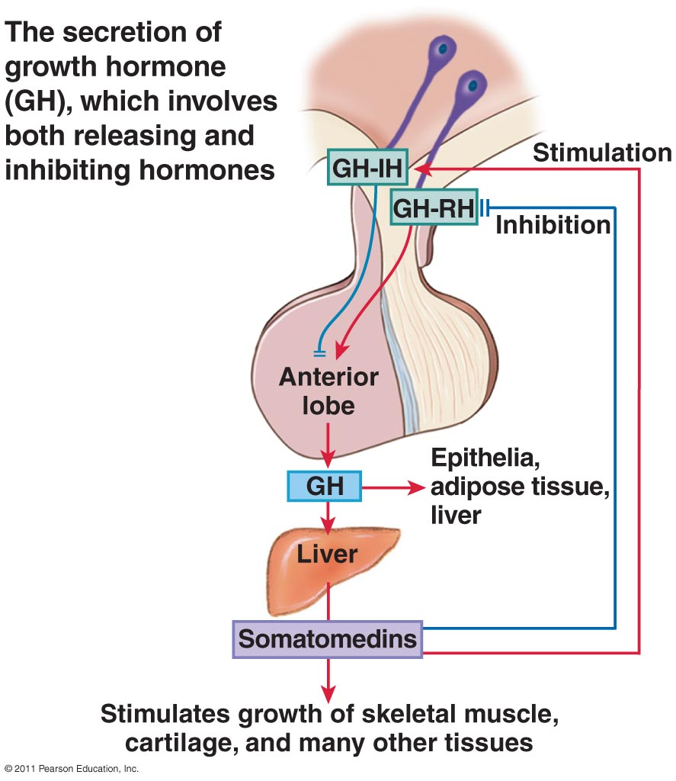
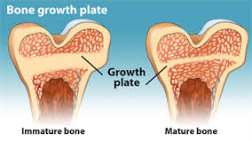
Growth Hormone Effects
Somatomedins
Fats and energy
Amino acids and proteins (anabolism & catabolism)
Bone
The abnormal

Slide 11
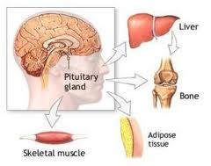

Slide 12
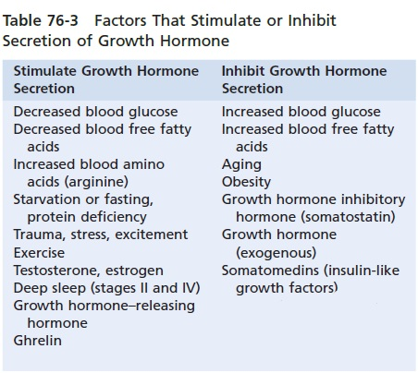

Slide 13
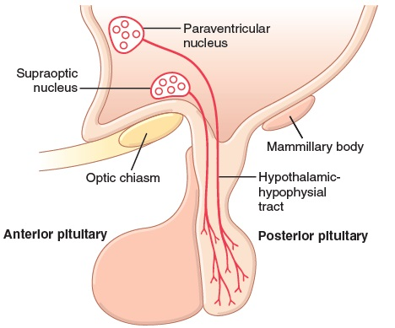
Let’s move on into the posterior pituitary:

Slide 15
Secretion of two hormones:
ADH:
Function on the kidney
And the function on the vascular smooth muscle
Oxytocin:
Contraction of the pregnant uterus
Milk ejection by the breasts

Slide 16
Some Clinical Cases
Panhypopituitarism: decreased secretion of all of the pituitary gland hormones.
Gigantism: before puberty, diabetes, probably tumor so it might kill you.
Acromegaly: after puberty, bones of the face and hands. Soft tissues.
the African pygmy and the Lévi-Lorain dwarf

