Slide 1
Medical Microbiology Respiratory System - Pneumonia Staphylococcal Pneumonia
Dr. Sameer Naji, MB, BCh, PhD (UK)
Dean Assistant
Head of Basic Medical Sciences Dept.
Faculty of Medicine
The Hashemite University

Slide 2
Definition of Pneumonia
An acute infection of the pulmonary parenchyma that is caused by bacteria, viruses, fungi, or parasites. It is characterized primarily by inflammation of the microscopic air sacs (alveoli). The air sacs may fill with fluid or pus (purulent material), causing cough with phlegm (sputum) or pus, fever, chills, and difficulty breathing, accompanied by an acute infiltrate on CXR or auscultatory findings consistent with pneumonia
Pneumonia can range in seriousness from mild to life-threatening. It is most serious for infants and young children, people older than age 65, and people with health problems or weakened immune systems

Slide 3
Classification
I. Etiology
A. Bacterial Causes:
Gram-positive organisms
Streptococcus
Staphylococcus
Gram-negative organisms
Haemophilus influenzae
Klebsiella
Pseudomonas aeruginosa
Moraxella catarrhalis
Escherichia coli
Serratia species
Enterobacter species
Acinetobacter species

Slide 4
B. Atypical organisms
Mycoplasma pneumoniae
Legionella pneumophila
Chlamydia psittaci
Chlamydia pneumoniae
C. Anaerobic bacterial infections
Peptostreptococcus species
Bacteroides melaninogenicus
Fusobacterium necrophorum
Bacteroides asaccharolyticus
Porphyromonas endodontalis
Porphyromonas gingivalis

Slide 5
D. Viral causes
Influenza virus
Para-influenza virus
Respiratory syncytial virus
Corona virus (SARS)
MERS
Human metapneumovirus

Slide 6
E. Other causes
Rickettsial infections
Varicella
Rubella
Aspiration pneumonitis
Lipoid pneumonitis
Pneumocystis Jeruvici (carinii)
Cytomegalovirus
Tuberculosis
Fungal infections

Slide 7
II. Variants
• Community-acquired pneumonia (CAP)
• Nursing home–acquired pneumonia
• Nosocomial pneumonia (Hospital-acquired pneumonia)
when patient was hospitalized with any another diagnosis, and after 48 hours in the hospital (not earlier!) pneumonia was diagnosed, or pneumonia after artificial lung ventilation (Ventilator-associated pneumonia)
• Pneumonia due to aspiration. It results from the aspiration of gastric contents in addition to aspiration of upper respiratory flora in secretions.
• Pneumonia in immunocompromised host – patients with AIDS or immunodeficit of other origin. Causes of pneumonia – viruses, fungi of saprofites (E. coli etc.)

Slide 8
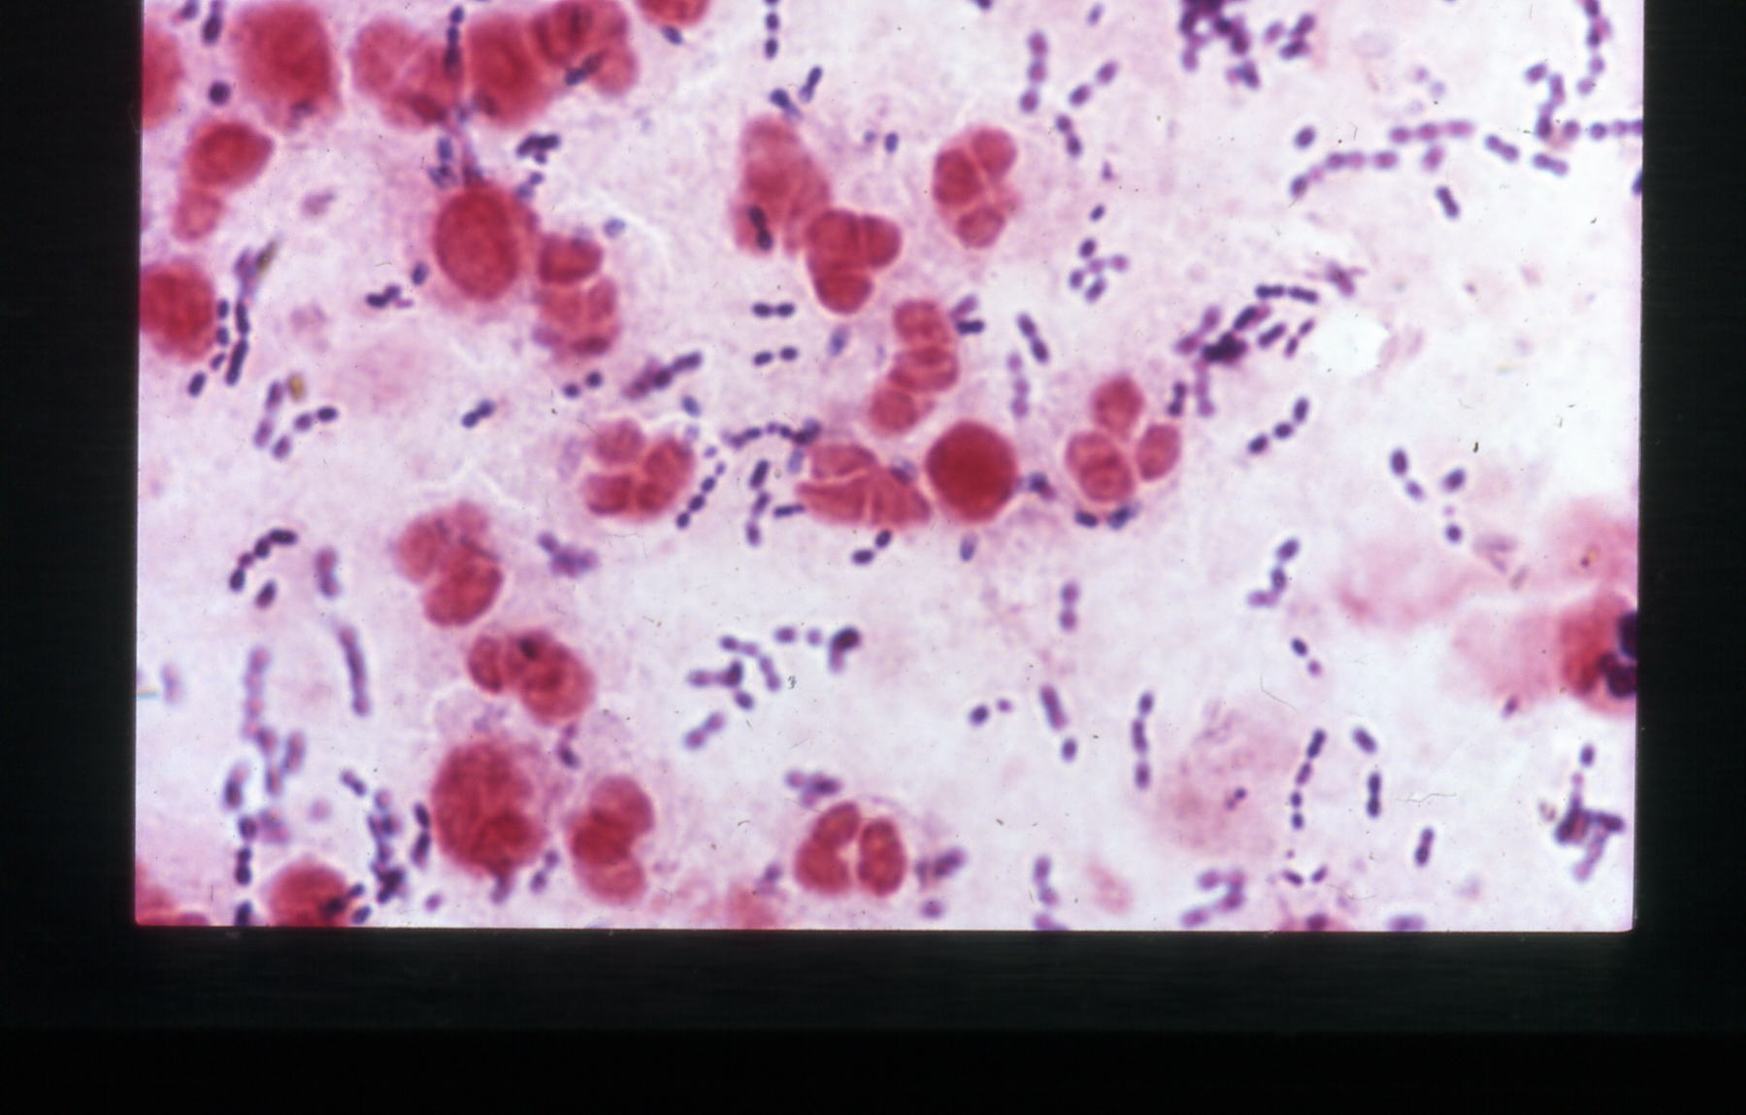

Slide 9
Pneumonia: infecting organisms in approximate descending order of frequency
Community acquired
Streptococcus pneumoniae
Mycoplasma pneumoniae
Influenza virus A
Haemophilus influenzae
Legionella pneumophila
Staphylococcus aureus
Coxiella burneti
Chlamydia psittaci
Hospital acquired
Gram-negative bacilli
Staphylococcus aureus (+MRSA)
Streptococcus pneumoniae
Legionella pneumophila
Haemophilus influenzae
Pseudomonas spp
Acinetobacter species
Klebsiella pneumoniae
Serratia marcescens
Immunocompromised patients
Pneumocystis carinii
Cytomegalovirus
Mycobacterium avium-intracellulare
Mycobacterium tuberculosis
Streptococcus pneumoniae
Haemophilus influenzae
Legionella pneumophila
Actinomyces israelii
Aspergillus fumigatus
Nocardia asteroides

Slide 10
Risk Factors for pneumonia
age
alcoholism
smoking
asthma
immunosuppression
institutionalization
COPD
PVD
Dementia

Slide 11
Risk Factors for Mortality
age
bacteremia (for S. pneumoniae)
extent of radiographic changes
degree of immunosuppression
amount of alcohol

Slide 12
Clinical manifestations
Shaking chills
Rapidly rising fever ( 39.5 to 40.5 degree)
Stabbing chest pain aggravated by respiration and coughing
Tachypnea, nasal flaring
Patient is very ill and lies on the affected side to decrease pain
Use of accessory muscles of respiration e.g. abdomen and intercostals muscles
Cough with purulent, blood tinged, rusty sputum
Shortness of breath
Flushed cheeks
Loss of appetite, low energy, and fatigue
Cyanosed lips and nail beds
Diarrhea (Legionella)
URI, sinusitis (Mycoplasma)

Slide 13
Diagnostic Tests
History taking
Physical examination
Chest x-ray
Blood test
Gram Stain and Sputum culture
Blood Culture
Antigen Tests

Slide 14
Gram's Stain and Culture of Sputum
a sputum sample must have >25 neutrophils and <10 squamous epithelial cells per low-power field
sensitivity / specificity of the sputum Gram's stain and culture are highly variable
in cases of proven bacteremic pneumococci, the yield of positive cultures from sputum samples is 50%
Some patients, particularly elderly individuals, may not be able to produce an appropriate expectorated sputum sample.
The inability to produce sputum can be a consequence of dehydration, and the correction of this condition may result in increased sputum production and a more obvious infiltrate on radiography
For patients admitted to the ICU and intubated, a deep-suction aspirate or BAL (Bronchoalveolar lavage sample)

Slide 15
Blood Culture
The yield from blood cultures, even those obtained before antibiotic therapy, is disappointingly low. Only ~5–14% of cultures of blood from patients hospitalized with CAP are positive
The most frequently isolated pathogen is S. Pneumoniae
Since recommended empirical regimens all provide pneumococcal coverage, a blood culture positive for this pathogen has little effect on clinical outcome, susceptibility data may allow a switch from a broader-spectrum regimen to penicillin in appropriate cases
Because of 1) the low yield and 2) the lack of significant impact on outcome, blood cultures are no longer considered de rigueur Necessary) for all hospitalized CAP patients

Slide 16
should have blood cultured :
neutropenia secondary to pneumonia
Asplenia
complement deficiencies
chronic liver disease
severe CAP

Slide 17
Antigen Tests
Two commercially available tests detect
pneumococcal
certain Legionella antigens in urine
The test for Legionella pneumophila detects only serogroup 1, but this serogroup accounts for most CAP cases of Legionnaires'
The sensitivity and specificity of the Legionella urine antigen test are as high as 90% and 99%
The pneumococcal urine antigen test is also quite sensitive and specific 80% and >90%. False-positive results can be obtained with samples from colonized children, but the test is reliable
Both tests can detect antigen even after the initiation of appropriate antibiotic therapy and after weeks of illness
Other antigen tests include a rapid test for influenza virus and direct fluorescent antibody tests for influenza virus and RSV, the test for RSV is only poorly sensitive

Slide 18
Polymerase Chain Reaction
PCR tests are available for a number of pathogens, including :
L. Pneumophila
Mycobacteria
A multiplex PCR can detect the nucleic acid of
Legionella spp.
M. Pneumoniae
C. pneumoniae

Slide 19
STAPHYLOCOCCAL PNEUMONIA
Definition
Pneumonia caused by Staphylococcus aureus, serious and rapidly progressive infection, less frequent than viral or pneumococcal pneumonia
Staphylococcal pneumonia appears to be increasing in frequency and is a particularly important problem in early infancy when the disease tends to be specially severe and may prove fatal. Only early recognition and prompt treatment can reduce the high mortality rate in this age group

Slide 20
Epidemiology
preceded by a viral upper respiratory tract infection.
30% of all patients are younger than 3 months
70% are younger than 1 yr.
Boys are affected more commonly than girls.
Pneumonia due to S. aureus may be
primary (hematogenous) secondary to septic emboli, right-sided endocarditis, or the presence of intravascular devices, or
secondary after a viral infection such as influenza
Inhalation pneumonia is caused by alterations of mucociliary clearance, leukocyte dysfunction, or bacterial adherence initiated by a viral infection

Slide 21
Pathogenesis
it causes confluent bronchopneumonia
often unilateral or more prominent on one side than the other
extensive areas of hemorrhagic necrosis and irregular areas of cavitation.
The pleural surface is covered by a thick layer of exudate.
Numerous abscesses occur, containing clusters of staphylococci, leukocytes, erythrocytes, and necrotic debris.
Rupture of a small subpleural abscess may result in pyopneumothorax, which may erode into a bronchus, producing a bronchopleural fistula.

Slide 22
Clinical Manifestations
Infants younger than 1 year are commonly affected
history of an upper respiratory tract infection for several days to 1 wk.
A rapid progression of symptoms is characteristic.
onset with high fever, cough, and evidence of respiratory distress.
Signs and symptoms
tachypnea, grunting respirations, sternal and subcostal retractions, nasal flaring, cyanosis, and anxiety.
lethargic , irritable and toxic.
may develop severe dyspnea and a shocklike state.
gastrointestinal disturbances, = vomiting, anorexia, diarrhea, and abdominal distention secondary to a paralytic ileus.

Slide 23
Diagnosis
Recognizing early staphylococcal pneumonia in infants is often difficult.
Abrupt onset and rapid progression of symptoms of pneumonia in infants should be considered to be due to staphylococci until proved otherwise.
A history of furunculosis, a recent hospital admission, or maternal breast abscess should also alert physicians to the possibility of this diagnosis.
Other bacterial pneumonias that cause empyema or pneumatoceles and thus may be confused with staphylococcal disease include S. pneumoniae, group A Streptococcus,
Klebsiella, H. influenzae (both type b and nontypable), and primary tuberculous pneumonia with cavitation.

Slide 24
LABORATORY FINDINGS
Leukocytosis, increase primarily among the (WBCs) polymorphonuclear cells.
Mild to moderate anemia is common.
cultures -obtained by tracheal aspiration or pleural tap
Gram stain reveals gram-positive cocci in clusters
The finding of staphylococci in the nasopharynx is of no diagnostic value
blood cultures may be positive
Pleural fluid reveals an exudate with polymorphonuclear cell counts of 300-100,000/mm3 , protein above 2.5 g/dL, and a low glucose concentration.

Slide 25
Treatment
Antibiotics, a semisynthetic, penicillinase-resistant penicillin should be administered intravenously immediately after cultures are obtained (Cloxacillin, 100 mg/kg/24 hrs for 4 to 6 weeks), initially IV and when tolerates oral change to tablets. Infant can be given tablet after making it powder mix with honey)
drainage of collections of pus
should be given oxygen and placed in a semireclining position to relieve cyanosis and anxiety.
intravenous hydration and nutrition
Assisted ventilation may be needed
Pleural tap even if only a small empyema is present, in order to reduce the chance of bronchopleural fistula
Generally, pus reaccumulates so rapidly and becomes so viscous or loculated that closed drainage with a chest tube of the largest possible caliber is required

Slide 26
Complications
empyema,
pyopneumothorax,
pneumatoceles
they are considered part of the natural course of the illness
and not complications.
Septic lesions outside the respiratory tract = pericarditis, meningitis, osteomyelitis, and metastatic abscesses in soft tissue
Prognosis
mortality still ranges from 10-30%, Factors :
the length of illness before hospitalization
age of the patient,
adequacy of therapy,
the presence of other illness or complications

