Slide 1
RBC disorders 2 Anemia of diminished production
Ahmad T. Mansour, MD

Slide 2
Iron deficiency anemia
Anemia of chronic disease
Megaloblastic anemia
Others
anemia in liver disease
anemia in renal disease
aplastic anemia
myelophthisic anemia

Slide 3
All of the following can be found in iron deficiency anemia, except:
Low ferritin
Low serum iron
Low TIBC
Low transferrin saturation
Low MCV

Slide 4
Anemia of chronic disease is caused by elevated levels of:
Hepcidin
Iron
C. Ferritin
D. B12
E. neutrophils

Slide 5
3. All of the following are true regarding megaloblastic anemia, except:
A. defective DNA synthesis, resulting in nuclear immaturity
B. macrocytic anemia
C. can be seen in the setting of pernicious anemia
D. most common cause is nutritional deficiency of B12
E. can be associated with neurological symptoms in the case of B12 deficiency.

Slide 6
4. The most common cause of anemia in patients with liver disease is:
Iron deficiency
Hypersplenism
Therapy related hemolytic anemia
Therapy related suppression of EPO receptor
Alcoholic-cirrhosis-induced folate deficiency

Slide 7
5. One of the following can cause myelophthisic anemia:
Tuberculosis
B12 deficiency
Folate deficiency
Iron deficiency
Anemia of chronic disease.

Slide 9
Transferrin is the major transport protein in plasma and is normally one third occupied.
Plasma ferritin is derived largely from the storage pool of body iron; its levels correlate well with body iron stores, if total iron is decreased ferritin will be low, and vice versa.

Slide 10
Iron balance is maintained through absorption, excretion is limited to 1-2mg/day through shedding of mucosal cells.

Slide 12
Iron deficiency anemia
Deficiency of iron is the most common nutritional disorder in the world and results in clinical signs and symptoms that are mostly related to inadequate hemoglobin synthesis.

Slide 13
Iron deficiency can result from
(1) dietary
(2) impaired absorption,
(3) increased requirement,
(4) chronic blood loss.

Slide 14
Question time!!!
Which clinical scenario is more serious
A 19 year old lady, with sever menorrhagia presenting with shortness of breath on exertion, fatigue, pallor and a hemoglobin of 7.6g/dl, low MCV
A 79 year old asymptomatic gentleman who, on routine check up, was found to have a hemoglobin of 11g/dl and low MCV

Slide 15
Think of anemia as you think of fever!!!

Slide 16
pathogenesis
Negative iron balance due to any reason
Compensation by storage iron
Progressive deficiency until complete depletion
Anemia develops accompanied by low ferritin and low transferrin saturation

Slide 17
morphology

Slide 18
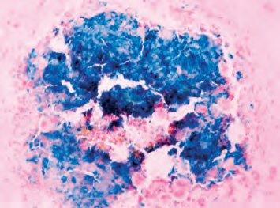

Slide 19
Clinical presentation
Symptoms and signs of anemia

Slide 20
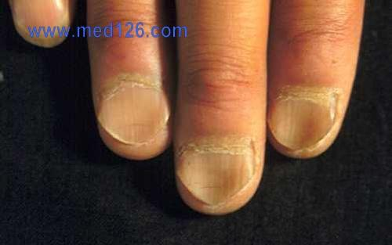
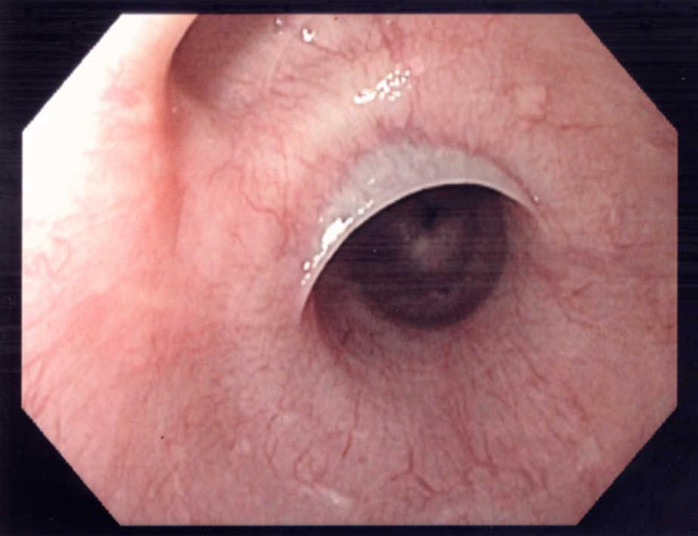

Slide 21
Lab findings
Low hemoglobin and hematocrit
Low MCV
Low MCH
Low iron levels
Low ferritin
High TIBC
High RDW
Low hepcidin
Low transferrin saturation

Slide 22
Treat by iron supplementation and treating the underlying cause.

Slide 23
Anemia of chronic disease
Anemia of chronic disease is impaired red cell production associated with chronic diseases that produce systemic inflammation
The most common cause of anemia among hospitalized patients
Examples include chronic microbial inflammation, autoimmune inflammation, and malignancy.

Slide 24
IL6 results in increased hepcidin

Slide 25
Starves the EP cells of iron.
Inhibits erythropoietin and subsequently decreases EP proliferation
Possible immunologic role for hepcidin

Slide 26
Clinical presentation
Mild anemia
Signs and symptoms of underlying disease

Slide 27
Lab findings
Low HB and Hct
Can be hypochromic microcytic or normochromic normocytic.
High ferritin and low TIBC (exactly opposite to iron deficiency anemia)

Slide 28
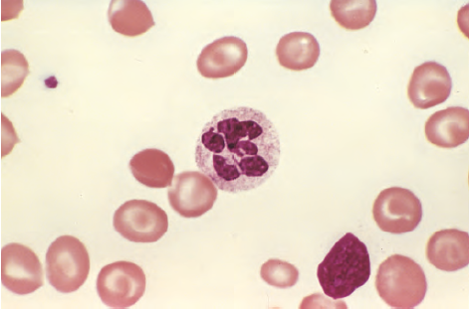
Megaloblastic anemia
Vitamin B12 or folate deficiency

Slide 29
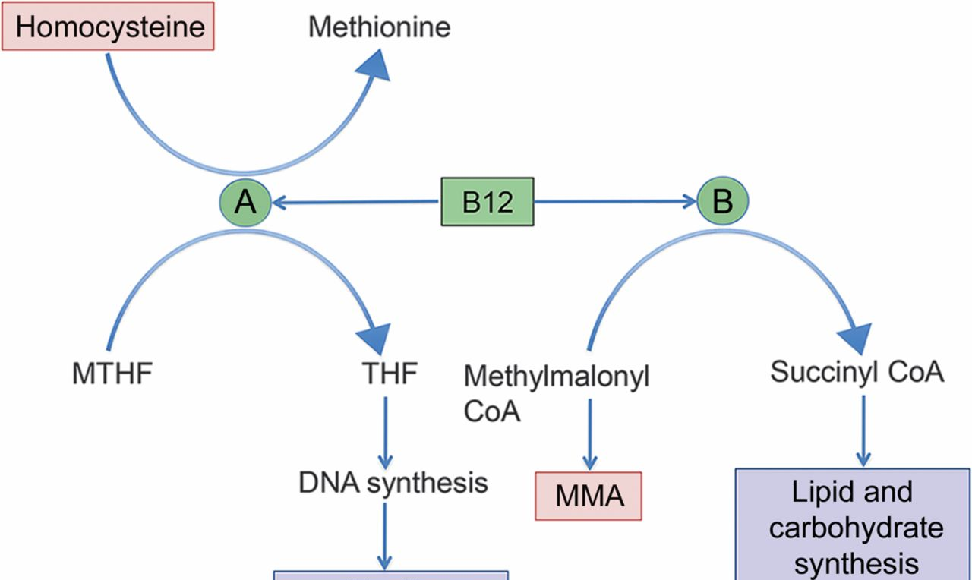
Biochemical role of B12
Two reactions

Slide 32
Pernicious anemia
Autoimmune attack on gastric mucosa.
three types of antibodies
1-parietal canalicular antibodies
2-blocking antibodies
3-intrinsic factor–B12 complex antibodies

Slide 33
Clinical manifestations
Related to anemia similar to those found in folate deficiency
Additionally, leukopenia with hypersemented neutrophils can be seen
Neurological symptoms:
Numbness
Unsteady gate
Loss of position sense
Increase risk of malignancy in patient with pernicious anemia

Slide 34
Folate

Slide 36
Clinical manifestations
Nonspecific symptoms of anemia, weakness, fatigue…etc
GI symptoms due to the effect on GI epithelial lining cells.
NO neurological symptoms
Diagnose by serum and RBC folate levels.

Slide 37
Anemia in liver disease
Multiple etiologies:
Iron deficiency is the most common
Hypersplenism
Therapy related hemolytic anemia and suppression of EPO receptor
Alcoholic-cirrhosis-induced folate deficiency

Slide 38
Spur cells

Slide 39
Anemia of renal disease
Most commonly a normochromic normocytic anemia
Related to decrease EPO production by the damaged kidney.
High levels of inflammatory cytokines
Hemolysis
Chronic bleeding
Folate deficiency in patients on dialysis.

Slide 40
ecchinocytes

Slide 41
Aplastic anemia
Aplastic anemia refers to a syndrome of chronic primary hematopoietic failure and attendant pancytopenia (anemia, neutropenia, and thrombocytopenia)

Slide 43
Fanconi anemia is an autosomal recessive disease characterized by a defect in the mutliprotein complex that is required for DNA repair.

Slide 44
Pathogenesis of aplastic anemia

Slide 45
Morphology

Slide 46
Clinical features
Any age with no gender predilection
Stigmata of pancytopenia
Normocytic and occasionally macrocytic anemia.
No splenomegaly
No increased reticulocyte count
Bone marrow exam is a must for diagnosis
Respond well to immunosuppressive therapy, BM transplantation is the treatment of choice with 5 year survival of more than 75%.

Slide 47
Myelophthisic anemia
Extensive infiltration of the marrow by tumors or other lesions.
Metastatic cancer (lung, breast, prostate)
Tuberculosis
Lipid storage disorders
Osteoscelrosis
Leukoerythroblastic reaction on peripheral blood.

Slide 48
1
3
2
1-tear drop RBC
2-immature erythroid precursor cell
3-immture myeloid cell

Slide 49
Patients present with anemia and thrombocytopenia
WBC are usually less affected.
Treatment is directed at the underlying etiology.

Slide 50
All of the following can be found in iron deficiency anemia, except:
Low ferritin
Low serum iron
Low TIBC
Low transferrin saturation
Low MCV

Slide 51
Anemia of chronic disease is caused by elevated levels of:
Hepcidin
Iron
C. Ferritin
D. B12
E. Neutrophils

Slide 52
3. All of the following are true regarding megaloblastic anemia, except:
A. defective DNA synthesis, resulting in nuclear immaturity
B. macrocytic anemia
C. can be seen in the setting of pernicious anemia
D. most common cause is nutritional deficiency of B12
E. can be associated with neurological symptoms in the case of B12 deficiency.

Slide 53
4. The most common cause of anemia in patients with liver disease is:
Iron deficiency
Hypersplenism
Therapy related hemolytic anemia
Therapy related suppression of EPO receptor
Alcoholic-cirrhosis-induced folate deficiency

Slide 54
5. One of the following can cause myelophthisic anemia:
Tuberculosis
B12 deficiency
Folate deficiency
Iron deficiency
Anemia of chronic disease.

Slide 55
THANK YOU

