Slide 1
Repair 3 and amyloidosis
Dr Heyam awad
FRCPath

Slide 2
wound healing
1. first intention
2. second intention

Slide 3
wound healing
Healing by first intention (primary union)
- healing of a clean, uninfected surgical incision approximated by surgical sutures
focal disruption of epithelial basement membrane continuity so.. A small scar is formed, with minimal wound contraction
- epithelial regeneration is the principal mechanism of repair

Slide 4
Healing by second intention or second Union
- tissue loss is extensive, e:g in large wounds, abscess , or ulceration
- The repair process is more complex and involves a combination of regeneration and scarring.

Slide 5
Healing by secondary union is characterized by
1. Intense inflammation
2.Abundant granulation tissue,
3. Formation of a large scar,
4. wound contraction mediated by myofibroblasts

Slide 6
Wound contraction
Within 6 weeks, large skin defects may be reduced to 5% to 10% of their original size.

Slide 7
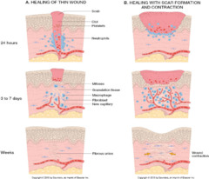

Slide 8
Wound strength
-sutured wounds= 70% of normal skin strngth due to the sutures.
-At 1 week (sutures removed) .. 10% of normal.
- strength then increases as a result of collagen synthesis exceeding degradation during the first 2 months and by structural modification of collagen.
- maximum strength reached: 70% to 80% of normal by 3 months .

Slide 9
amyloidosis
a condition associated with a number of inherited, neoplastic and inflammatory disorders.

Slide 10
deposition of extracellular fibrillar proteins
These abnormal fibrils are produced by the aggregation of misfolded proteins (which are soluble in their normal folded configuration).

Slide 11
Amyloid is deposited in the extracellular space in various tissues and organs of the body
These fibillary proteins are responsible for tissue damage and functional compromise

Slide 12
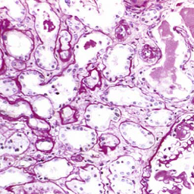
Amyloid stained by Congo red under light microscope

Slide 13
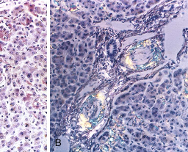
Amyloid stained by Congo red under polarizing microscope

Slide 14
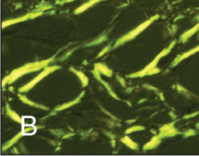
Congo red stain

Slide 15
By electron microscope
All types of amyloid consist of continuous, non-branching fibrils with a diameter of approximately 7.5 to 10 nm. With a cross-β-pleated sheet conformation

Slide 16
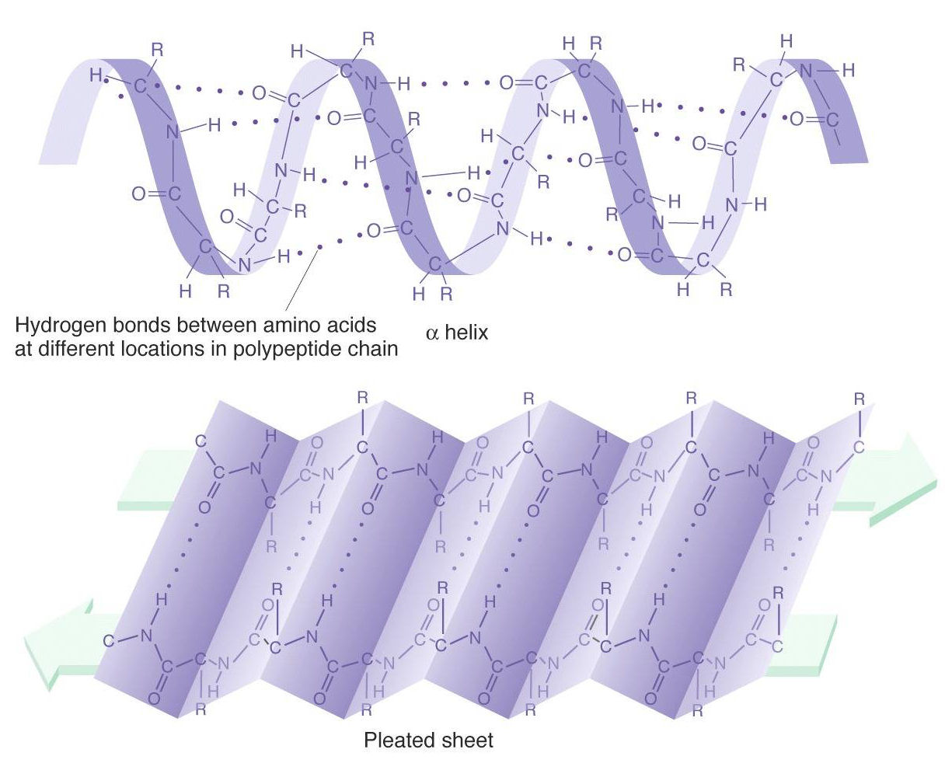

Slide 17
Chemical Properties of Amyloid Proteins
Amyloid is not a single chemical entity.
Primary and secondary amyloidosis.

