Slide 1
Diseases of the respiratory system lecture 5
Dr Heyam Awad
FRCPath

Slide 2
Restrictive lung diseases
- Are a group of disorders characterized by bilateral, patchy, chronic involvement of the lung connective tissue, mainly the interstitium in the alveolar walls.
- The hallmark feature of these disorders is reduced compliance (i.e., more pressure is required to expand the lungs because they are stiff), which in turn necessitates increased effort of breathing (dyspnea).
- Chest radiographs show diffuse infiltration by small nodules, irregular lines, or "ground-glass shadows

Slide 3
- With progression, patients can develop respiratory failure, and pulmonary hypertension and cor pulmonale
- Advanced forms of these diseases may be difficult to differentiate because they result in scarring and gross destruction of the lung, referred to as "honeycomb" lung.

Slide 4
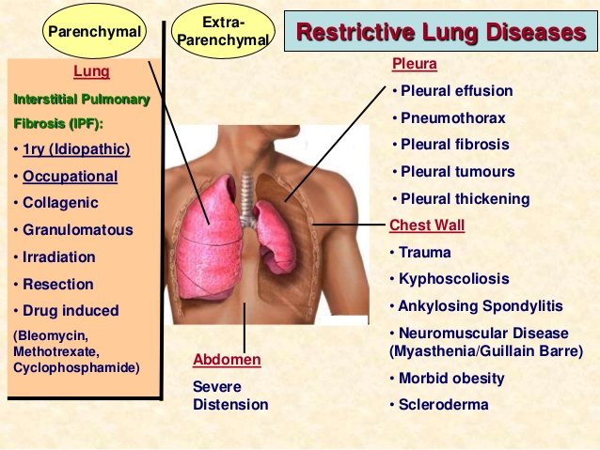
Restrictive lung diseases
Can be due to chest

Slide 5
NOTE: ARDS is an acute restrictive lung disease

Slide 6
Restrictive lung diseases of primary lung etiology
I. Granulomatous diseases : mainly sarcoidosis
2. Fibrosing diseases
2a. IPF
2b. Nonspecific interstitial pneumonia
2c. Cryptognic organizing pneumonia
2d. Pneumoconioses
2e. Drug and radiation induced fibrosis

Slide 7
IPF
= Idiopathic pulmonary fibrosis, Also known as cryptogenic fibrosing alveolitis, refers to a pulmonary disorder of unknown etiology.
- It is characterized by patchy but progressive bilateral interstitial fibrosis, which in advanced cases results in severe hypoxemia and cyanosis.

Slide 8
IPF
- Males are affected more often than females,
- Two thirds of patients are older than 60 years of age at presentation.
- The radiologic and histologic pattern of fibrosis is referred to as usual interstitial pneumonia (UIP), which is required for the diagnosis of IPF. However, similar pathologic changes are present in well-defined entities such as asbestosis and the collagen vascular diseases.
- Therefore, known causes must be ruled out before the term of idiopathic is used

Slide 9
PATHOGENESIS
- IPF is caused by "repeated cycles" of epithelial activation/injury by unidentified agent
- inflammation and induction of T_{H}2 type T cell response with eosinophils, mast cells, IL-4, and IL-13 in the lesions.
-Alternatively activated macrophages (M2) are important in its pathogenesis
- Abnormal epithelial repair at the sites of damage and inflammation gives rise to exuberant fibroblastic or myofibroblastic proliferation leading to the characteristic fibroblastic foci.

Slide 10
Pathogenesis/ continued
TGF-β1, which is released from injured type I pneumocytes induces transformation of fibroblasts into myofibroblasts leading to excessive and continuing deposition of collagen and ECM .
TGF-β1 also downregulates fibroblast caveolin-1, which acts as an endogenous inhibitor of pulmonary fibrosis

Slide 11
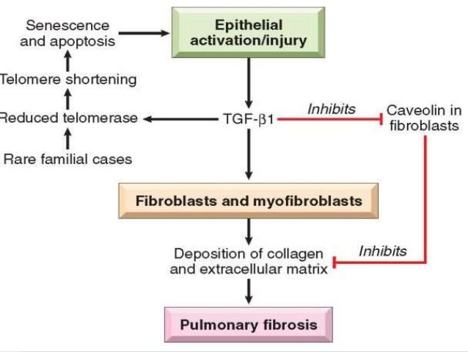
IPF

Slide 12
MORPHOLOGY
- The pattern of fibrosis in IPF is referred to as usual interstitial pneumonia (UIP)
-The histologic hallmark of UIP is patchy interstitial fibrosis, which varies in intensity and worsens with time.
The earliest lesions demonstrate exuberant fibroblastic proliferation and appear as fibroblastic Foci Over time these areas become more collagenous and less cellular.
- Quite typical is the existence of both early and late lesions (temporal heterogeneity)

Slide 13
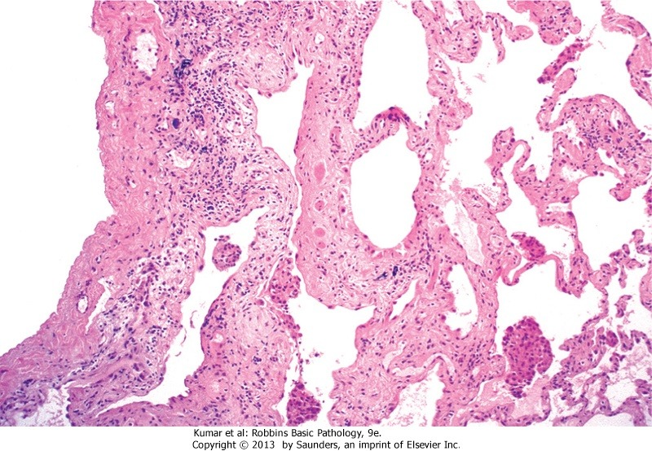
Usual interstitial pneumonia

Slide 14
Clinical fatures
Insidious onset
Nonproductive cough and progressive dyspnea
Cyanosis and cor pulmonale can develop
Poor outcome, patients survive 3 years only
Only hope: lung transplantation

Slide 15
Nonspecific interstitial pneumonia
Chronic, bilateral interstitial disease of unknown etiology
Has a better prognosis than IPF
Cellular OR fibrosing pattern on microscopy.. The 2 patterns do not coexist

Slide 16
Cryptogenic organizing pneumonia
= BOOP = bronchiolitis obliterans organizing pneumonia
Unknown etiology
Histologically: polypoid plugs of loose organizing connective tissue within alveoli, alveolar ducts and bronchioles
The fibrosis present is all of the same age
Some patients recover spontaneously, others need 6 months of steroid treatment
Good prognosis

Slide 17
Pulmonary involvement by collagen vascular diseases
Collagen vascular diseases: systemic diseases that include scleroderma and SLE
Lung fibrosis can be present in such diseases
Outcome depends on the underlying disease

Slide 18
Drug and radiation induced fibrosis
Bleomycin is a chemotherapeutic drug that can cause pulmonary fibrosis
Amiodarone is an antiarrhythmic drug also can cause fibrosis
Chronic radiation pneumonitis after radiotherapy is characterized by fibrosis

