Slide 1
Sexual and Reproductive Health and Rights

Slide 2
Sexual and Reproductive Health and Rights
This lecture will discuss some key sexual health issues that females face through their life, which have a human rights consideration :
Fertility control
Violence and sexual abuse against women
Sex-selective abortion
Female genital mutilation
Unsafe abortion
Obstetric Fistula
Human Trafficking

Slide 3
Fertility Control: a human right or a human obligation?
No one would question the inherent good in pollution control or nuclear arm control, but when it comes to birth control, it becomes controversial.
The problem is that control measures are applied without attention to the privacy of fertility decisions, particularly among the poorest in the world, for whom children often represent security, hope, and an asset for the future.
Policies formulated at the national level and executed in a manner unrelated to health priorities at the local level has led to severe conflicts.

Slide 4
Fertility Control: a human right or a human obligation?
In India, after compulsory sterilization of the mid-1970s, the concept of family planning became associated with coercion (use of force), and contraception decreased to very low levels. Planning was renamed into “welfare”.
In China, people were obliged to reduce the number of children, but that coercion was more successful in china because there was no freedom of speech to protest against the political force put upon families’ reproductive decisions.

Slide 5
1. Domestic Violence/Intimate Partner Violence
The UN definition of IPV: “any act of gender-based violence that may results in physical, sexual or mental (emotional/psychological) harm or suffering to women, including threats of such acts, coercion, or deprivation of liberty, whether occurring in public or private life.
It is widespread around the world: A WHO multi country study found that between 15% and 71% of women aged 15 to 49 years reported physical and/or sexual violence by an intimate partner at least once in their life.
Health consequences: include injuries, chronic pain, STIs, depression, post-traumatic stress disorder, suicide attempts, permanent disability, or death.
The perpetrators are more likely to be men who are less educated, unemployed, or under the influence of alcohol and other intoxicating substances.

Slide 6
1. Domestic Violence/Intimate Partner Violence, cont.
Risk Factors: Violence is always directed towards the weaker and more fragile person. Poorer, uneducated, younger age of marriage, having many children, and less empowered women are more likely to be victims of IPV. Wealth of the household is not related to domestic violence.
Children who grow up in an abusive family, are more likely to use violence with others, and to abuse their own children.
Screening and Management of IPV: Women who have been abused usually seek care for other complaints when they go to emergency departments or clinics….. They are ashamed or frightened to admit that their injuries were a result of IVP. Routine screening for IPV is endorsed by many health professional organizations. Barriers for screening are no time, lack of effective interventions, patient unwillingness to disclose, and fear of offending the patient.

Slide 7
2. Sex-selective abortion
Although sex determination for the purpose of sex selection is illegal in the two countries where it is most common (India and China), sex-selective abortion remains creating a major disparity in sex ratio.
The number of male babies born per 100 female babies is called the sex ratio at birth. Normally is 102 to 106 males per 100 females. In affected countries, this ratio is 110 to 130. Around 1.5 million girls are missing at birth every year.
The shortage in girls does not lead to an increase in their status as individuals, even if it does increase their value as a commodity. Rather, girl shortage contributes to greater family control and more restrictions on girls’ movement and behavior, it also increases female trafficking and early and forced marriage.
Three factors influence sex selection before birth: son preference (the key determinant), sex selection technology, and low fertility levels. Son preference is deeply rooted in some cultures regardless of education, income, or urbanization.

Slide 8
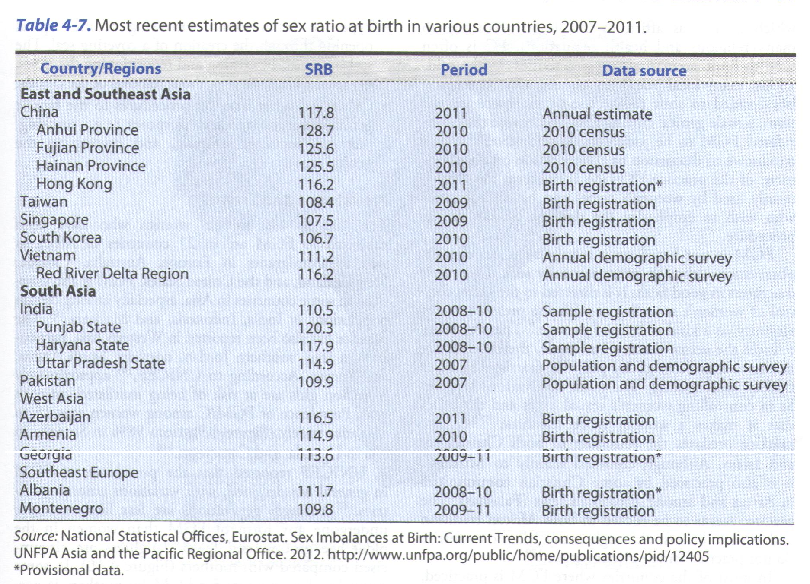

Slide 9
3. Female Genital Mutilation (FGM)
FGM (Referred to as “female circumcision”), as defined by the WHO, “all procedures involving partial or total removal of the external female genitalia or other injury to the female genital organs for non-medical reasons.
The UN defined FGM as a human rights violation, and was banned in 2012.
100 to 140 million women have been subjected to FGM in the world.
Mostly performed on girls less than 15 years, but this varies from one community to another. FGM practice predates the founding of both Christianity and Islam, and it seems to be rooted in Africa, in addition to certain populations in India, Malaysia, and Indonesia (see Figure 4.9).
FGM has no benefits, it is painful and traumatic. It harms girls and women in many ways. Parents seek FGM for their girls with good faith to preserve their virginity prior to marriage. FGM is performed usually by traditional circumcisers. FGM is decreasing with increasing education of mothers.
There are many immediate and long-term physical and psychosexual health complications of FGM, in addition to childbirth complications.

Slide 10
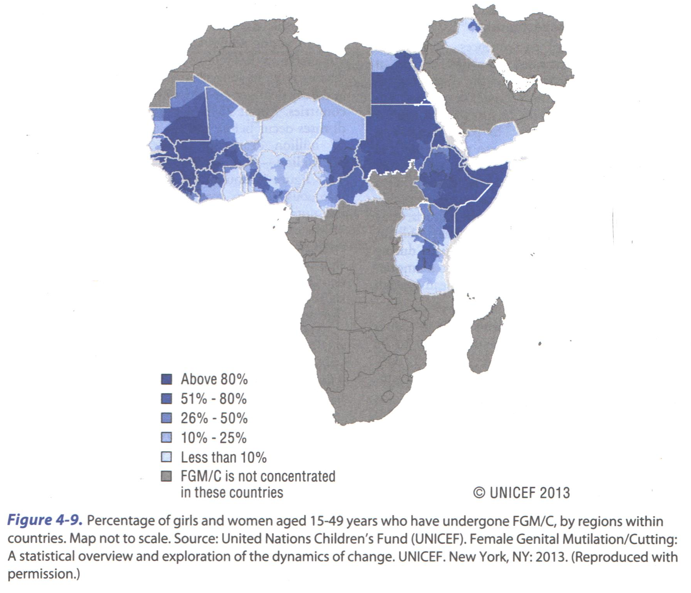

Slide 11
4. Unsafe Abortion
Most of the disability, morbidity, and mortality associated with abortion is the result of unsafe abortion, mostly in low- and middle-income countries in which abortion is legally restricted.
Unsafe abortions is a procedure for terminating unwanted pregnancy by persons lacking the necessary skills, with inappropriate equipment, poor technique, and/or unhygienic conditions.
The WHO estimated that of the 211 million pregnancies worldwide each year, about 46 million end in induced abortion. Only about 60% of abortions carried out each year worldwide are safe.

Slide 12
4. Unsafe Abortion
The mortality rate for unsafe abortion is at least 100 times greater than safe abortion.
In countries with high rate of maternal mortality, one third of maternal deaths could be avoided through an effective family planning program.
In countries where abortion laws are more liberal, and abortion is a common method of family planning (eastern Europe and Japan), it is essential that these services be widely available, so that women do not turn to unsafe abortion providers.

Slide 13
5. Obstetric Fistula
An obstetric fistula is a condition in which a hole opens in a woman between the bladder and the vagina, or between the rectum and the vagina. This results in urine or feces leaking through the vagina.
It is estimated that 2 million women worldwide are living with a fistula.
Early childhood marriage (young mothers) is the most common cause of obstructed labor resulting in fistula, in addition to undernutrition, multiple births in addition to Female genital mutilation and trauma (rape or sexual violence).

Slide 14
5. Obstetric Fistula
As a consequence, the child dies in childbirth, and the mother suffers a lifetime of pain and discomfort from chronic infection and poor hygiene.
Women with fistula are abandoned by their husbands and terribly socially stigmatized, where some communities view fistula as a curse and hide women away, rather than realizing that it is a medical condition.
Most women with fistula are unaware of the any opportunities for repairing their fistula or getting support to help them return to normal life.

Slide 15
Human Trafficking
A modern-day form of slavery, every year, as many as 27 million men, women, and children around the world are subject to force, or coercion for the purpose of forced labor or sexual exploitation. It is a global problem.
The International Labor Organization (ILO) conservatively estimates that 21 million persons are labor trafficked around the world.
Trafficking victims are of all ages, races, nationalities, socioeconomic status, sexual orientation and educational levels. The perpetrators come from the same categories.
Human trafficking can have many forms: children abducted to serve as combatants can be sexually abused, migrant workers with unsafe working conditions with huge debt pay their debt with sexual favors, domestic servants in an informal workplace may be physically, socially, and/or culturally isolated.

Slide 16
Human Trafficking
Street children, runaways, or children living in poverty can fall under the control of traffickers who force them into begging rings. Poor people recruited for organ trafficking (sale of a kidney).
The Health care provider may be the first responder to the person who is being trafficked. Victims are likely to seek care as a onetime visit in an emergency department or free community clinic, with severe health problems. The trafficker may kill the victim if very sick.
They may be accompanied by someone who claims to be a relative who speaks on behalf of the person. The provider should be suspicious when observing unusual trauma or fearfulness, and can have a confidential discussion with victim.
Careful documentation of findings from history and physical examination can support any legal investigation later on.

