Slide 1
Skin Pharmacology
Dr. Alia Shatanawi
5/3/2016

Slide 2
Dermatologic Pharmacology
Variables affecting Pharmacologic Response:
Regional variation in drug penetration.
Concentration gradient.
Dosing schedule.
Vehicles and occlusion.

Slide 3
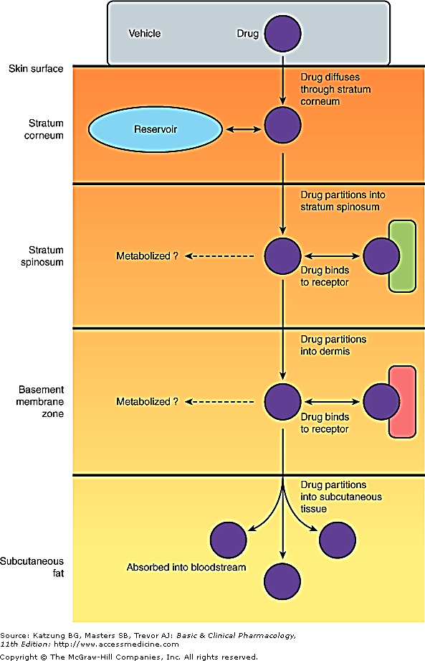
Percutaneous Absorption.

Slide 4
Dermatologic Formulations
Tinctures.
Wet dressings.
Lotions.
Gels.
Powders.
Pastes.
Creams.
Ointments.

Slide 5
Adverse Effects of Dermatologic Preparations
Burning or stinging sensation.
Drying and irritation
Pruritus.
Erythema.
Sensitization.
Staining
Superficial erosion.

Slide 7
Topical Antibacterial Agents
Gram-positive bacteria
Bacitracin
Gramicidin
Gram-negative bacteria
Polymyxin B Sulfate
Neomycin
Genatamicin

Slide 8
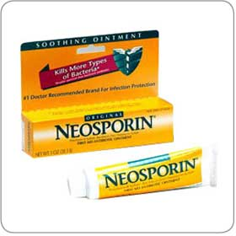
BACITRACIN
Active against streptococci, pneumococci, and staphylococci
Also , most anaerobic cocci, neisseriae, tetanus bacilli, and diphtheria bacilli are sensitive.
MOA???
Bacitracin alone or with neomycin, polymyxin B, or both.
Side effects: Toxicity ???
Allergic contact dermatitis occurs frequently, and immunologic allergic contact urticaria rarely. Bacitracin is poorly absorbed through the skin, so systemic toxicity is rare.

Slide 9
GRAMICIDIN
Only for topical use, in combination with other antibiotics such as neomycin, polymyxin, bacitracin, and nystatin
MOA??
Hemolysis

Slide 10
POLYMYXIN B SULFATE
gram-negative :Pseudomonas aeruginosa, Escherichia coli, enterobacter, and klebsiella.
Proteus and serratia are resistant, as are all gram-positive organisms.
Side effects: total daily dose applied to denuded skin or open wounds should not exceed 200 mg in order to reduce the likelihood of toxixity “neurotoxicity and nephrotoxicity”
Allergic contact dermatitis NOT common.

Slide 11
NEOMYCIN & GENTAMICIN
Neomycin
Aminoglycoside antibiotics
gram-negative :E coli, proteus, klebsiella, and enterobacter.
SE: allergic contact dermatitis
Gentamicin generally shows greater activity against P aeruginosa than neomycin.
Gentamicin more active against staphylococci and group A β-hemolytic streptococci.
Be careful with systemic toxicity : esp in renal failure
Hospital acquired resistant

Slide 12
Topical Antibacterials in Acne
Clindamycin.
10% absorbed, so, possibility of Pseudomembranous colitis.
Erythromycin.
Metronidazole: rosacea
Sodium sulfacetamide.
Daspone

Slide 13
Topical Antifungal Agents
Azole Derivatives:
Clotrimazole
Econazole.
Ketoconazole.
Miconazole.
Oxiconazole.
Sulconazole.
Activity against dermatophytes (epidermophyton, microsporum, and trichophton) and yeasts, including Candida albicans and Pityrosporum orbiculare.

Slide 14
Topical Antifungal Agents
Ciclopirox Olamine.
Naftifine and Terbinafine.
Tolnaftate.
Nystatin and Amphotericin B:
Only for Candida albicans.
Available as topical preparations, oral suspension, or vaginal tablets

Slide 15
Oral Antifungal Agents
Azole Derivatives:
Fluconazole.
Itraconazole.
Ketoconazole.
Affect the permeability of fungal cell membrane through alteration of sterol synthesis.
Effective in systemic mycosis, mucocutaneous candidiasis, and other cutaneous infections.
Might have systemic side effects: hepatitis and liver enzyme elevations, and interactions.

Slide 16
Oral Antifungal Agents
Azole Derivatives.
Griseofulvin:
Effective against epidermophyton, microsporum, and trichophton.
Requires prolonged treatment:
4-6 weeks for the scalp.
6 months for fingernails.
8-18 months for toenails.
Has many side effects.
Terbinafine:
Recommended for onchomycosis.
6 weeks for fingernails.
12 weeks for toenails.

Slide 17
NYSTATIN & AMPHOTERICIN B
Topical therapy of C albicans infections but ineffective against dermatophytes.
Cutanuoes and mucosal candida infections
Amphotericin B : broader antifungal
intravenously in the treatment of many systemic mycoses and to a lesser extent in the treatment of cutaneous candida infections.
Toxicity with systemic administration

Slide 18
Topical Antiviral Agents
Acyclovir.
Valacyclovir.
Penciclovir.
Famciclovir.
Synthetic guanine analogs with inhibitory activity against herpes viruses.
Ointments and creams are useful for recurrent orolabial herpes simplex infection

Slide 19
Immunomodulators
Imiquimod:
Stimulates peripheral mononuclear cells to release interferon- ά and to stimulate macrophages to produce interleukins-1,-6, and -8 and tumor necrosis factor-ά.
Uses:
For external genital and perianal warts.
Actinic keratosis on the face and scalp.
Primary basal cell carcinoma.
Tacrolimus.
Pimecrolimus.
Useful for atopic dermatitis.
Inhibit T-lymphocyte activation and prevent release of inflammatory cytokines and mast cell mediators
(Black box warning)

Slide 20
Ectoparasiticides
Permethrin:
Toxic to Pediculus humanus, Pthirus pubis, and Sarcoptes scabiei
Pediculosis:cream applied for 10 minutes and then rinsed off with warm water.
Scabies: cream applied for the whole body for 8-14 hours.
Lindane(Hexachlorocyclohexane):
10% absorbed and concentrated in fatty tissues.
Can cause neurotoxicity and hematoxicity
Crotamiton.
Sulfur.
Malathion.

Slide 21
Agents affecting Pigmentation
Hydroquinone.
Monobenzone.
Monobenzone may be toxic to melanocytes resulting in permanent depigmentation.
Mequinol
Reduce hyperpigmentation of skin by inhibiting the enzyme tyrosinase which will interfere with biosynthesis of melanin.

Slide 22
Agents affecting Pigmentation
Trioxsalen.
Methoxsalen.
Are psoralens used for the repigmentation of depigmented macules of vitiligo.
Must be photoactivated by long-wave-length ultraviolet light (320-400nm) to produce a beneficial effect.
They intercalate with DNA.
Can cause cataract and skin cancer.

Slide 23
Sunscreens and Sunshades
Sunscreens absorb UV light.
Examples are para amino benzoic acid (PABA) and its esters.
Sunshades are opaque materials that reflect light, like titanium dioxide.
Useful in polymorphous light eruption, lupus erythematosus, and drug –induced photosensitivity.

Slide 24
Acne Preparations
Retinoic Acid and Derivatives:
Retinoic Acid.
Adapalene.
Tazarotene.

Slide 25
Acne Preparations
Retinoic Acid and Derivatives:
Retinoic Acid( Tretinoin): is the acid form of Vitamin A. Stabilizes lysosomes, increases RNA polymerase activity, increases PGE₂, cAMP, and cGMP levels, and increases the incorporation of thymidine into DNA.
Decreases cohesion between epidermal cells and increases epidermal cell turnover. This will result in expulsion of open comedones and the transformation of closed comedones into open ones.
Also, promotes dermal collagen synthesis, new blood vessel formation, and thickening of the epidermis, which helps diminish fine lines and wrinkles.
Can cause erythema and dryness.
Tumerogenic in animals

Slide 26
Acne Preparations
Isotretinoin( Accutane):
Restricted for severe cystic acne resistant to standard treatment.
Inhibits sebaceous gland size and function.
Given orally.
Toxic: dryness, itching, headache, corneal opacities, pseudotumor cerebri, inflammatory bowel disease, anorexia, alopecia, and muscle and joint pains. Also lipid abnormalities.
Teratogenicity

Slide 27
Acne Preparations
Benzoyl Peroxide:
Penetrates the stratum corneum or follicular openings and converted to benzoic acid within the epidermis and dermis.
Has antimicrobial activity against P. acnes and peeling and comedolytic effects.
Can be combined with erythromycin or clindamycin.
Potent contact sensitizer.
Can cause bleaching of hair or colored fabrics.
Azelaic Acid:
Has antimicrobial activity and inhibits conversion of testosterone to dihydrotetosterone.

Slide 28
Drugs for Psoriasis
Acitretin:
Related to isotretinoin.
Given orally.
Hepatotoxic and teratogenic.
Patients should not become pregnant for 3 years after stopping treatment, and also should not donate blood.

Slide 29
Drugs for Psoriasis
Tazarotene:
Topical.
Anti-inflammatory and antiproliferative actions.
Teratogenic. Also, can cause burning, stinging, peeling, erythema, and localized edema of skin.
Calcipotiene:
Synthetic vitamin D₃ derivative

Slide 30
Drugs for Psoriasis
Biologic Agents:
Alefacept:
Immunosuppressive dimer fusion protein of CD2 linked to the Fc portion of human IgG₁.
Efalizumab:
Recombinant humanized IgG₁ monoclonal antibody.
Withdrawn :progressive multifocal leukoencephalopathy (PML),
Can cause thrombocytopenia.
Etanercept:
Dimeric fusion protein of TNF receptor linked to the Fc portion of human IgG_{1.}

Slide 31
Anti-inflammatory Agents
Topical Corticosteroids:
Hydrocortisone.
Prednisolone and Methylprednisolone.
Dexamethasone and Betamethasone.
Triamcinolone.
Fluocinonide.

Slide 32
Anti-inflammatory Agents
Topical Corticosteroids:
Absorption:
1% of hydrocortisone applied to the ventral forearm.
0.14 times of hydrocortisone applied to the plantar foot.
0.83 times of hydrocortisone applied to the palm.
3.5 times of hydrocortisone applied to the scalp.
6 times of hydrocortisone applied to the forehead.
9 times of hydrocortisone applied to the vulvar skin.

Slide 33
Anti-inflammatory Agents
Topical Corticosteroids:
Absorption:
Absorption increased with inflammation.
Increasing the concentration does not proportionally increase the absorption.
Can be given by intralesional injection.

Slide 34
Anti-inflammatory Agents
Topical Cortcosteroids:
Dermatologic disorders very responsive to steroids:
Atopic dermatitis.
Seborrheic dermatitis.
Lichen simplex chronicus.
Pruritus ani.
Allergic contact dermatitis.
Eczematous dermatitis.
Psoriasis

Slide 35
Anti-inflammatory Agents
Topical Cortcosteroids:
Adverse Effects:
Suppression of pituitary-adrenal axis.
Systemic effects.
Skin atrophy.
Erythema.
Pustules.
Acne.
Infections.
Hypopigmentation.
Allergic contact dermatitis.

Slide 36
Anti-inflammatory Agents
Topical Cortcosteroids.
Tar compounds:
Mainly for psoriasis, dermatitis, and lichen simplex chronicus
Can cause irritant folliculitis, phototoxicity, and allergic contact dermatitis.

Slide 37
Keratolytic and Destructive Agents
Salicylic acid:
Solubilizes cell surface proteins resulting in desquamation of keratotic debris.
Keratolytic in 3-6% concentration, but destructive in higher concentrations.
Can result in salicylism due to systemic absorption.
Locally, can cause urticaria, anaphylactic and erythema multiforme reactions, irritation, inflammation, and ulceration.

Slide 38
Keratolytic and Destructive Agents
Salicylic acid:
Propylene Glycole:
Usually used as a vehicle for organic compounds.
Used alone as a keratolytic agent in concentrations of 40%- 70%, with plastic occlusion, or in gel with 6% salicylic acid.
Minimally absorbed, oxidized in liver to lactic acid and pyruvic acid.
Develops an osmotic gradient through the stratum corneum, thereby increasing hydration of the outer layers of skin.

Slide 39
Keratolytic and Destructive Agents
Salicylic acid.
Propylene Glycole.
Urea:
Has a humectant activity, i.e. softening and moisturizing effect on the stratum corneum.
Increases water content as a result of its hygroscopic characteristics.
Decreases the unpleasant oily feel of dermatologic preparations.
When absorbed, it is excreted in urine.

Slide 40
Keratolytic and Destructive Agents
Salicylic acid.
Propylene Glycole.
Urea:
Podophyllum Resin and Podofilox:
An alcoholic extract of Podophyllum peltatum( Mandrake root or May apple).
Used in the treatment of condyloma acuminatum and other verrucae.
Cytotoxic activity with specific affinity for the microtubule protein of the mitotic spindle.
Can cause N, V, muscle weakness, neuropathy, coma, and even death.

Slide 41
Keratolytic and Destructive Agents
Salicylic acid.
Propylene Glycole.
Urea:
Podophyllum Resin and Podofilox.
Flurouracil:
Antimetabolite that resembles uracil and inhibits thymidylate synthetase, thus interferes with DNA and may be RNA synthesis.
Used in multiple actinic keratosis.

Slide 42
Keratolytic and Destructive Agents
Salicylic acid.
Propylene Glycole.
Urea:
Podophyllum Resin and Podofilox.
Flurouracil.
Nonsteroidal Anti-inflammatory Drugs:
3% gel formulation diclofenac.

Slide 43
Keratolytic and Destructive Agents
Salicylic acid.
Propylene Glycole.
Urea:
Podophyllum Resin and Podofilox.
Flurouracil.
Nonsteroidal Anti-inflammatory Drugs.
Aminolevulinic Acid:
Used in actinic keratosis.
After topical application(20%) and exposure to light, produces a cytotoxic superoxide and hydroxyl radicals.

Slide 44
Antipruritic Agents
Doxepine:
Potent H₁ and H_{2 –} receptor antagonist.
Can cause drowsiness and anticholinergic effects.
Pramoxine:
Is a topical local anesthetic agent.

Slide 45
Trichogenic and Antitrichogenic Agents
Minoxidil (Rogaine):
Designed as an antihypertensive agent.
Effective in reversing the progressive miniaturization of terminal scalp hairs associated with androgenic alopecia.
Vertex balding is more responsive than frontal balding.

Slide 46
Trichogenic and Antitrichogenic Agents
Minoxidil.
Finasteride (Propecia):
5ά-reductase inhibitor which blocks the conversion of testosterone to dihydrotestosterne.
Oral tablets.
Can cause decreased libido, ejaculation disorders, and erectile dysfunction.

Slide 47
Trichogenic and Antitrichogenic Agents
Minoxidil.
Finasteride.
Eflornithine:
Is an irreversible inhibitor of ornithine decarboxylase, therefore, inhibits polyamine synthesis. Polyamines are important in cell division and hair growth.
Effective in reducing facial hair growth in 30% of women when used for 6 months.

Slide 48
Drugs for Leishmania
Caused by three Leishmania species:
L.tropica causes: Cutaneous leishmaniasis or oriental sore.
L. brazeliensis causes: Mucocutaneous leishmaniasis.
L. Donovani causes: Visceral leishmaniasis

Slide 49
Sodium Stibogluconate
Pentravalent antimonial
Binds to SH groups on proteins.
Typical preparations contain 30% to 34% pentavalent antimony by weight as well as m-chlorocresol added as a preservative.
Also, inhibits phosphofructokinase
Local, IM or slow IV, irritant.
Given for 20-28 days.
Drug of choice for all forms of leishmaniasis.
Resistance is increasing, especially in India.
Cough, V, D, myalgia, arthralgia, ECG changes, Rash, Pruritus.

Slide 50
Amphotericin
Antifungal agent, difficult to use, and toxic.
Alternative therapy for visceral leishmaniasis, especially in areas with high resistance.

Slide 51
Miltefosine
For visceral leishmaniasis.
Given orally, for 28 days.
Causes V & D, hepatotoxicity, nephrotoxicity, and it is teratogenic.

Slide 52
Pentamidine
Inhibits DNA replication.
Also, DHF reductase inhibitor
Given IM or IV injection and Inhalation
Binds avidly to tissues, not the CNS.

Slide 53
Pentamidine
Leishmaniasis:
Alternative to Na stibogluconate
Pneumocystis jiroveci:
Treatment and prophylaxis of patients who cannot tolerate or fail other drugs.
Trypanosomiasis:
For early hemolymphatic stage.

Slide 54
Pentamidine
Adverse Effects:
Rapid Infusion: Hypotension, tachycardia, dizziness.
Pain at the injection site.
Others: Pancreatic, Renal, and Hepatic toxicity.

Slide 55
Antilepromatous Drugs
Dapsone and Sulphones:
Related to sulphonamides.
Inhibit folate synthesis.
Resistance develops.
Combined with Rifampin and Clofazimine.
Also used for Pn. Jeroveci in AIDS patients.
Well absorbed and distributed.
Retained in the skin, muscle, liver and kidney.

Slide 56
Antilepromatous Drugs
Dapsone and Sulphones:
Hemolysis, particularly in G-6-PD deficiency.
GIT intolerance
Fever, Pruritus, Rashes.
Erythema Nodosum Leprosum:
suppressed by steroids or thalidomide.

Slide 57
Antilepromatous Drugs
Rifampin:
Discussed with antituberculous drugs.
Clofazimine:
Binds to DNA.
Stored widely in RES and skin.
Released slowly from storage sites, t_{1/2} = 2 months.
Given for sulphone- resistant or intolerant cases.
Causes skin discoloration (red-brown to black) and
GIT intolerance.

