Slide 1
Biochemistry of neurotransmitters
Dr. Mamoun Ahram Neuroscience
2017
Read the slides carefully
Doctors notes are underlined italic

Slide 2
References
This lecture
Mark’s Basic Medical Biochemistry, 4th ed, pp. 908- 918
http://what-when- how.com/neuroscience/neurotransmitters-the- neuron-part-1/

Slide 3
Definition of a neurotransmitter
A neurotransmitter is a chemical substance that is:
synthesized in a neuron,
released at a synapse following depolarization of the nerve terminal (usually dependent on influx of calcium ions(,
Neurotransmitter binds to receptors on the postsynaptic cell and/or presynaptic terminal
to elicit a specific response.
Read this slide carefully

Slide 4
Characteristics of a neurotransmitter
A chemical substance that:
  Is synthesized and stored in a presynaptic neuron (the enzymes needed for its synthesis must be present in the neuron(
  Is released at a synapse following depolarization of the nerve terminal (usually dependent on influx of calcium ions(
  binds to receptors on the postsynaptic cell and/or presynaptic terminal,
  elicits rapid-onset and rapidly reversible responses in the target cell,
  Is removed or inactivated from the synaptic cleft by different inactivation mechanisms "enzymatic, diffusion, reuptake" depending on the neurotransmitter itself
Read this slide carefully

Slide 5
Types of neurotransmitters
Small-molecule;
  Amines (acetylcholine, epinepherine, dopamine, histmaine, etc(
  Amino acids (glutamate, aspartate(
Neuropeptides (relatively larger neurotransmitter)
Gases (nitric oxide( very small
More than one transmitter (usually a small-molecule transmitter and a neuroactive peptide) coexist in many mature neurons (e.g., most spinal motor neurons contain acetylcholine and calcitonin gene-related peptide). so one neuron can produce different types and even different classes of neurotransmitter at the same time

Slide 6
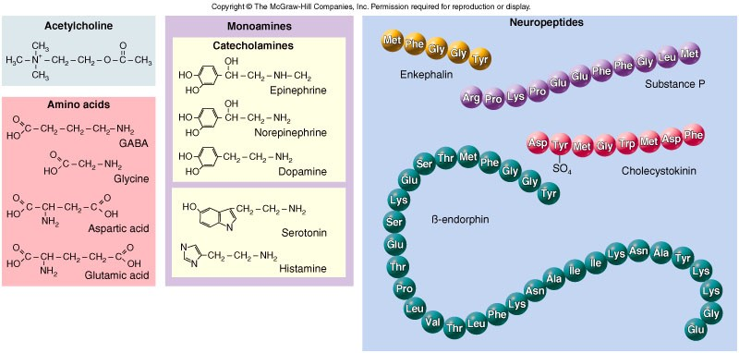
Structures of neurotransmitters
Not important

Slide 7
Neuropeptides

Slide 8
Introduction
More than 50 neuropeptides have been described with
different actions and effects :
  Behavior
  Pain perception
  Memory
  Appetite
  Thirst
  Temperature
  Homeostasis
  Sleep
Just read this slide

Slide 9
Neuropeptides: neurohormones
or neurotransmitters?
Neurohormones: a messenger that is released by neurons into the haemolymph and exert its effects on distant peripheral targets.
Neurotransmitter: a messenger released from a neuron at an anatomically specialized junction, which diffuses across a narrow cleft to affect one or sometimes two postsynaptic neurons, a muscle cell, or another effector cell.
→ How is a neuropeptide considered neurotransmitter or a neurohormone?
- depends on where they act, if a neuropeptide acts within the vicinity "the same area" where it is released, it is considered a neurotransmitter, if its released in the blood and acts far away from its releasing site then it is considered a neurohormone.

Slide 10
Classification of neuropeptides
Peptides can be grouped by structural and functional similarity;
they have different effects and receptors due to the small difference in AA sequence
Neuropeptide Families (the doctor read this) | Opiate Family(not mentioned by the doctor)
Tachykinins: substance P, bombesin, substance K Insulins: insulin, insulin-like growth factors Somatostatins: somatostatin, pancreatic polypeptide Gastrins: gastrin, cholecystokinin Opioids: opiocortins, enkephalins, dynorphin | Name | Amino Acid Sequence
 | Leu- enkephalin | Tyr-Gly-Gly-Phe-Leu-OH
 | Met- enkephalin | Tyr-Gly-Gly-Phe-Met-OH
The doctor mentioned these examples :
 | Beta- endorphin | Tyr-Gly-Gly-Phe-Met-Thr-Ser-Glu-Lys- Ser-Gln-Thr-Pro-Leu-Val-Thr-Leu- Phe-Lys-Asn-Ala-Ile-Val-Lys-Asn-Ala- His-Lys-Gly-Gln-His-OH
 | Dynorphin | Tyr-Gly-Gly-Phe-Leu-Arg-Arg-Ile-Arg- Pro-Lys-Leu-Lys-Trp-Asp-Asn-Gln-OH
Vasopressin and oxytocin share 7 of 9 amino acids, but have different functions.
Opiate peptides share a common
sequence, but are receptor-selective.
The three glycoprotein hormones from the anterior pituitary, TSH, LH, and FSH, share a common α subunit, but have distinct β subunits.

Slide 11
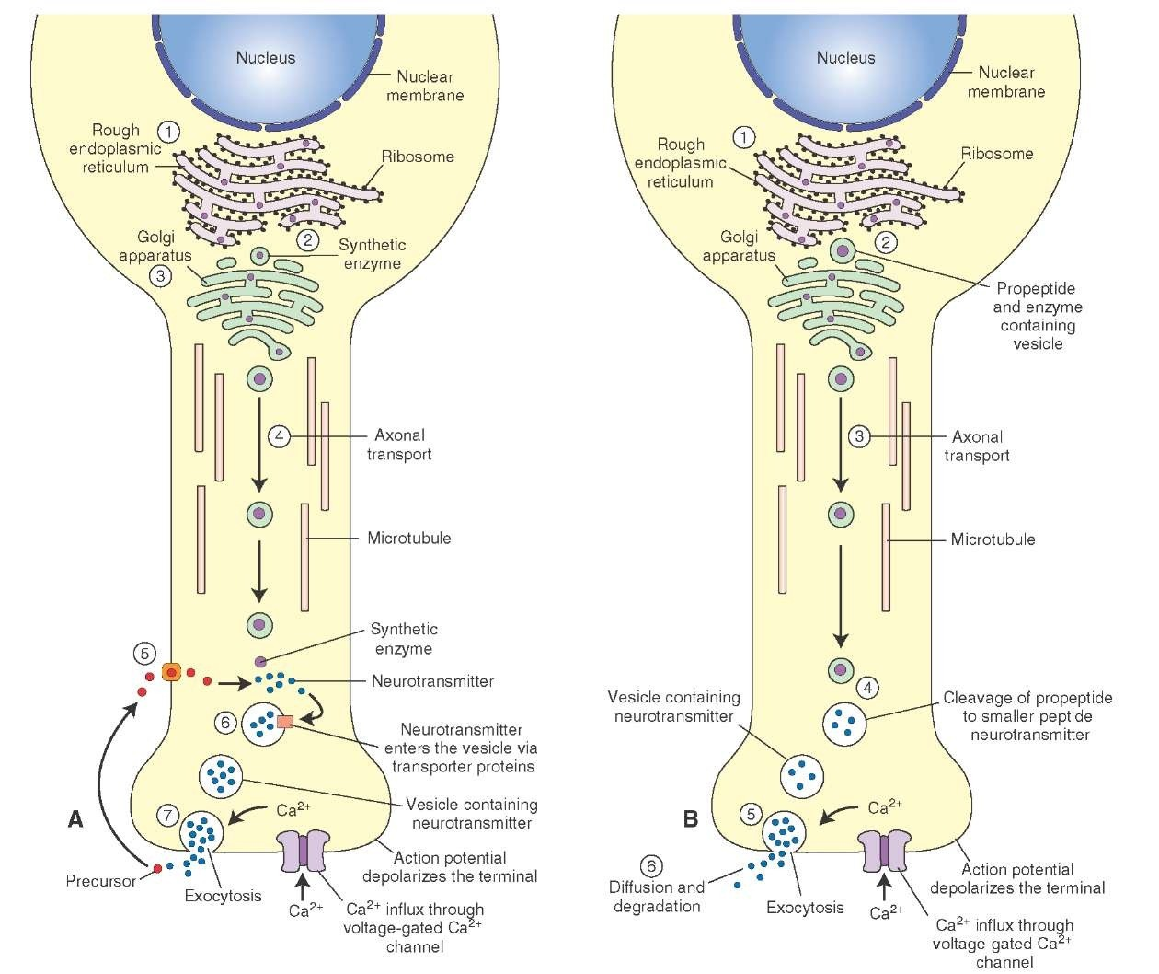
Stages of action
Synthesis (in ER and Golgi apparatus)
Packaging into large-dense core vesicles (with modifying enzymes(
Transport (fast-axonal transport)
  During the transport, proteases cleave the precursor neuropeptid into the final mature form.
Release
  They are released gradually ove time in response to general increases in the level of intracellular calcium.
Action )prolonged( because they are stable
Termination by diffusion and degradation
Read this slide carefully

Slide 12
Added slide
Levels of regulation of neuropeptide synthesis:
Expression
Transcription
Alternative splicing/ post transcriptional regulation (to be discussed)
post translational regulation (to be discussed)

Slide 13
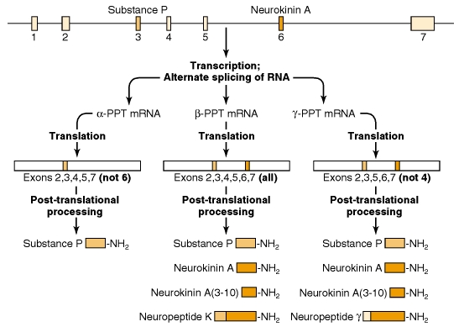
Diversity: alternative splicing
Alternative splicing of mRNA leads to translation of distinct precursors, and subsequent processing leads to unique mature peptides.
  Example is the substance P mRNA that normally also includes mRNA encoding substance K, & neurokinin

Slide 14
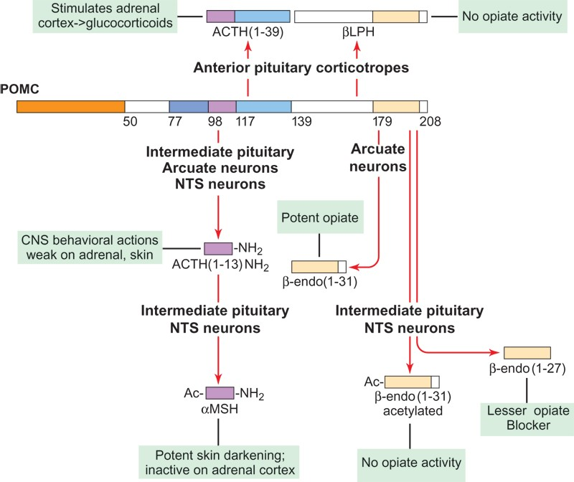
Diversity: proteolytic, differential,
Sequential processing
NOT MENTIONED BY THE DOCTOR :
→ Neuropeptides are produced from a longer precursor protein by:
According to the doctor :
Here we talk about post translational level regulation :
one large polypeptide includes
different types of neuropeptides
ex: POMC (Pro-piomelanocortin)
cleaved to several types of hormones
Proteolytic processing.
Vesicular packaging of different proteases that regognize different cleavage sequences
Hiding a proteolytic site by post-translational modifications (example: addition of a carbohydrate side chain)
Tissue-specific
Mentioned by the doctor :
Processing of the pro-opiomelanocortin (POMC) precursor proceeds in an ordered, stepwise fashion. Some of the reactions are tissue specific. ACTH, adrenocorticotropic hormone; CLIP, corticotropin-like intermediate lobe peptide; JP, joining peptide; LPH, lipotropin; MSH, melanocyte- stimulating hormone; PC, prohormone convertase.

Slide 15
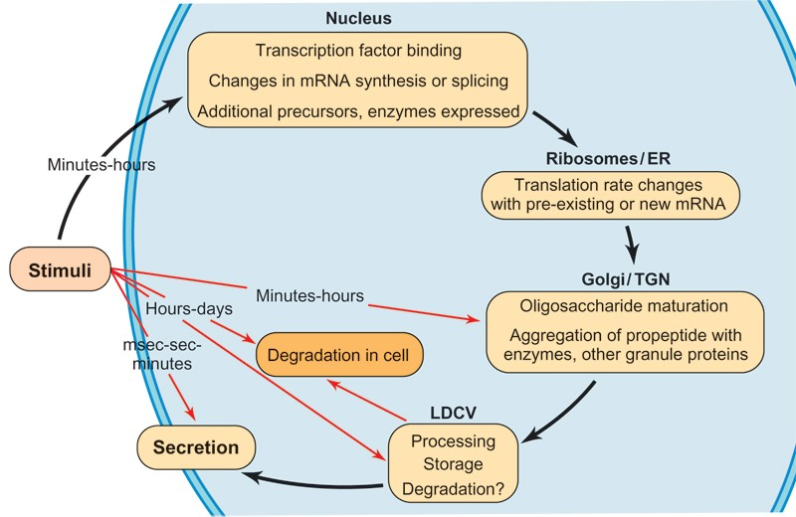
The levels of regulation of neuropeptide expression
Not mentioned by the doctor

Slide 16
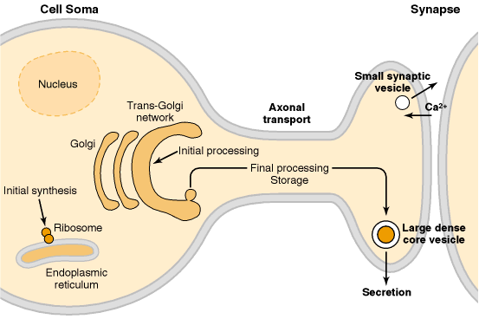
Role of calcium
Neurotransmitter vesicles are located further away from the presynaptic membrane and away from area of Ca influx which is different in the case of small molecule neurotransmitter-discussed in a bit
Ca influx can be from external of internal sources.

Slide 17
II. Small-molecule neurotransmitters

Slide 18
Types of small-molecule neurotransmitters
Nitrogen-containing molecules
  amino acids and their derivatives
  intermediates of glycolysis and the Krebs cycle (TCA cycle(

Slide 19
Stages of action
Synthesis of enzymes
  Cytosol
  ER-Golgi apparatus (packaging into large-dense core vesicles)
Transport of enzymes (slow and fast-axonal transport)rem. Neuropeptides vesicle are fast axonal transport
Synthesis in pre-synaptic terminal
Packaging in synaptic vesicles
Release
  They are released in brief pulses each time an action potential triggers the infulx of calcium
Action (short)
Termination by diffusion, inactivation, or re- uptake into the presynaptic cells .
once released, their action is short due to their short half life
The presynaptic cells can take up these neurotransmitter again, which has important implication therapeutically!

Slide 20
Added slide- about small neurotransmitters
Ca influx will induce fusion of vesicles containing the neurotransmitters occur near the site of influx (which is different from the neuropeptides as we mentioned before)
vesicles line up near the plasma membrane waiting for Ca influx to fuse with the membrane releasing neurotransmitter
once released, reuptake occurs by endocytosis back to the presynaptic cell
See the next 2 slides

Slide 21
[Ca+] = 2 mM
[Ca+] = 50-100 uM
[Ca+] = 0.1 uM

Slide 22
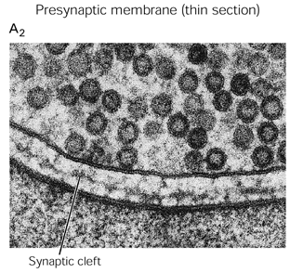
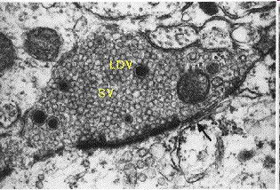
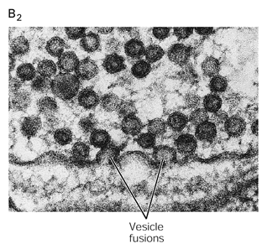
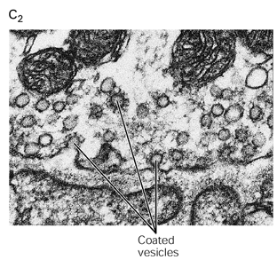

Slide 23
Added slide- Why would Ca induce fusion of vesicles to plasma membrane?
- because Ca is required for the interaction between different proteins that exists on the plasma membrane and the synaptic vesicles
- so Ca level goes up allowing these interactions to occur between vesicles and membrane
- another mechanism for fusion not mentioned in the slides, which is that these vesicles bind to microtubules and then they jump from microtubules to the actin on plasma membrane, but there is a gap or empty region between the actin and the membrane , when the Ca increase inside the cell, the actin cytoskeleton move and interact with the plasma membrane allowing for the vesicles to get near the plasma membrane so that they fuse and release the neurotransmitter

Slide 24
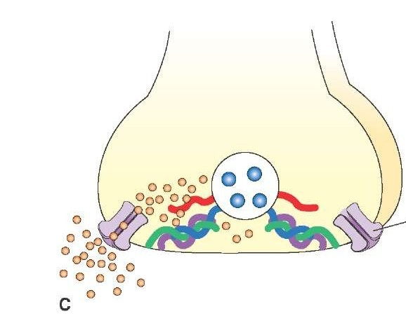
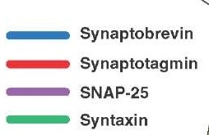
Proteins and exocytosis
The SNARE proteins in the vesicular and presynaptic membranes form complexes in close apposition of the vesicular and the presynaptic membranes. The influx of Ca2+ ions as a result of depolarization into the terminal allows for calcium ions to interact with synaptotagmin, leading to fusion of the vesicular and presynaptic membranes.
Not mentioned by the doctor

Slide 25
Note the differences between neuropeptides and neurotransmitters
Onset and duration of action
Synthesis, transport, and packaging
Concentration for action and receptor binding
Concentration of [Ca+] for release
Site of synthesis, modification
Fate

Slide 26
II. Small-molecule neurotransmitters
A. Tyrosine-Derived Neurotransmitters(catecholamines)
Dopamine, norepinephrine, and epinephrine
“They are called catecholamines because they contain a Catechol ring”

Slide 27
Notes
Role of cofactors- Vitamin and vitamin derivatives- in regulating the synthesis of small molecule neurotransmitter
  S-adenosylmethionine for methyl transfer
  Pyrodoxal phosphate (vitamin B6): transamination, decarboxylation
  Tetrahydrobiopterin (BH4); involved in synthesis of catecholamines
important

Slide 28
Added slide- important
Catecholamine Synthesis: (very important)
Synthesized from tyrosine (hence called tyrosine derived)
tyrosine is hydroxylated in a rate limiting step reaction catalyzed by tyrosine hydroxylase which needs (THBP) as a cofactor, producing DOPA
DOPA is then decarboxylated by Vit B6 producing dopamine “which is a stimulant”,
The earlier two reaction occur in the cytoplasm
Then the dopamine is packaged into vesicles, inside these vesicles dopamine is converted to norepinephrine
So norepinephrine synthesis is vesicular!
then norepinephrine again leaks out to the cytoplasm and converted to epinephrine via methyltransferase which requires (s-adenosylmethionine)
“epinephrine synthesis is cytoplasmic!”
Then it gets packaged inside synaptic vesicles.

Slide 29
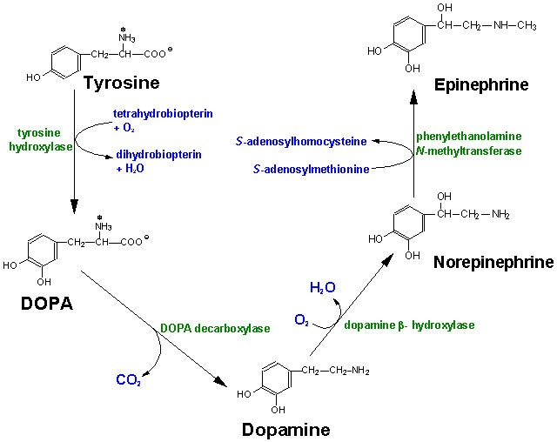
Diet/ liver
phenylalanine hydroxylase
Rate-limiting step
Vitamin B12 or folate
cytoplasm
Pyridoxal phosphate
vesicular

Slide 30
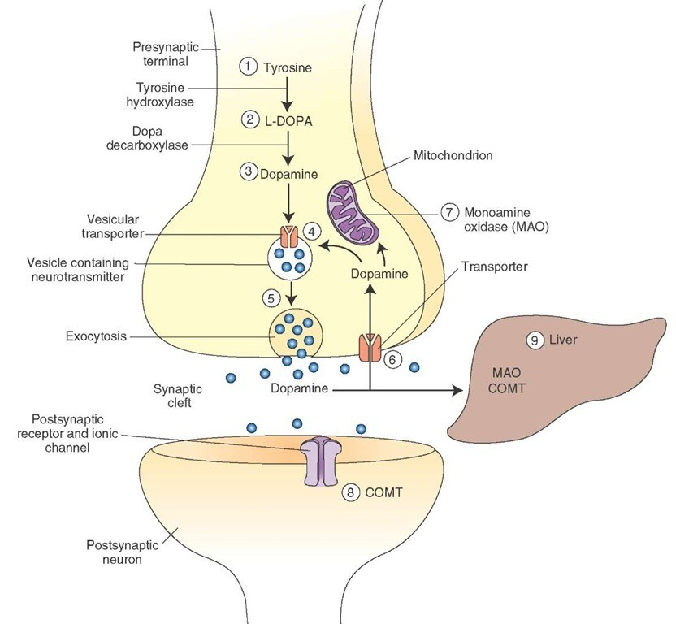
Dopamine inactivation mechanism :
Dopamine is inactivated enzymatically by Mono-Amine-Oxidase “MAO” or Catecholamine Methyl-Transferase “COMT” Catechol-O-methyltransferase,
50% of it is reuptaken by the presynaptic neuron, and packaged inside vesicles (recycled).
and some of it is taken by the postsynaptic cell or neuron
50%
10%

Slide 31
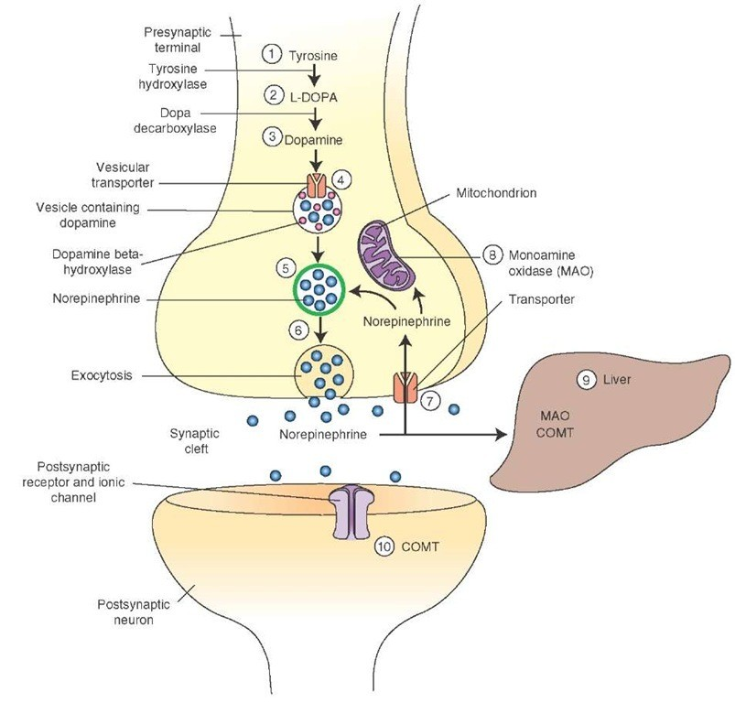
LDCV
Norepinephrine inactivation mechanism:
Norepinephrine inactivation is by diffusion, MAO, or reuptake in pre- and post- synaptic cells

Slide 32
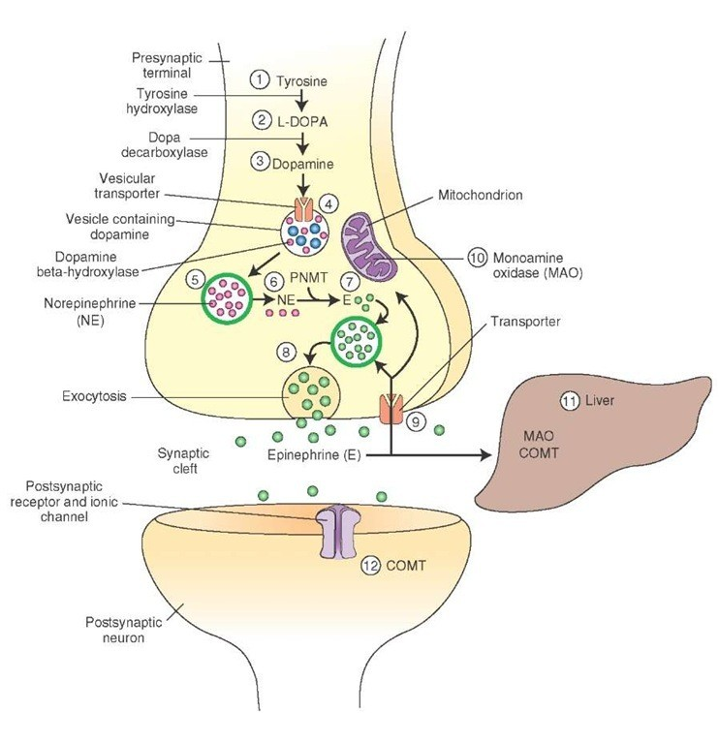
Leaking
Epinephrine inactivation mechanism :
same mechanism of inactivation as norepinephrine

Slide 33
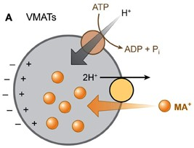
Packaging into vesicles - important
The catecholamines (dopamine an epinepherine) are transported into vesicles by an ATP-dependent process linked to a proton pump.
Protons are pumped into the vesicles by a vesicular ATPase (V-ATPase).
The protons then exchange for the positively charged catecholamine via the transporter VMAT2 (vesicle monoamine transporter 2).

Slide 34
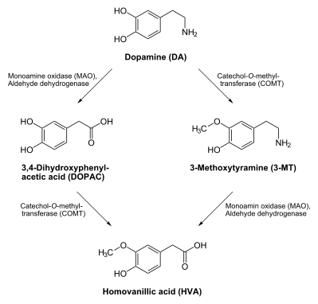
COMT and MAO
Mentioned by the doctor :
Enzymatic inactivation process is done by two enzymatic reactions:
- MAO and COMT
Doesn’t matter which one happens is first but both of them are required !
The final product is homovanillic acid, its level is reduced in Parkinson’s disease which considered a marker for the disease
Inactivation is dependent on SAM, vitamin B12 and folate
Parkinson’s disease

Slide 35
Regulation
Tyrosine hydroxylase
Short term
  Inhibition by free cytosolic catecholamines
    Catecholamines compete with BH4 binding to enzyme
  Activation by depolarization
– Tight binding to BH4 following phosphorylation by PKA, CAM kinases, PKC
– Long-term by gene expression which takes hours
(plus dopamine β-hyroxylase)

Slide 36
II. Small-molecule neurotransmitters
B. Tryptophan-Derived Neurotransmitters
Serotonin and melatonin

Slide 37
Added slide- Serotonin
Serotonin synthesis occurs inside the cytosol → packaged inside vesicles → Ca influx produces depolarization → release
- Once they're outside, they get inactivated by reuptake in presynaptic cell, diffusion or enzymatic inactivation by MAO
- Serotonin is responsible for happiness and relaxation.
- So depressed people are giving a drug that inhibit serotonin reuptake, (SSRIs) which keeps the serotonin in the CNS for a long time
- In the US a drug named Prozac “an SSRI” is giving in a ridiculous way to anyone who thinks he’s depressed!

Slide 38
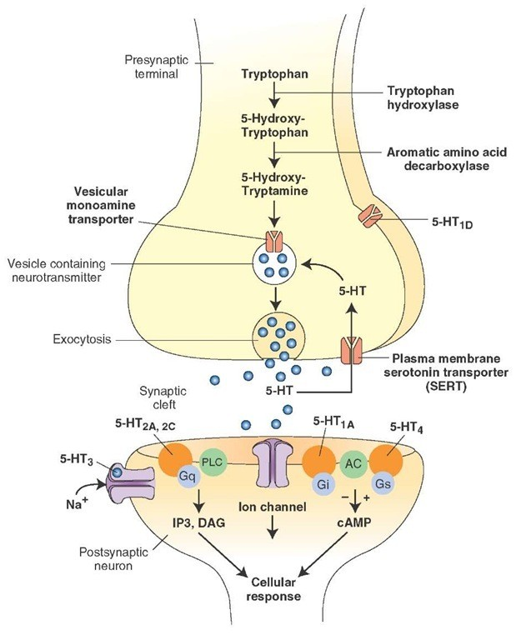
BH4
Serotonin
Antidepressants , called selective serotonin re-uptake inhibitors (SSRIs), like Prozac® inhibit the reuptake process resulting in prolonged serotonin presence in the synaptic cleft.
5-hydroxyindoleacetic acid
urine

Slide 39
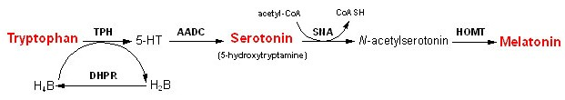
Melatonin
Serotonin is synthesized in the pineal gland serves as a precursor for the synthesis of melatonin, which is a neurohormone involved in regulating:
  sleep patterns
  Seasonal and circadian (daily) rythyms
  Dark-light cycle
People who travels to a far-away places might suffer from "jet lag ; i.e Extreme tiredness and other physical effects felt by a person after a long flight across several time zones", so they're advised to take melatonin to regulate and balance their circadian rhythm

Slide 40
II. Small-molecule neurotransmitters
C. Glutamate and aspartate

Slide 41
Glutamate and aspartate
Nonessential amino acids
Do not cross BBB
  must be synthesized in neurons
Main synthetic compartments
  neurons
  glial cells
Both are excitatory neurotransmitters.

Slide 42
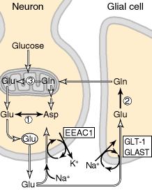
Synthesis of glutamate
Three Sources:
1. Glycolysis → Krebs cycle →
Dehydrogenationor transamination of α- ketoglutarate
Glu
Dehydro
2. Glutamine (deamination)
1
transaminase
3. Aspartate (transamination)
α-KG
2
glutaminase
Glutamine synthetase
Removal or inactivation
excitatory amino acid carrier-1
(EAAC1)
3
glutamate transporter-1 (GLT-1)
GABA
and glutamate—aspartate transporter (GLAST)

Slide 43
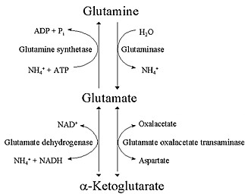
Sources of glutamate
(supplementary)
Added by the doctor :
Inactivation of glutamate:
Once released, it can be reuptaken by presynaptic cells, or by glial
cells
Inside the glial cells glutamate can't be released, rather it gets converted to glutamine, and glutamine can then be released out of the glial cells, then it’s taken up by presynaptic cells and gets packaged there and so on...
So this is a salvage mechanism, which
means a pathway by which we can save the source of glutamate in order not to synthesize it again! (recycling)

Slide 44
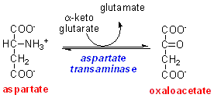
Aspartate
It can be synthesized by transamination reaction from oxaloacetate, (intermediate of Krebs cycle)
A vesicular uptake mechanism for aspartate has not yet been demonstrated, somewhat weakening the case for considering aspartate to be a neurotransmitter
Precursor: oxaloacetate (transamination)

Slide 45
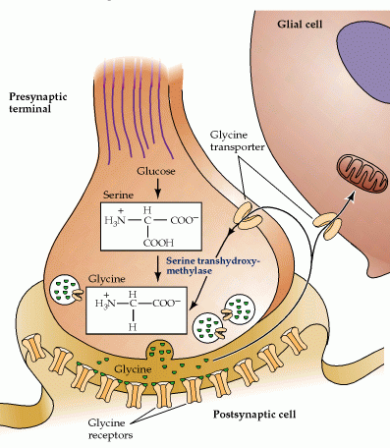
Glycine
The major inhibitory
neurotransmitter in the spical cord
Synthesized from serine by serine hydroxymethyltransferase through 3-phosphoglycerate
Removal: high-affinity transporter
Folic acid

Slide 46
GABA
GABA is present in high concentrations (millimolar) in many brain regions.
  These concentrations are about 1,000 times higher than concentrations of the classical monoamine neurotransmitters in the same regions.
Glutamate is α-decarboxylated forming GABA via glutamate decarboxylase (GAD), which requires pyridoxylphosphate (vitaminB6).
The GABA shunt is a closed-loop process with the dual purpose of producing and conserving the supply of GABA.

Slide 47
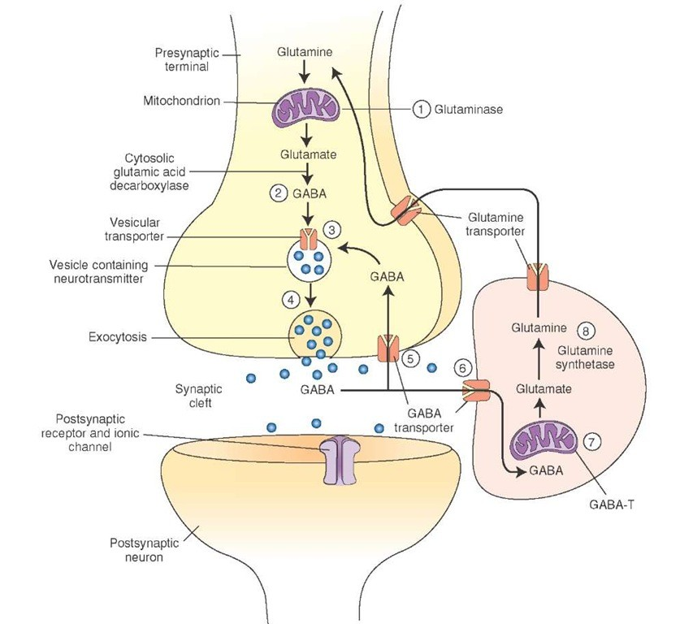
GABA shunt
Glutamine is converted into glutamate by glutaminase.
Glutamate is α-decarboxylated forming GABA via glutamate decarboxylase (GAD), which requires pyridoxyl phosphate (vitamin B6).
GABA is the stored in vesicles until released.
GABA is either taken up into presynaptic terminal and repackaged OR goes into the GABA Shunt where it is taken up into the glia and converted to glutamate.
Glutamate is converted into glutamine, which is transported into the neighboring nerve terminals to synthesize glutamate.

Slide 48
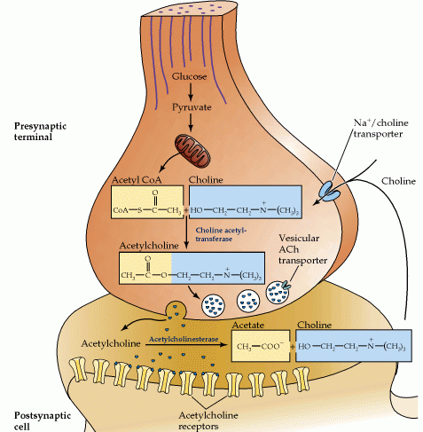
Synthesis of acetylcholine
Synthesized from Choline + acetylcoenzyme-A by choline acetyltransferase in cytoplasm
Transported into and stored in vesicles.
Removal: hydrolysis by acetylcholinesterase
Diet
Membrane PL
Chemical weapons produced by using
serine gas which inhibits this esterase, which leads to convulsions and paralysis due to high levels of acetylcholine which in the end results in death

Slide 49
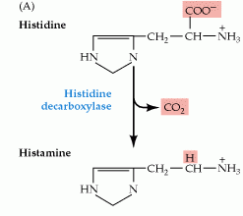
Histamine
it does not penetrate the blood-brain barrier and, hence, must be synthesized in the brain.
Histamine is inactivated by two enzymes—histamine methyltransferase and diamine oxidase (histaminase).
Histamine is synthesized
from histidine
by (histidine decarboxylase)
Pyridoxal phosphate
No recycling
X
Astrocytes (MAO)
Neuron

Slide 50
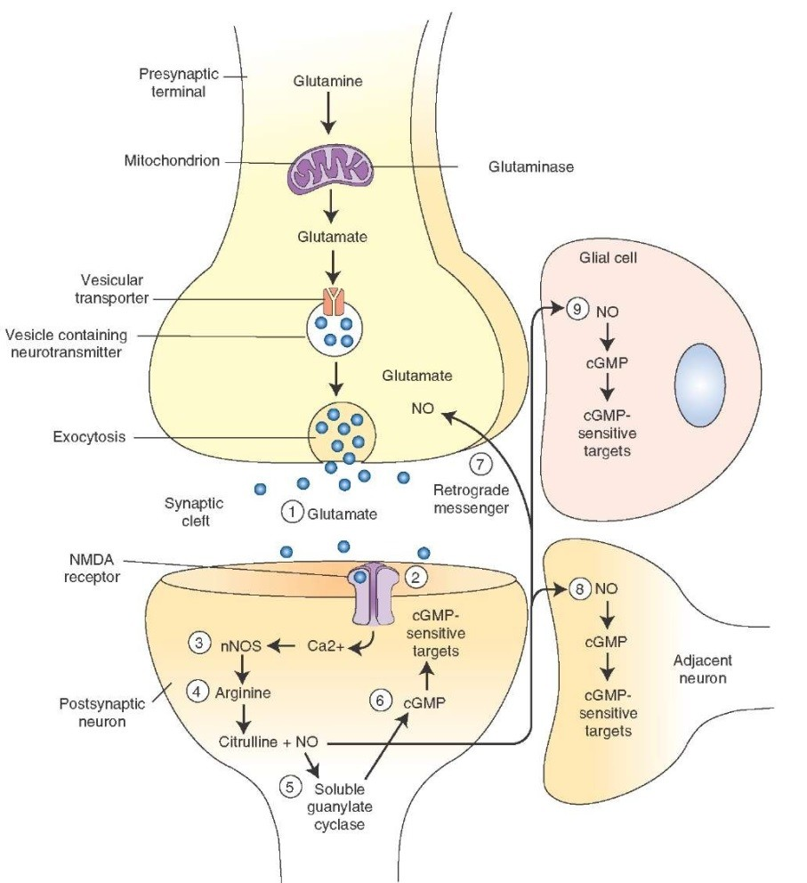
Nitric oxide (NO)
((Different from all other neurotransmitters!))
Glutamate is released from the presynaptic cell ) 1( and acts on NMDA receptors located on the post-synaptic neuron (2)
Ca2+ enters the postsynaptic neuron activating NOS (NO synthase) (3) which forms NO froms arginine (4)
NO stimulates guanylate cyclase forming cGMP (5) which results in a physiological response(6)
No can diffuse out: a) to the presynaptic terminal (retrograde messenger) prolonging effect and into adjacent neurons and glial cells stimulating guanylate cyclase.
Half-life: 2-4 seconds, short distance
NO is inhibited by hemoglobin and other heme proteins which bind it tightly

Slide 51
Is NO a neurotransmitter?
Yes, but:
  It is not stored in vesicles rather it diffuse out of the cell
  It is not released by calcium-dependent exocytosis (it diffuses(
  Its inactivation is passive (there is no active process that terminates its action(
    It decays spontaneously
  It does not interact with receptors on target cells
    Its sphere of action depends on the extent to which it diffuses, and its action is not confined to the conventional presynaptic-postsynaptic direction.
  NO acts as a retrograde messenger and regulates the function of axon terminals presynaptic to the neuron in which it is synthesized.

Slide 52
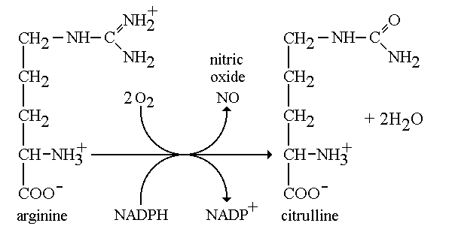
NO synthase
NO synthase has 3 isoforms which exists in different types of cells
but all of them require BH2 as a cofactor and NADPH as a coenzyme.
“isoforms not for memorization”
Isoform I (nNOS or cNOS)
  Neurons and epithelial cells
  activated by the influx of extracellular calcium
isoform II (iNOS)
  Macrophages and smooth muscle cells
  induced by cytokines
and isoform III (eNOS)
  Endothelial cells lining blood vessels
  activated by the influx of extracellular calcium
All three isoforms require BH2 as a cofactor and nicotinamide adenine dinucleotide phosphate (NADPH) as a coenzyme
THE END

