Slide 1
Small bowel obstruction

Slide 2
bowel obstruction outline
Definition
Types; Functional, mechanical
Small bowel mechanical obstruction
Large bowel obstruction
Ileus

Slide 3
Definitions
Interruption in the normal flow of intestinal contents along the intestinal tract
Ileus; when obstruction is functional

Slide 4
Etiology
Postoperative adhesions; appendectomy, colorectal surgery, and gynecologic and upper gastrointestinal (GI) procedures
Hernias
Malignancy
Inflammatory causes; Crohns’ disease
Volvulus
Foreign bodies; bezoars
In pediatric patients include congenital atresia, pyloric stenosis, and intussusception

Slide 5
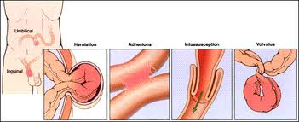
Small bowel obstruction

Slide 6
Clinical types
Partial or complete
Simple or strangulated
SBO accounts for 20% of all acute surgical admissions

Slide 7
Closed loop obstruction
Hernia
Volvulus
Colonic obstruction with a competent ileocecal valve
intussusception
Some adhesive obstructions

Slide 8
Pathophysiology
Increased peristalsis→ abdominal colic, exaggerated bowel sounds, and borborygmi
Proximal bowel distension → third space losses , electrolyte imbalance, air-fluid levels
Increased secretion and decreases absorption → fluid accumulation
Swallowed air accumulation
Bacterial overgrowth and translocation
Increased wall tension compromise of circulation

Slide 9
History
Abdominal pain
Crampy and intermittent, is more prevalent in simple obstruction.
Central
Changes in the character of the pain may indicate the development of a more serious complication (i.e., constant pain of a strangulated or ischemic bowel).

Slide 10
History
Nausea
Vomiting; reflex and reflux
constipation or obstipation
Diarrhea; in partial and intermittent obstruction
Fever and tachycardia - Occur late and may be associated with strangulation
Previous abdominal or pelvic surgery, previous radiation therapy, or both
History of malignancy - Particularly ovarian and colonic malignancy

Slide 11
Physical Examination
Abdominal distention; The proximal small bowel has less distention when obstructed than the distal bowel has when obstructed.
Hyperactive bowel sounds occur early as GI contents attempt to overcome the obstruction
Visible peristalsis
Borborygmi
Abdominal scars
Abdominal hernias
Rectal examination:
Gross or occult blood, which suggests late strangulation or malignancy
Masses, which suggest obturator hernia

Slide 12
Strangulated SBOs
Check for findings commonly believed to be more diagnostic of intestinal ischemia, including the following:
Fever
Tachycardia
Peritoneal signs
No reliable way exists to differentiate simple from early strangulated obstruction on physical examination.
Serial abdominal examinations are important and may detect changes early.

Slide 13
Terms
Bowel fatigue; ileus complicating mechanical obstruction
Feculent vomiting
Both are indicative of prolonged obstruction and need for surgery

Slide 14
Labs
Blood urea nitrogen (BUN) level
Electrolytes
Creatinine
Complete blood count (CBC)
Urinalysis
Type and cross match

Slide 15
Imaging tests
Plain radiographs first for patients in whom SBO is suspected. At least 2 views, supine or flat and upright, are required. Plain radiographs are diagnostically more accurate in cases of simple obstruction.
Enteroclysis is valuable in detecting the presence of obstruction and in differentiating partial from complete blockages. This study is useful when plain radiographic findings are normal in the presence of clinical signs of SBO or when plain radiographic findings are nonspecific.
Computed tomography (CT) scanning is the study of choice if the patient has fever, tachycardia, localized abdominal pain, and/or leukocytosis.
Ultrasonography is less costly and invasive than CT scanning and may reliably exclude SBO in as many as 89% of patients; specificity is reportedly 100%.

Slide 16
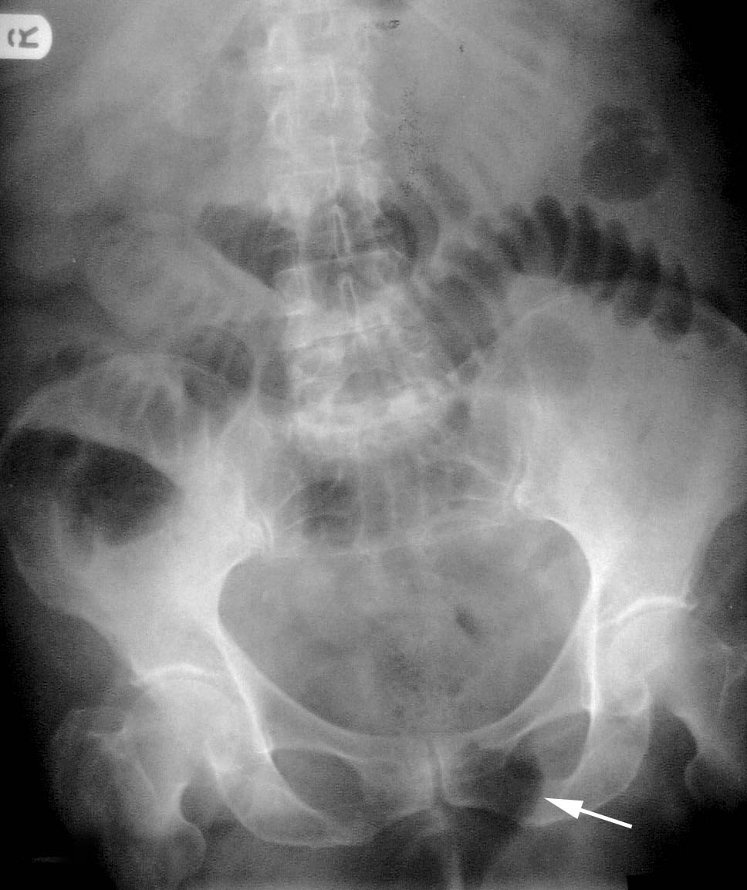
plain radiography

Slide 17
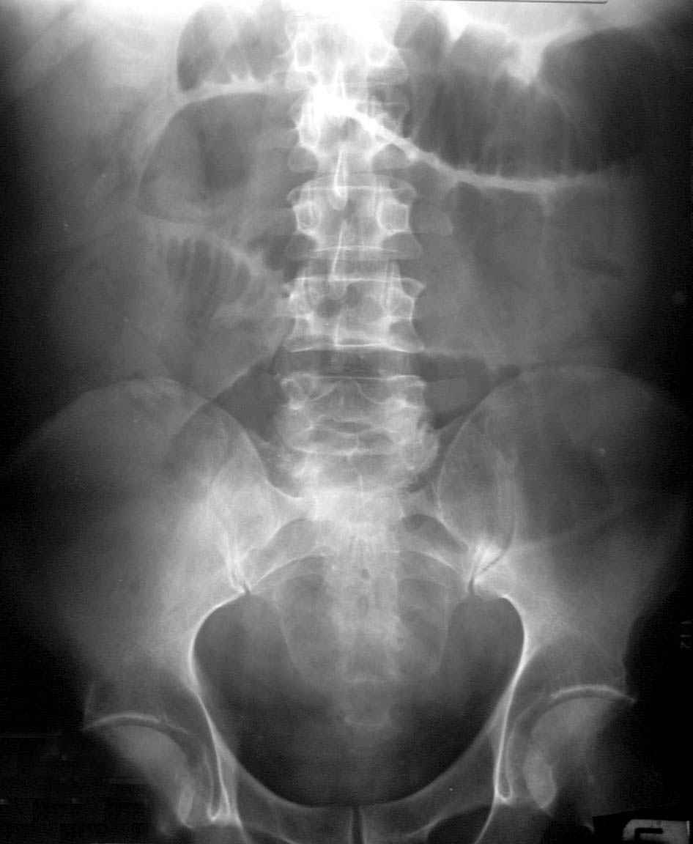
plain radiography

Slide 18
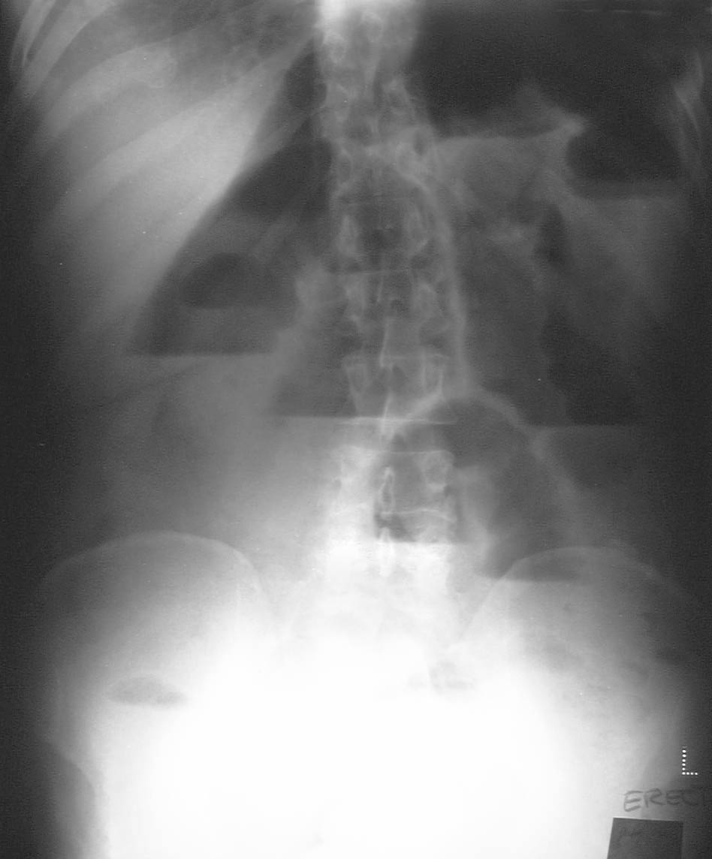
plain radiography

Slide 19
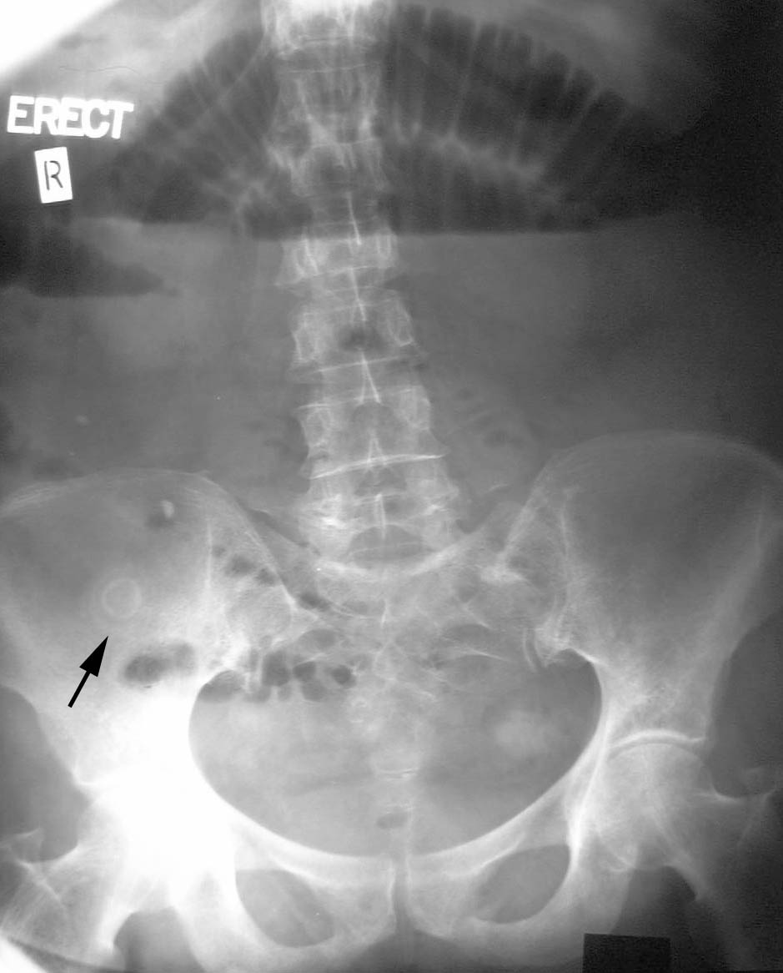
plain radiography

Slide 20
Enteroclysis
is valuable in detecting the presence of obstruction and in differentiating partial from complete blockages. This study is useful when plain radiographic findings are normal in the presence of clinical signs of small-bowel obstruction (SBO) or when plain radiographic findings are nonspecific.
Enteroclysis distinguishes adhesions from metastases, tumor recurrence, and radiation damage.

Slide 21
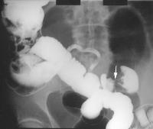
Enteroclysis

Slide 22
Computed tomography (CT)
High sensitivity and specificity
early diagnosis of strangulated obstruction
delineating the myriad other causes of acute abdominal pain, particularly when clinical and radiographic findings are inconclusive.
distinguishing the etiologies of small-bowel obstruction (SBO), that is, in distinguishing extrinsic causes (such as adhesions and hernia) from intrinsic causes (such as neoplasms and Crohn disease) and intraluminal causes, such as bezoars.

Slide 23
Computed tomography (CT)
CT scanning is capable of revealing abscess, inflammatory process, extraluminal pathology resulting in obstruction, and mesenteric ischemia
enables the clinician to distinguish between ileus and mechanical small bowel obstruction in postoperative patients.
The modality does not require oral contrast for the diagnosis of SBO, because the retained intraluminal fluid serves as a natural contrast agent.

Slide 24
Computed tomography (CT)
Obstruction is present if
the small-bowel loop is greater than 2.5 cm in diameter
dilated proximal to a distinct transition zone of collapsed bowel less than 1 cm in diameter.
A smooth beak indicates simple obstruction without vascular compromise; a serrated beak may indicate strangulation.
Bowel wall thickening, portal venous gas, or pneumatosis indicates early strangulation.

Slide 25
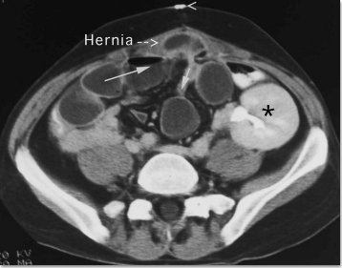
Computed tomography (CT)

Slide 26
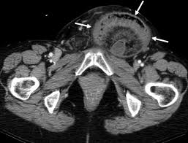
Computed tomography (CT)

Slide 27
CT Enterography
Examination of choice for intermittent small-bowel obstruction (SBO) and in patients with a complicated surgical history (e.g. prior surgery, tumors).
CT enterography displays the entire thickness of the bowel wall and allows evaluation of surrounding mesentery and perinephric fat
It uses CT-scanning technology to scan thin slices of bowel while simultaneously using large-volume enteric contrast material for imagery
CT enterography is more accurate than conventional CT scanning at finding the cause of SBO (89% vs 50%, respectively), as well as at locating the site of the obstruction (100% vs 94%, respectively).
It is useful in patients being managed conservatively

Slide 28
Ultrasonography
Is less costly and invasive than CT scanning and may reliably exclude SBO in as many as 89% of patients; specificity is reportedly 100%.
Emergency physician ̶ performed ultrasonography compared favorably with radiography.

Slide 29
Nonoperative treatment of SBO
Adhesions
Malignant tumor - Obstruction by tumor is usually caused by metastasis; initial treatment should be nonoperative (surgical resection is recommended when feasible)
Inflammatory bowel disease - high-dose steroids; consider parenteral treatment for prolonged periods of bowel rest, and undertake surgical treatment, bowel resection, and/or stricturoplasty if nonoperative treatment fails.
Intra-abdominal abscess - CT scan ̶ guided drainage is usually sufficient to relieve obstruction
Radiation enteritis - acutely, nonoperative treatment accompanied by steroids is usually sufficient; if the obstruction is a chronic sequela of radiation therapy, surgical treatment is indicated
Pediatric obstructed hernia - Initially use manual reduction and observation; advise elective hernia repair as soon as possible after reduction
Acute postoperative obstruction - This is difficult to diagnose due to postoperative ileus

Slide 30
Diagnosis and management of adhesive small bowel obstruction (ASBO)
In the absence of signs of strangulation and a history of persistent vomiting or combined CT-scan signs, patients with partial ASBO can be safely managed with nonoperative management;
Tube decompression should be attempted
Water-soluble contrast medium is recommended for both diagnostic and therapeutic purposes in patients undergoing nonoperative management

Slide 31
Diagnosis and management of adhesive small bowel obstruction (ASBO)
Nonoperative management can be prolonged for up to 72 hours in the absence of signs of strangulation or peritonitis
surgery is recommended after 72 hours of nonoperative management without resolution
Open surgery is frequently used for patients with
strangulating ASBO
after failed conservative management
in appropriate patients, a laparoscopic approach using an open access technique is recommended

Slide 32
Obstructed hernia
Pediatric inguinal hernia; the obstruction is mostly due to muscle spasm
manual reduction after sedation. Surgery on next list
Adult obstructed hernia; obstruction id due to narrow neck of the sac or adhesions within it surgery after stabilization

Slide 33
Complications of SBO
Sepsis
Intra-abdominal abscess
Wound dehiscence
Aspiration
Short-bowel syndrome (as a result of multiple surgeries)
Death (secondary to delayed treatment)

Slide 34
strangulated obstruction
A strangulated obstruction is a surgical emergency.
In patients with closed loop obstruction and in patients with a complete small-bowel obstruction (SBO), the risk of strangulation is high and early surgical intervention is warranted.
Patients with simple complete obstructions in whom nonoperative trials fail also need surgical treatment but experience no apparent disadvantage to delayed surgery.
Laparoscopy has been shown to be safe and effective in selected cases of SBO

Slide 35
strangulated obstruction mortality
If untreated, strangulated obstructions cause death in 100% of patients.
If surgery is performed within 36 hours, the mortality rate decreases to 8%.
The mortality rate is 25% if the surgery is postponed beyond 36 hours in these patients.

Slide 36
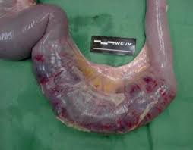
strangulated obstruction

Slide 37
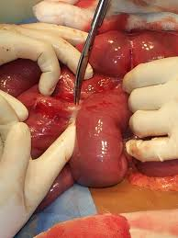
Open adhesiolysis

