Slide 1
T-test + Anova Notes for slides 13 + 14
DONE BY : Mohammad Da’as I tried my best to illustrate as much as I can the exam questions won’t get out of these slides , hope you understand them well :D فاصبر لها فلعلّها و لعلّها , و لعلّ من خلق الفضاء يحلها
<3

Slide 2
T-test
Conditions : 1- the dependent variable should be Continuous 2- compare the continuous data between two groups “means”. 3- the data are normally distributed using a. Pearson's skewness coefficient b. fisher’s “it is more accurate” then we multiply it by 3 and compare it with 1.96 to see if it was severe skewed or not 4- Homogeneity of variance between groups using Levene’s test “ the result must be insignificant comparing it with alpha point”

Slide 3
T-test answers three questions 1- if there is a significant relation between variables. 2- the magnitude . 3- to which direction.

Slide 4
types
1- one sample T-Test:
We compare our group with Norm “normal” references.
Examples:
A researcher might want to test whether the average IQ score for a group of students differs from 100.
a cereal manufacturer can take a sample of boxes from the production line and check whether the mean weight of the samples differs from 1.3 pounds at the 95% confidence level.

Slide 5
2- independent samples t-test procedure compares means for two groups of cases. Example. Patients with high blood pressure are randomly assigned to a placebo group and a treatment group. The placebo subjects receive an inactive pill and the treatment subjects receive a new drug that is expected to lower blood pressure.
After treating the subjects for two months, the two-sample t test is used to compare the average blood pressures for the placebo group and the treatment group. Each patient is measured once and belongs to one group.

Slide 6
3- dependent sample “paired T-test”
When comparing between the same group at two different times example :
We give section 1 a test before illustrating anatomy, and then we record the results now we give them another test but after we illustrate it and we record the results again. We use this kind of test to compare between them. ☺

Slide 7
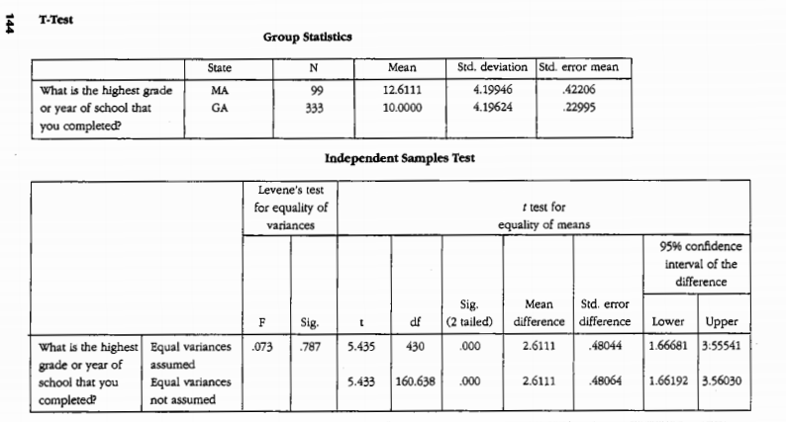
The order of the means is important
1
3
2
we check the first line only

Slide 8
First we go to levene’s , the number “0.787” is higher than alpha 0.05 so it is not significant. This means : 1- T-Test is valid
2- there are two comparable groups
3- variance is not significant
4- there is no significant confounder or any other intervention will affect the highest grade except the one we are studying “country”

Slide 9
Second, we go to column number 2 and see if the p-value is significant or not if it was significant then we reject the null hypothesis and we accept the alternative “ there is a significant DIFFERENCE between the two groups we are studying” . We answered the first question we can solve this problem using “non-parametric statistics” by transforming the data into NOMINAL and using CHI SQUARE TEST “ cross tabulation 2X2” or to ORDINAL and using MW or KW .

Slide 10
At last we check box number 3 to know what is the magnitude of difference between the two groups “the number it self” and we check if it was negative or positive for the direction. Magnitude = 5.435 direction = positive “this means that the first group (MA) is better than the second group (GA) in reaching high grades or years” if it was negative it means that the 2nd is better “this is why we told you that the order of the means is important” being positive doesn’t always mean that the 1st is better than the 2nd for example if we were comparing between two Diets the diet that makes you loose weight more Is the better so lets assume that the magnitude was -9.7 this means that the 1st diet is better than the 2nd diet in decreasing weight ☺
It depends on the variables it self , you need to focus in the scenario of the question.
و هاي هي قصة ال
T-Test

Slide 11
Important notes:
1_ the levene’s test is significant is less than alpha then (T-test is not valid) the question is solved
2_ the difference between the two groups is not significant “ higher than 0.05” the question is solved. “ there is no magnitude and Direction”

Slide 12
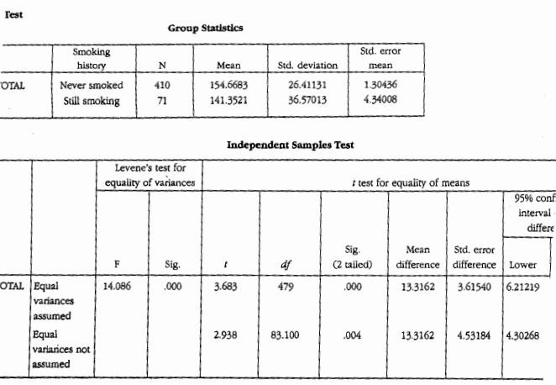

Slide 13
Anova
Conditions : they are the same as T-Test except that we should have more than two groups to compare between ☺ t-test → compare the means b/w 2 groups Anove → compare the means b/w more than 2 groups

Slide 14
Types
1 – one way anova test “one dependent”
2- two ways anova test “two ….. “
3- three ways anova test “three …”
4-multi-variate anova test “more than three…” it reflects the number of the dependent variables *don’t mix it with the independent variables they have to be more than two

Slide 15
Anova should answer many questions 1- wither there is Null hypothesis “ no significant difference between studied groups” 2- which one of the studied groups are more effective
So in anova we study the interaction “posthoc test” of the groups in pairing way “ we study the interaction of each two groups alone”

Slide 16
In the next example we will study the difference between the desirability of having a concert in a three different living places .
Very very very important note: the desirability was measured in following , 0= undesirable up to 10 = very attractive “most of us though it was ordinal level of measurement, it is the same question we had in the mid-term, the truth is when we use a scale ( 0 to 10 ) this is called ranking and we consider it CONTINUOUS level of measurement -interval-”
this is why we can use ANOVA test.

Slide 17
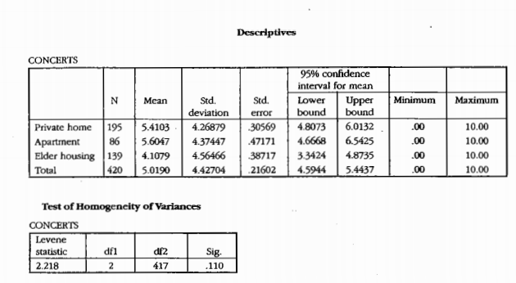
This table shows the descriptive statistics , remember that we can’t take a decision based on the difference between the means or the stdv , we can say “it seems that there is a significant difference between apartments and elder housing
Alpha = 0.05
It’s higher than alpha , not significant so Anova test is valid

Slide 18
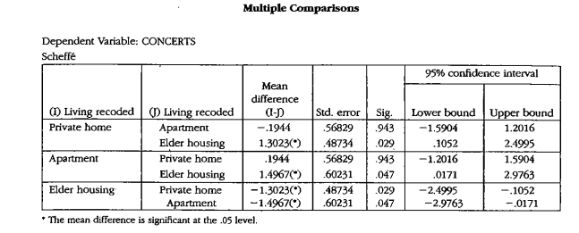
( Dependant group)
There is a significant difference between the study groups
2
1

Slide 19
Regarding the 4th table pay attention , cause we have to know what it the most desirable place to have a concert in “ the direction” we start using interactions we take the first group and compare it separately with each group by using the column number 1 in order to see if there was significant relation or not “p-value is less than alpha”
Cheating trick ☺ : you’ll find a small star in column 2 this means that there is a significant relation (*) then we take the 2nd group and compare it with 3rd and 1st ……. وهكذا

Slide 20
Results
There is no significant difference between 1st and 2nd groups
there is a significant difference between 1st and 3rd group “check the small star”
there is no significant difference between 2nd and 1st “ a repeated point”
there is a significant difference between 2nd and 3rd
Now which two groups have the highest significant difference ? we take the smallest p-value “ closest to the zero = 0.029” which is between the 1st and the 3rd groups .

Slide 21
In order to know which place is the most effective or desired to have a concert in , we have to use the direction , we go back to column number 2 so, the mean difference between 1st “private home” and the 3rd “Elder housing” is 1.3023 (this is the magnitude) the positive value means that the 1st group has higher desirability than the 3rd (we are looking for the place that has high desirability to throw a concert in that’s why we took the positive value into consideration) IF it was negative “ then it means the 3rd group is better” “ same story as T-Test”
وصلى الله و سلم على رسوله الكريم :)
حتلاقوا كتير أخطاء قواعدية و إملائية
Sorry for that GOOD LUCK in tomorrow’s exam o inshallah high marks <3 <3

