Slide 1
The Adrenal Gland

Slide 2
Anatomy:

Slide 3
Histology:

Slide 4
Aldosterone
Principle: stimulates Na+/water reabsorbtion
K+ excretion
Lumen
cells

Slide 5
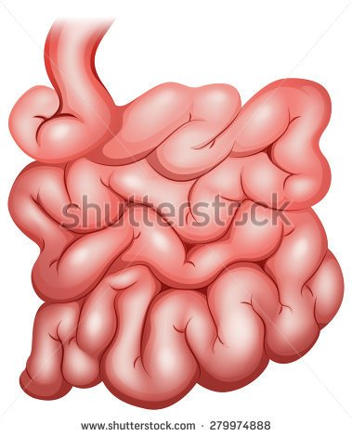
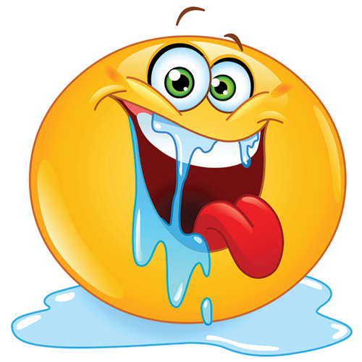
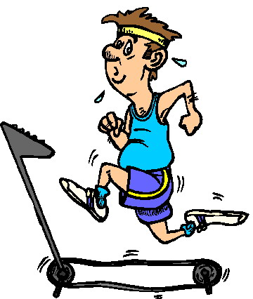
Site of action:
intestines
sweat glands
Salivary glands
Kidney

Slide 6
Aldosterone

Slide 7
Cellular mechanism
Aldosterone diffuses readily to the interior of the cell aldosterone binds its receptor Aldosterone receptor complex diffuses into the nucleus and stimulate DNA transcription to mRNA mRNA diffuses back to the cytoplasm where it is translated to proteins.

Slide 8
The protein formed are 2 types:
Enzymes: Na+_K+ ATPase which serves as the principle part of the pump for sodium and potassium exchange.
Membrane transport proteins: epithelial sodium channel (ENaC) which allows rapid diffusion of sodium into the cell from the lumen.

Slide 9
ALDOSTERONE EXCESS
HYPERTENSION
ALKALOSIS
MUSCLE WEAKNESS

Slide 10
Aldosterone
Blood flow
Filtration

Slide 11
Aldosterone ESCAPES WITH HYPERTENSION!!!

Slide 12
Aldosterone
Principle: stimulates Na+/water reabsorbtion
K+/ H+ excretion (ALKALOSOS)!!!
Lumen
cells
K
K
K
K
K
H+
K
H+
K
H+
H+

Slide 13
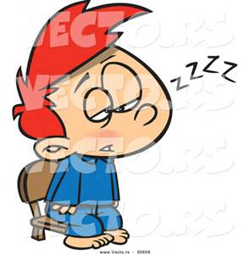
MUSCLE WEAKNESS = MEMBRANE EXCITABILITY DECREASES

Slide 14
ALDOSTERONE EXCESS
HYPERTENSION
ALKALOSIS
MUSCLE WEAKNESS

Slide 15
Aldosterone Deficiency:
Acidosis
Cardiac shock
Hypotension

Slide 16
Aldosterone regulation
Potassium ion concentration
Angiotensin 2 concentration, for example:
Angiotensin 2 is secreted in response to diminished blood flow to the kidneys or to sodium loss.
Angiotensin2 is secreted in response to renin which is secreted by the kidney.
Sodium concentration, increased sodium concentration in the extra cellular fluid slightly decreases aldosterone secretion.
ACTH is necessary for aldosterone secretion but has a slight role in the amount secreted

Slide 17
Sweat gland/ salivary gland/ intestines
To prevent water and salt loss!!

Slide 18
Cortisol Mineralocorticoids
Cortisone Mineralocorticoid

Slide 19
CORTISOL & carbohydrates

Slide 20
CORTISOL & proteins
Body except the liver
the liver

Slide 21
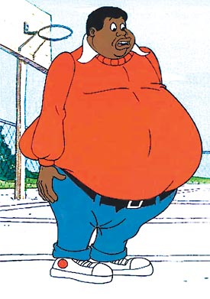
Cortisol and fat
Lipolysis ,,,,,BUT:

Slide 22
CORTISOL & stress

Slide 23
Regulation of cortisol secretion:
Cortisol secretion is regulated by adrenocortico tropic hormone ( ACTH)
ACTH secretion is regulated by:
corticotrophin releasing factor (CRF) from the hypothalamus. CRF is highly secreted in response to physiological stimuli.
Cortisol by negative feedback mechanism. so excess cortisol has inhibitory effect on the hypothalamus( decrease CRF secretion) and the anterior pituitary (decrease ACTH secretion)
ADH

Slide 24
ANDROGENS
Zona reticularis produces ANDROGENS + LITTLE AMOUNT OF ESTROGENS.
Regulated by ACTH

Slide 25
CLINICAL PROBLEMS:

Slide 26
CLINICAL PROBLEMS:

Slide 27
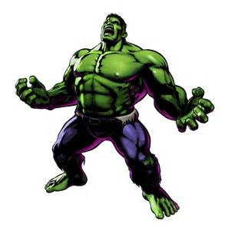
Adrenogenital Syndrome:
Caused by an Adrenocortical tumor which secretes high amounts of androgens.

