Slide 1
The case of Dennis Fawcett
5-years old
Presented by: Laila Al-Hafez

Slide 2
My boy is sick!
Severe acute infection of the ethmoid sinuses

Slide 4
History
pneumonia
Pneumocystis jirovecii
Notes:
recurrent sinus infections since he was 1 year old, pneumonia
from an infection with Pneumocystis jirovecii when he was 3 years old

Slide 5
Severe acute infection of the ethmoid sinuses
My boy is sick!
streptococci were cultured

Slide 6
WBCs count should be high
UHHA
↓WBC count
↓neutrophil number
↑Monocytes number
Notes:
You however treated with IV antibiotics

Slide 7
Seven days later..
NO antibodies against the streptococcal antigen were found
IgG low
IgA undetectable
IgM elevated
B cells: surface lgM and lgD
none with surface lgG or lgA.
Notes:
treated with intravenous antibiotics, his serum was tested for antibodies against
streptolysin 0,

Slide 8
HyperIgM Syndrome
AKA CD40 Ligand Deficiency(x-linked)
Could also result from CD40 deficiency(AR), although rare.

Slide 9
Normal Immunology

Slide 10
B cell activation
IgD
IgM
IgM
CD40/CD40L not involved This pathway is intact.

Slide 11
Class switching
CD40 CD40L
CD4+
IL-4, IL-5, others

Slide 12
The combination of CD40 signals and cytokines activate the APCs
CD4+ T cell
Macrophage
CD40L CD40
IFN-γ

Slide 13
Let’s think of why..

Slide 14
Let’s think of why..
Severe acute infection of the ethmoid sinuses
My boy is sick!
streptococci were cultured
Pyogenic; Encapsulated ↓IgG - opsonin
Notes:
pyogenic (pus-forming) bacteria such as
Haemophilus influenzae, Streptococcus pneumoniae, Streptococcus pyogenes,
and Staphylococcus aureus, which are resistant to destruction by phagocytic
cells unless they are coated (opsonized) with antibody and complement

Slide 15
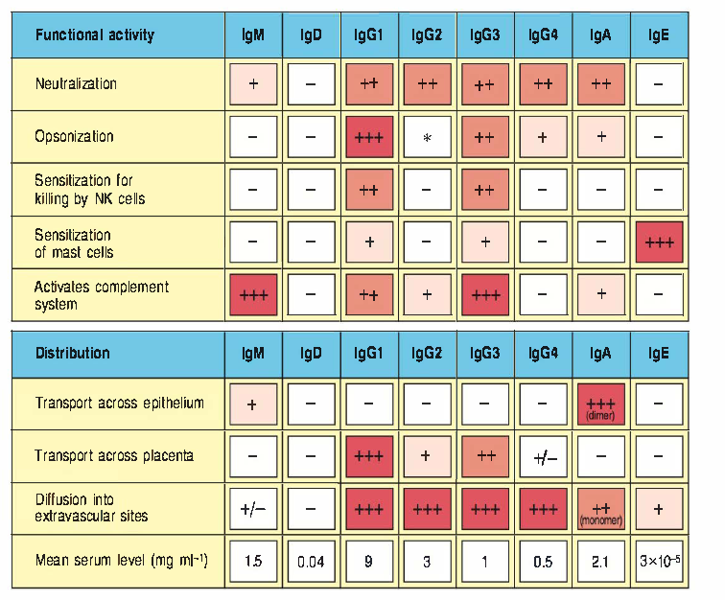

Slide 16
Let’s think of why..
WBCs count should be high
UHHA
CD40/CD40L also critical for helper T-cell mediated activation of macrophages
↓WBC count
↓neutrophil number
↑Monocytes number
IFN-γ
Notes:
You however treated with IV antibiotics

Slide 17
Let’s think of why..
WBCs count should be high
UHHA
Very high IgM attach circulating cells causing cytopenia
↓WBC count
↓neutrophil number
↑Monocytes number
IFN-γ
Notes:
You however treated with IV antibiotics

Slide 18
History
Let’s think of why..
pneumonia
Pneumocystis jirovecii
Immunodeficiency= opportunistic infections. Intracellular pathogen
Notes:
recurrent sinus infections since he was 1 year old, pneumonia
from an infection with Pneumocystis jirovecii when he was 3 years old

Slide 19
Seven days later..
Let’s think of why..
NO antibodies against the streptococcal antigen were found
IgG low
IgA undetectable
IgM elevated
B cells: surface lgM and lgD
none with surface lgG or lgA.
IgG2 class is induced by pneumococcal capsular polysaccharide
Notes:
treated with intravenous antibiotics, his serum was tested for antibodies against
streptolysin 0,

Slide 20
T-independent non-protein antigens do induce Ig isotypes other than IgM

Slide 21
Seven days later..
Let’s think of why..
NO antibodies against the streptococcal antigen were found
IgG low
IgA undetectable
IgM elevated
B cells: surface lgM and lgD
none with surface lgG or lgA.
TGF-β secreted by many non-lymphoid cells at mucosal sites help mediate IgA switch
Notes:
treated with intravenous antibiotics, his serum was tested for antibodies against
streptolysin 0,

Slide 22
Seven days later..
Let’s think of why..
did he not have any difficulty in isotype switching from lgM to lgD?
NO antibodies against the streptococcal antigen were found
IgG low
IgA undetectable
IgM elevated
B cells: surface lgM and lgD
none with surface lgG or lgA.
Notes:
treated with intravenous antibiotics, his serum was tested for antibodies against
streptolysin 0,

Slide 23
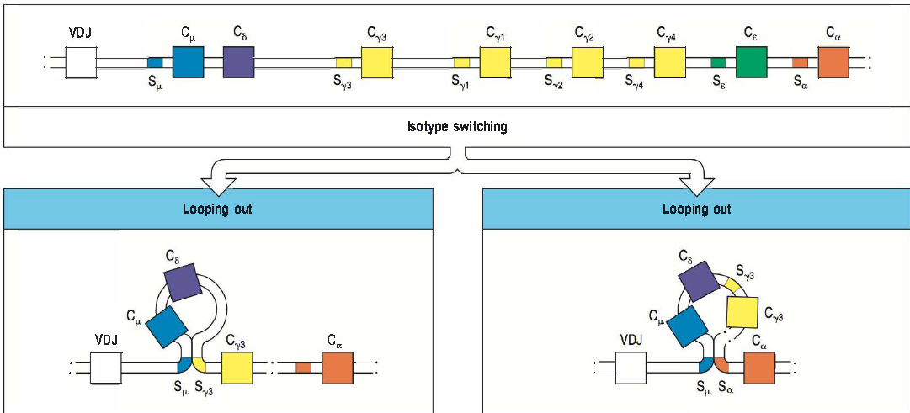
Notes:
switch region (S)

Slide 24
did Dennis make antibodies against blood group A and B antigens but not against tetanus toxoid, typhoid 0 and H, and streptolysin antigens? Would he have made any antibodies in response to his Streptococcus pyogenes infection
Let’s think of why..

Slide 25
B cell activation
IgD
IgM
IgM
Non-peptide antigens
CD40/CD40L not involved This pathway is intact.

Slide 26
peptide antigens
Class switching
CD40 CD40L
CD4+
IL-4, IL-5, others

Slide 27
Newborns have difficulty in transcribing the gene for CD40L.↑susceptibility of newborns to pyogenic infections.
Cyclosporin A, (immunosuppression in graft) inhibits transcription of the gene for CD40L. What does this imply for patients taking this drug?

Slide 28
Dennis died of liver failure at 21 years of age.
The End
Notes:
1 5 years of age, he developed severe, watery diarrhea. Cryptosporidium parvum.

