Slide 1
Medical Virology Viral Carditis
Dr. Sameer Naji, MB, BCh, PhD (UK)
Dean Assistant
Head of Basic Medical Sciences Dept.
Faculty of Medicine
The Hashemite University
Edited by: Mohammad Qussay Al-Sabbagh

Slide 2
Myocarditis – Introduction
Myocarditis is an inflammatory disorder of the myocardium with (1)necrosis of the myocytes and (2)associated inflammatory infiltrate.
There are multiple etiologies including viral, bacterial, parasitic, fungal, allergic, eosinophilic, granulomatous, toxic, and post-viral immune-mediated response.
It can be acute, subacute, or chronic, and there may be either focal or diffuse involvement of the myocardium.
suspected myocarditis can be classified into the following 3 types based on pathologic findings as defined in the Dallas Criteria (1987).

Slide 3
Dallas criteria:
Active myocarditis: the presence of an inflammatory infiltrate of the myocardium with necrosis and/or degeneration of adjacent myocytes not typical of the ischemic damage associated with coronary artery disease (CAD).
Borderline myocarditis: the presence of an inflammatory infiltrate of the myocardium without necrosis or degeneration of adjacent myocytes.
Nonmyocarditis
If an active or borderline inflammatory process is found, follow-up biopsies can be subclassified into ongoing, resolving, or resolved myocarditis.

Slide 4
Historical Background
Recognized as early as 1806 as a persistent inflammatory process of the myocardium following infections, such as diphtheria (lysogenic C. diphtheria), that led to progressive cardiac damage and dysfunction.
In 1837, the term myocarditis was first introduced to describe inflammation or degeneration of the heart detected by postmortem examination.
In 1980, Endomyocardial biopsy allowed the sampling of human myocardial tissue during life and consequently enabled antemortem diagnosis of myocarditis.

Slide 5
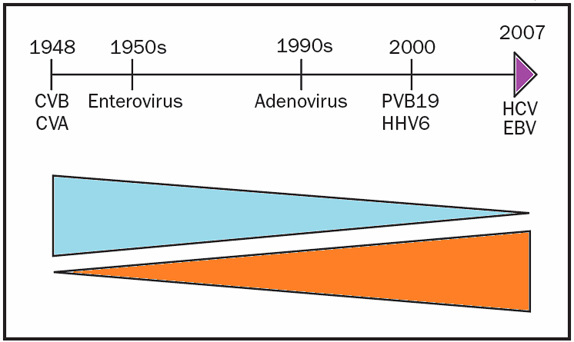
Most common cause is CVB
Evolution of viral causes of myocarditis over time
Enterovirus Myocarditis
Nonenterovirus Myocarditis
CVA = coxsackievirus A; CVB = coxsackievirus B; EBV = Epstein-Barr virus;
HCV = hepatitis C virus; HHV6 = human herpesvirus 6; PV-B19 = parvovirus B19.

Slide 6
Pathphysiology
Myocarditis generally results in a decrease in myocardial function, with concomitant enlargement of the heart and an increase in the end-diastolic volume caused by increased preload.
Normally, the heart compensates for dilation with an increase in contractility (Starling law), but because of inflammation and muscle damage, a heart affected with myocarditis is unable to respond to the increase in volume.
In addition, inflammatory mediators, such as cytokines and adhesion molecules, as well as apoptotic mechanisms are activated.
The progressive increase in left ventricular end-diastolic volume increases left atrial, pulmonary venous, and arterial pressures, resulting in increasing hydrostatic forces.
These increased forces lead to both pulmonary edema and congestive heart failure.
Without treatment, this process may progress to end-stage cardiac failure and death.

Slide 7
Pathogenesis
Both direct viral-induced myocyte damage and post-viral immune inflammatory reactions contribute to myocyte damage and necrosis
Inflammatory lesions and the necrotic process may persist for months, although the viruses only replicate in the heart for at most two or three weeks after infection
Evidence from experimental models has incriminated cytokines such as interleukin-1 and TNF, oxygen free radicals and microvascular changes as contributory pathogenic factors

Slide 8
Three phases:
Viral Infection and Replication
Autoimmunity and injury
Dilated cardiomyopathy

Slide 9
Phase I: Viral Infection and Replication
Viruses like coxsackievirus B cause an infectious phase, which lasts 7-10 days, and is characterized by active viral replication
Virus infection directly contributes to cardiac tissue destruction by cleaving the cytoskeleton protein dystrophin, leading to a disruption of the dystrophin-glycoprotein complex causing the release of antigenic intracellular components such as myosin into the bloodstream
Not that important, you have to know only that viral infection Causes release of myosin

Slide 10
Phase II: Autoimmunity and injury
The local release of cytokines, such as interleukin-1, interleukin-2, interleukin-6, tumor necrosis factor (TNF), and nitric oxide may play a role in determining the T-cell reaction and the subsequent degree of autoimmune perpetuation.
These cytokines may also cause reversible depression of myocardial contractility without causing cell death.
Immune-mediated by CD8 lymphocytes and autoantibodies against various myocyte components
Antigenic mimicry, the cross reactivity of antibodies to both virus and myocardial proteins
Myocyte injury may be a direct result of CD8 lymphocyte infiltration
The cytotoxic activity against healthy cardiomyocytes was myocyte - specific, induced by CD8⁺ lymphocytes and MHC restricted.

Slide 11
Phase III: Dilated Cardiomyopathy (DCM)
Viruses may also directly cause myocyte apoptosis.
During the autoimmune phase, cytokines activate the matrix metalloproteinase, such as gelatinase, collagenases, and elastases. (Don’t memorize the names)
In later stages of immune activation, cytokines play a leading role in adverse remodeling and progressive heart failure.
Cardiomyopathy develops despite the absence of viral proliferation but is correlated with elevated levels of cytokines such as TNF.

Slide 12
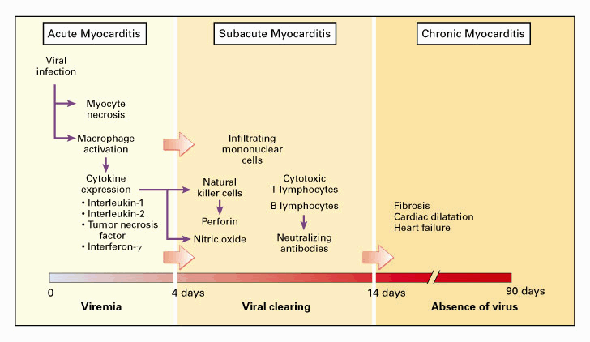
Stages of Viral Myocardium Infection
Read only

Slide 13
Viral Causes
Memorize underlined viruses only
Infecting organisms include the following:
Coxsackievirus types A and B, especially type B, are the most common viral causes of myocarditis.
Adenovirus (types 2 and 5 most common)
Cytomegalovirus
Echovirus
Epstein-Barr virus
Hepatitis C virus
Herpes Simplex virus
Human immunodeficiency virus
Influenza and parainfluenza viruses
Measles virus
Mumps, associated with endocardial fibroelastosis (EFE)
Parvovirus B19
Poliomyelitis virus
Rubella virus
Varicella -Zoster virus

Slide 14
Coxsackieviruses
Coxsackie B viruses are estimated to be responsible for at least 50% of the cases of infection-caused heart diseases.
For reasons yet unknown, the cardiac disease caused by this virus mainly occurs in middle-aged men, with onset occurring, on average, around age 42 years.
The cardiac disease becomes apparent about two weeks after exposure to the virus.
Child with myocarditis → think about Coxsakie B

Slide 15
Coxsackie Virus Clinical Manifestations
The early symptoms of the coxsackie -induced cardiac myopathy include some generalized viral symptoms-fever, fatigue, malaise-with the addition of chest pain.
As the virus enters the heart cells, the immune system attacks and damages both infected and normal heart cells; the affected individual feels severe fatigue when there is significant impairment of heart function.
In most cases, the disease is resolved spontaneously without any treatment, though some permanent heart damage may have occurred
In about 20% of the cases, there can be progressive disease or recurrence of symptoms; the heart damage can be extensive, causing arrhythmias, weakened left ventricular functions, and, in the worst cases, heart failure requiring heart transplantation.

Slide 16
In these severe cases, cardiac disease progression persists after the virus is long gone; the immune system continues to damage the heart.
Heart failure: This is the most common presenting picture in all ages.
Chest pain: Although rare in young children, this may be the initial presentation for older children, adolescents, and adults.
Chest pain may be due to myocardial ischemia or concurrent pericarditis.
Arrhythmia

Slide 17
Laboratory Diagnosis
Complete blood count with differential
Acute anemia of any origin may cause heart failure, and chronic anemia exacerbates heart failure; both respond to blood transfusion.
The presence of lymphocytosis or neutropenia supports diagnosis of a viral infection.
Blood culture: It is important to rule out any bacterial infection
Viral culture: Nasopharyngeal and rectal swabs may help identify etiology.
Viral Serology: A 4-fold increase in a specific titer from the acute to convalescent phase is strong evidence of infection.
Molecular Tests:
In situ hybridization
Polymerase chain reaction (PCR) – not antigen-antibody rxn

Slide 18
Enzyme Biomarkers:
Elevated secondary to myocardial damage from inflammatory cell infiltrates, cytokine activation and virus- mediated cell death.
More useful when high sensitivity thresholds are used
Troponin T threshold of >0.1ng/mL increases sensitivity from 34% to 53% and a specificity of 94%
Cardiac biomarkers i.e. creatine kinase and troponin T and I ( elvated in around 40%) are routinely measured
CKMB is not useful - too insensitive (overall 8%).
ESR found to have low sensitivity and specificity.

Slide 19
Treatments/Therapeutic Approaches
Read only
Supportive therapy
Immunosuppression
Interferon
Intravenous immunoglobulin
Immune adsorption
Immune modulation
Vaccination

Slide 20
Prognosis
Acute myocarditis and mild cardiac involvement generally will recover in the majority of cases without long-term sequelae, Granulomatous necrotizing myocarditis is lethal if overlooked and untreated.
Nonfulminant active myocarditis has a mortality rate of 25% to56% within 3 to 10 years.
Myocarditis Treatment Trial, still have a relatively poor prognosis. These patients all had the diagnosis of myocarditis based on the Dallas biopsy criteria and showed a mortality of 20% at 1 year and 56% at 4.3 years, with many cases of chronic heart failure despite OMT.
Not that important, only know that the prognosis is good in most cases

Slide 21
Epidemiology
No racial predilection exists.
No sex predilection exists in humans, but there is some indication in laboratory animals that the disease may be more aggressive in males than in females.
Certain strains of female mice had a reduced inflammatory process when treated with estradiol.
In other studies, testosterone appeared to increase cytolytic activity of T lymphocytes in male mice.
No age predilection exists.
Younger patients, especially newborns and infants, and immunocompromised patients may be more susceptible to myocarditis.

Slide 22
Mortality/Morbidity
With suspected coxsackievirus B, the mortality rate is higher in newborns (75%) than in older infants and children (10-25%).
Complete recovery of ventricular function has been reported in as many as 50% of patients.
Some patients develop chronic myocarditis (ongoing or resolving) and/or dilated cardiomyopathy and may eventually require cardiac transplantation.

Slide 23
Prevention
As a result of the widespread use of vaccination in developed countries, myocarditis secondary to measles, rubella, mumps, poliomyelitis, and influenza is now rare
Similarly, the elimination of trichinosis by meat inspection has eliminated this infection
It is possible that vaccines against other cardiotropic viruses may prevent viral myocarditis

Slide 24
Other Rare Causes of Heart Infection
Bacterial Causes
- Diphtheria - Myocarditis
- Psittacosis (Chlamydia psittaci) - Endocarditis
- Q fever (Coxiella burnetii) - Pericarditis, myocarditis, and
endocarditis. Endocarditis is frequently associated with
purpuric rash, renal insufficiency, stroke, and heart failure.
- Typhus (Rickettsia spp) - Myocarditis
Parasitic Causes
- Chagas' Disease (americanTrypanosoma cruzi) - Myocarditis
- Trichinosis (Trichinella spiralis) – Myocarditis: it loves contractile tissues, so it resides in skeletal muscles, but may infect thr heart.
- Amebiasis ( Entameba histolytica) - Pericarditis
- Trypanosomiasis (Trypanosoma brucei rhodesiense or T b
gambiense/ Tsetse is the vector ) - Myocarditis
Important

