Slide 1
White blood cells disorders
Non-neoplastic

Slide 2
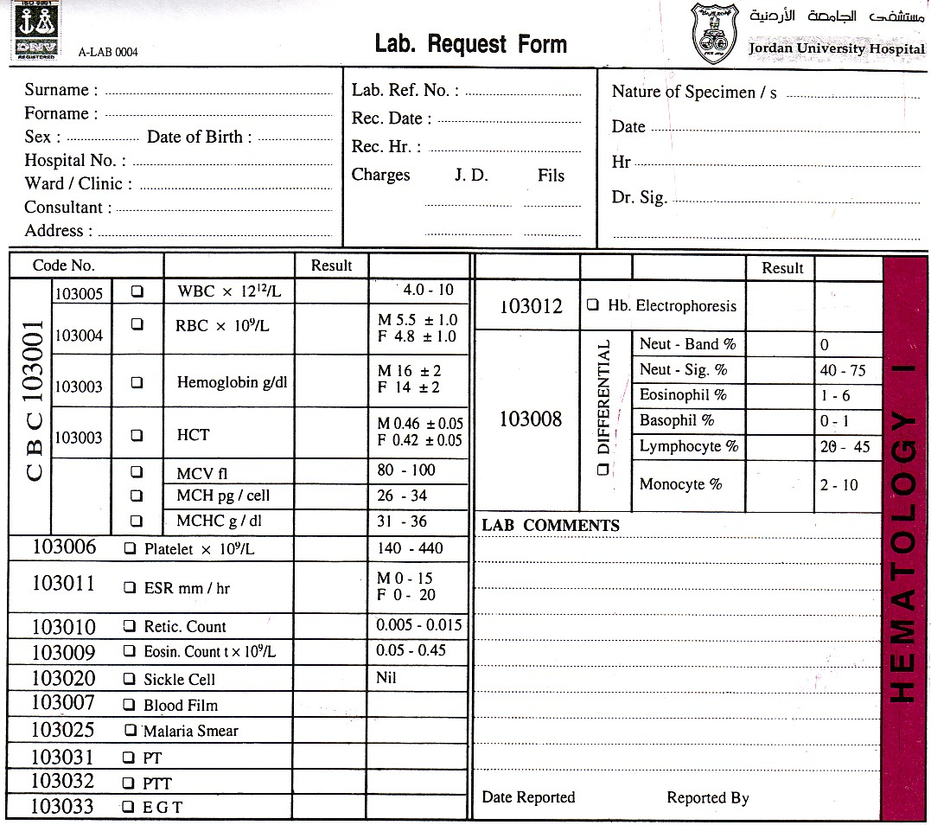

Slide 3
Leukopenia
Leukopenia: decrease in WBC count below average levels, results most commonly from a decrease in neutrophils

Slide 4
Neutropenia
ANC < 1500 cell/ microliter
Severe neutropenia: <500, spontaneous infection

Slide 5
Causes of neutropenia
1) Decreased production
Part of pancytopenia: aplastic, myelophthisic, megaloblastic anemias, myelodysplastic syndrome, chemotherapy
Isolated neutropenia:
Acquired: drugs (anti epileptic, anti psychotic, anti-hyperthyroidism), autoimmune
Congenital:
Schwachman-Diamond Syndrome: AR, SBDS gene mutation, skeletal abnormalities, pancreatic exocrine deficiency
Chediak- Higashi syndrome: AR, LYST gene, abnormal lysosomal aggregation and dysfunction, platelet dysfunction, albinism
BM morphology: decreased myeloid cells (hypocellular)

Slide 6
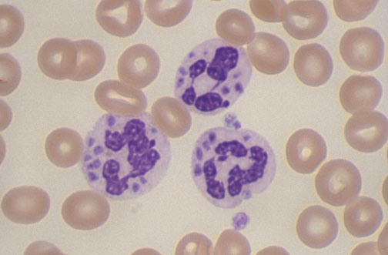
Chediak-Higashi syndrome (CHS) is due to aberrant cellular handling of lysosomes. Giant granules are found in many cell types, including neutrophils. CHS patients may also be neutropenia

Slide 7
Causes
Increased destruction
Special infection settings (severe sepsis, salmonella, brucella)
Immune mediated
Cyclic neutropenia (ELANE gene mutation, abnormal Elastase accumulation, apoptosis)
Hypersplenism
PNH
BM morphology: increased myeloid cells (hypercellular)

Slide 8
Lymphopenia
Less common than neutropenia
HIV infection (increased destruction)
Corticosteroid therapy (inhibits migration)
Congenital immunodeficiency (decreased production)

Slide 9
Reactive Leukocytosis
An increase in the number of white cells in the blood is common in a variety of inflammatory states caused by microbial and nonmicrobial stimuli. Leukocytoses are relatively nonspecific and are classified according to the particular white cell series that is affected
Leukemoid reaction: marked increase in WBC count with left-shifted granulpoiesis, mimicking chronic myelogenous leukemia. Occurs in severe stress, paraneoplastic syndrome

Slide 10
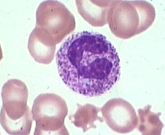
Neutrophilia
Infection (bacterial)
Burn
Tissue necrosis (myocardial infarction)
steroid
Neutrophils show toxic granulation and cytoplasmic vacuoles

Slide 11
Eosinophilia
Allergic reactions
Parasitic infections
Drug reactions
Some malignancies (Hodgkin lymphoma)

Slide 12
Monocytosis
Chronic infections
Inflammatory bowel disease
Rheumatologic diseases

Slide 13
Lymphocytosis
Viral infections
Tuberculosis
Rheumatologic diseases

Slide 14
Reactive Lymphadenitis
Lymphocyte response to antigen stimulus in the body (Infections, autoimmune)
Leads to lymph node enlargement (lymphadenopathy)
Acute is commonly painful, follows bacterial or viral infections

Slide 15
Chronic Reactive Lymphadenitis
Follicular hyperplasia: proliferation of germinal center B-cells resulting in enlarged follicles, occur in HIV, Toxoplasmosis, Rheumatologic diseases
Paracortical (diffuse) hyperplasia: proliferation of T-cells in the interfollicular areas, caused by viral infection, drug reaction, post vaccination

Slide 16
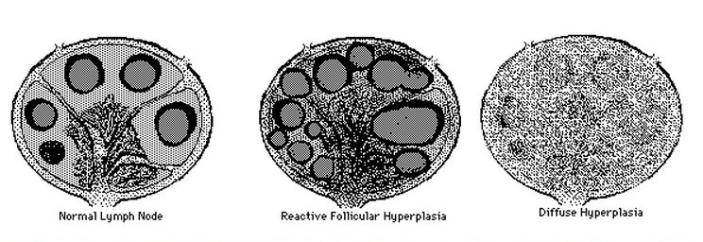

Slide 17
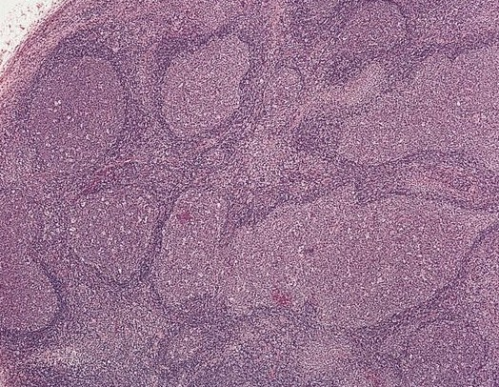
Reactive follicular hyperplasia: note the enlarged follicles, variable sizes and shapes

