Slide 1
colonic obstruction

Slide 2
Etiology
The most common causes of adult large-bowel obstruction
Neoplasm (benign or malignant)
Stricture (diverticular or ischemic)
Volvulus (colonic, sigmoid, cecal)
Intussusception, usually with an identifiable anatomic abnormality in adults but not in children
Impaction

Slide 3
Pathophysiology
Bowel dilatation above the obstruction causes
Mucosal edema and wall tension impair venous and arterial blood flow to the bowel.
Bowel edema and ischemia increase the mucosal permeability of the bowel
Bacterial translocation and systemic toxicity
Dehydration and electrolyte abnormalities.
Bowel ischemia can lead to perforation and fecal soilage of the peritoneal cavity.
In cases of closed loop obstructions, such as colonic obstruction in the presence of a closed ileocecal valve or incarcerated hernia, this process may be accelerated.

Slide 4
Colonic obstruction
It is important to distinguish colonic obstruction from ileus, and differentiate between a true mechanical obstruction and a pseudo-obstruction, as the treatment differs.
Colonic obstruction is more common in elderly individuals, due to the higher incidence of neoplasms and other causative diseases in this population.
In neonates, colonic obstruction may be caused by an imperforate anus or other congenital anatomic abnormalities

Slide 5
clinical
History
bowel movements, flatus, obstipation
Attempt to distinguish complete bowel obstruction from partial obstruction, which is associated with passage of some gas or stool.
Also inquire about the patient's current and past history

Slide 6
clinical
History
crampy abdominal pain
abdominal distention
nausea
Vomiting
An abrupt onset of symptoms makes an acute obstructive event (eg, cecal or sigmoid volvulus) a more likely diagnosis.
A history of chronic constipation, long-term cathartic use, and straining at stools implies diverticulitis or carcinoma.
Changes in the patient's caliber of stools strongly suggest carcinoma. When associated with weight loss, the likelihood of neoplastic obstruction increase

Slide 7
clinical
Physical Examination
Abdominal distention is prominent
The bowel sounds may be normal early
the abdomen is hyperresonant to percussion.
Fever, severe tenderness, and abdominal rigidity are ominous signs that suggest peritonitis secondary to strangulation or perforation.
The cecum is the area most likely to perforate (Laplace law)

Slide 8
clinical
Physical Examination
The presence of rigidity or peritoneal signs may be indicative of another intra-abdominal process, such as an abscess.
Sigmoid diverticulitis and a perforated sigmoid secondary to carcinoma are clinically difficult to differentiate.
A rectal or lower sigmoidal mass may be palpated on rectal examination.
An abdominal mass or fullness may be palpated

Slide 9
clinical
Physical Examination
Evaluation of the inguinal and femoral regions should be an integral part of the examination in a patient with suspected large-bowel obstruction.
Incarcerated hernias represent a frequently missed cause of bowel obstruction. In particular, colonic obstruction is often caused by a left-sided inguinal hernia with the sigmoid colon incarcerated in the hernia

Slide 10
                clinical
                Physical Examination
Digital rectal examination
Perform a digital rectal examination to verify the patency of the anus in a neonate. The examination focuses on identifying rectal pathology that may be causing the obstruction and determining the contents of the rectal vault.
Hard stools suggest impaction; An empty vault suggests obstruction proximal to the level that the examining finger can reach.
Fecal occult blood testing should be performed. A positive result may suggest the possibility of a more proximal neoplasm.

Slide 11
Plain radiographs
An upright chest radiograph is useful to screen for free air which would suggest perforation.
Flat and upright abdominal radiographs can help distinguish severe constipation from bowel obstruction.
Plain films may also help localize the site of obstruction (large vs small bowel).
Sigmoid or cecal volvulus may have a kidney-bean appearance on the abdominal films
Intramural air is an ominous sign that suggests colonic ischemia.
The absence of free air does not exclude perforation

Slide 12
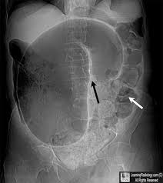
Sigmoid volvulus

Slide 13
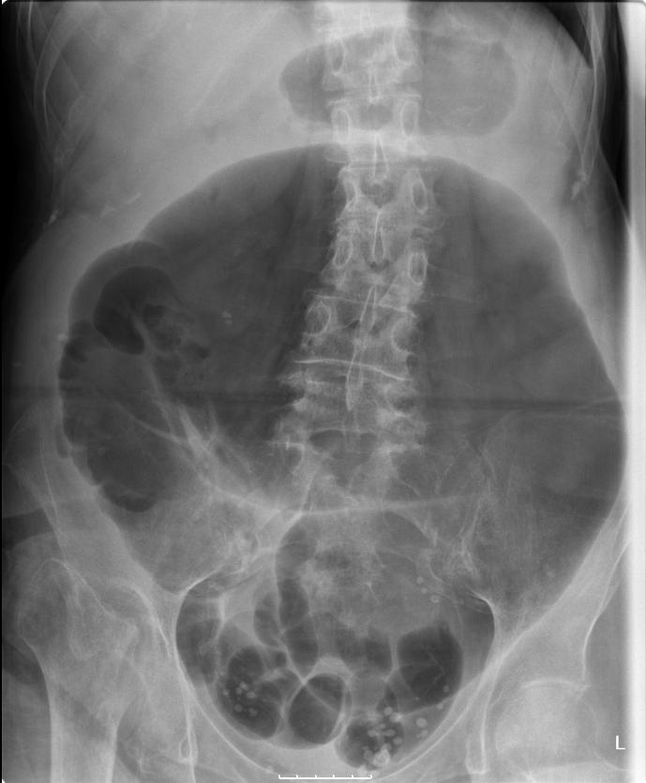
Cecal volvulus

Slide 14
Contrast studies
include an enema with water-soluble contrast
Contrast studies that reveal a column of contrast ending in a "bird's beak" are suggestive of colonic volvulus.

Slide 15
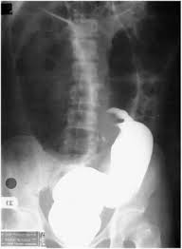
Gastrographin enema in sigmoid volvulus

Slide 16
Computed tomography
CT scanning is the imaging of choice if a colonic obstruction is clinically suspected.
Contrast-enhanced CT (PO and IV) can help to delineate between partial and complete obstruction, ileus, and small-bowel obstruction.
water-soluble contrast should be used preferentially

Slide 17
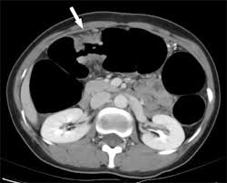
CA COLON

Slide 18
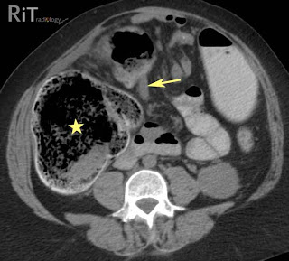
OBSTRUCTED CA COLON

Slide 19
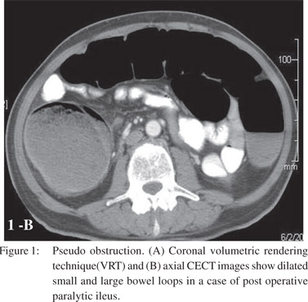
Ogilvie syndrome

Slide 20
Labs
Routine complete blood cell count
CBC
serum chemistries
urinalysis.
prothrombin time (PT) as well as a type and crossmatch.

Slide 21
Management
Initial therapy in patients with suspected large-bowel obstruction
volume resuscitation,
appropriate preoperative broad-spectrum antibiotics
timely surgical consultation.
A nasogastric tube should be considered for patients with severe colonic distention and vomiting.
intravenous fluid (IVF) resuscitation with isotonic saline or Ringer lactate solution is necessary.
Surgical intervention is frequently indicated, depending on the cause of the obstruction. Closed loop obstructions, bowel ischemia, and volvulus are surgical emergencies

Slide 22
Volvulus
A colonic volvulus results when the colon twists on its mesentery, which impairs the venous drainage and arterial inflow. The cecum and sigmoid colon are most commonly affected.
Volvulus typically occurs in elderly, debilitated individuals; patients living in an institutionalized setting; or patients with a history of chronic constipation (western type).
African type is related to high fiber diet
during pregnancy, most commonly occurring in the third trimester

Slide 23
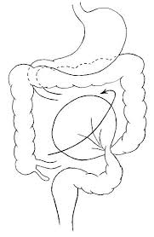
Volvulus

Slide 24
Volvulus
Endoscopic reduction and decompression of a sigmoid volvulus can be performed in the absence of peritoneal signs. This procedure is also contraindicated when evidence of mucosal ischemia is present on endoscopy
Recurrence after decompression is as high as 50%; thus, surgical resection is indicated.
Emergency surgery is indicated in patients with evidence of perforated or ischemic bowel, or if attempts at endoscopic reduction and decompression are not successful.
The preferred treatment for cecal or transverse colon volvulus is surgical resection and anastomosis.
Endoscopic detorsion and decompression is an option when the patient is a poor surgical candidate.

Slide 25
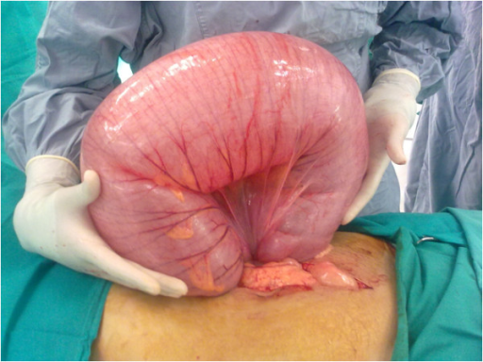

Slide 26
Intussusception
Intussusception is primarily a pediatric disease
between 5% and 16% of all intussusceptions in the Western world occur in adults.
Two thirds of adult intussusception cases are caused by tumors.
Two main types of intussusception affect the large bowel: enterocolic and colocolic.
Enterocolic intussusceptions involve both the small bowel and the large bowel. These are composed of either ileocolic intussusceptions or ileocecal intussusceptions, depending on where the lead point is located.
Colocolic intussusceptions involve only the colon. They are classified as either colocolic or sigmoidorectal intussusceptions

Slide 27
intussusception
A contrast enema (barium or air) can successfully reduce 60-80% of intussusceptions. It is often successful in children in whom a pathologic leading point for the intussusception is unlikely.
In adults, typically a pathologic leading point for the intussusception is present. Reduction with a contrast enema is far less likely, and patients are more likely to require surgery to deal with their pathology.
Surgery is indicated if there are signs of peritonitis or bowel perforation, or if attempts at reduction by contrast enema are unsuccessful.
Intussusception may recur in approximately 3% of patients after contrast enema reduction and 1% of patients after operative repair

Slide 28
Acute colonic pseudo-obstruction/Ogilvie syndrome
Ogilvie syndrome, is thought to result from an autonomic imbalance, which results from decreased parasympathetic tone or excessive sympathetic output.
is characterized by a loss of peristalsis and results in the accumulation of gas and fluid in the colon.
This condition usually occurs in the setting of a wide range of medical or surgical illnesses.
If untreated, colonic ischemia or perforation can occur.
The right colon and cecum are most commonly involved.
The risk of perforation ranges from 3-15%

Slide 29
Ogilvie syndrome
Management
If no perforation is present, pseudo-obstruction is treated with conservative management for the first 24 hours. This includes bowel rest, hydration, and management of underlying disorders.
Pharmacologic treatment with neostigmine, tap water enemas, octreotide drip and rectal tube insertion
colonoscopic decompression may be effective in cases that do not resolve with conservative management. Colonoscopic decompression may be successful in as many as 80% of patients with acute colonic pseudo-obstruction.
Surgical intervention for acute colonic pseudo-obstruction is associated with a high mortality and morbidity. This treatment is reserved for refractory cases or cases complicated by perforation.

Slide 30
Left colon carcinoma
Surgical treatment of left colon carcinoma includes
  resection without primary anastomosis
  resection with primary anastomosis and intraoperative lavage
Endoscopically placed expandable metal stents can be used to relieve the large-bowel obstruction, thus allowing for a primary colorectal anastomosis

Slide 31
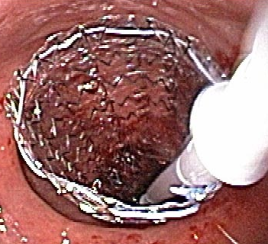
Stenting

Slide 32
Right colon cancer
Right colectomy and a primary anastomosis between the ileum and the transverse colon.
Patients with high-risk features for surgery (advanced age, complete obstruction, or severe comorbidities) may benefit from stent placement until the patient can be optimized for a surgical procedure
Palliative colorectal stents are an option in patients who are poor surgical candidates or have advanced cancer.

Slide 33
Diverticular disease
Patients with persistent obstruction secondary to diverticular disease despite appropriate medical management are treated surgically.
Surgical resection follows the same principles as the treatment of carcinomas.
Elective colonic resection is offered to patients with recurrent disease.

Slide 34
Complications
Perforation
Peritonitis from bowel perforation secondary to rough attempts at reduction of a volvulus or intussusception, or injudicious attempts to dilate or stent an unsuitable colonic obstruction
Sepsis; Seen more frequently in cases in which a delay in diagnosis or treatment occurred
Intra-abdominal abscess from anastomotic leakage
Dehydration
Electrolyte disturbance
Death

Slide 35
Prognosis
In general, overall mortality rates for large bowel obstructions are 20%, which increases to 40% if there is colonic perforation.
The mortality rate for acute colonic pseudo-obstruction is 15% with early care; mortality increases to 36% if colonic ischemia or perforation develops

Slide 36
Ileus

Slide 37
Definitions
Interruption of the normal propagation of intestinal contents due to decreased motor activity
Synonyms;
  functional
  Paralytic
  adynamic

Slide 38
Etiology
Peritonitis
Postoperative
Stress, sepsis, hypoperfusion, hypoxia
Trauma
Drugs, narcotics, anticholinergics, sedatives,… etc.
Metabolic, electrolyte disturbances, DKA, organ failures
Idiopathic

Slide 39
Distribution
Generalized
Localized
  Small bowel as in pancreatitis
  Large bowel as acute appendicitis

Slide 40
Diagnosis clinical
The predisposing factor
Constipation or obstipation
Abdominal distention
Vomiting or regurge
Diminished bowel sounds
Minimal or no abdominal pain

Slide 41
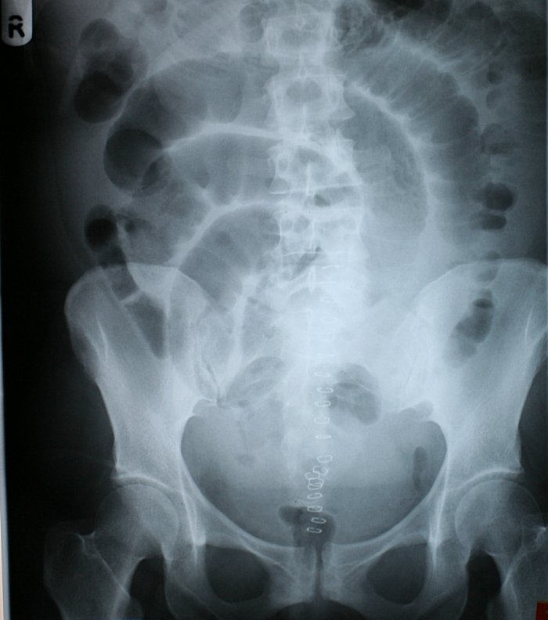
Diagnosis radiological

Slide 42
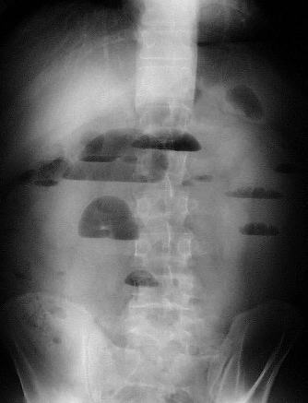

Slide 43
Postoperative ileus
Affects small and large bowel
Small bowel regains activity before the large (usually within hours)
May last few days
CT scan is the best modality to distinguish postop ileus from postop mechanical obstruction

Slide 44
General Management
NPO
Nasogastric intubation
Fluid and electrolyte resuscitation
Reverse the primary cause
Use of prokinetic drugs ?

