Slide 1
Diseases of the respiratory system lecture 4
Dr Heyam Awad
FRCPath

Slide 2
Bronchial asthma
Asthma is a chronic inflammatory disorder of the airways that causes recurrent episodes of wheezing, breathlessness, chest tightness, and cough, particularly at night and/or early in the morning.

Slide 3
Asthma is characterized by:
1. Intermittent and reversible airway obstruction,
2. Chronic bronchial inflammation with eosinophils
3. Bronchial smooth muscle cell hypertrophy and hyperreactivity,
4. Increased mucus secretion.

Slide 4
Types of asthma
1. Atopic Asthma
- This is the most common type of asthma,
- Usually beginning in childhood,
Is a classic example of type I IgE-mediated hypersensitivity reaction
A positive family history of atopy and/or asthma is common,
- Asthmatic attacks are often preceded by allergic rhinitis, urticaria, or eczema.
- The disease is triggered by environmental antigens, such as dusts, pollen, and foods
-A skin test with the offending antigen results in an immediate wheal-and-flare reaction.
- Atopic asthma also can be diagnosed based on serum radioallergosorbent tests (RASTs) that identify the presence of IgE specific for a panel of allergens

Slide 5
Types of asthma
2. Non-Atopic Asthma
- No evidence of allergen sensitization,
- Skin test results usually are negative.
-A positive family history of asthma is less common than in atopic sthma.
- Respiratory infections due to viruses (e.g., rhinovirus, parainfluenza virus) and inhaled air pollutants (e.g., sulfur dioxide, ) are common triggers.
- It is thought that virus-induced inflammation of the respiratory mucosa lowers the threshold of the subepithelial vagal receptors to irritants.

Slide 6
Note:
-Although the connections are not well understood, the ultimate humoral and cellular mediators of airway obstruction (e.g., eosinophils) are common to both atopic and nonatopic variants of asthma, so they are treated in a similar way.

Slide 7
Types of asthma
3. Drug-Induced Asthma
- Several pharmacologic agents provoke asthma--aspirin being the most striking example
-Patients with aspirin sensitivity present with recurrent rhinitis and nasal polyps, urticaria, and bronchospasm
-The precise mechanism remains unknown, but it is presumed that aspirin inhibits the cyclooxygenase pathway of arachidonic acid metabolism without affecting the lipoxygenase route, thereby shifting the balance of production toward leukotrienes that cause bronchial spasm.

Slide 8
PATHOGENESIS
- The major etiologic factors of asthma are:
1. Genetic predisposition to type I hypersensitivity (atopy)
2. Acute and chronic airway inflammation,
3. and bronchial hyperresponsiveness to a variety of stimuli.

Slide 9
pathogenesis
Role of type 2 helper T (T_{H}2) cells may be critical to the pathogenesis of asthma.
- The classic atopic form of asthma is associated with an excessive T_{H}2 reaction against environmental antigens.

Slide 10
T helper 2 ells
Cytokines produced by T_{H}2 cells account for most of the features of asthma
a.IL-4 stimulates IgE production,
b. IL-5 activates eosinophils,
c. IL-13 stimulates mucus production

Slide 11
IgE role
IgE coats submucosal mast cells, which, on exposure to allergen, release granule contents.
This induces two waves of reaction: an early (immediate) phase and a late phase

Slide 12
- - Early reaction is dominated by
a. Bronchoconstriction, triggered by direct stimulation of subepithelial vagal receptors
b. Increased mucus production and
Vasodilation.
ALL THESE EFFECTS ARE CAUSED BY MEDIATORS MAINLY HISTAMINE

Slide 13
The late-phase reaction consists of inflammation, with
a. Activation of eosinophils, neutrophils, and T cells.
b. Epithelial cells are activated to produce chemokines that promote recruitment of more T_{H}2 cells and eosinophils (including eotaxin, a potent chemoattractant and activator of eosinophils),

Slide 14
- Repeated bouts of inflammation lead to structural changes in the bronchial wall, referred to as airway remodeling:
1. Hypertrophy of bronchial smooth muscle and mucus glands,
2. Deposition of subepithelial collagen.

Slide 15
Gross:
- The most striking macroscopic finding is occlusion of bronchi and bronchioles by thick, mucous plugs.

Slide 16
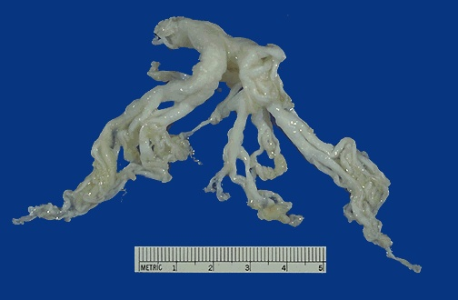
Mucus plug of Asthma

Slide 17
Histologically,
a. The mucous plugs contain whorls of shed epithelium (Curschmann spirals).
b. Numerous eosinophils
c. Charcot-Leyden crystals (collections of crystalloids made up of eosinophil proteins) in the mucus.

Slide 18
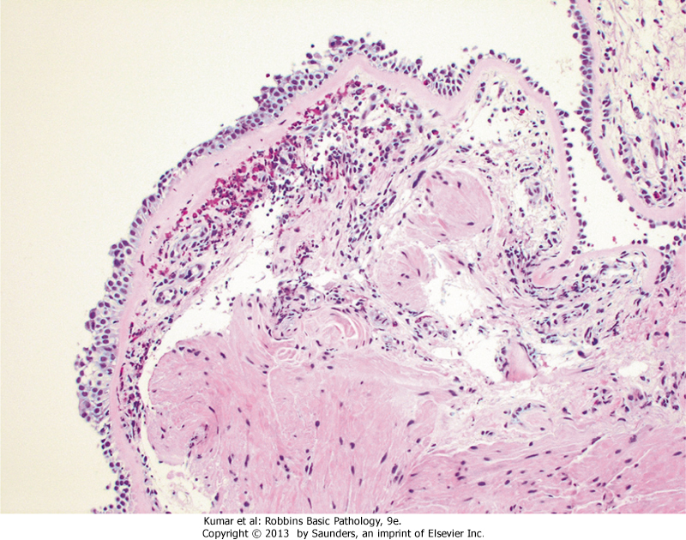
Asthma

Slide 19
Airway remodeling," include
a. Thickening of airway wall Sub-basement membrane fibrosis
b. Increased vascularity in submucosa
c. An increase in size of the submucosal glands and goblet cell metaplasia of the airway Epithelium
d.Hypertrophy and/or hyperplasia of the bronchial muscles

Slide 20
Asthma is a complex genetic disorder in which multiple susceptibility genes interact with environmental factors to initiate the pathologic reaction.
There is significant variation in the expression of these genes and in the combinations of polymorphisms that effect the immune response or tissue remodeling.

Slide 21
Clinical Features
- An attack of asthma is characterized by severe dyspnea with wheezing; the chief difficulty lies in expiration.
.
- Occasionally a severe paroxysm occurs that does not respond to therapy and persists for days and even weeks (status asthmaticus).

