Slide 1
iddle e r
Int rnal r
n tu
Ca ti g
ry
le

Slide 2
1-THE EXTERNAL EAR
Made of
A-AURICLE (PINNA)
B-EXTERNAL AUDITORY MEATUS
A-AURICLE
It consists of:
A-Skin
B-a thin plate of elastic cartilage adherent to perichondrium on lateral surface …risk for hematoma (except the lobule, which is devoid of cartilage)…best for earings
3-It possesses both extrinsic and intrinsic muscles, which are supplied by
the facial nerve.

Slide 3
Helix.
Crus of helix
Auricular tubercle.
Antihelix.
Crura of antihelix.
Triangular fossa.
Scaphoid fossa.
Concha of auricle.
External acoustic meatus.
Tragus.
Antitragus.
Intertragic notch.
Lobule of auricle.
Prominent ears (also known as ‘bat’ ears) are caused by the absence or inadequacy of an antihelical fold.
Anotia is complete absence of the external ear, and is most
likely caused by a developmental disturbance between the seventh and eighth gestational week.

Slide 4
The sensory innervation of the auricle is complex and not fully determined.
This is perhaps because the external ear represents an area where skin originally derived from a branchial region meets skin originally derived from a postbranchial region.
Auriculotemporal nerve: upper ½ of the outer surface Lesser occipital nerve: the upper ½ of the inner surface
Auricular branch of vagus
supplies an area on the inner surface
Great auricular nerve: the lower ½ of both inner and outer
surfaces
Notice the involvement of the cranial nerves (vagus and Auriculotemporal branch of madibular nerve) in the innervation of the Auricle

Slide 5
B-The external auditory meatus
Outer 1/3 _{Inner 2/3}
_{Outer 1/3} Inner 2/3
the adult the external meatus is about 1 in. (2.5 cm) long and is narrowest about 0.2 in. (5 mm) from the tympanic membrane

Slide 6
The meatus is lined by skin,
and its outer third is provided with hairs and sebaceous and ceruminous glands. secrete a yellowish
brown wax
➢The inner two
third is
bone
➢The outer third of the meatus is
formed by the
tympanic plate
elastic cartilage
(directed upwards and backwards)
Fixed
(directed
downwards and
Mobile
forwards).
Opposite
Move the mobile part to make meatus straight

Slide 7
Clinical Notes
Tympanic Membrane Examination
Otoscopic
examination of the tympanic membrane is facilitated by first straightening the external auditory meatus by gently pulling the auricle upward and backward in the adult,
And
straight backward or backward and downward in the infant

Slide 9
The middle ear has
ROOF
FLOOR
ANTERIOR WALL
POSTERIOR WALL
LATERAL WALL
MEDIAL WALL

Slide 10
The lateral wall
The tympanic membrane (ear drum)
Is a thin, fibrous membrane
➢The membrane is obliquely placed, facing downward,
forward, and laterally
➢Is formed of: 1-An outer layer;
skin
2-Middile layer; fibrous tissue 3-Inner layer ;
mucous membrane

Slide 11
Remember that the middle fibrous layer is present in the major parts of the ear drum which called
pars tensa.
However, this layer is absent in the upper part
of the ear drum which is called pars flaccida Shrapnell's membrane (also known as
Rivinus’ ligament)
The pars tensa and flaccida are separated from each other by two folds called the anterior and posterior malleolar folds

Slide 12
The tympanic membrane is
extremely
sensitive to pain
and is innervated on its outer surface
by the auriculotemporal nerve and the auricular branch of the vagus
In otoscopy (TM examination)
The antero-inferior quadrant of the ear drum is called
The cone of
light
(because it reflects the light coming from the otoscope)

Slide 13
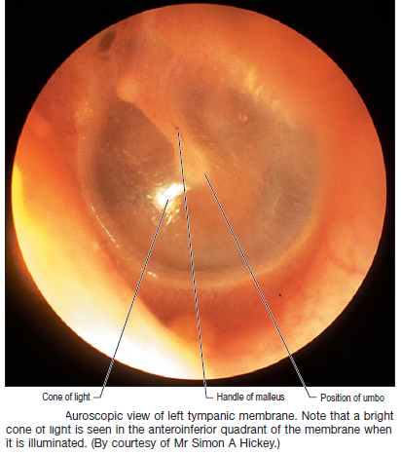

Slide 14
THE ROOF
TEGMENTAL WALL
Is formed by a thin plate of bone, the tegmen tympani, which is part of the petrous temporal bone
It separates the tympanic cavity from the meninges and the temporal lobe of the brain in the middle cranial fossa.
THE FLOOR
JUGULAR WALL
is formed by a thin plate of bone, which may be partly replaced by fibrous tissue. It separates the tympanic cavity from the superior bulb of the internal jugular vein

Slide 15
THE ANTERIOR WALL
➢is formed below by a thin plate of bone that separates the tympanic
cavity from the internal carotid artery
➢At the upper part of the anterior wall are the openings into two canals.
The lower and larger of these leads into the auditory tube
the upper and smaller is the entrance into the canal for the tensor tympani muscle

Slide 16
THE POSTERIOR WALL
1-has in its upper part a large, irregular opening, the
aditus
to the mastoid
2-Below this is a small, hollow, conical projection, the pyramid, from whose apex emerges the tendon of the stapedius muscle.

Slide 17
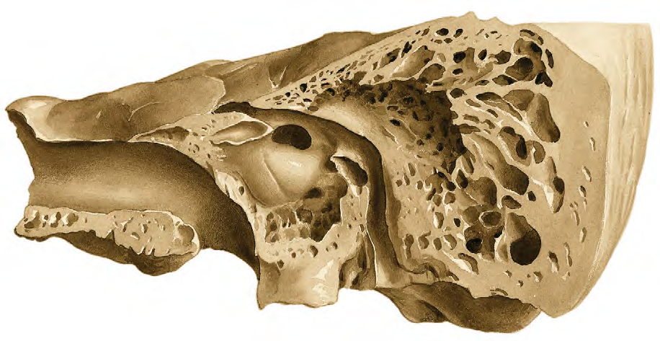
3-The horizontal part of the facial nerve
Stylomastoid foramen
3-The vertical part of the facial nerve

Slide 18
The medial wall
Is formed by the lateral wall of the inner ear.
The greater part of the wall shows a rounded projection, called the promontory, which results from the underlying first turn of the cochlea
Above and behind the promontory lies the fenestra vestibuli, which is oval shaped and closed by the base of the stapes
Below the posterior end of the promontory lies the fenestra cochleae, which is round and closed by the secondary tympanic membrane.
The horizontal part of the facial nerve arching above the promontory

Slide 19
Auditory Tube
(EUSTACHIAN TUBE):
It connects
The anterior wall of the tympanic cavity to the nasal pharynx
It serves to equalize air pressures in the tympanic cavity and the nasal pharynx
➢Its posterior inner third is bony,
r
its anterior two thirds is cartilaginous
➢As the tube descends it passes over the upper border of the superior constrictor muscle

Slide 21
Pharyngotympanic tube blockage in children
The pharyngotympanic tube serves to ventilate the middle ear, exchanging
nasopharyngeal air with the air in the middle ear, which has been altered in its composition
via transmucosal gas exchange with the haemoglobin in the blood vessels of the mucosa.
The tube also carries mucus from the middle ear cleft to the nasopharynx as a result of ciliary transport.
In children, the pharyngotympanic tube is relatively narrow. It is prone to obstruction when the mucosa swells in response to infection or allergic challenge: obstruction results in a relative vacuum being created in the middle ear secondary to transmucosal gas exchange, and this in turn promotes mucosal secretion and the formation of a middle ear effusion. Because of the collapsibility of the pharyngotympanic tube, the vacuum thus created can overcome the distending effect of the muscles of the tube and ‘lock’ the tube shut. The resultant persistent middle ear effusion, otitis media with effusion (glue ear), can caus hearing loss by splinting the tympanic membrane and impeding its vibration. It can also provide an ideal environment for the proliferation of bacteria, with the result that an acute otitis media may develop. It is possible to relieve the vacuum and unlock the tube, and then remove
the effusion by myringotomy, i.e. by surgically creating a hole in the tympanic membrane. This hole will generally heal rapidly and it is common practice to insert a fl anged ventilation tube (a grommet or tympanostomy tube) to keep the hole open. Migration of the outer squamous layer of the tympanic membrane eventually displaces the
++tube and the myringotomy heals.

Slide 22
Infections and Otitis Media
The meninges and the temporal lobe of the brain lie superiorly meningitis and a cerebral abscess in the temporal lobe.
(acute mastoiditis)
into the mastoid antrum
through the auditory tube from the nasal part of the pharynx.
The posterior wall of the mastoid antrum is related to the
sigmoid venous sinus. If the infection spreads in this direction, a thrombosis in the sigmoid sinus may well take place
A spread of the infection in this direction can cause a facial nerve palsy and labyrinthitis with vertigo

Slide 23
CONTENTS OF THE MIDDLE EAR
cles are:
S
➢It contains the auditory
A-3 Auditory Ossicles B-2 muscles
C-2 nerves D-air
ossicles, whose function is to transmit the vibrations of the tympanic membrane (eardrum) to the perilymph of the
The auditory ossi
MALLEU
internal ear.
INCUS STAPES
1-The malleus is the largest ossicle and possesses head, a neck, a long process or handle,
an anterior process, and a lateral process.
its head is rounded and articulates posteriorly
with the incus.
The stapes has a head, a neck, two limbs, and a base
The head articulates with the long process of the incus.
The neck is narrow and receives the
insertion of the stapedius muscle. The two limbs diverge from the neck and are attached to the oval base which closes the oval window of the internal ear
The handle is firmly attached to the medial surface of the tympanic membrane
The incus possesses:
a large body and two processes:
The body articulates with the head of the malleus.
The long process articulates with the head of the stapes.

Slide 24
Muscles of the Ossicles
These are the tensor tympani and the stapedius muscles.

Slide 25
Tympanic Nerve
➢The tympanic nerve arises from the glossopharyngeal nerve, just below the jugular foramen
➢It passes through the floor of the middle ear and onto the promontory
➢Here it splits into branches, which form the tympanic plexus.
➢The tympanic plexus supplies the lining of the middle ear and gives off the lesser petrosal nerve, which sends secretomotor fibers to the parotid gland via the otic ganglion
➢It leaves the skull through the foramen ovale

Slide 26
•The chorda tympani
•arises from the facial nerve just above the stylomastoid foramen
•It enters the middle ear close to the posterior border of the tympanic membrane.
It then runs forward over the
tympanic membrane and crosses the root of the handle of the malleus
•It lies in the interval between the mucous membrane and the fibrous layers of the tympanic membrane. The nerve leaves the middle ear through the petrotympanic fissure and enters the infratemporal fossa, where it joins the lingual nerve
The chorda tympani contains:
Taste fibers from the mucous membrane covering the anterior two thirds of the tongue (not the vallate papillae) and the floor of the mouth.

