Slide 1
Environmental Health
Dr. Sireen Alkhaldi, DrPh
Community Medicine, First semester 2015/ 2016
Faculty of Medicine/ The University of Jordan

Slide 2
Environmental Health
Across the world, the environment is a key determinant of health and well-being.
Unimproved water and sanitation, ambient air pollution, indoor pollution from solid fuels, and lead exposure are among the leading contributors to global burden of disease.
In addition, many current and emerging exposures in food, water, soil, air, and consumer products adversely affect human health.

Slide 3
What is the environment?
The trees, air, & soil around us
ALL the places we live, work & play
Our fields, farms, factories & the food we grow
Our oceans, lakes, and rivers
Notes:
Procedure: Ask students to call out words they associate with the term “environment.” When they have had a chance to come up with most of the places listed on the slide (and maybe more!), CLICK 4 TIMES to make the graphics and text appear. Make sure to emphasize that the “environment” isn’t only pristine nature, but cities, towns, workplaces, schools - anywhere humans spend time.
Relevant Text from Student Reading:
“Your health depends on the environment around you. Environmental health is the study of how the environment affects human health. It differs from the study of how humans affect the environment, because it focuses on people’s health. An environmental scientist might study how water pollution is hurting fish. An environmental health scientist would study what happens to the health of people when they catch and eat those fish. Environmental health is not just about the health of the environment – it always comes back to you and whether the environment you are part of is helping you stay healthy, or making you sick.”

Slide 4
What is Environmental Health?
The World Health Organization (WHO) defines environment, as it relates to health, as “all the physical, chemical, and biological factors external to a person, and all the related behaviors.”
Environmental health consists of preventing or controlling disease, injury, and disability related to the interactions between people and their environment.

Slide 5
What is Environmental Health?
Environmental Health is the field of science that studies how the environment influences human health and disease.
“Environment” in this context, means things in the natural environment like air, water and soil, and also all the physical, chemical, biological and social features of our surroundings.

Slide 6
Why Is Environmental Health Important?
Maintaining a healthy environment is central to increasing quality of life and years of healthy life.
Globally, nearly 25 percent of all deaths and the total disease burden can be attributed to environmental factors.

Slide 7
Environmental Health?
Air
Sunlight
Food
Environmental Health
Noise
Water
Soil
The study of how the environment
affects our health.

Slide 8
Good Things Around Us ( in the environment)
Oxygen in the air
Beautiful scenery to look at
Nutrients in food
Medicine & vitamins
Family & friends
There are many things around us that help us stay healthy.

Slide 9
Hazards
Every day, you come in contact with things in your environment that can help you or hurt you. Some of these things are important for keeping you healthy, such as oxygen or medicines.
However, some of these things may be harmful to your health, such as tobacco smoke or snake venom.
Things in the environment that are harmful are called hazards and include things like chemicals, disease-causing bacteria, loud noises and even stress.
Hazards can be natural or human-made.

Slide 10

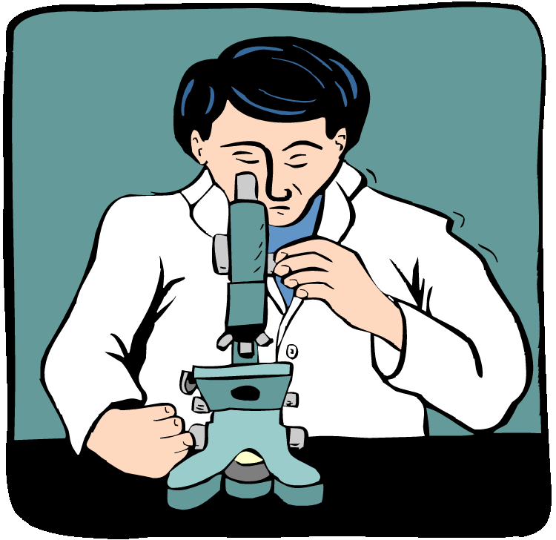

Environmental Health Careers
Work for corporations making sure workplaces are safe for workers
People working in the field of environmental health . . .
Work as scientists in research labs
Work for the government writing regulations and studying pollution

Slide 11
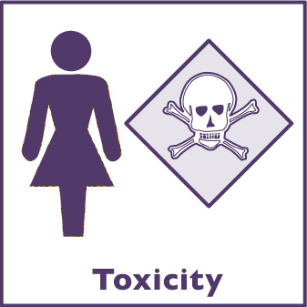
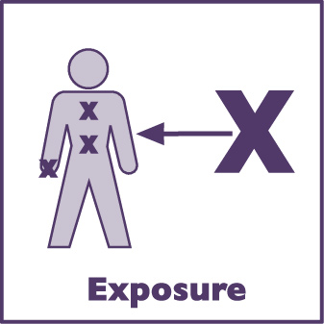
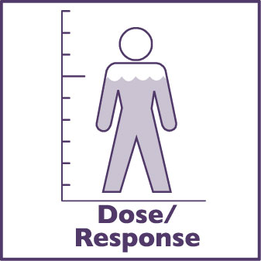




The 7 Core Concepts

Slide 12
Toxicity
poisonous or dangerous
Toxic means _____________________.
Toxic_____ is the study of poisons.
ology
Toxicity is a measure of how dangerous a chemical is.

Slide 13
Toxicology
Toxicology is the study of how environmental hazards, such as natural and human-made chemicals, can enter our bodies and make us sick.
When scientists study different chemicals in the environment to see if they might be dangerous to humans, they are trying to understand the toxicity of those chemicals.”

Slide 14


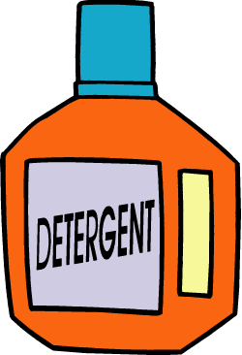

How would rate these products in Toxicity?
Toxicity Rating
Highly Toxic
Moderately Toxic
Slightly Toxic
Not Toxic

Slide 16



Exposure is
The total amount of a hazard that comes in direct contact with the body.
Notes:
Procedure: This slide introduces the term exposure and provides students with a definition.
Relevant Text from Student Reading:
“We all know what it means to be “exposed” to something like a cold or a flu. Everyday our bodies are exposed to all sorts of environmental hazards, such as bacteria, viruses, and the sun’s ultra-violet (UV) rays. Some of these hazards exist naturally and some of them are the result of human activities. There are many possible sources of hazards, such as cars, industry, even volcanic eruptions. In order for us to be exposed, however, the hazard has to get from the source to us. To do this, it travels along an environmental pathway. Pathways include the air we breathe, the water we drink, the food we eat, and even the soil we work in, play in, and use to grow much of our food.
Environmental health scientists use the term exposure to describe the total amount of a hazard that comes in direct contact with your body.”

Slide 17

The 3 parts of exposure
The
Source
of the hazard
(bus exhaust)
The
Environmental
Pathway
(air)
The
Contact
(inhaled fumes)

Slide 18
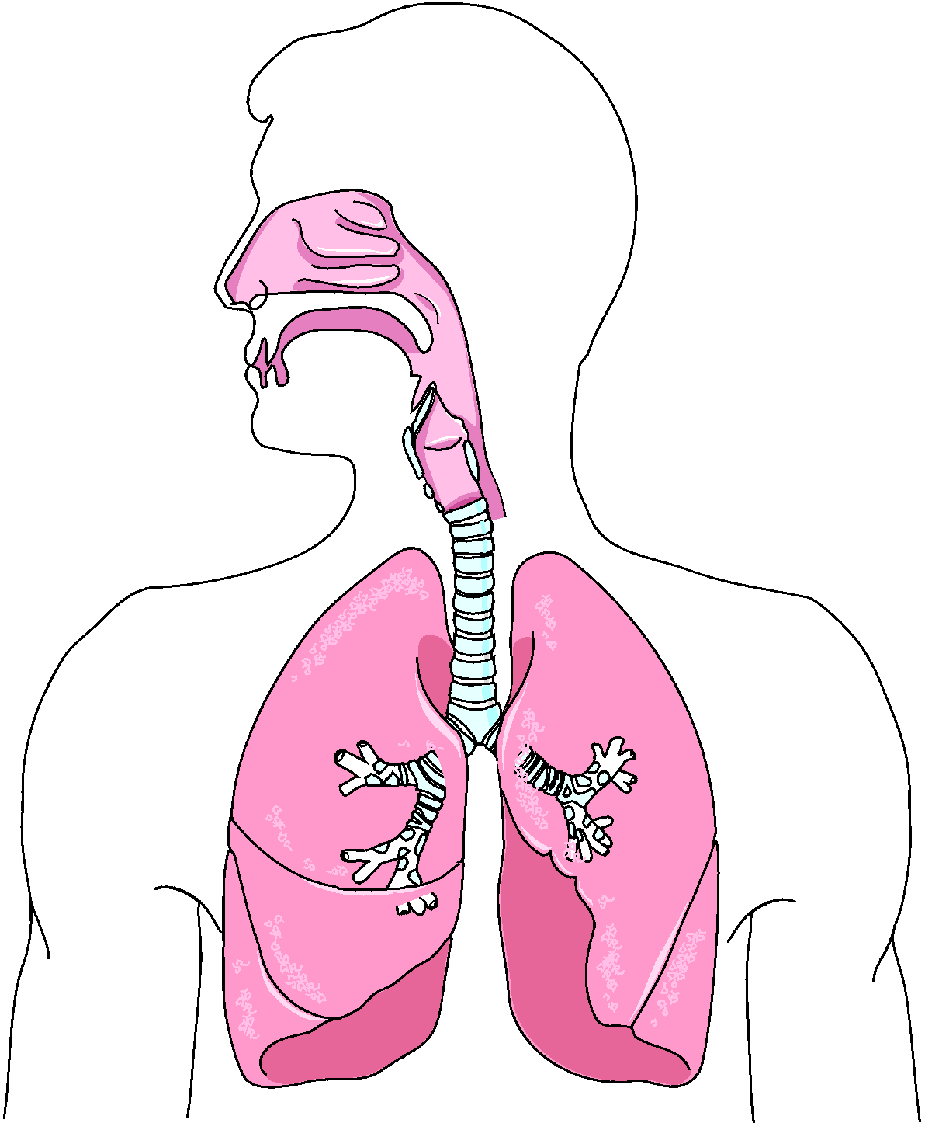
Which route will the hazards take? Route #1: Inhalation
Hazard!
Inhalation:
Breathing. When chemicals enter the body through this route of exposure, they can get stuck in the lungs and/or be taken up into the bloodstream.

Slide 19
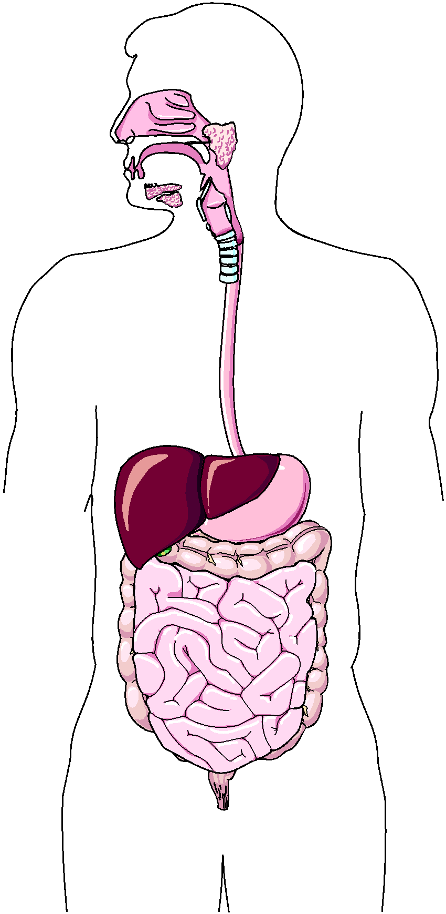
Route #2: Ingestion
Hazard!
Ingestion:
Swallowing (usually by eating or drinking). When chemicals enter the body through this route of exposure, they can easily be taken up into the bloodstream.

Slide 20
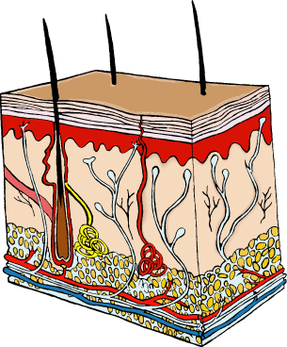

Route #3: Dermal Absorption
Hazard!
Dermal Absorption:
Absorbing a chemical through any part of the skin, including the eyes. When chemicals come in contact with the skin, they can sometimes enter the bloodstream through this route of exposure.

Slide 22

What is dose?
X
Exposure
X
X
X
Dose
X
X
X
X
X
X
X
X
X
X = hazard
Dose is the amount of a hazard that actually enters your body.

Slide 23



Dose can depend on…
Duration of Exposure:
How long?
Frequency of Exposure:
How often?
Body Size:
How big or small are you?
L
M
S
S

Slide 24
What determines Exposure?
Imagine that some people have been exposed to a hazardous chemical through one of the three possible routes of exposure. They have now received a dose of that chemical.
Dose is the amount of the hazard that actually enters the body. The amount that gets into their body (their dose) depends on many factors, including:
1. How long they are exposed
2. How often they are exposed, and
3. How big or small they are.

Slide 25
Dose/ Response Relationship
The dose you receive can influence how your body responds to a hazard.
For most hazards, the larger the dose, the more extreme the response will be. The smaller the dose, the more mild the response will be.

Slide 27
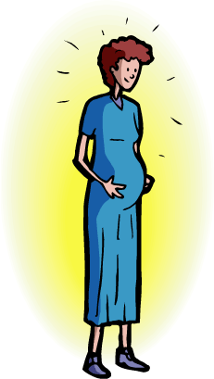
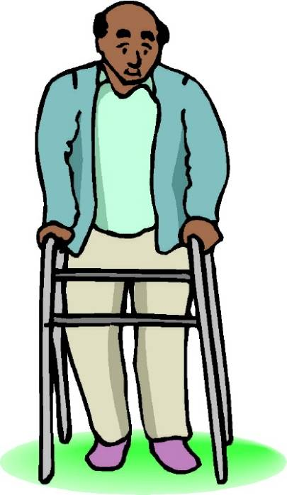



Individual Susceptibility
Why are these people more likely to be harmed by exposure to a hazard than the man below?

Slide 28


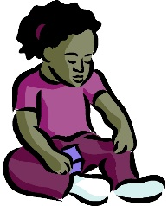
Individual Susceptibility
Pregnant women and their developing babies
Elderly people whose defense mechanisms are less efficient
Sick people who have weakened immune systems
Infants and children who are still developing

Slide 30



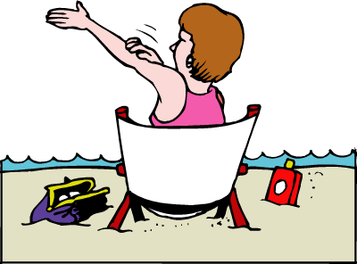
What are the risks & benefits?
1
3
2

Slide 31
Risks and Benefits
We live in an industrial society that depends on the use of both natural and human-made chemicals to function. The use of these chemicals results in benefits to society as well as risks.
Pesticides, for example, make it easier to grow fruits. Unfortunately, in some cases, pesticides can make people sick.

Slide 32
Risks and Benefits
We can reduce the risk of getting sick without giving up the health benefits that fruit offers by washing or peeling the fruit before we eat it.
By understanding the risks and benefits that we face each day, we can make decisions that reduce our risk and keep us as safe and healthy as possible.

Slide 33


Risks & Benefits
BENEFITS
RISKS
People ingest pesticides with the fruit and get sick
Pesticides get into dirt and water
Animals ingest pesticides and get sick
No bugs!
Better looking fruit that is more visually appealing
Bigger crops so farmers can make more profit

Slide 35

What is environmental justice?
Environmental Justice (EJ) means that everyone has a right to live in an environment that doesn’t make them sick, regardless of their race, culture, or income.

Slide 36
Environmental Justice
Unfortunately, some neighborhoods or communities are exposed to more environmental hazards than others, and may suffer higher rates of health problems.
These communities often have less economic or political power in society when decisions are made. For example, toxic waste dumps, polluting factories, and busy highways are often built in lower-income neighborhoods or communities of color.

Slide 37
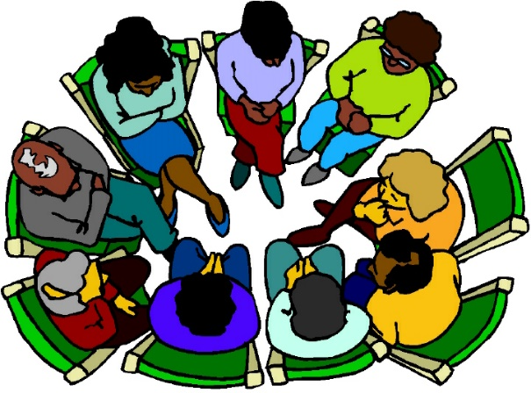

The E J Process
Who is producing the hazard?
Establish a dialog between the decision makers, scientists, and the affected community.
Empower community members to bring about change.
Who is being exposed?
Share information and decisions with community members.
Who are the decision makers?

Slide 39
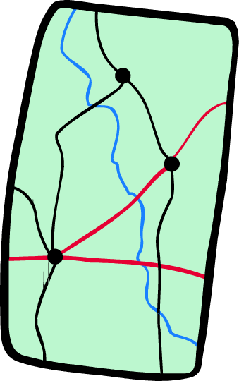


Where can you go for information?
Your Town
Schools
Libraries
Universities
City hall
State agencies
Federal agencies
Doctors
Nurses
Hospitals
Health Department
Caution!

Slide 40
Emerging Issues in Environmental Health
Climate Change
Disaster Preparedness
Nanotechnology
The Built Environment
Exposure to Unknown Hazards
Blood Lead Levels

Slide 41
The 6 Themes of Environmental Health: Healthy People 2020
The Healthy People 2020 Environmental Health objectives focus on 6 themes, each of which highlights an element of environmental health:
Outdoor air quality
Surface and ground water quality
Toxic substances and hazardous wastes
Homes and communities
Infrastructure and surveillance
Global environmental health

