Slide 1
VIRAL HEPATITIS
SUPERVISED BY: Dr Mohammad Rasheed
PREPARED BY: Dr Rawan AL Soud

Slide 2
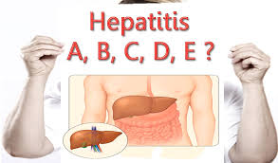

Slide 3
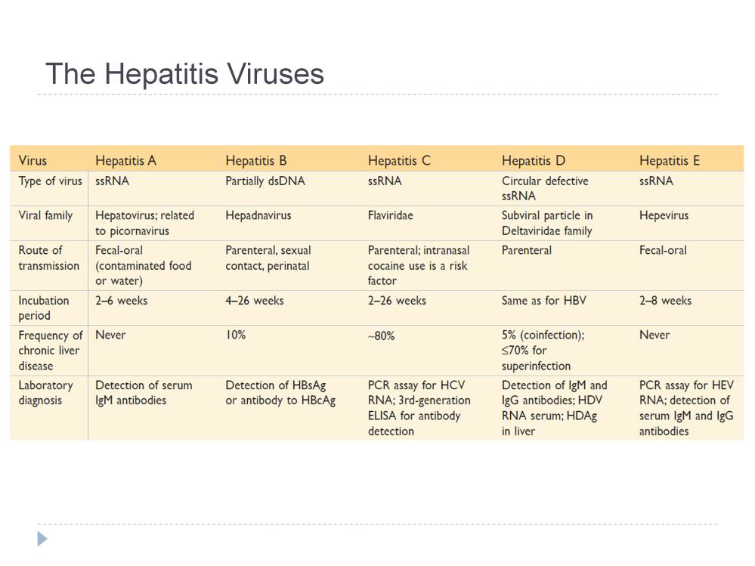

Slide 4
HEPATITIS A

Slide 5
Global Prevalence of Hepatitis A Infection
HAV Prevalence
High
Intermediate
Low
Very Low

Slide 6
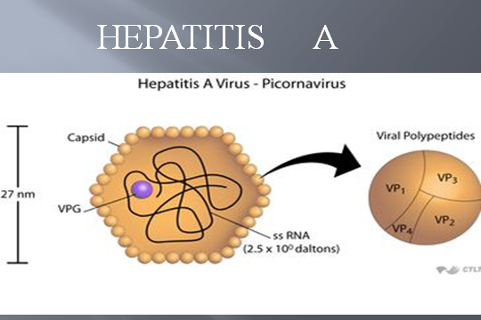

Slide 7
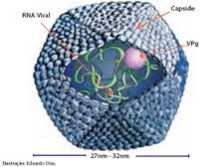

Slide 8
HEPATITIS A VIRUS
Virus | Hepatitis A
Family | Picornaviridae
Genus | Hepatovirus
Virion | 27 nm icosahedral
Envelope | No (NAKED VIRUS)
Genome | ssRNA
Genome size | 7,5kb
Stability | Heat- and acid-stable
Transmission | Fecal-oral
Prevalence | High
Fulminant disease | Rare
Chronic disease | Never
Oncogenic | No

Slide 9
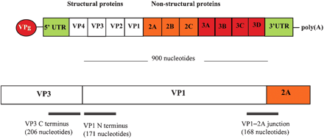
Genome organisation of HAV
Notes:
This figure shows the genome organisation of HAV
The genome consist of a long ORF divided into 3 regions;
The structural proteins P1
And the non-structural proteins P2 and P3.
The C-terminal part of VP3, the N-terminal part of VP1, as well as the VP1-2PA junction are the most variable regions and has therefore been used in molecular epidemiological studies.
Based upon sequencing 168 bp within the VP1-2PA Betty Roberston and workers mange to distinguish geographical distributed strains and classified them into genotypes.

Slide 10
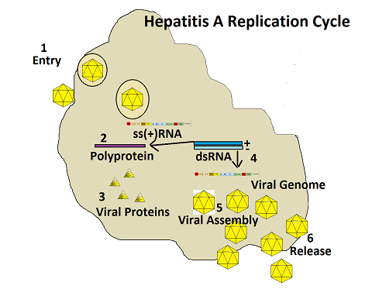
Hepatitis A Virus Life Cycle
Notes:
Tim 1 receptor isn’t liver specific but the virus is

Slide 11
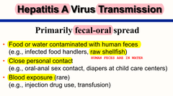

Slide 13
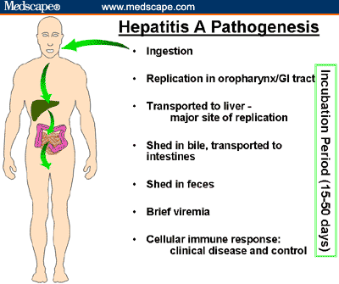

Slide 14
Pathogenesis of HAV
HAV replicates slowly in the liver without producing apparent cytopathological effects (CEPs). In the absence of cytolysis, the virus readily establishes a persistent infection.
Jaundice, resulting from damage to the liver
Antibody is detected and cell-mediated immune responses to the virus
The virus isn’t hepatotoxic but the cell mediated immune response is the one causing damage to the hepatocytes

Slide 15
Clinical Variants of Hepatitis A Infection
1) Asymptomatic (anicteric) disease
  Children under 6 years of age, > 90%
  Children from 6-14 years old, 40-50%
2) Symptomatic (icteric) disease
  Adults and children over 14, 70-80%
Notes:
Slide 47
Clinical Variants of Hepatitis A Infection
Hepatitis A infection can result in either an asymptomatic or symptomatic clinical illness. The illness typically has an abrupt onset with symptoms that can include transient fever, malaise, anorexia, nausea, vomiting, abdominal pain, and jaundice. The likelihood of symptoms and jaundice are related to the patient’s age. Fewer than 10% of children under 6 years of age have jaundice. In contrast, over two-thirds of older children and adults have symptomatic disease with jaundice. The duration of illness is < 2 months in most cases. Complete recovery and the development of natural immunity to reinfection ultimately occur in all infected individuals.
Hadler SC, Webster HM, Erben JJ, Swanson JE, Maynard JE. Hepatitis A in day-care centers: a community-wide assessment. N Engl J Med 1980; 302:1222-1227.
Lednar WM, Lemon SM, Kikpatrick JW, Redfield RR, Fields ML, Kelley PW. Frequency of illness associated with epidemic hepatitis A virus infection in adults. Am J Epidemiol 1985; 122:226-233.

Slide 16
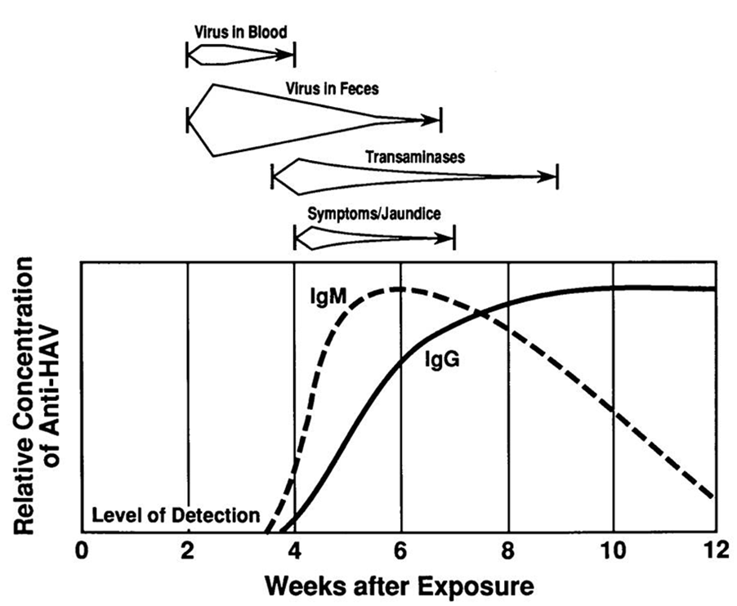

Slide 17
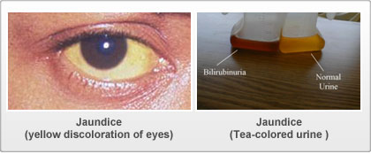

Slide 18
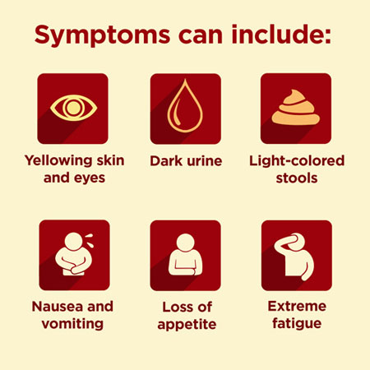

Slide 19
COMPLICATIONS
Complications:Fulminant hepatitis
Cholestatic hepatitis
Relapsing hepatitis
Chronic sequelae: None
Notes:
7

Slide 21


Slide 22
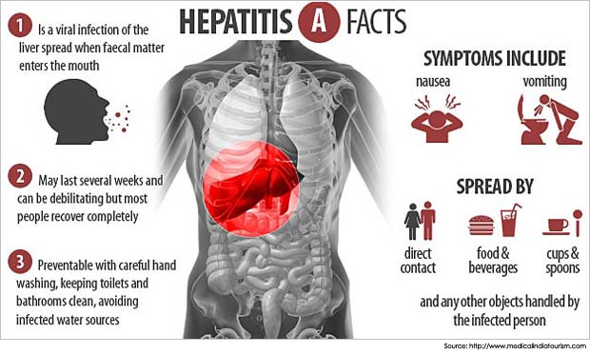

Slide 23
HEPATITIS B VIRUS

Slide 24
Prevalence of HBsAg Carrier State
>8%
2-8%
<2%
WHO
Notes:
Slide 61
Epidemiology of Hepatitis B
Hepatitis B infection is a global health problem. Approximately 350 million people worldwide are chronic carriers of HBV. Chronic hepatitis B is endemic in most parts of Africa, Asia and Alaska, with carrier rate higher than 20%.
In United States, the latest population survey showed prevalence of chronic hepatitis B to be 0.42%. However, in that study, people at high risks, such as those imprisoned or incarcerated, were not surveyed. Hence, the actual prevalence may be even higher.
Kao JH, Chen DS. Global control of hepatitis B virus infection. Lancet Infec Dis 2002;2:395-403.
McWuillan GM, et al. Prevalence of hepatitis B virus infection in the United States: the National Health and Nutrition Examination Surveys, 1976 through 1994. Am J Public Health. 1999 Jan;89(1):14-8.

Slide 25
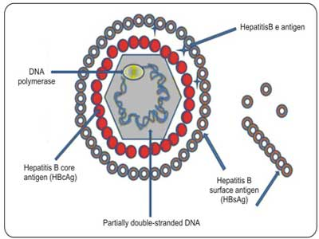

Slide 27
HEPATITIS B VIRUS
Virus | Hepatitis B
Family | Hepadnaviridae
Genus | Orthohepadnavirus
Virion | 42 nm, spherical
Envelope | Yes (HBsAg)
Genome | dsDNA
Genome size | 3,2kb
Stability | Acid-sensitive
Transmission | Parenteral
Prevalence | High
Fulminant disease | Rare
Chronic disease | Often
Oncogenic | Yes

Slide 28
Key points
HBV causes chronic hepatitis and a carrier state
Chronicity is more common in childhood infections
Symptomatic infections are more common in adults
Associated with acute and chronic hepatitis and hepatocellular carcinoma
Similar to hepatitis A, direct cytopathic effect of the virus is unlikely

Slide 29
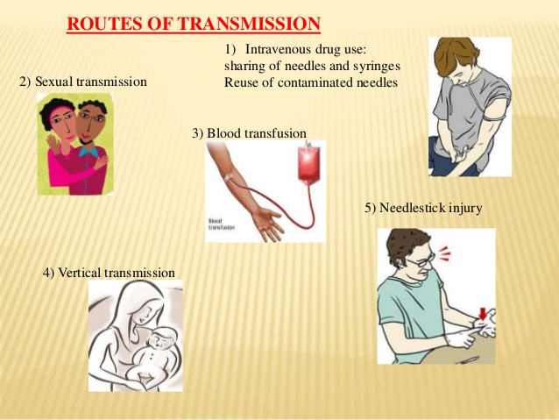
Virus transmission

Slide 30
WHO IS AT GREATEST RISK FOR HBV INFECTION?
DRUG ABUSERS
BLOOD PRODUCT RECIPIENTS
HEMODIALYSIS PATIENTS
PEOPLE FROM SOUTHEAST ASIAN COUNTRIES (70-80%)
LAB PERSONNEL WORKING WITH BLOOD PRODUCTS
SEXUALLY ACTIVE HOMOSEXUALS
PERSONS WITH MULTIPLE AND FREQUENT SEX CONTACTS
MEDICAL/DENTAL PERSONNEL
Notes:
30

Slide 31


Slide 32
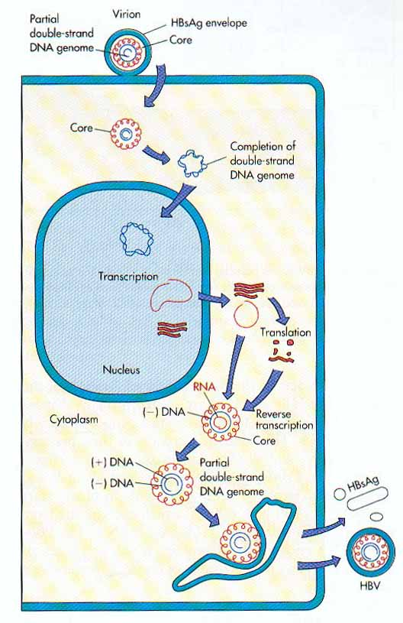

Slide 33
HBV: Replication
Reverse transcription: one of the mRNAs is replicated with a reverse transcriptase making the DNA that will eventually be the core of the progeny virion
RNA intermediate: HBV replicates through an RNA intermediate and produces and release antigenic decoy particles.
Integration: Some DNA integrates into host genome causing carrier state

Slide 34
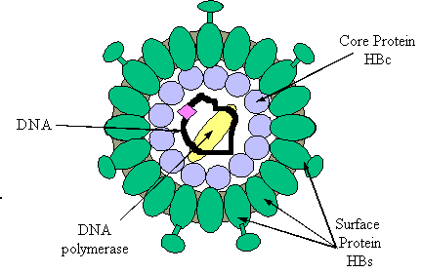
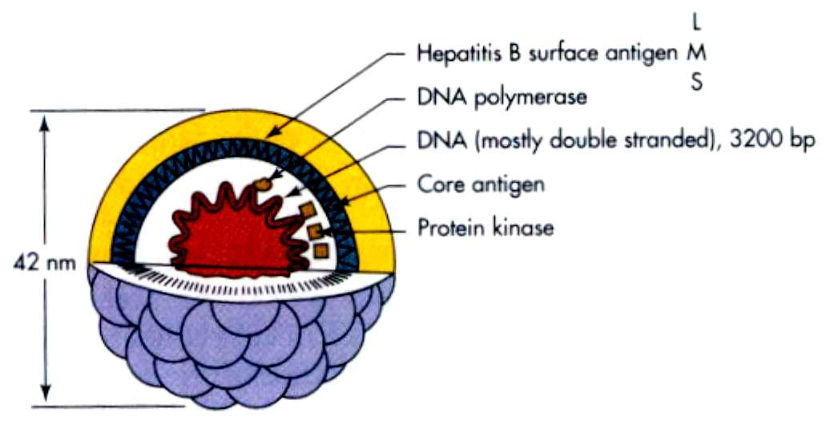
ANTIGEN OF HEPATITIS B VIRUS:
HBsAg = surface (coat) protein ( 4 phenotypes : adw, adr, ayw and ayr)
HBcAg = inner core protein (a single serotype)
HBeAg = secreted protein; function unknown

Slide 35
Pathogenesis and Immunity
Virus enters hepatocytes via blood
Immune response (cytotoxic T cell) to viral antigens expressed on hepatocyte cell surface responsible for clinical syndrome
5 % become chronic carriers (HBsAg> 6 months)
Higher rate of hepatocellular carcinoma in chronic carriers, especially those who are “e” antigen positive
Hepatitis B surface antibody likely confers lifelong immunity (IgG anti-HBs)
Hepatitis B e Ab indicates low transmissibility

Slide 36
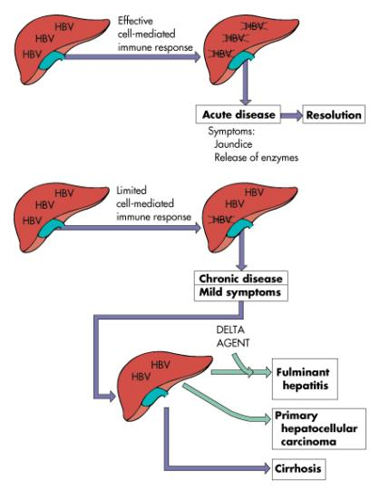
Determinants or acute and chronic HBV infection

Slide 43
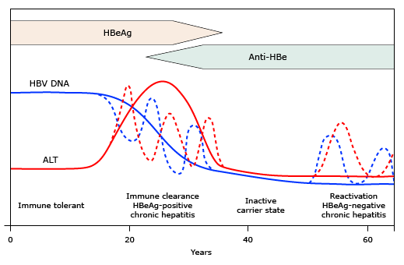
Course of chronic HBV infection

Slide 45

Acute Infection
HBV - Diagnosis
HBV DNA
HBeAg
Anti-HBe
Anti-HBs
Anti-HBc
HBsAg
Anti-HBc IgM
0 2 4 6
Months Years
Notes:
Slide 80
Serological Markers of Acute HBV Infection
Incubation period of HBV infection ranges from 60 to 180 days. HBsAg is the first serological marker of acute HBV infection. Early in the course of acute HBV infection, markers of active viral replication (HBeAg and HBV DNA), are also detectable. As the patients recover, serum HBV DNA level markedly decrease but may remain detectable by PCR assay for up to several decades, HBeAg to anti-HBe seroconversion occurs and finally HBsAg becomes undetectable. Persistence of HBsAg for more than 6 months indicates progression to chronic HBV infection.
Anti-HBc IgM is the first antibody to be detected and usually persists for several months. It may be the only marker of acute HBV infection during the ‘window’ period after HBsAg is cleared and before anti-HBs is detected. Recovery from acute HBV infection is indicated by the presence of anti-HBc IgG and anti-HBs.

Slide 46

HBV - Diagnosis
Chronic Infection
HBV DNA
HBeAg
Anti-HBe
HBsAg
Anti-HBc IgG
Anti-HBc IgM
Months
Years
Notes:
Slide 81
Serological Markers of Chronic HBV Infection
Chronic HBV infection is indicated by the presence of HBsAg persisting for more than 6 months and detection of anti-HBc IgG. During the early phase of chronic HBV infection, markers of HBV replication: HBeAg and high serum HBV DNA levels are also present. Over time, patients seroconvert from HBeAg to anti-HBe, accompanied by decrease in serum HBV DNA levels.

Slide 47
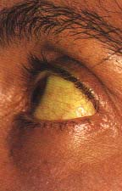
Jaundice

Slide 49
THANK YOU

