Slide 1
Repair 2
Dr Heyam Awad
FRCpath

Slide 2
Role of extracellular matrix in tissue repair
ECM is composed of several proteins that assemble into a network which surrounds cells.

Slide 3
ECM functions
Mechanical support.
Sequesters water.
Provides turgor for soft tissue.
sequesters minerals .. Important in bone rigidity.
Regulates proliferation, movement and differentiation of cells.
Reservoir of growth factors.

Slide 4
ECM
Two basic forms:
1. interstitial matrix.
2. basement membrane

Slide 5
Interstitial matrix
Present in spaces between cells in connective tissue.
Also between epithelium and supportive vascular and smooth muscle structures.
It is synthesized by mesenchymal cells, like fibroblasts.
Forms 3D amorphous gel.

Slide 6
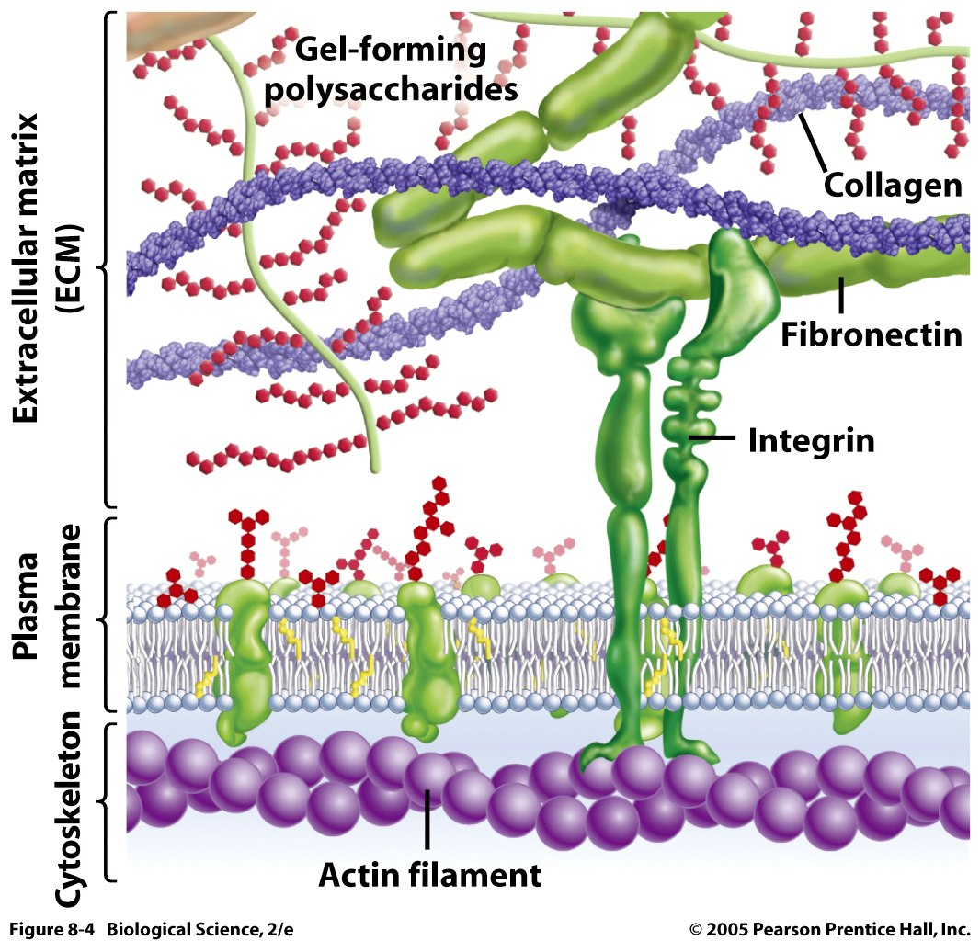
ECM

Slide 7
Basement membrane
Highly organised matrix around epithelial cells, endothelial and smooth muscle cells.
Composed of 1) Amorphous nonfibrillar type IV collagen and
2) laminin.

Slide 8
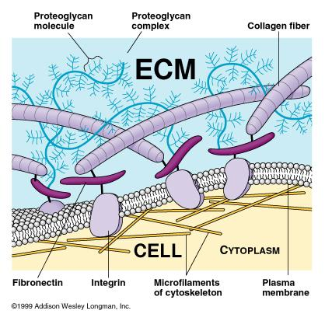

Slide 9
Components of extracellular matrix
Fibrous structural proteins: Collagen and Elastin
Water hydrated gel :Proteoglycans and hyaluronon
Adhesive glycoproteins and adhesion receptors

Slide 10
collagen
Fibrillar collagen (types I, II, III, and V)
Important for tensile strength.
Forms a major proportion of connective tissue in healing.
Strength is vitamin C dependant.

Slide 11
Nonfibrillar collagens
1. type IV present in basement membranes
2. type IX present in intervertebral disks
3. type VII present in dermal-epidermal junctions

Slide 12
elastin
Important for recoil and returning to a baseline structure after stress .
Important in large blood vessels, skin and ligaments.

Slide 13
Proteoglycans and hyaluronic acid
Form compressible gel important for lubrication.
Reservoir of growth factors.

Slide 14
Adhesive Glycoproteins
- Involved in cell-to-cell adhesion, the linkage of cells to the ECM.
- include: Fibronectin, laminin and integrins

Slide 15
Scar formation
Three steps:
angiogenesis.
Migration and proliferation of fibroblasts.
Remodeling.

Slide 16
angiogenesis
Development of new blood vessels from existing vessels , mainly venules.

Slide 17
Angiogenesis.. steps
1. vasodilation ( due to NO) and increased permeability (VEGF)
2. Separation of pericytes from abliminal surface.
3. endothelial cell migration
4. endothelial cell prolifeartion
5. remodeling into capillary tubes
6. recruitment of periendothelial cells: pericytes and smooth muscle cells.
7.Supression of endothelial proliferation
8. Deposition of basement membrane

Slide 18
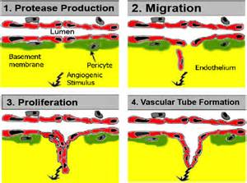

Slide 19
GF in angiogenesis
VEGF family.. Stimulate migration and proliferation of endothelial cells.
- Antibodies against VEGF can be used in treating some tumors and in age related macular degeneration
EGF
Angiopoietins ANG 1 AND ANG2 … especially important for ECM production

Slide 20
Scar formation
A. Migration and proliferation of fibroblasts into the site of injury and
B. Deposition of ECM proteins produced by these cells.

Slide 21
Fibroblast migration and activation
PDGF, TGF BETA.
Stimulated fobroblasts: synthetic activity.
Synthesize ECM components.

Slide 22
Note:
- Collagen synthesis, is critical to the development of strength .
- Collagen synthesis by fibroblasts begins early in wound healing and continues for several weeks, depending on the size of injury.

Slide 23
Note:
- Net collagen accumulation at site of injury depends on increased synthesis and decreased degradation
-

Slide 24
Granulation tissue
The blood vessels , fibroblasts , inflammatory cells and ECM component = granulation tissue.

Slide 25
The term granulation tissue
Gross
- Granular and pink in color
Histologically :
a. Proliferation of fibroblasts
b. Formation of new thin-walled, delicate capillaries(angiogenesis)

Slide 26
scar
Granulation tissue changes to a scar… less cells, more collagen and loss of the blood vessels.

Slide 27
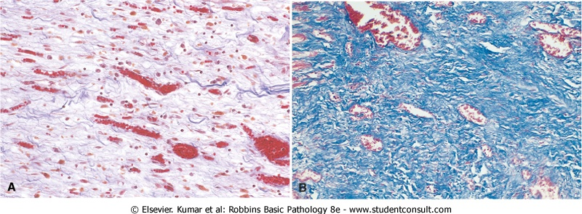
Granulation tissue and Fibrosis

Slide 28
Remodeling of the scar
- the scar continues to be modified and remodeled.
- Thus, the outcome of the repair process is a balance between synthesis and degradation of ECM proteins by MMPs= matrix metalloproteinases

Slide 29
MMPs
1. Interstitial collagenases, cleave fibrillar collagen
2. Gelatinases ,degrade amorphous collagen and fibronectin
3.Stromelysins ,degrade laminin, fibronectin

Slide 30
- The activity of the MMPs is tightly controlled.
a. produced as inactive precursors … activated by proteases (e.g., plasmin
b. can be inhibited by specific tissue inhibitors of metalloproteinases (TIMPs)

Slide 31
.FACTORS THAT INFLUENCE TISSUE REPAIR
1. Infection: the most important cause of delay in healing; because it prolongs inflammation and increase tissue destruction.
2. Nutrition
A. protein deficiency, leads to deficiency of fibrillar collagen
B. Vitamin C deficiency inhibit collagen synthesis
.

Slide 32
3 . steroids: decrease TGF beta
4. Poor perfusion, due to arteriosclerosis and diabetes or to obstructed venous drainage (e.g., in varicose veins),
5. Foreign bodies such as fragments of steel, glass..

Slide 33
Aberrations of cell growth and ECM production
1. Keloid
accumulation of very large amounts of collagen forming prominent, raised scars
2. "proud flesh”
- exuberant granulation tissue .

Slide 34
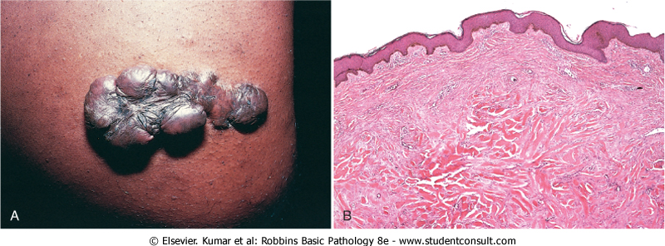
keloid

