Slide 1
Introduction to immunology
Mohammad Qussay Al-Sabbagh
3rd year medical student- University of Jordan
Dec,2016

Slide 2
Case study in immunology-Case 37
Systemic lupus erythematosus

Slide 3
Introduction

Slide 4
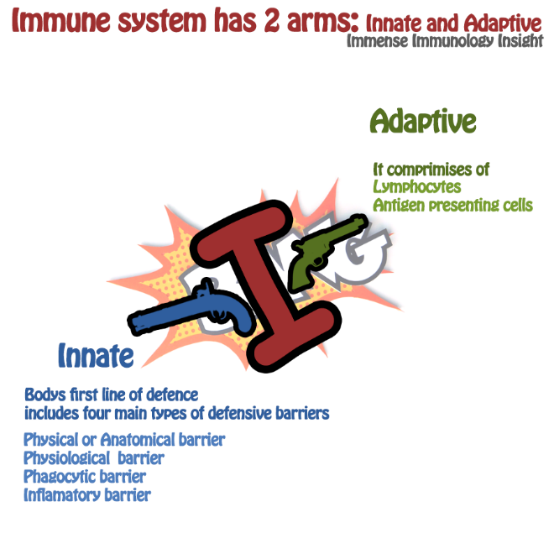
Immunity..
Our immune system has two arms; Adaptive and innate.
Adaptive immunity has evolved to fight neoplastic and viral infected cells.
Adaptive immunity is highly specific, this is accomplished by random arrangement of the genome.
You have to pay the price!

Slide 5
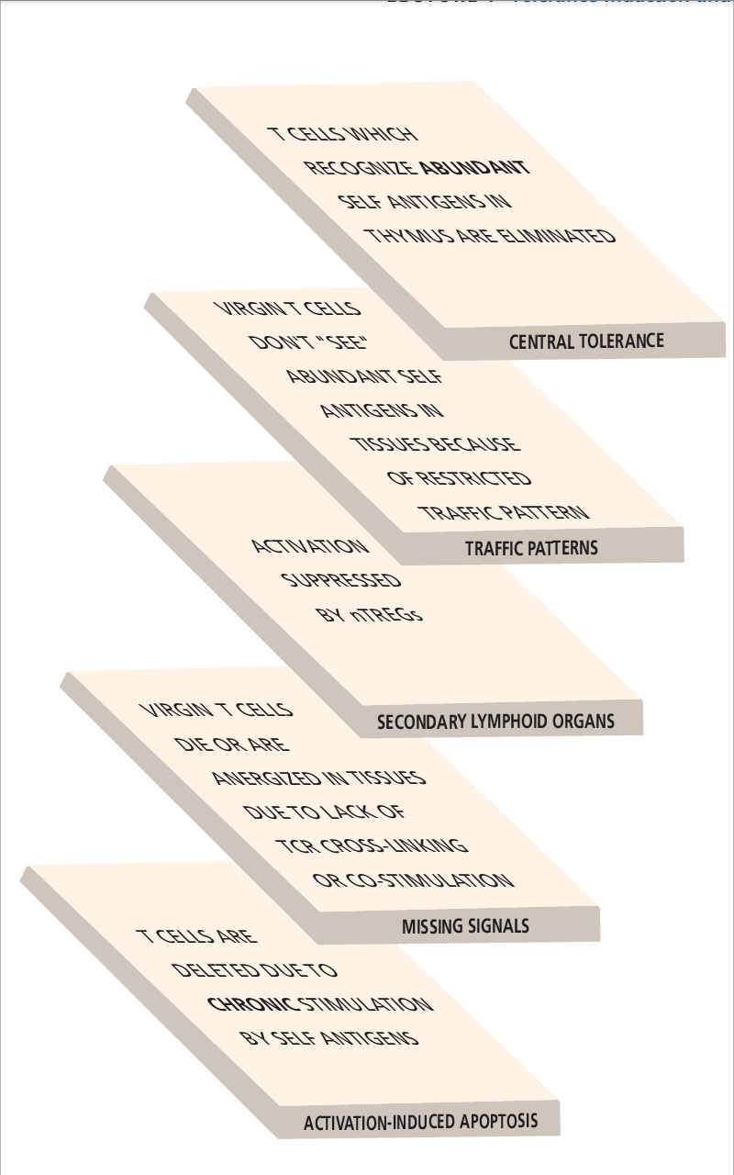
tolerance
Tolerance is a multilayered process in which multiple levels of tolerance-inducing mechanisms insure that, for most humans, autoimmunity never happens.
But if, for some reasons, autoreactive cells managed to overcome this, autoimmuniy will occur.

Slide 6
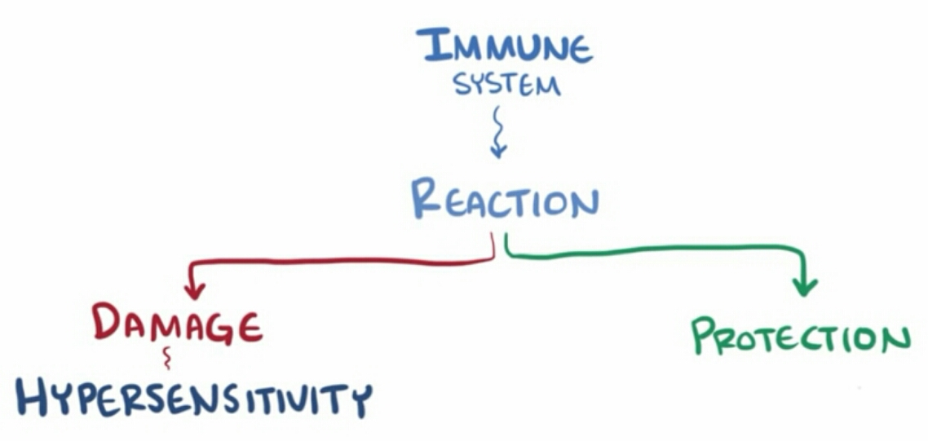
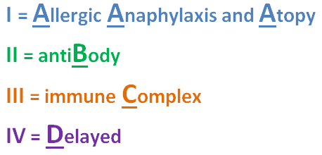
The Immune System Gone Wrong
for autoimmune disease to occur,
a person must have MHC molecules that can present a self antigen. (Hereditary)
as well as lymphocytes with receptors that can recognize the self antigen. (Chance)
There also must be environmental factors that lead to the break- down of the tolerance mechanisms.

Slide 7
The Immune System Gone Wrong
Most autoimmune disorders:
Affect females more than males.
Occur during childbearing age or late adolescence

Slide 8
Ladies first ?!
Most autoimmune disorders Affect females more than males.
Sex hormones (estrogen and progesterone) increase the risk for autoimmunity.
All normal females are mosaics “Special chimeras”

Slide 9
Type III hypersensitivity (A disease caused by immune complexes)

Slide 10
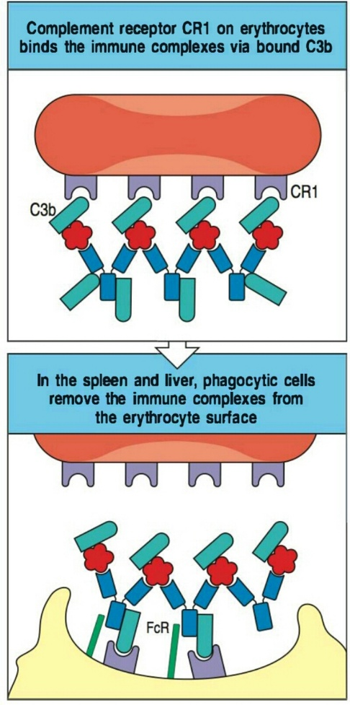
Immune complexes ?!
Immune complexes are produced whenever there is an antibody response to a soluble antigen.
immunecomplexes trigger the activation of complement.
These activated complement components then bind the triggering immune complexes.
Large complexes are effciently cleared by:
binding to complement receptor 1 (CR1) on erythrocytes.
which convey them to liver and spleen.
There, they are removed from the red-cell surface through interaction Kupffer cells and other phagocytes

Slide 11
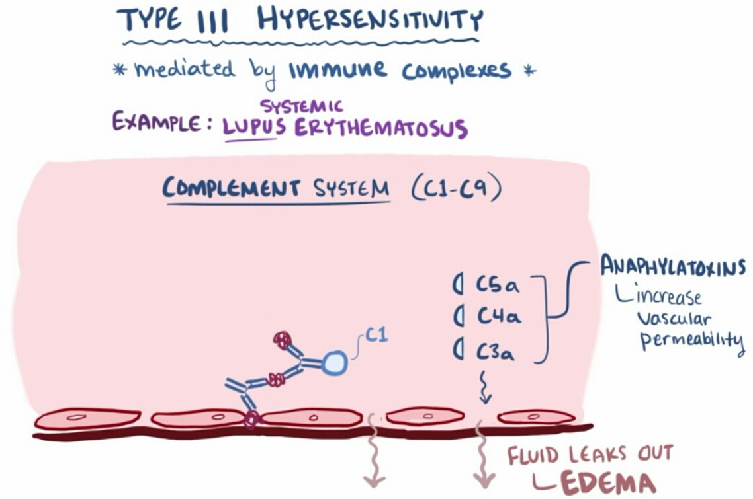
Immune complexes ?!
When antigen is released repeatedly, there may be a sustained for­mation of small immune complexes.
these complexes tend to be trapped in the small blood vessels of the renal glomeruli and synovial tissue of the joints.
Tissue injury is mediated by complement.

Slide 13
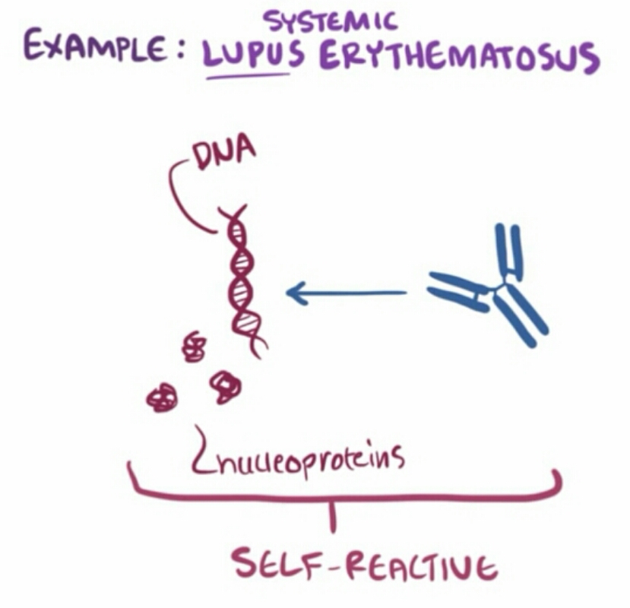
Immune complexes ?!
The most prevalent immune-complex disease is systemic lupus erythemat­osus (SLE).
it is characterized by the formation of antibodies againstDNA.
Bonemarrow is a rich source of such antigens as millions of nuclei are extruded from erythroblasts daily

Slide 14
The case of Nicole Chawner

Slide 15
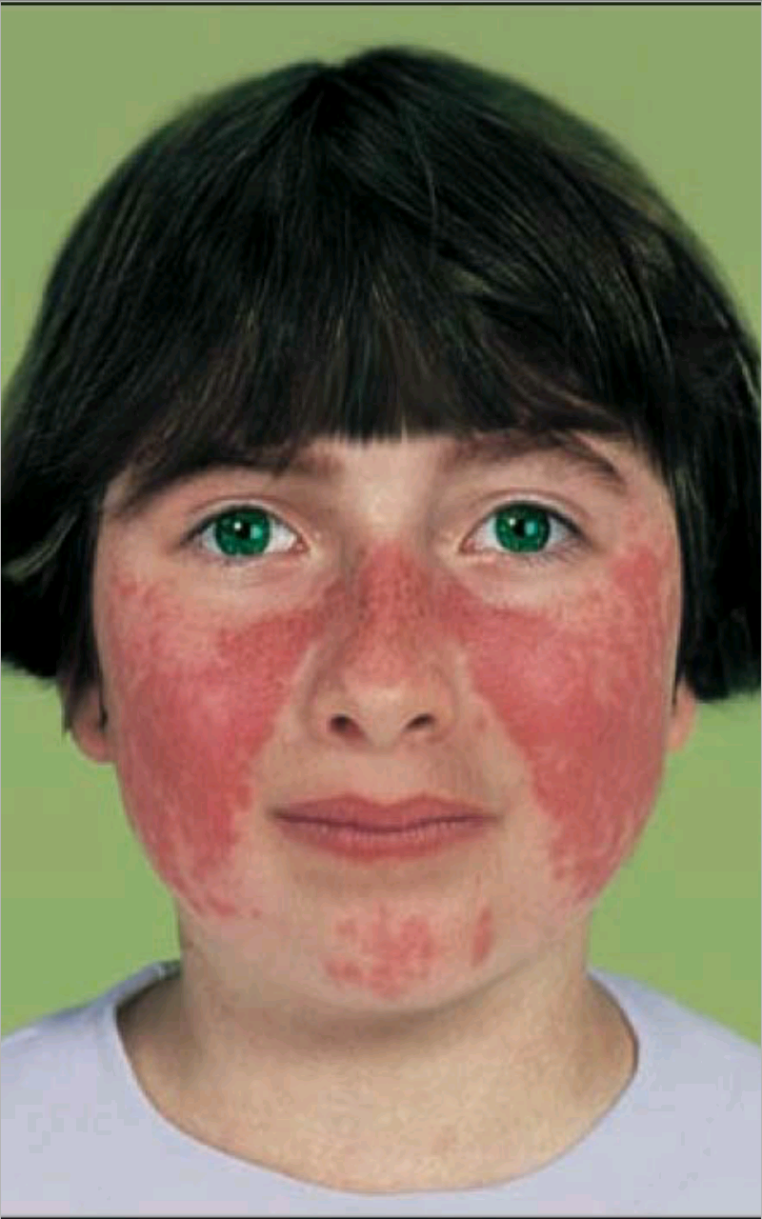
too much sun at the beach
healthy 16-year-old until this summer.
after exces­sive exposure to the sun on the beach, she developed a red rash on her cheeks.
her family doctor recognized that the butterfly rash on her cheeks and bridge of her nose was typical of systemic lupus erythematosus (SLE).
He referred Nicole to the Children's Hospital,
Nicole said that when she woke up in the morning her fingers and knees were stiff, although they got better as the day wore on /some symmetric swelling in her fingers.

Slide 16
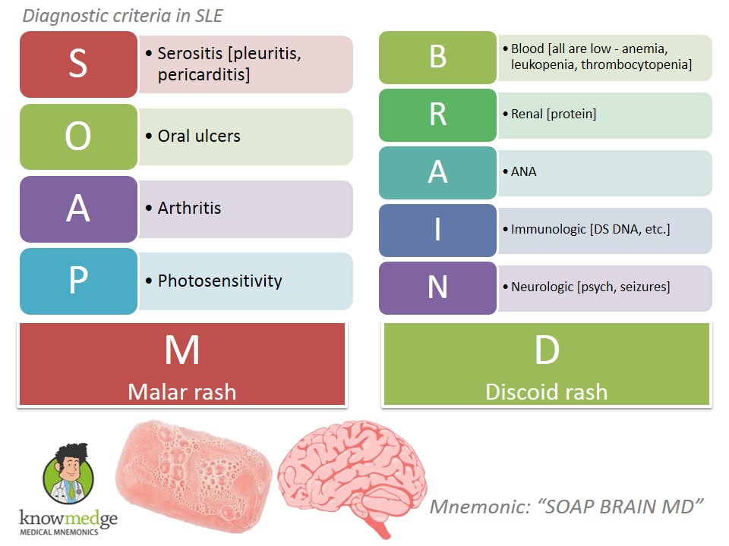
Lab tests and management ..
+Ve for anti-nuclearantibodies (ANA) at a titer of 1 :1280.
Diagnostic for SLE if at least 3 out of 10 clinical symptoms present with it.
Because of this result, further tests were perormed :
elevated level of anti ds-DNA.
serum C3 level was 73 mg dl-1 (normal 100-200mg dl-1).
platelet count was normal at225,000 microL-1
-Ve direct and indirect Coombs tests.
-Ve for anti-phospholipid antibodies.
normal urine.
advised to take an antimalarial agent, hydroxychloroquine sulfate(Piaquenil), and to avoid direct sunlight.

Slide 17
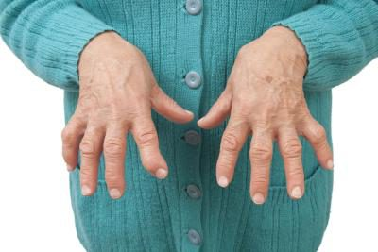
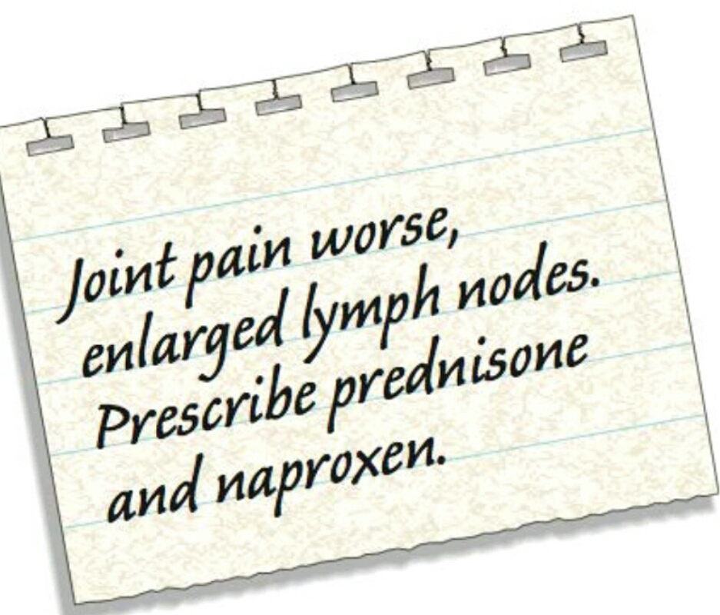
Relapse
After a month, morning stiffnessworsened.
developed a fever of 39°C accompanied by shaking chills.
Enlarged cervical lymph nodes.
She also lost 4.6 kg over the course of the next 2 months.
When she returned to the hospital for a check-up, her buterffly rash had disappeared.
She had diffuse swelling of the proximal joints in her fingers and toes.
Increased levels of anti-DNA antibodies.
serum C3 level was 46 mg dl-1.
Nicole was advised to take 10mg of prednisone twice a day, as well as 250 mg of naproxen twice a day.
This quickly controlled her symptoms, and she remained well. At her next visit, her serum C3 level was 120 mg dl-1.

Slide 18
Summary
16- yrs old female.
Butterfly rash, and symmetric morning stiffness.
+ve ANA
Low serum C3
Negative Coomb’s test.
Normal urine (no hematuria)
advised to take an antimalarial agent, hydroxychloroquine sulfate
After a month, morning stiffness in her fingers and knees worsened.
She developed fever
Enlarged cervical lymph nodes.
Advised to take prednisone twice a day, as well as 250 mg of naproxen twice a day.

Slide 19
SLE (systemic lupus erythematosus)

Slide 20
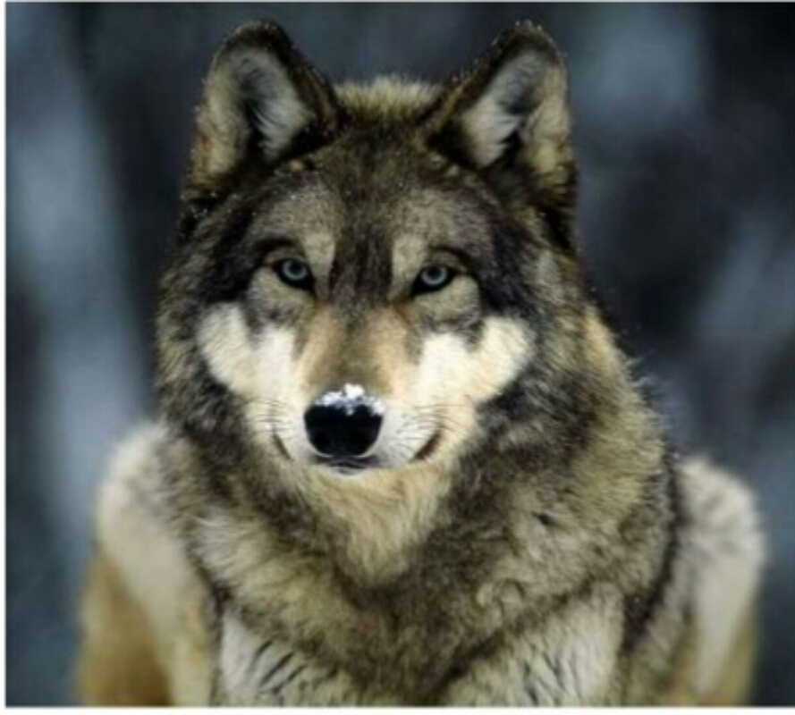
Systemic lupus erythematosus
'lupus' is Latin for wolf.
Due to the common symp­tom of SLE, the butterfly rash on the face.
It’s the most prevalent immunecomplex disease in developed countries.
It afects 10 times as many females as males.
Patients with SLE usually have antibodies against multiple autoantigens.

Slide 21
Autoantigens?!
Patients with SLE usually have antibodies against multiple autoantigens, ex:
60% of all SLE patients have anti double-stranded DNA. Ab (Most common)
against small ribonucleoproteins.
Autoantibodies against platelets and red blood cells,.
against the phospholipid (antiphospholipid antibodies).
Most patients tend to have a range of these autoantibodies.

Slide 22
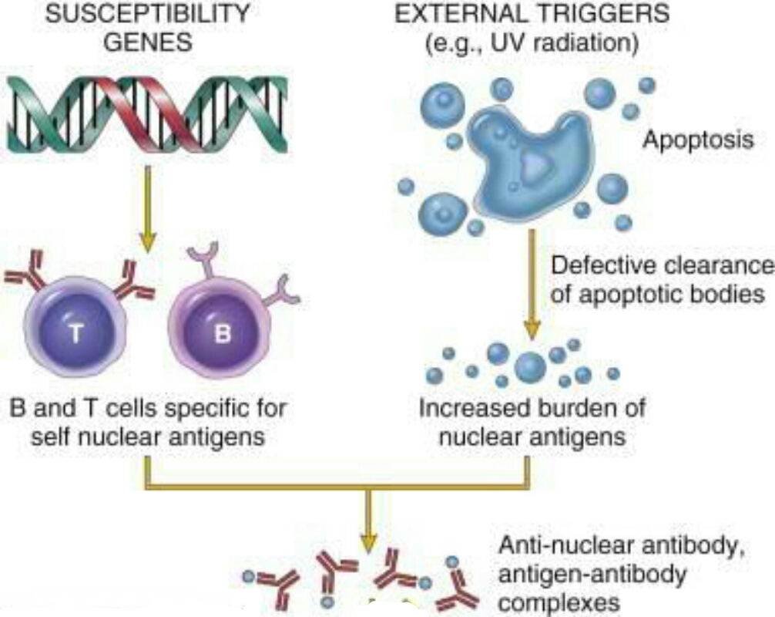
Pathogenesis
Certein genetic factors, produse autoreactive B and T cells.
External factors that release nuclear material, activating autoreactive B cells (UV radiation)
Release of Anti-nulear antibodies, and formation of Ag-Ab complex.

Slide 23
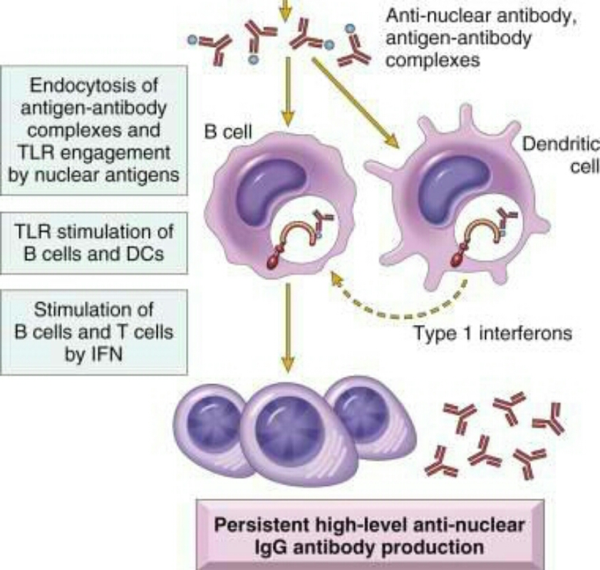
Pathogenesis
Engulfment of these complexes by B-Cells and APCs
Necluar material will bind and activate TLR inside lysosomes.
TLR → IRF5 → type 1 interferons → activation of autoreactive T and B cells.

Slide 24
Pathogenesis :p
When antigen is released repeatedly, there may be a sustained for­mation of small immune complexes.
these complexes tend to be trapped in the small blood vessels of the renal glomeruli and synovial tissue of the joints.
Tissue injury is mediated by complement.

Slide 25
Notes:
Certain mutation in any protein involved in the pathogenesis increase the risk for SLE.
IRFS haplotypes were one ofthe first genetic sus­ceptibility factors identifed in SLE
small percentage of patients on IFN-atreatment develop lupus. This drug has been withdrawn.
There’s a seasonal variation to the onset of SLE, which is greatest in the Northern Hemisphere between March and September, when the greatest amount ofultraviolet light penetrates the atmosphere.
Antimalarials such as hydroxy­chloroquine seem particularly helpful in the treatment of lupus skin disease.

Slide 26
Questions

Slide 27
Q1:
Why do you think Nicole's serum C3 was measured, both on her first visit to the hospital and after therapy?
A: The serum levels of complement proteins C3 and C4 are lowered in SLE by the large number of immune complexes binding C3 and C4, triggering their cleav­age. The depletion ofthese proteins is therefore proportional to the severity ofthe disease. Successful immunosuppressive therapy is reflected in an increase in the serum levels of C3 and C4. Measurement of either C3 or C4 is suffcient;it is not necessary to measure both, and C3 is most usually measured.

Slide 28
Q2:
What are the direct and indirect Coombs tests, and what did they tell us in this case?
A: The objective of these tests was to establish whether Nicole had autoimmunehemolytic anemia, which occurs in SLE when there are antibodies againsterythrocytes. Nicole did not have hemolytic anemia

Slide 29
Q3:
Why was Nicole told to avoid direct exposure to sunlight?
A: Because ultraviolet light provokes the onset of SLE and causes relapses.
Q4:
Repeated analysis of Nicole's urine was negative. What does thismean?
A: She had not developed glomerulonephritis. If she had, her urine would have contained protein and red blood cells.

Slide 30
Q5:
Nicole had a serum lgG level of2020 mg dt-1,This substantiallyelevated level of lgG is commonly found in patients with SLE. How couldyou explain this? And what would you expect to fnd if we took a biopsy ofNicole's swollen lymph nodes?
A: As aresult ofthe constant stimulation oftheir B cells by autoantigens, patientsbwith SLE have a greatly expanded B-cell population and consequently anincreased number of plasma cells secreting immunoglobulin. A lymph node biopsy fom Nicole would have exhibited follicular hyperplasia in the cortex and increased numbers of plasma cells in the medulla.

Slide 31
Q6:
The antigen in the immune complexes formed in SLE is often a complexantigen, such as part of a nucleosome or a ribonucleoprotein particle,which contains several different molecules. Patients often produce autoantibodies against each of these different components. What is thereason for the production of this variety of autoantibodies, and what type of failure in tolerance could be responsible for autoantibody production?

Slide 32
Answer of Q6
In the frst place, a large multimolecular complex such as a nucleosome car­ries many separate epitopes, each of which can stimulate antibody produc­tion by a B cell specifc for that epitope. Any of these antibodies can bind thenucleosome particle to form an immune complex. Such potentially autoreac­tive B cells probably exist normally in the circulation but, provided that T-celltolerance is intact, they are never activated because this requires T cells to bereactive against the same autoantigen. SLE is probably caused by a failure ofT-cell tolerance. T cells for each ofthe components ofthe complex antigen willnot be needed to induce antibodies against its individual components. As Fig.A37.6 shows, aTcell that is specifc for one protein component of a nucleo­some could activate B cells specifc for both protein and DNA components.

Slide 33
Thank you
Mohammad qussay Al-Sabbagh

