Slide 1
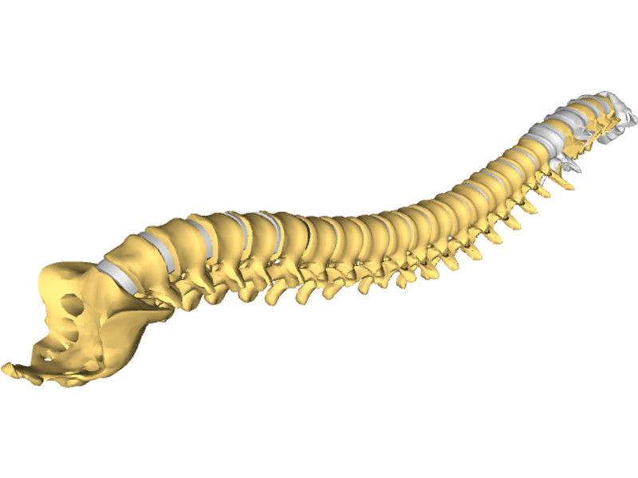
The vertebral column Dr.Qussay Salih AlSabbagh Neurosurgery department

Slide 2
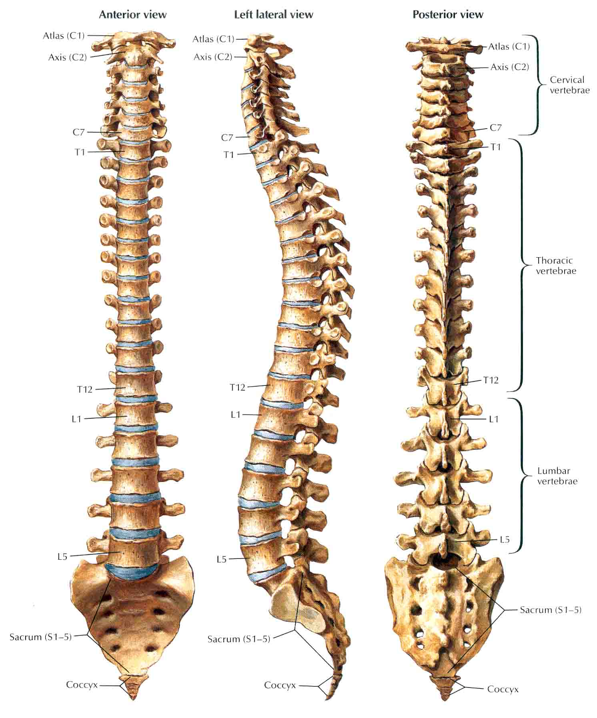
The vertebral column consists of 33 vertebrae (7 cervical, 12 thoracic, 5 lumbar, 5 sacral, and 3–4 coccygeal).
These vertebrae, along with their ligaments and intervertebral discs, form the flexible, protective, and supportive vertebral column that contains the spinal cord.

Slide 3
The vertebral column
A thorough understanding of the normal relationships between these osseous, discoligamentous, and neural elements is essential for safe and effective surgical intervention.

Slide 4
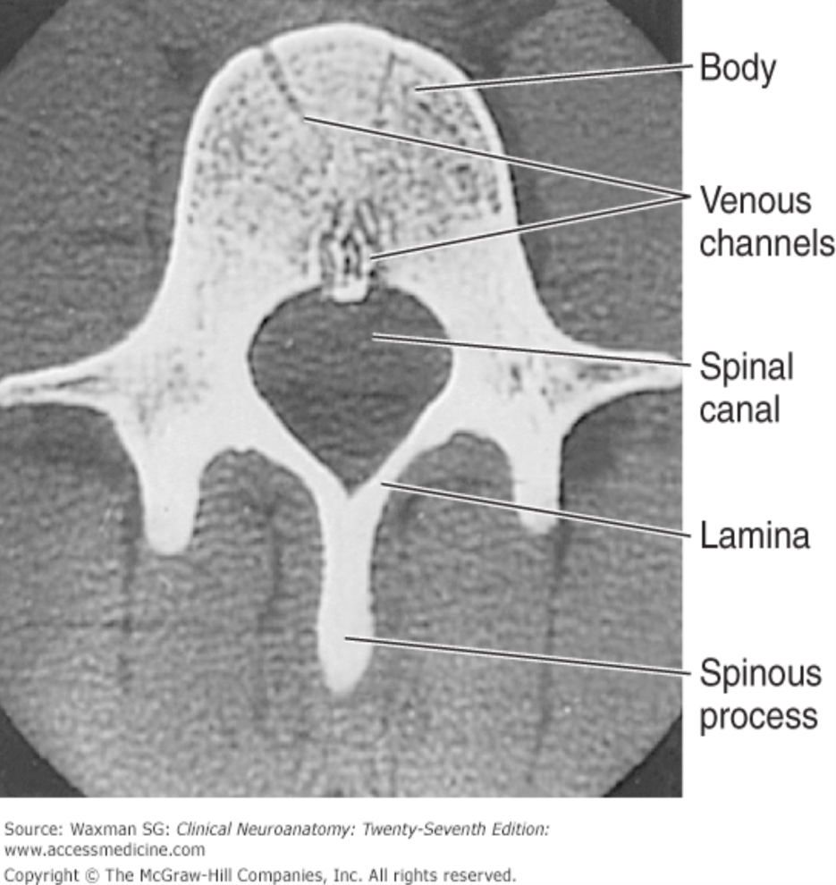
The Typical Vertebra
Read only
A typical vertebra consists of the followings:
1-Body. The anterior vertebral region that is the primary weight-bearing component of the vertebrae.
2-Vertebral arch. Arches posteriorly from the vertebral body and forms the vertebral foreman, which contains the spinal cord.
3-Pedicle. Part of the vertebral arch that joins the vertebral body to the transverse process.
4-Transverse processes. Extend laterally from the junction of the pedicle and lamina.

Slide 5
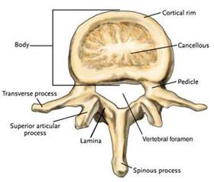
The Typical Vertebra
Read only
5-Superior and inferior articular facets. Form synovial zygapophyseal (facet) joints with the vertebrae above and below.
6-Laminae. The paired posterior segments of the vertebral arch that connect the transverse processes to the spinous process.
7-Spinous processes. The posteriorly projecting tip of the vertebral arch. These processes are easily palpated beneath the skin.
8-Vertebral foramen. The space in which the spinal cord, its coverings, and the rootlets of the spinal nerves lie. The series of vertebral foramina form the vertebral canal.
9-Intervertebral foramina. Bilateral foramina that form the space between pedicles of adjacent vertebrae for passage of spinal nerves.

Slide 6
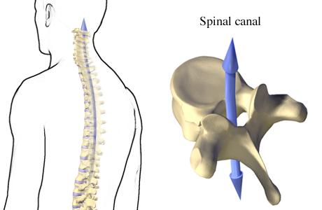
The Spinal Canal
Spinal canal dimensions vary along the rostral-caudal axis, being greatest in the cervical region and smallest in the midthoracic region. This variation is principally due to changes in the ventral-dorsal diameter.

Slide 7
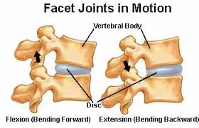
The discoligamentous structures:Vertebral Articulations
There are two types of articulations that enable the 33 vertebrae to not only provide support, protection, and absorb shock, but also to provide flexibility.
These two articulations are the intervertebral discs and the zygapophyseal joints.

Slide 8
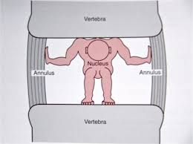
The Intervertebral discs
The general function of the intervertebral disc is twofold:
It deforms to accommodate compressive loads, a role assumed by the nucleus pulposus, and
It resists tensile and torsional stresses, a role assumed by the anulus fibrosus

Slide 9
The Intervertebral discs
At a microscopic level, the nucleus pulposus consists of a semifluid, gel-like substance embedded in a fine meshwork of fibrous strands. This structure results in a viscoelastic property that allows the disc to withstand and absorb axial stress.
The anulus fibrosus has a lamellated boundary of intersecting fibrous strands. Anular fibers known as Sharpey fibers penetrate the dense cortical bone that makes up the outer ring of the vertebral end plate.

Slide 10
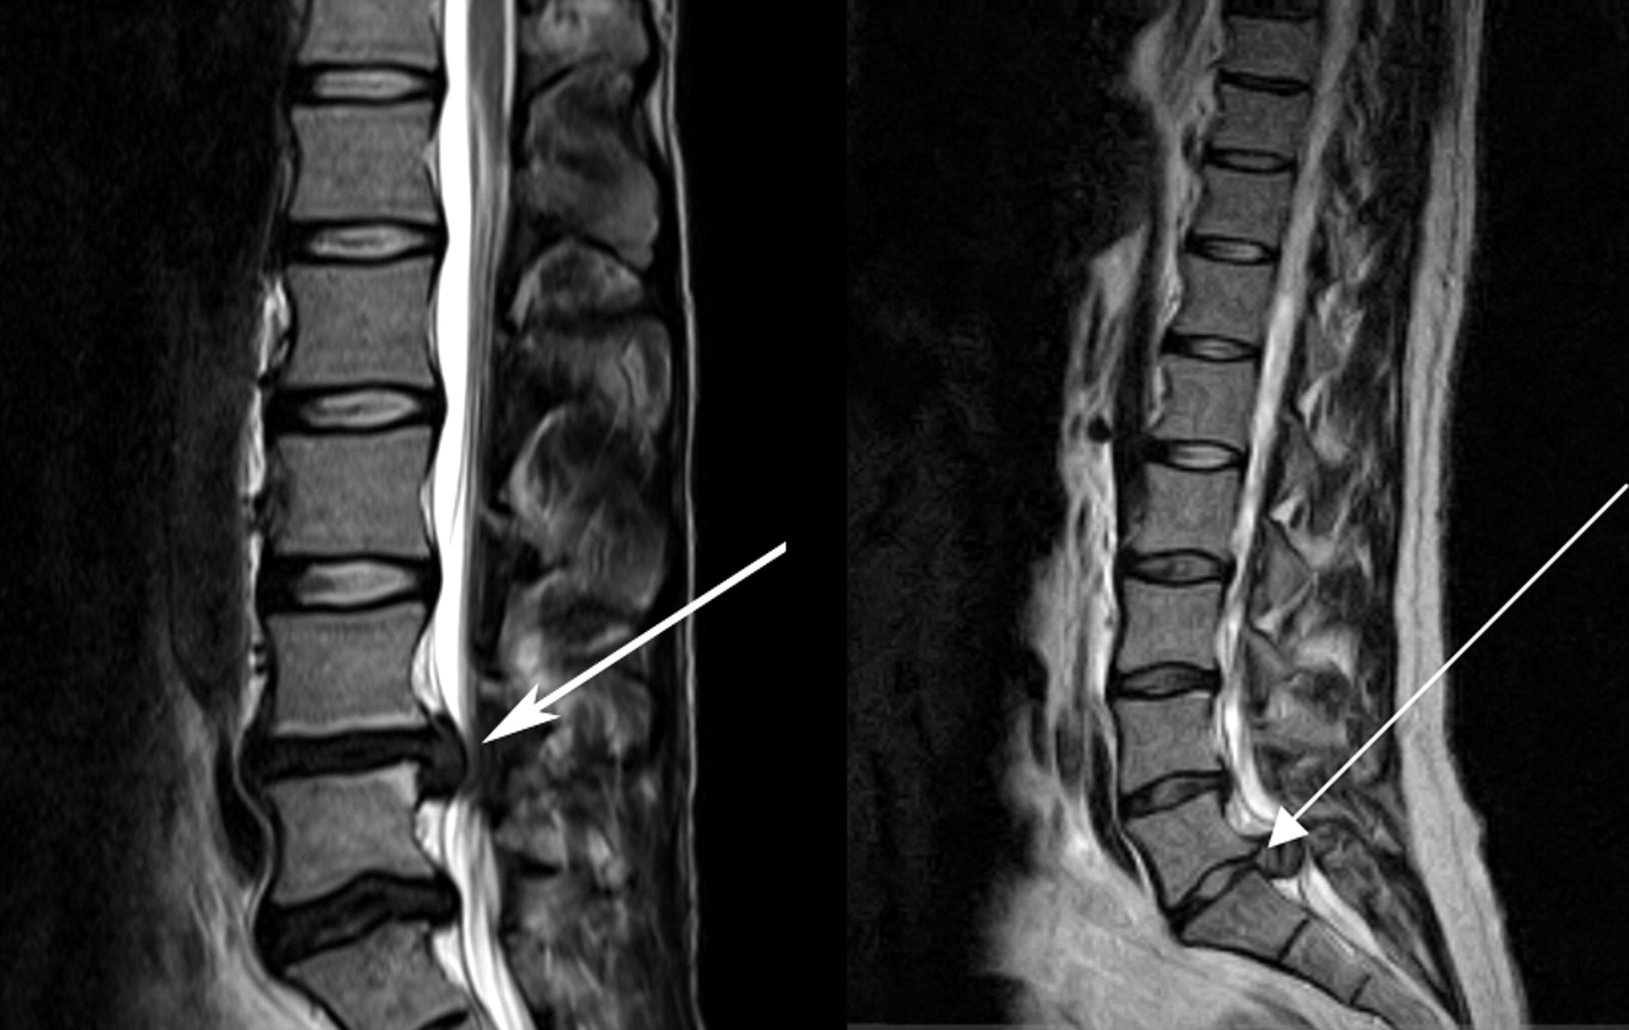
Damage to the anulus fibrosus may allow the softer nucleus pulposus to bulge or herniate, which may compress the segmental nerve roots. This is often referred to as a “prolapsed or heniated disc”.

Slide 11
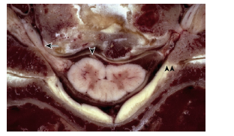

Slide 13
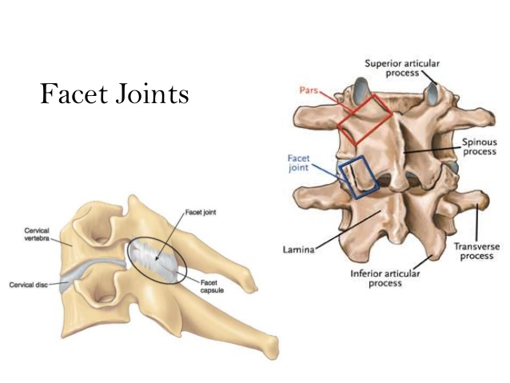
Zygapophyseal joints(facet)
The facet joint, or zygapophyseal joint, is formed by an inferior articulating process emanating from the level above and a superior articulating process emanating from the level below.

Slide 14
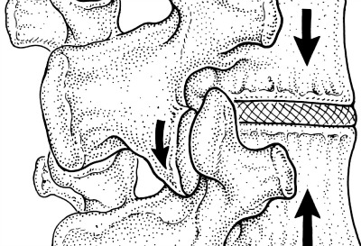
The facet joint is a synovial joint, possessing a true joint capsule. Gliding articulation at the facet joint is limited by the capsular fibers, which are relatively lax in the cervical region but increase in tautness along the rostral caudal axis.

Slide 15
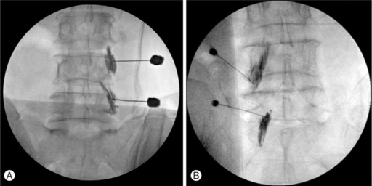
Facet joint block for low back pain

Slide 16
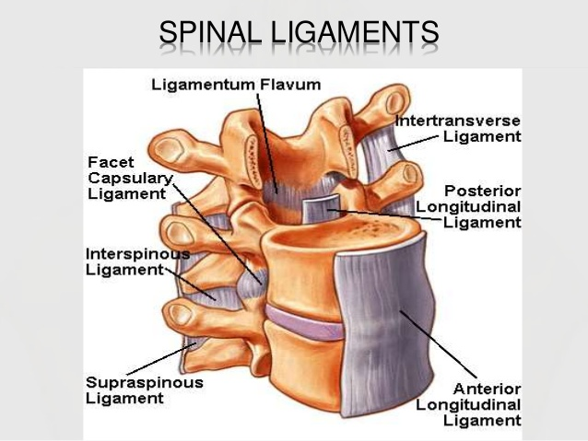
Vertebral Ligaments
Important
Ligamentum flavum.
Supraspinous ligament. Connects the apices of the spinous processes from C7 to the sacrum.
Interspinous ligament. Connects adjoining spinous processes.
Nuchal ligament. Extends from the external occipital protuberance along the spinous processes of C1–C7.
Posterior longitudinal ligament.
Anterior longitudinal ligament.

Slide 17
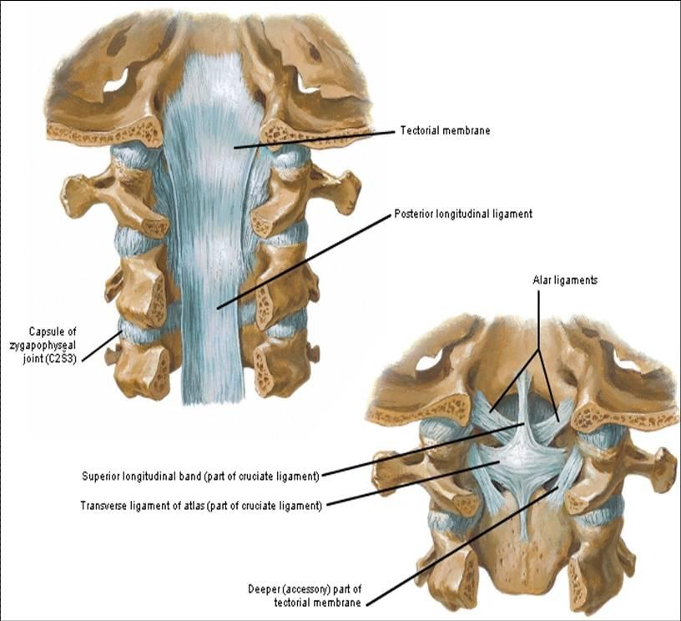

Slide 18
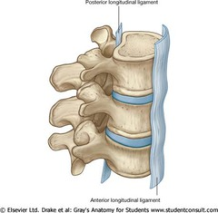
Anterior Longitudinal Ligament
(ALL) is a strong, broad ligament that spans the ventral surface of all the vertebral bodies.
Its width increases along the rostral-caudal axis; at the lower lumbar levels, it encompasses almost half of the total circumference of the vertebral body. .
Because of relative strength, the ALL is an important contributor to spine stability, particularly in the lumbar spine. It resists hyperextension and, to a lesser degree, translational motion.

Slide 19
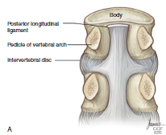
Posterior Longitudinal Ligament
(PLL) also spans the full rostral-caudal axis of the spine . It is located along the dorsal surface of the vertebral bodies, within the spinal canal .
At the midbody level, it is relatively narrow, but it widens considerably at the level of the disc before narrowing again as it transitions to the level below.
It is adherent at the level of the end plate and annulus but elevated from the concave dorsal surface of the midvertebral body.
Although the PLL’s contribution to spine stability is modest, it serves to direct disc herniations dorsolaterally, away from the central portion of the spinal canal.

Slide 20
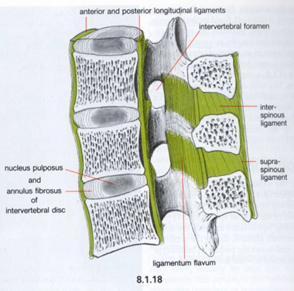
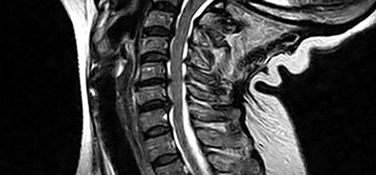
Ligamentum Flavum
Important
The ligamentum flavum is a thick, yellow ligament that goes from the sacrum to C2.
Its characteristic appearance and consistency result from a relatively increased ratio of elastic to collagen fibers.
The ligamentum flavum is discontinuous, emanating from the rostral surface of the lamina below, spanning the interlaminar space, and inserting on the ventral surface of the lamina above
Hypertrophy of this ligament can cause spinal canal stenosis –narrow canal in hyperextension.

Slide 21
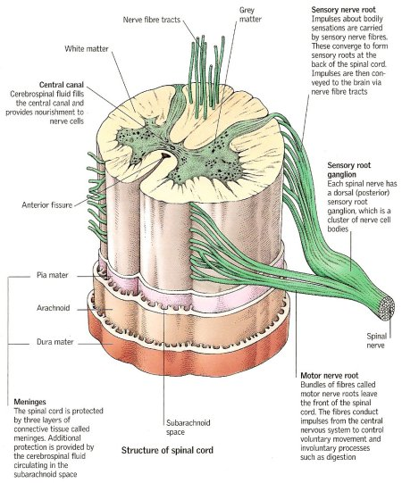
THE NEURAL STRUCTURES Spinal Cord
The gray matter of the spinal cord is divided into a ventral motor portion and a dorsal sensory portion.
Major white matter tracts are depicted in . Somatotopy of white matter tracts is usually such that fibers to rostral segments are positioned medial to fibers to more caudal segments.

Slide 22
During fetal development and childhood, the vertebral column grows faster than the spinal cord, resulting in ascension of the conus medullaris within the spinal canal.
In the normal adult, the conus typically terminates at L1, though it may occupy positions ranging from T11-12 to the upper vertebral body of L3.

Slide 24
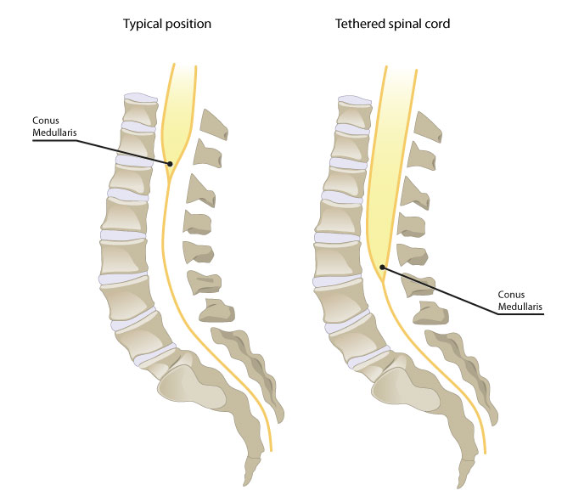
Tethered spinal cord syndrome is a neurological disorder caused by tissue attachments that limit the movement of the spinal cord within the spinal column, resulting in low lying conus medullaris.

Slide 25
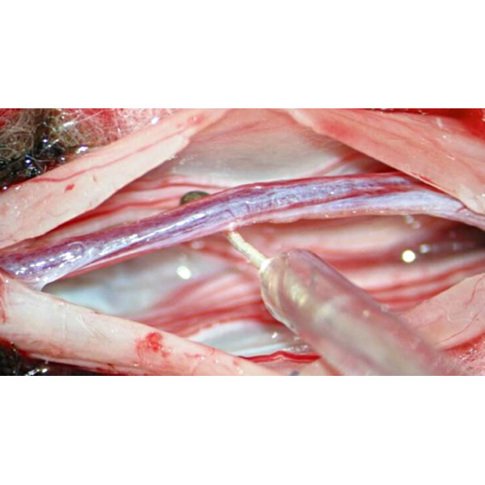

Slide 26
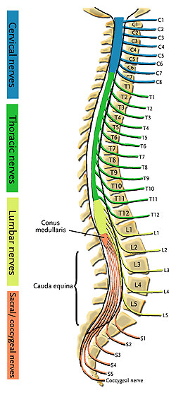
There is a discordance between spinal level (the level defined by spinal rootlets’ origin) and vertebral level (the level of the neural foramen).
A fracture-dislocation in the upper and midthoracic spine will typically cause cord injury at the level of injury or one level below. A fracture-dislocation in the lower thoracic spine would be expected to cause cord injury two or more levels caudal to the bony injury.

Slide 27
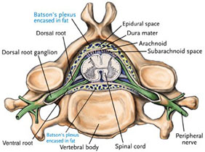
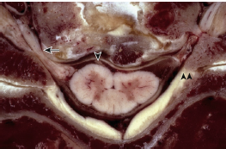
Intradural nerve roots
The spinal nerves represent the union of ventral and dorsal roots that arise independently from the spinal cord . Each root, in turn, represents the union of numerous rootlets that arise from the anterolateral sulcus (for the ventral root) and posterolateral sulcus (for the dorsal root).

Slide 28
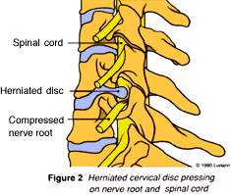
The cervical roots
The ventral and dorsal roots both traverse the intervertebral neural foramen above their same-numbered pedicle (i.e., the C5 nerve roots exit in the C4-5 neural foramen, above the C5 pedicle). The C8 pedicle exits the C7-T1 intervertebral foramen.
The first cervical root does not have a dorsal root ganglion and consequently does not have a corresponding sensory dermatome.

Slide 29
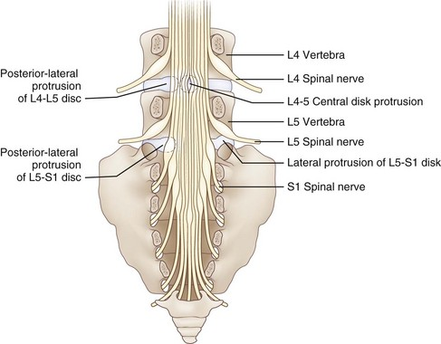
The Cauda Equina
The descending intradural roots of the cauda equina possess a rough somatotopy that may be of practical use during intradural procedures.
Sacral roots tend to occupy a more central position within the canal (having emanated from the tip of the conus), while lower lumbar roots are located in a paramedian position and upper lumbar roots are located most laterally.

Slide 30
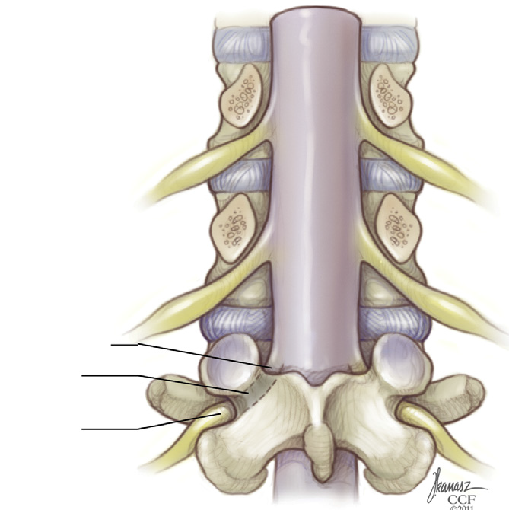
At the lateral border of the thecal sac, each root becomes ensheathed in dura.
In the lumbar spine, the root angles obliquely downward to pass below the like-numbered pedicle; in so doing, it crosses the plane of the intervertebral disc. In the cervical spine, by contrast, the nerve takes a relatively horizontal course to its corresponding foramen (above the like-numbered pedicle).

Slide 31
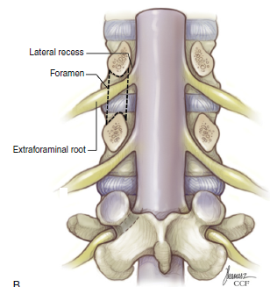
The lateral recess& neural foramen
Before entering the neural foramen, a nerve root traverses the lateral recess:is a space defined medially by the edge of the thecal sac and laterally by the medial pedicular plane at the level of the midvertebral and lower vertebral body .
The neural foramen is a space defined rostrally by the pedicle, caudally by the pedicle, ventrally by the inferior portion of the vertebral body and the intervertebral disc, and dorsally by the superior articular process of the level below, with its capsular covering .

Slide 32
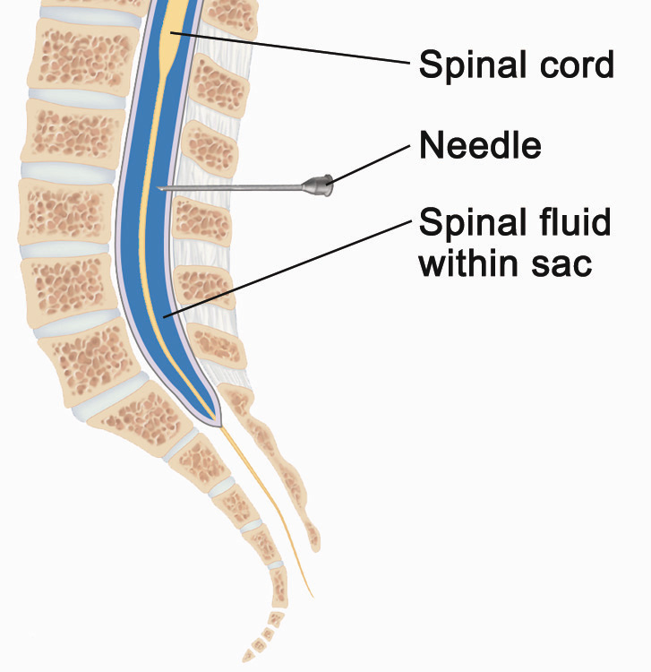
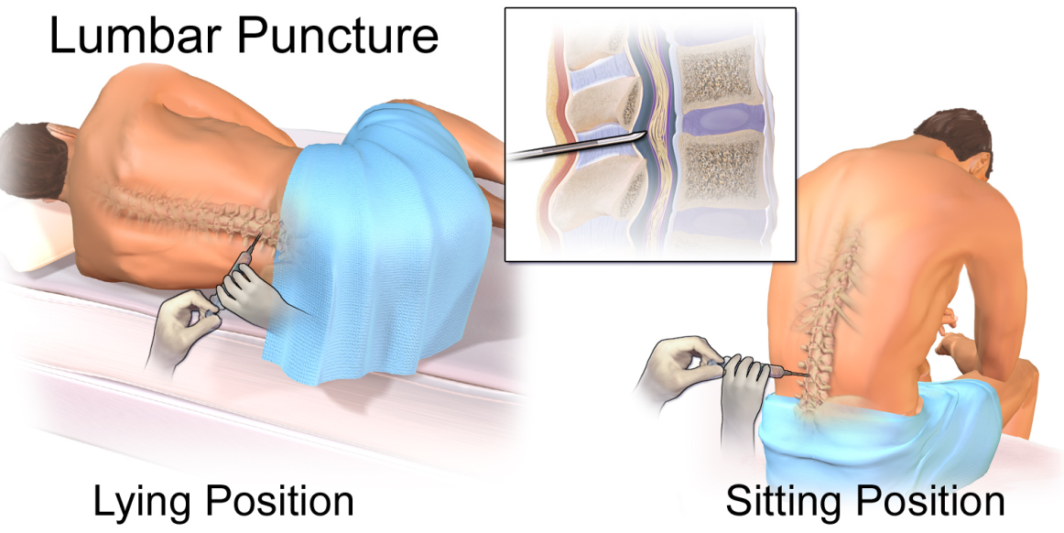
Lumbar puncture

Slide 33
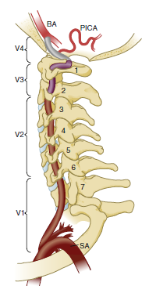
Vascular Anatomy- Vertebral Artery Anatomy
The vertebral arteries are paired vessels that lie close to the cervical spine.
The course of the vertebral artery is divided into four segments.
The V1 segment represents the segment from origin until the artery enters its first foramen transversarium. In 87.5% of cases, this is at the C6 level.
Important

Slide 34
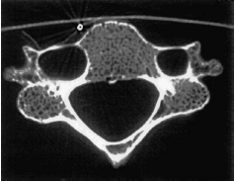
The V2 segment is the portion that traverses the foramina transversaria and terminates after the C2 foramen transversarium. This is the most vulnerable segment of the vertebral artery in most common cervical spine surgeries.
The V2 segment may have a tortuous course, and awareness of these anomalies must be achieved radiographically before performing cervical surgery .

Slide 35
The V3 segment continues until the vertebral artery penetrates the dura.
The V4 segment is the intradural portion of the vessel, ending at the vertebrobasilar junction.

Slide 36
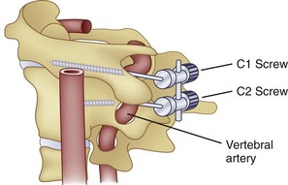
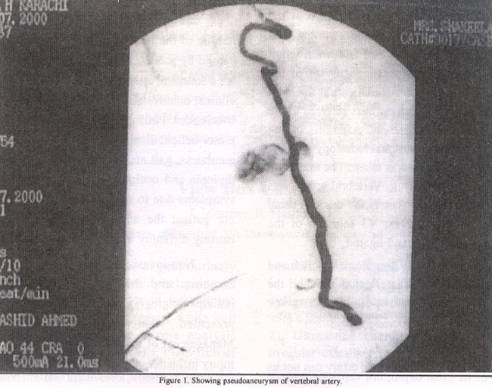

Slide 37
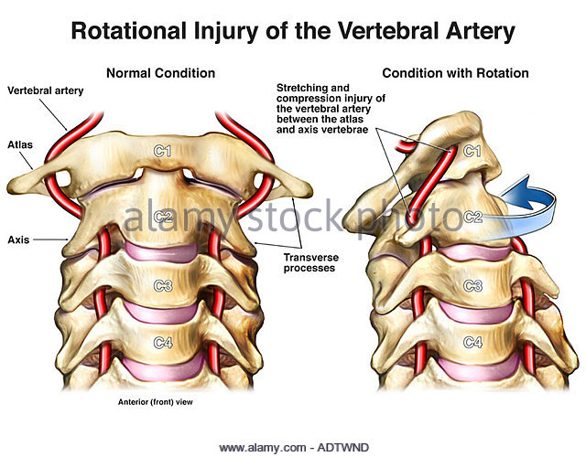

Slide 38
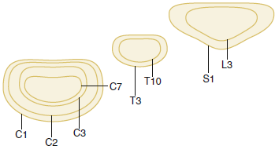
Variation in the shape of the vertbrae

Slide 39
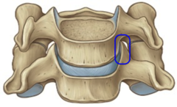
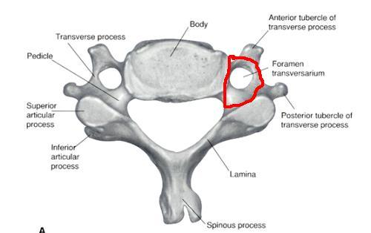
TYPICAL CERVICAL VERTBRA(SUBAXIAL)
Read only
vertebral body is roughly cylindrical in geometry ,are smaller than the vertebral bodies of the thoracolumbar spine .
The lateral edges of the superior end plate curve sharply upward to form the uncinate processes bilaterally which articulate with complementary bevels on the lateral surfaces of the adjacent inferior end plate. “uncovertebral joint,” it contains no synovial fluid
The transverse foramen, or foramen transversarium, fenestrates the transverse process and carries the vertebral arteries bilaterally .

Slide 40
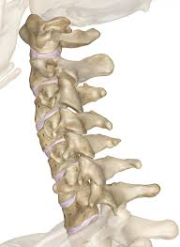
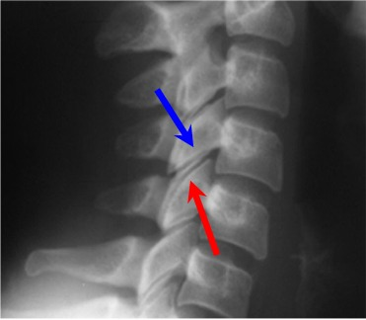
Read only
The superior and inferior articular processes of the cervical spine are oriented obliquely on sagittal projection .
A bifid spinous process rostrally (typically from C2 to C6) and a monofid spinous process caudally (typically from C6 and below).

Slide 41
Typical thoracic vertbra
Read only
In cross section, thoracic vertebrae possess a heart shape,
In Sagittal vertebral morphology ,thoracic vertebral bodies are wedge shaped, ventral height being shorter than dorsal height. This results in the normal thoracic kyphosis.
The vertebral body gradually increases in cross-sectional area and height from the thoracic spine to the midlumbar spine .

Slide 42
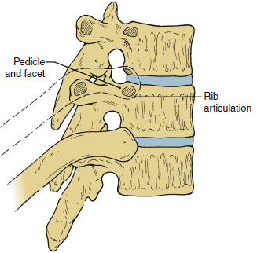
Read only
Thoracic facets have an alignment that is oblique to all three cardinal planes .
The transverse process projects dorsolaterally and articulates at its tip with the like-numbered rib.
The 2nd through 9th ribs articulate with their like-numbered vertebrae, as well as the vertebra below, via paired demifacets.

Slide 43
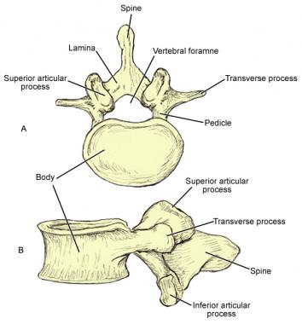
Typical lumbar vertbra
Read only
The 11th and 12th vertebral bodies, in particular, possess a mixture of thoracic and lumbar morphology.
lumbar vertebrae are more kidney shaped; a concavity along the dorsal aspect of each marks the ventral portion of the spinal canal.
In the lumbar spine, ventral and dorsal heights are generally comparable, and it is the disc shape, rather than vertebral body shape, that is the principal contributor to lumbar lordosis.

Slide 44
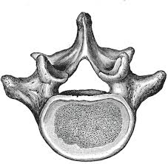
Read only
Lumbar facets occupy a plane that is intermediate between the sagittal and coronal planes.
Thick shorter pedicles and transverse processes compared with that of thoracic vertebra.

Slide 45
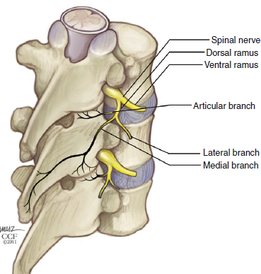
Innervation of the Spine
1-The medial branch of the dorsal primaryramus is believed to be important because it is a major source of innervation to the facet joint.

Slide 46
2-The sinuvertebral nerve (nerve of Luschka ) is a recurrent nerve that may originate from the distal margin of the dorsal root ganglion, the spinal nerve, or the rami communicantes .
It then passes back through the the neural foramen to innervate the intervertebral discs above and below, as well as the ventral dura.

Slide 47
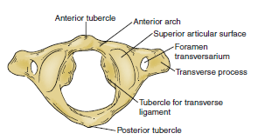
The Atypical vertebra
C1 or the atlas:
Is composed of a ventral and dorsal arch, joined laterally by symmetrical lateral masses.
- The ventral arch with- a dorsal articular surface forming a synovial joint with the odontoid process
-an anterior tubercle ventrally to which the longus colli muscle attaches.
-The dorsal arch of the atlas typically forms a posterior tubercle in the midline .

Slide 48
. The dorsomedial walls of the C1 lateral masses form a small tubercle that serves as the attachment for the transverse atlantoaxial ligament.
The superior surface of the lateral dorsal arch forms a groove known as the sulcus arteriosus on which the vertebral arteries run bilaterally

Slide 49
Jefferson fracture

Slide 50
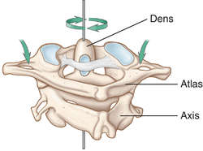
The C2, or axis
The odontoid process, a peg like rostral projection, forms a synovial joint with the atlas along its ventral border and allows the atlas to rotate on C2, with translational restriction created by a complex of ligaments.

Slide 51
Ligaments Of The Odontoid
The tip of the odontoid process serves as the attachment for the apical ligament, which connects C2 to the basion (the ventral lip of the foramen magnum).
The paired alar ligaments span the divide between C2 and the occipital condyles.
The transverse atlantoaxial ligament traverses the dorsal border of the odontoid process, which often carries a groove for this strong ligament.

Slide 52
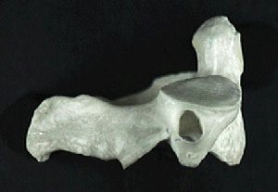
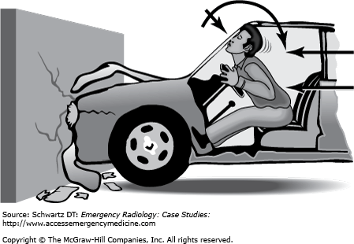
C2 has a relatively long pars interarticularis between superior and inferior articulating processes
The disproportionate length of the C2 pars interarticularis has important clinical implications. Because the superior and inferior articulating processes of C2 are coronally offset, extension applies significant strain on the C2 pars interarticularis.
Under forceful hyperextension, the pars interarticularis may fracture, giving rise to the mechanism and morphology of the so-called hangman’s fracture

Slide 54
Embryology

Slide 55
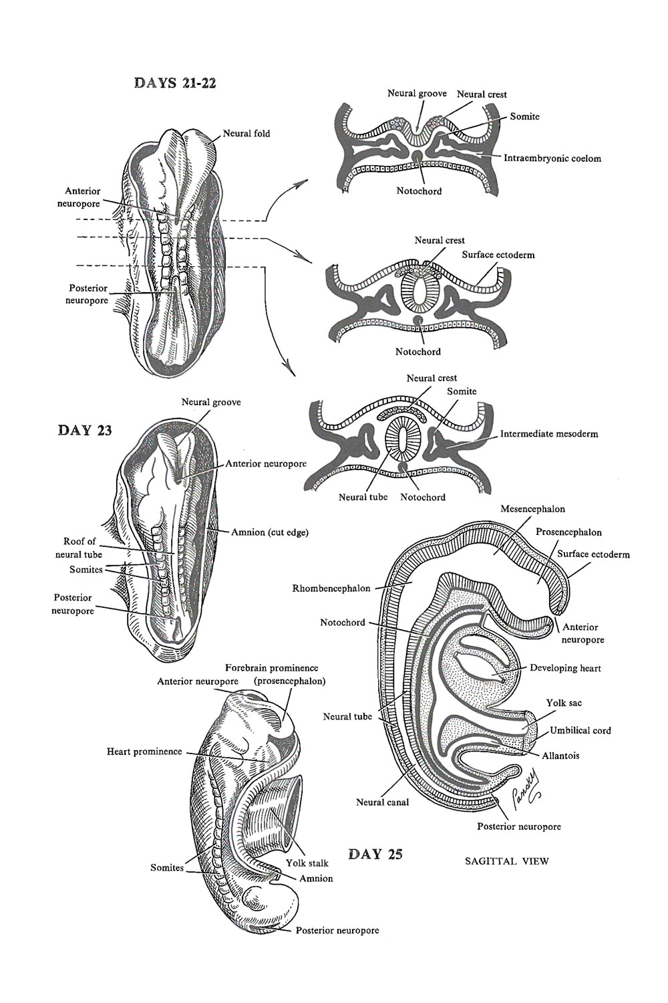

Slide 56
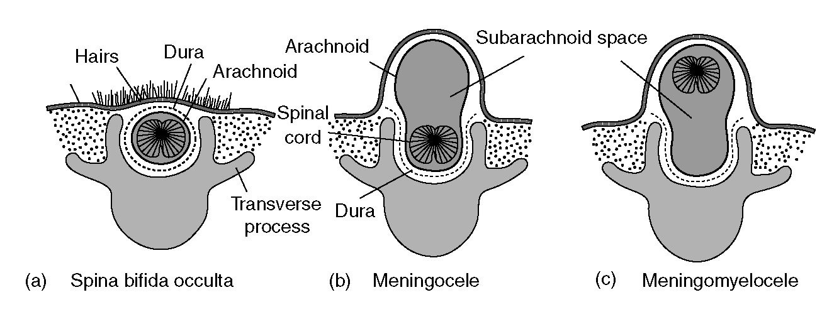
Spina bifida occulta and aperta
Important

Slide 57
Congenital disorders(dysraphism)

