Slide 1
Thyroid Gland Done by : Mohammad Da’as
Fekra 2014

Slide 2
Thyroid Gland

Slide 3
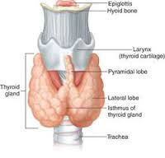
Anatomy review
Notes:
1.First organ to be formed in gestation → formed in the foramen cecum → descends downwards → lower third of ANT. Triangle of the neck
2. Two lobes “ right , left” joined together by the isthmus
3.Pyramidal lobe : is an embryological remnant from the descending of the thyroid tissue, it connects the thyroid gland with the upper thyroid cartilage ☺
4. Voice box → larynx
5. Blood supply :
a- superior thyroid artery
b- inferior thyroid artery

Slide 4
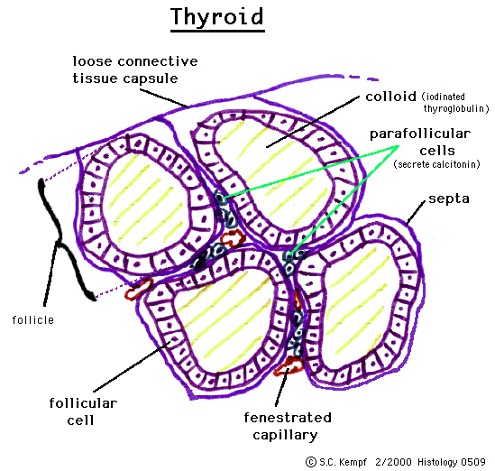
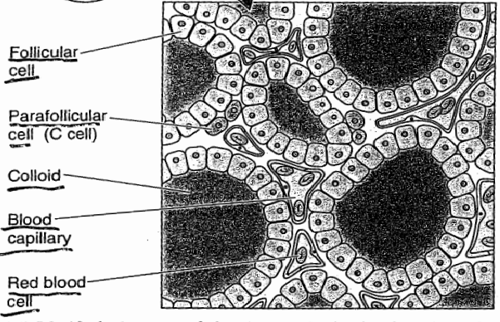
histology review
Notes:
Thyroid Follicles → a group of cells resting on the same basal lamina , facing the same environment “colloid , thyroglobulin”
Thyroglobulin → secretory products of the thyroid follicular cells.
The interstitial tissue in between the follicles is extremely vascular.
Follicular cells :
a- normal → euthyroid status → cuboidal
b- Hyperactivity → columnar
c- Hypoactivity → squamous
5. Parafollicular cells “c-cells” → secretes Callcitonin “when it’s stimulated by elevated blood Ca+2 levels” → inhibits osteoclast activity.

Slide 5
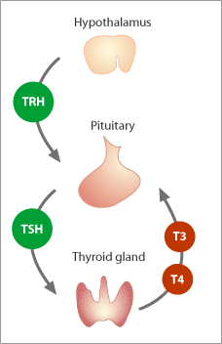
Physiology of Thyroid gland
*TRH → tri-peptide hormone
*TSH → Thyroid stimulating hormone
*thyroid hormones : T4 & T3
*TSH is inhibited by Dopamine & somatostatin
*Somatostatin inhibits cortisol & growth hormone
TSH composed of two subunits
TSH mechanism of action : “2nd messengers”
A- cAMP → synthesis & secretion Hormones
B- Phospholipase C → “DAG & IP3” → metabolism of thyroid cells
Notes:
TRH → thyrotropin releasing hormone

Slide 6
Embryology:
1- 12th week of gestation
2- production of thyroid hormones.
3- maternal → fetus “cannot pass”

Slide 7
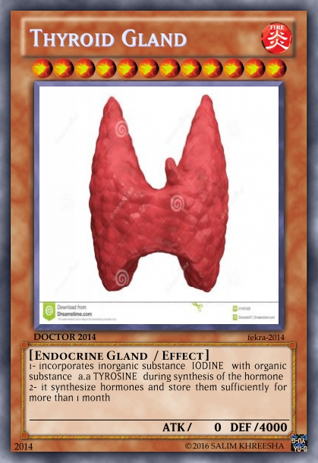
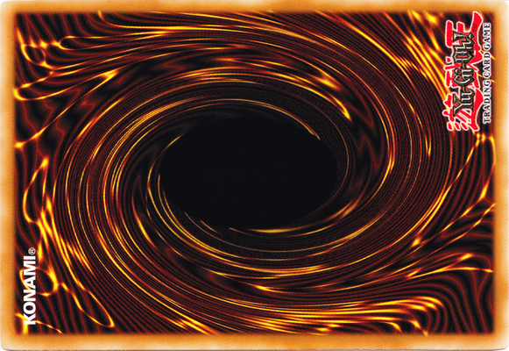
Thyroid gland is unique ☺
1- incorporates inorganic substance “IODINE” with organic substance “a.a TYROSINE”
2- it synthesize hormones and store them sufficiently for more than 1 month

Slide 8
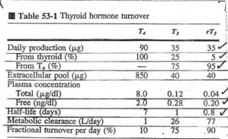
“iodination + coupling” →Thyroid Hormones
Tyrosine
I2
MIT
DIT
1) 2 DIT → T4 “pro-hormone”
2) MIT + DIT → T3 “most active”
3) Metabolism of T4 → inactive form → rT3
T4 produces :
a- inactive rT3
b- Tetrac (tetraiodoacetic acid)
c- active T3
d- DIT
Peroxidase
Notes:
Iodination : addition of iodine to tyrosine
I- → I2 “follicular cell membrane has peroxidases that oxidize this”
rT3→ similar to T3 but they differ in the location of iodine on the tyrosine

Slide 9
pinocytosis

Slide 10
TH binding proteins
TBG (thyroxin-binding globulin)
Albumin
TBPA (thyroxin-binding prealbumin)
Bounding to plasma proteins has two advantages on hormones :
a-To prevent filtration→maintain conc
b-Prolonging half life
Notes:
Thyroid hormones → lipid soluble “ free = danger”
99.5% t3 → BP
99.98% T4 → BP

Slide 11
TH Intracellular actions
Affects all our cells → lipophilicity
Lipid soluble hormones signaling pathways :
Penetrate → bind R→ DNA → mRNA → physiological responses ☺
*Physiological responses → gene expression

Slide 12
Factors Affecting TH secretion
GH + “IGF-I” + TH + insulin+ cortisol+ androgens + estrogens → growth
TH excess = overgrowth
“no growth without energy”
TH conc. Are very low
T4 → permissive effect on the action of GH on proteins synthesis, if it’s abscent= less stimulation for a.a uptake and protein synthesis

Slide 13
Clinical application
Pituitary dwarfism vs. cretinism
Hypothyroidism
Hyperthyroidism

Slide 14
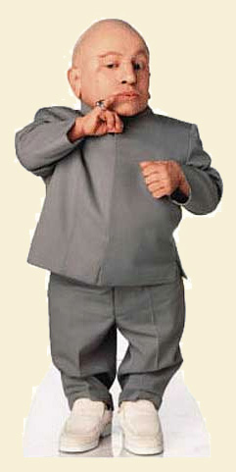
Pituitary dwarfism
Cretinism
in childhood
= Dwarfs + Normal intelligence
in childhood
= Dwarfs + mental retardation
Named thyroid Dwarfism
Failure in developing skeletal , mental , sexual abilities
GH
TH

Slide 15
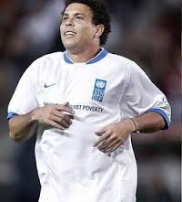
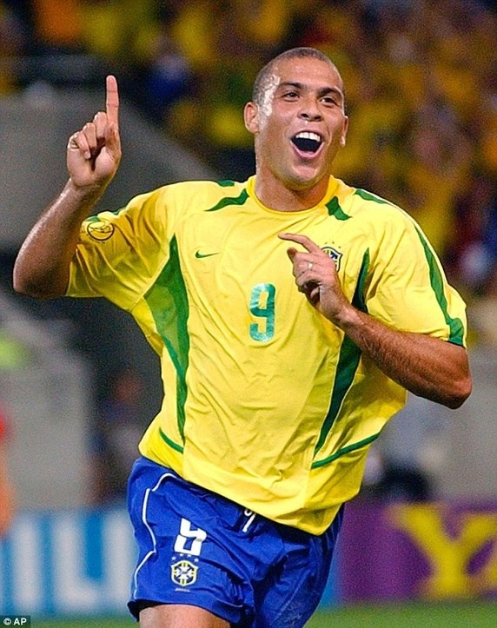
Hypothyroidism
causes
Iodine deficiency
Autoimmune diseases
Surgical removal
Radiation treatment
symptoms
Cretinism
Myxoedema
Childhood
Adulthood

Slide 16
Hyperthyroidism
Causes :
1- increased TSI
2- 2nd excess hypothalamic & pituitary secretions
3- Hypersecreting thyroid tumor “Adenoma”
Graves’ Disease “toxic diffuse goiter”
Symptoms :
1- Exophthalmos :
increase in “TSI” → act against protein in Extraocular muscle & C.T behind the eye → tissue swelling
2- Goiter : in hypo or hyper or Normal.
Sometimes + exophthalmos
Goiter has two types :
a- Simple benign “nontoxic” T3,T4 levels are low
Is formed as a diffuse or as a nodular goiter
b- Malignant “Toxic”
T3,T4 levels are high overproduction of TH causes this type.

Slide 17
