Slide 1
Endocrine Physiology
Mohammad Qussay Al-Sabbagh
2nd year medical student- University of Jordan
June,2016

Slide 2
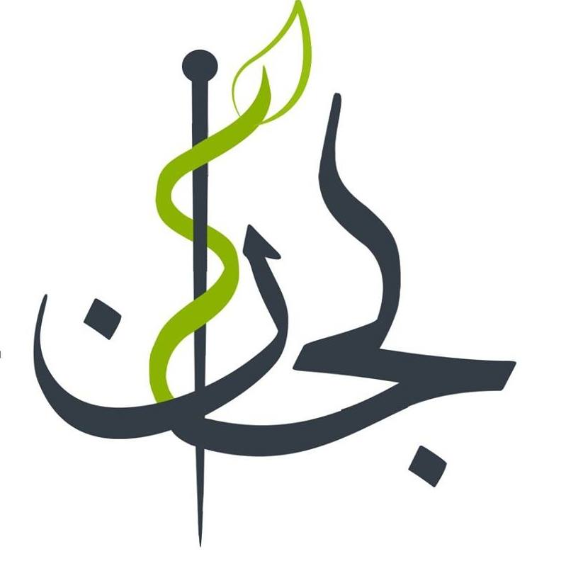
Endocrine Physiology
لجان الدفعات- كلية الطب دفعة 2014
Thyroid Gland

Slide 3
Introduction

Slide 4
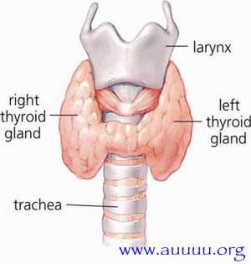
Thyroid Gland (general description)
first gland to start functioning in the body.
Structure of the thyroid gland
right and left lobes
isthmus,
pyramidal lobe (if present)

Slide 5
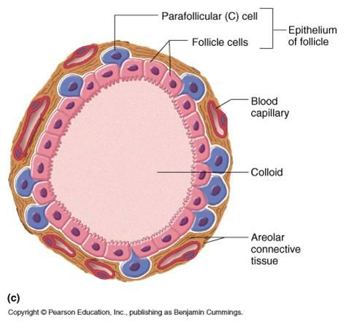
Thyroid Gland (histology)
Thyroid glands appers follicular
Cells
Follicle Cells
Parafollicular (C) Cells

Slide 6
Thyroid Gland (histology)
Follicle Cells
cells that line the follicles
Secrete Thyroxine+ triidothyronine .
hyperactivity →columnar
hypoactivity →squamous
Parafollicular (C) Cells
- Secrete calcitonin

Slide 7
Thyroid metabolic hormones

Slide 8
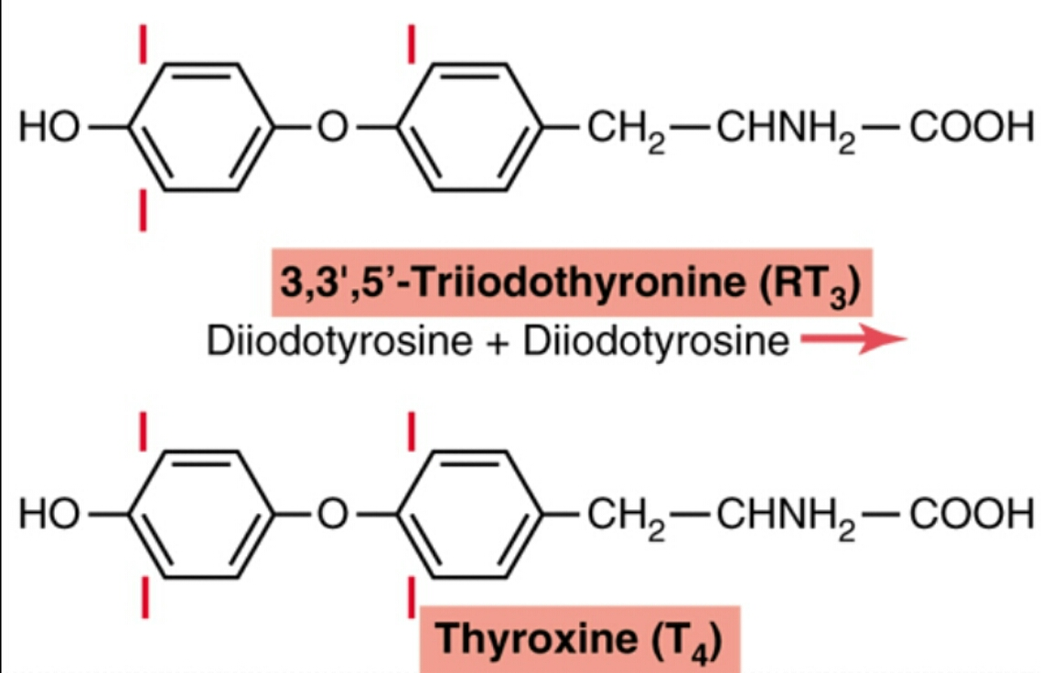
Thyroid metabolic hormones (Thyroxine+ triidothyronine)
93% of TMH are thyroxine
But triidothyronine Is 4X as potent as thyroxine
Amino acids derivatives (tyrosine)
Lipid soluble
Affect all our cells
Idoine Is required for formation of thyroxine

Slide 9
Thyroid metabolic hormones (Thyroxine+ triidothyronine)
Regulate metabolism.
-⬆ BMR
Activaite CVS
CNS development
Growth ?
Idoine Is required for formation of thyroxine

Slide 10
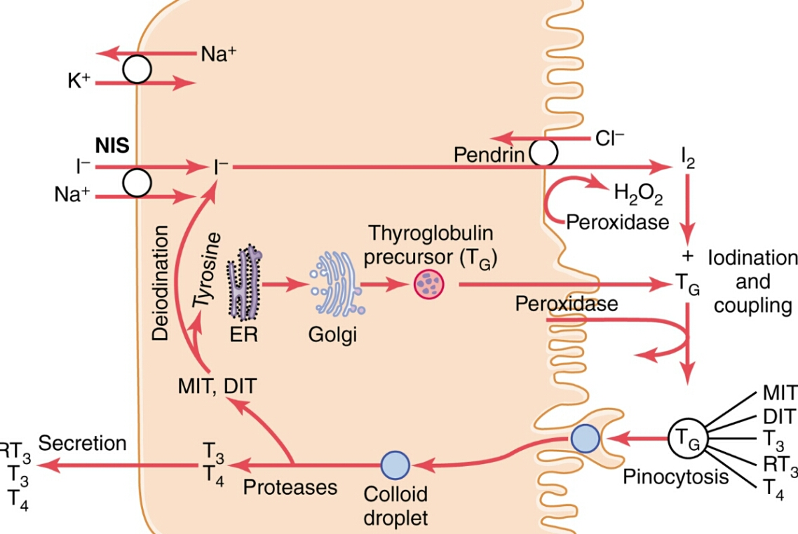
Synthesis and secretion of TMH
Iodide trapping
Thyroglobulin secretion.
Organification Of Thyroglobulin
Release of T3 & T4 from the thyroid gland.
transport of T3 & T4 to tissues

Slide 11
Synthesis and secretion of TMH
Iodide trapping
- Sodium iodide symporter.
-Chloride- iodide counter transporter (pendrin)
- Oxidation of iodide ion (peroxidase)
TSH effect?

Slide 12
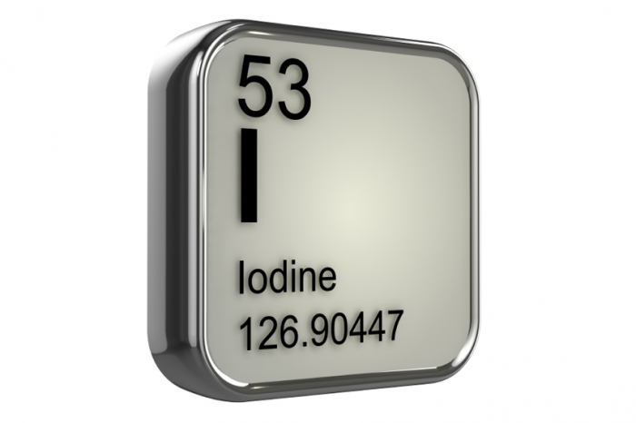
Iodine Vs iodide
Elemental iodine is two iodine atoms bonded together.
Iodide is the ion state of iodine, occurring when iodine bonds with another element, such as potassium.
Iodides simply represent a safe form of iodine for ingestion .
Oxidation of I- by the H2O2/peroxidase system leads to the formation of iodinium ions I+ which bond to thyroglobulin by electrophilic substitution

Slide 13
Synthesis and secretion of TMH
Thyroglobulin secretion.
- Exocrine secretion.
- each molecule containes 100 – 120 tyrosine residues.

Slide 14
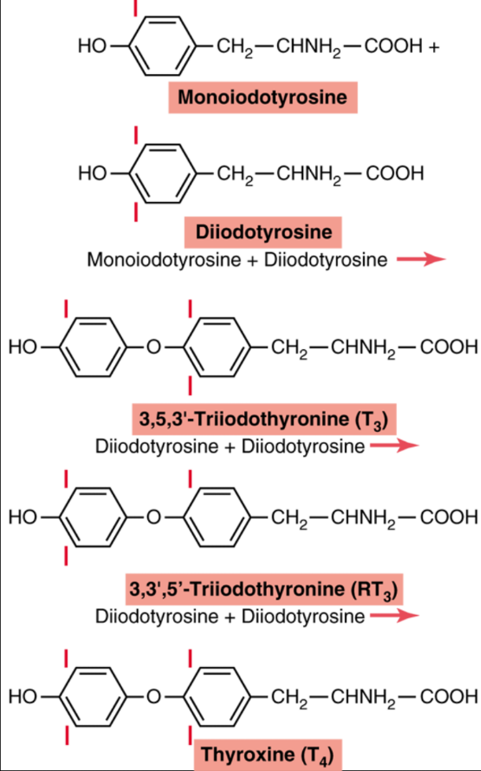
Synthesis and secretion of TMH
Organification Of Thyroglobulin.
Storage of Thyroglobulin.
-Thyroid hormones
are stored by this way.
-sufficient to supplay body for 3 Months.

Slide 15
Synthesis and secretion of TMH
Release of T3 & T4 from the thyroid gland.
Pinocytosis
Poteases
→T3+T4
- MIT+DIT are recycled by deiodinase.

Slide 16
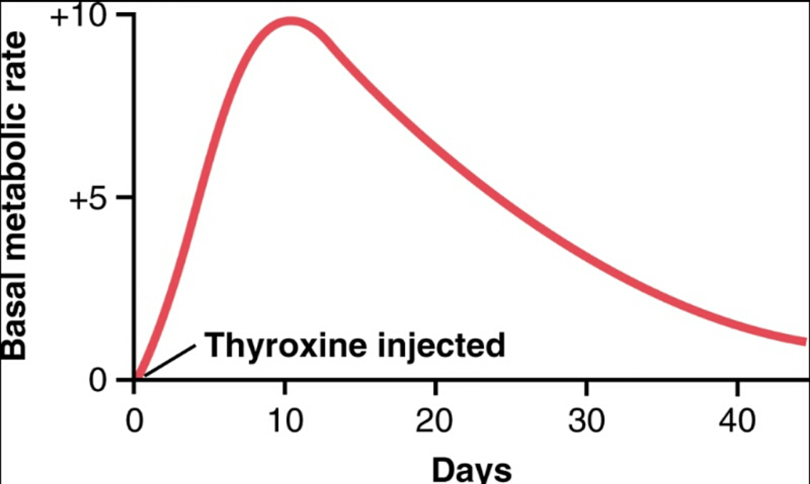
Synthesis and secretion of TMH
transport of T3 & T4 to tissues
T3 & T4 are bound to plasma proteins.
-Thyroxin-binding globulin/albumin/ prealbumin
Bind with high affinity
slow release
long half life
long latent period

Slide 17
Phsyological functions of Thyroid hormones

Slide 18
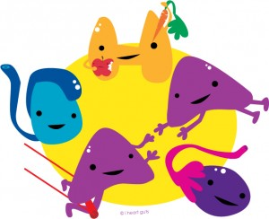
General functions of T3 & T4
Due to its lipophilicity it affects all our cells.
Activate transcription factors
-increase our metabolic activity.
T3 is more active than T4
-Almost all T4s are converted to T3 before acting on the target cells

Slide 19
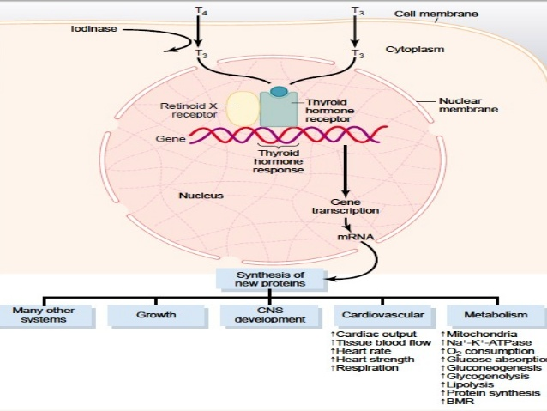
Mechanism of action of T3 & T4

Slide 20
General functions of T3 & T4
T3/T4 affects
Cellular metabolism.
-increase the activity of Na/K pump.
-increase mitocondria number and activity.
Cellular metabolism
growth
Metabolic activity
Organ systems
Thermoregulatory effect?

Slide 21
General functions of T3 & T4
T3/T4 affects
growth.
- No growth without energy!
- Permissive interaction with GH.
CNS and MSS development.
Cellular metabolism
growth
Metabolic activity
Organ systems
Dwarfism due to hypothyroidism ?

Slide 22
General functions of T3 & T4
T3/T4 affects
Metabolic activity
-increase carbohydrates metabolism.
Glycolysis
Gluconeogenesis
Glycogenolysis
Carbohydrates absorption in GIT
Insulin secretion
Cellular metabolism
growth
Metabolic activity
Organ systems
GH + thyroxin + insulin = growth

Slide 23
General functions of T3 & T4
T3/T4 affects
Metabolic activity
-increase lipid metabolism.
TAG hydrolysis.
Plasma FFA.
- But decrease lipids & cholesterol conc. In the plasma.
Cellular metabolism
growth
Metabolic activity
Organ systems
Hypothyroidism is a risk factor for atherosclerosis

Slide 24
General functions of T3 & T4
T3/T4 affects
Metabolic activity
-increase vitamins requirements.
Incease BMR.
Decrease body weight.
Increase apptite
Cellular metabolism
growth
Metabolic activity
Organ systems

Slide 25
General functions of T3 & T4
T3/T4 affects
Organ systems effects
CVS activaiton
inc. Heart rate
Inc. Cardiac output
Inc. Heart strength
Myocardial failure
But with normal arterial pressure
inc. Cystolic bp
Normal diastolic bp
-increase resperation.
Cellular metabolism
growth
Metabolic activity
Organ systems
Cardiovascular system

Slide 26
General functions of T3 & T4
T3/T4 affects
Organ systems effects
GI activaiton.
- diarrhea
CNS overactivation.
Anaxiaty.
Paranoia.
Insomnia.
MSS problems
-tremors
Cellular metabolism
growth
Metabolic activity
Organ systems
GI + MSS + CNS

Slide 27
General functions of T3 & T4
T3/T4 affects
Organ systems effects
endocrine
inc. insulin
Inc. PTH
Inc. ACTH and cotisol
Cellular metabolism
growth
Metabolic activity
Organ systems
Endocrine

Slide 28
General functions of T3 & T4
T3/T4 affects
Organ systems effects
Sexual functions
hyperthyrodism.
Impotence in males
Excessive menstrual bleeding in females
-hypothyrodism
dec. lipido in males
Reduced bleeding during menstrual cycle in females
Cellular metabolism
growth
Metabolic activity
Organ systems
Sexual functions

Slide 29
Regulation of Thyroid hormone secretion

Slide 30
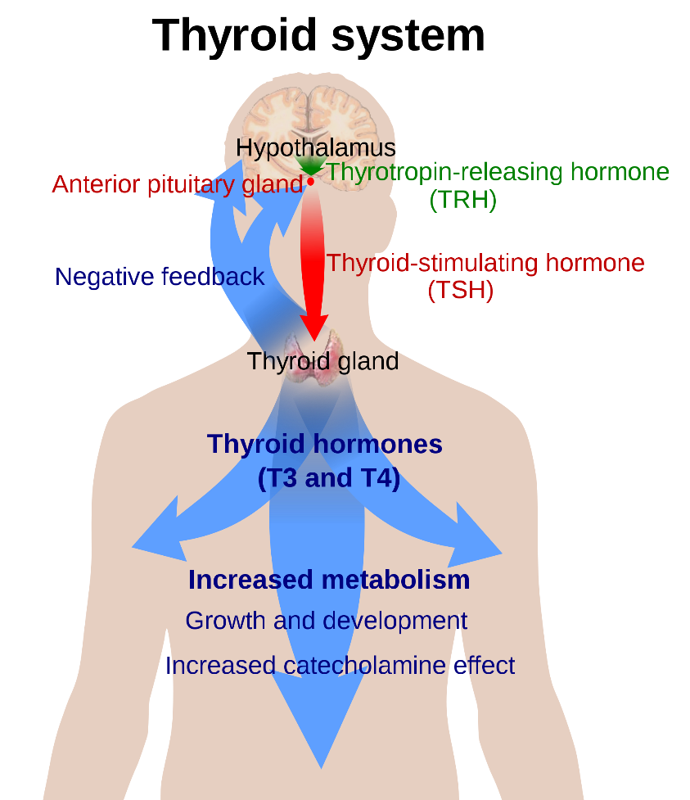
Regulation of Thyroid hormone secretion
TRH from hypothalamus.
TSH secretion from anterior pituitary.
Increase all secretory pathways that increase T4 conc.

Slide 31
Regulation of Thyroid hormone secretion
TRH from hypothalamus.
Tripeptide secreted from hypothalamus.
Increase the rate of TSH secretion.
But not necessary.
PLC signaling pathway.

Slide 32
Regulation of Thyroid hormone secretion
TSH secretion from anterior pituitary.
Increase all the secretory activites of thyroid gland.
cAMP signaling pathway.

Slide 33
Feedback mechanism of Thyroid hormone secretion
Dec. Body temp.
→ Hypothalamic centers for temp. Control → TRH → TSH → T4 → BMR
High T4 levels inhibit TRH and TSH secretion by –ve feedback mechanism

Slide 34
Abnormalities in thyroid hormone Levels
Hypothyroidism
-common causes : inflamation (hashimoto thyroditis) / goiter
-symptomes: Fatigue, Increased sensitivity to cold, Constipation, Weight gain, Puffy face, Muscle weakness, Elevated blood cholesterol level, Heavier than normal or irregular menstrual periods, Slowed heart rate
In children it causes cretinism, characterized by dwarfism and mental retardation
Hyprthyroidism
-common causes : inflamation (graves disease)
-symptoms: hyperthermia, tachycardia, exophthalmos, weight loss, anxiety, tremors.

Slide 35
Thank you
لجان الدفعات- كلية الطب دفعة 2014
Mohammad qussay Al-Sabbagh

